Slide 1
DevOps Posture Maturity Assessment --Pulkit.

Slide 2
DevOps Maturity Model
DevOps – Level 2
DevOps – Level 3
CI
DevOps – Level 1
Ad-hoc
Culture
Random
Standards exist; Feedbacks actioned
Organization Structure
Collaboration tools
Measure, Rinse & Repeat, Improve
Implementation Parameters
Architecture
Monolithic
Modularized
Micro services
Containerization
Delivery Pipeline
Manual
Unit/Integration Tests
Quality tools
Automated
Acceptance Tests
Automated
Performance Tests
Infrastructure
Manual
Bespoke scripts
Infra as code Monitoring Tools
Integrated
You are here when you
have…
A planned integration phase
Manual Tests
Fully dressed
deployments
Build /commit
Developers respond
Around 60%
Code coverage
Components
CI in place
Code quality Validations
Release packets/ promotable builds to QA
DevOps compliant organization
Consistent use of
standards
Automated Acceptances tests
Auto-promotable builds to staging/prod
Monitoring and alerting tools in place
Every commit is deployable
Automated
performance tests
Automated environment provisioning in place
Containerization
Collaboration tools / practices between dev and ops
Evolve continuously
Stakeholders bring the problems
forward
Refinements continue to happen

Slide 3
DevOps Assessment Process
Key Inputs:
Solution Architecture
CI process
Physical Architecture/ Environments
Branching strategy
Team structure
Release process
Roles and Responsibilities
Testing process
PM Process and tools
✔
Identify
Key Pain Points
✔
Assess Current Capabilities
✔
Produce Heat Maps
✔
Review Heat Maps
1
2
3
4
…in the delivery process
…using the DevOps maturity model
…of capability gaps and areas of improvement to determine priority
…with milestones and execution timelines
Use these four Steps Process wherever necessary to adopt DevOps case to case basis

Slide 4
DevOps Assessment Results
Deep Dive

Slide 5
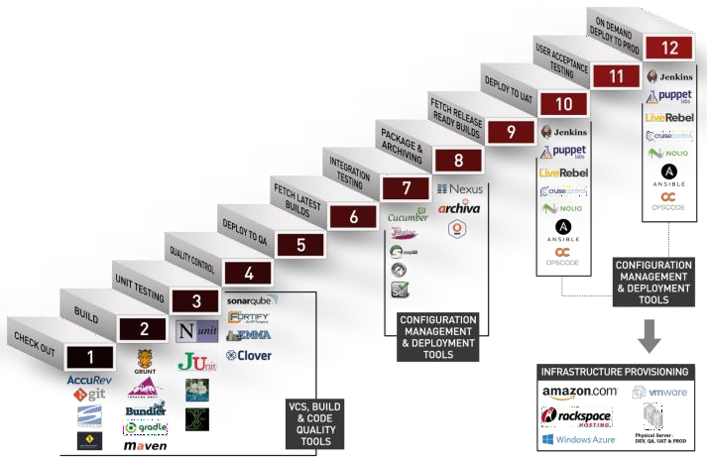
Current State – DevOps Pipeline (Example)
Bamboo + uDeploy [Checkin]
(Separate pipe For each service)
Bamboo (Combined) [Nightly]
uDeploy
(Combined – Snapshot at level)
[Planned]
Not Integrated
Automated
Partly Integrated
Manual
Fully Integrated
Automated
uDeploy
Monitoring Tools
uDeploy
Junit
HPOV
Fortify
Code
uDeploy
QPASA
Splunk
Parasoft
Code
New Relic
Mockito
Junit
Pair
Maven
UAT
SVN
End to End Testing
TESTING TOOLS
Performance Testing
Security Testing

Slide 6
Future State – DevOps Pipeline (Modularization Example)
Bamboo + uDeploy [Check in]
uDeploy [Planned]
Not Integrated
Automated
Partly Integrated
Manual
Fully Integrated
Automated
uDeploy
Monitoring Tools
uDeploy
Junit
HPOV
 | Pair |  | uDeploy
 | Fortify Code
 | Sonar
Junit
QPASA
Splunk New Relic
Maven
UAT
SVN
End to End Testing
TESTING TOOLS
Performance Testing
Security Testing

Slide 7
Culture – Heat Map
Sub Category | Current State | Future State | Recommendations / Comments
Project Collaboration & Community | DevOps Level 1 | DevOps Level 2 | Communities created at enterprise level / across verticals on different skills e.g. PM community, UX Community, DevOps Community via a Community / Collaboration platform e.g. jive
Team Collaboration | DevOps Level 1 | DevOps Level 2 | Production Support team also do code changes for hot fixes on path to production branch A unified and aligned single team responsible for all the way to production. “You build it, you run it” – philosophy followed with change in mind set
Overall Release Management | CI | DevOps Level 2 | (1) Publish the exit criteria for each gate, and automate as much as possible through the Bamboo pipeline (2) Development team has real-time awareness about health of production environment e.g. receive production alerts (2) Regularize the release cycle to UAT environment Weekly
Application Release Strategy | CI | DevOps Level 2 | (1) Implement zero downtime deployment (2) Implement a DevOps Pipeline visualization e.g. as Bamboo stages, to promote DevOps culture and team alignment for DevOps (2) Measuring the key metrics on deployment- mean time to recover, change failure rate, deployment frequency etc.
Data Release Strategy | N/A | N/A | Database is a separate service.
DevOps Metrics – Deployment Frequency | DevOps Level 1 | DevOps Level 2 | (2) Move to Daily release on UAT
Change Lead Time | DevOps Level 1 | DevOps Level 2 | Ability to do release in less than 1 week, however subject to Director’s approval. This should be an automated approval based on quality and testing gates as part of the pipeline
Change Failure Rate | DevOps Level 1 | DevOps Level 2 | Perform fortnightly analysis of production issues to understand root cause to bring down change failure rate to less than 1%
Mean Time To Recover (MTTR) | DevOps Level 1 | DevOps Level 2 | Measure MTTR and keep it between it from 1hr < x <6 hr

Slide 8
Culture – Heat Map
Sub Category | Current State | Future State | Recommendations / Comments
Application Code and Configuration | DevOps Level 2 | - | Proper Version control integrated with code display (Fisheye), defect/story tracking systems (jira) to provide traceability and reporting via dashboards Tagging is automated
Binary/Distribution Management | DevOps Level 2 | - | Proper distribution tool used to manage storage, distribution of all application and dependent libraries using uDeploy version control
Dev Quality | CI | DevOps Level 2 | (1) Implement Sonar for TS project(s) for both Code and DB (1) Implement quality gates for sonar static code violation and fail the build for any blocker and critical issue reported (1) Implement quality gate for any violation during Fortify checks and fail the build (2) Implement formal process to address Tech Debt in the application and factor in effort to reduce it per sprint / release
Unit Testing | CI | DevOps Level 2 | (1) Monitor code coverage as part Sonar (1) Implement quality gates for sonar code coverage and fail the build if below 80% (2) Implement strict standard on TDD so that coverage doesn’t drop below 80% ever
Build | CI | DevOps Level 2 | (1) Implement a single build process to build all TS components (1) Integrate integration test cases to be part of build process (2) Integrate deployment to UAT as part of build process
Deploy | DevOps Level 1 | DevOps Level 2 | Implement zero downtime deployments [blue green strategy]
Automated Testing | DevOps Level 1 | DevOps Level 2 | Increase the scope of integration test cases from 75% to 95% Progressive testing is automated in the same iteration / sprint Measure code coverage while running integration testing and maintain a threshold of 80% (of the end points etc.)
NFR (Non Func Req) Testing | CI | DevOps Level 2 | (1) Create an automated load testing suit to certify a release as required. This can be used on periodic basis to assess impact on performance (2) Implement a controlled performance regression suite to be run on QA / SIT environment to check for any degrade between releases, as part of pipeline
Testing Gates | CI | DevOps Level 2 | (1) Define Testing gates [Unit test cases, code coverage, regression results, performance results] and enforced strictly (2) Publish Dashboards as part of each release to show how different gates are met from a quality perspective
DB Versioning & Change Management | N/A | N/A | All DB Scripts are Consistently checked in Code Repository SVN
Pipeline Agility | CI | DevOps Level 2 | (1) Bring down Integration test time between 1-2 hrs. (2) Bring down Integration test time to less than 1 hrs.

Slide 9
Infrastructure on Demand (PaaS) – Heat Map
Sub Category | Current State | Future State | Recommendations / Comments
Automated Provisioning * Post hardware / OS is provided | DevOps Level 2 | - | Proper support On Demand build out and tear down of environment in minutes. This includes standardized software, app installation, configuration and usage from dev. to prod via CloudFoundary
Infrastructure Code and Configuration | DevOps Level 2 | -
Application Monitoring | DevOps Level 1 | DevOps Level 2 | Data Alerts to be added as part of Application or Support Application. Discuss with DBA Team
End User Monitoring | N/A | N/A
Logging Insights | DevOps Level 2 | - | Spulnk tool is used across PaaS application to monitor logs across products and user journey.
Infrastructure Monitoring | DevOps Level 2 | - | Proper infrastructure for monitoring and alerting across all environments via New Relic and Splunk

Slide 10
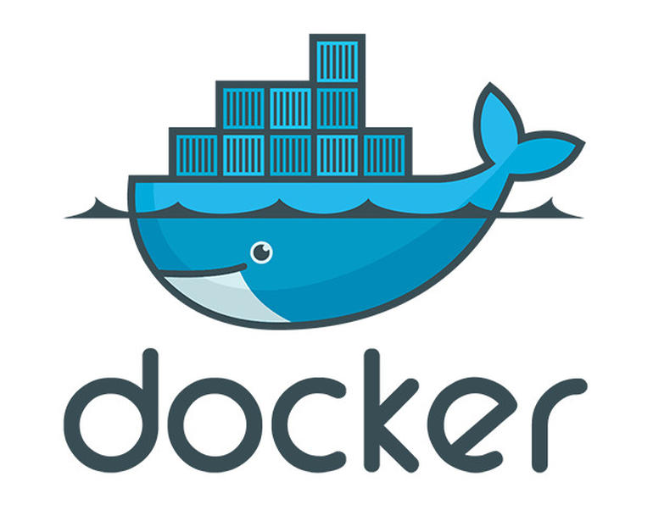




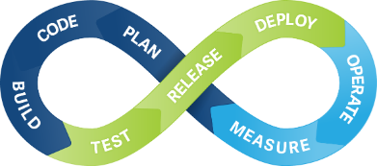


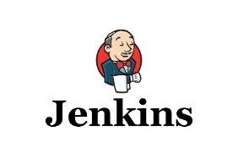



DevSecOps - CI process with Security checks
Code development – in IDE
SVN Checkin
Jenkins – Dev Build
Secure Assist – in IDE – Catch Vulnerabilities at project level
Code Coverage Check from IDE – Target 90-95%
Jenkins CI- Additional check with Coverity & Black Duck Opensource Scan
Jenkins – Deploy (By Developer)
Jenkins – Deploy (By Dev Ops)
Code development – in IDE
SVN Checkin
Jenkins – Dev Build
Secure Assist – in IDE – Catch Vulnerabilities at project level
Code Coverage Check from IDE – Target 90-95%
Jenkins CI- Additional check with Coverity & Black Duck Opensource Scan
Jenkins – Deploy (By Developer)
Jenkins – Deploy (By Dev Ops)
Jenkins Dev build
Binary built in Jenkins and copied to File server
Docker script creates the docker image
Jenkins – Deploy (By Developer)
Deploys on the target env – Dev
Jenkins – Deploy (By Dev Ops)
Pre-built Dev Image deployed to target environment

Slide 11
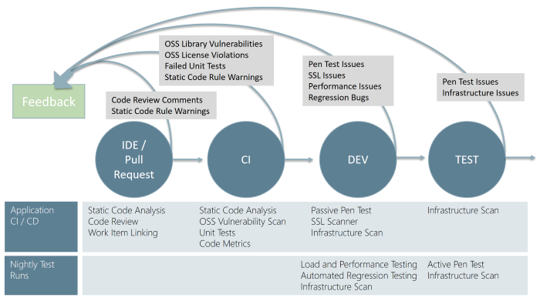
DevSecOps - Continuous security validation to CI/CD pipeline – Industry Recommendations
DevSecOps incorporates the security team and their capabilities into the DevOps practices making security a responsibility of everyone on the team
Security needs to shift from an afterthought to being evaluated at every step of the process.
Securing applications is a continuous process that encompasses secure infrastructure, designing an architecture with layered security, continuous security validation, and monitoring for attacks.

Slide 12
Issues and Pain points – Can be addressed
1) Selection of Version Control Tool
2) Branching strategy/tagging and code syncing (Major Issue)
3) Moving from Traditional Infrastructure to Microservices
4) Integrating Tools of Different Domains
5) Changing Well Defined Processes to More Efficient Ones
6) Separate Tools Set for Dev and Ops Team
7) Adoption of New Tools
8) Resistance to Change
9) A few interfacing products are not aligned to the overall agile processes and takes time to deliver changes resulting into delay in plan – need basis

Slide 13





Benefits
Reduced outages
Increased awareness of scheduled
maintenance issues can be resulted in reduced avoidable outages
Data-driven discussions
Data-driven discussions with all stakeholders will result in more productive outcomes and a better relationships
Data-driven decision-making
Through analysis of historical data patterns, we can target common issues and prioritize automation
Improved partner transparency
Increased awareness of the overall products and services for the events that occur across the environment
Organization- level consistency
We can have a consistent way to analyze historical data and make operational decisions across a diverse set of internal business units

Slide 14
Approx. Resources, Time and ROI
Approx time taken for the Analysis, suggestions and POC (1- 2 applications with approx. 10 – 20 VMs/containers: 3 to 4 Weeks.
Approx. resources requirement: 1 Sr. DevOps SME, 2 DevOps Engr.
Build of 16 hrs can be converted into 5 mins using modularization.
Every commit can be deployed in production with confidence.
ROI in terms of time , money and resources: ¾ reduction.

