Slide 1

On Simultaneous Clustering and Cleaning over Dirty Data
Turn Waste into Wealth:
Shaoxu Song, Chunping Li, Xiaoquan Zhang
Tsinghua University

Slide 2
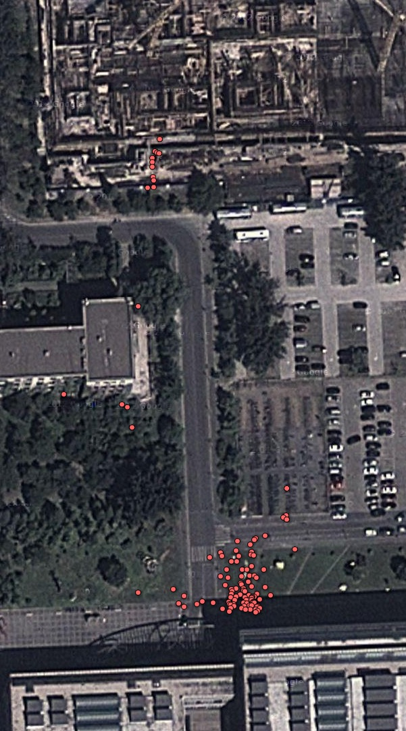
Motivation
Dirty data commonly exist
Often a (very) large portion
E.g., GPS readings
Density-based clustering
Such as DBSCAN
Successfully identify noises
Grouping non-noise points in clusters
Discarding noise points

Slide 3
Mining Cleaning
Useless
Guide
Make
Valuable
Find

Slide 4
Mining + Repairing
Repair
Knowledge
Constraints
Rules
Density
(Dirty)
Data
Repaired
Discover

Slide 5
Discarding vs. Repairing
Simply discarding a large number of dirty points (as noises) could greatly affect clustering results
Propose to repair and utilize noises to support clustering
Basic idea: simultaneously repairing noise points w.r.t. the density of data during the clustering process

Slide 6
Density-based Cleaning
Both the clustering and repairing tasks benefit
Clustering: with more supports from repaired noise points
Repairing: under the guide of density information
Already embedded in the data
Rather than manually specified knowledge

Slide 7
Basics
DBSCAN: density-based identification of noise points
Distance threshold 𝞮
Density threshold 𝞰
𝞮-neighbor:
if two points have distance less than 𝞮
Noise point
With the number of 𝞮-neighbors less than 𝞰
Not in 𝞮-neighbor of some other points that have 𝞮-neighbors no less than 𝞰 (core points)

Slide 8
Modification Repair
[SIGMOD’05] [ICDT’09]
A repair over a set of points is a mapping λ : P → P
We denote λ(p_{i}) the location of point p_{i} after repairing
The ε-neighbors of λ(p_{i}) after repairing is C_{λ}(p_{i}) = { p_{j} ∈ P | δ( λ(p_{i}) , λ(p_{j}) ) ≤ ε }

Slide 9
Repair Cost
Following the minimum change principle in data cleaning
Intuition: systems or humans always try to minimize mistakes in practice
prefer a repair close to the input
The repair cost ∆(λ) is defined as
∆(λ) = ∑_{i} w( p_{i} , λ(p_{i}) )
w( p_{i} , λ(p_{i}) ) is the cost of repairing a point p_{i} to the new location λ(p_{i})
E.g., by counting modified data points

Slide 10
Problem Statement
Given a set of data points P, a distance threshold ε and a density threshold η
Density-based Optimal Repairing and Clustering (DORC) problem is to find a repair λ (a mapping λ : P → P ) such that
(1) the repairing cost ∆(λ) is minimized, and
(2) each repaired λ(p_{i}) is either a core point or a board point
for each repaired λ(p_{i}), either |C_{λ}(p_{i})| ≥ η (core points),
or |C_{λ}(p_{j})| ≥ η for some p_{j} with δ(λ(p_{i}),λ(p_{j})) ≤ ε
All the points are utilized, no noise remains

Slide 11
Technique Concern
Simply repairing only the noise points to the closest clusters is not sufficient
e.g., repairing all the noise points to C1 does not help in identifying the second cluster C2
Indeed, it should be considered that dirty points may possibly form clusters with repairing (i.e., C2)

Slide 12
Problem Solving
No additional parameters are introduced for DORC
besides the density and distance requirements η and ε for clustering
ILP formulation
Efficient solvers can be applied
Quadratic time approximation
via LP relaxation
Trade-off between Effectiveness and Efficiency
By grouping locally data points into several partitions

Slide 13
Experimental Results
Answers the following questions
By utilizing dirty data, can it form more accurate clusters?
By simultaneous repairing and clustering, in practice is the repairing accuracy improved compared with the existing data repairing approaches?
How do the approaches scale?
Criteria
Clustering Accuracy: purity and NMI
Repairing Accuracy: root-mean-square error (RMS) between truth and repair results
dirty
truth
RMS
repair

Slide 14
Artificial Data Set
Compared to existing methods without repairing
DBSCAN and OPTICS
Proposed DORC (ILP/Quadratic-time-approximation) shows
Higher clustering purity

Slide 15
Real GPS Data
With errors naturally embedded, and manually labelled
Compared to Median Filter (MF)
A filtering technique for cleaning the noisy data in time-space correlated time-series
DORC is better than MF+DBSCAN

Slide 16
Restaurant Data
Tabular data, with artificially injected noises
Widely considered in conventional data cleaning
Compared to FD
A repairing approach under integrity constraints (Functional Dependencies), [name,address → city]

Slide 17
More results
Two labeled publicly available benchmark data,
Iris and Ecoli, from UCI
Normalized mutual information (NMI) clustering accuracy
Similar results are observed
DORC shows higher accuracy than DBSCAN and OPTICS

Slide 18
Summary
Preliminary density-based clustering can successfully identify noisy data but
without cleaning them
Existing constraint-based repairing relies on external constraint knowledge
without utilizing density information embedded inside the data
With the happy marriage of clustering and repairing advantages
both the clustering and repairing accuracies are significantly improved

Slide 19
References (data repairing)
[SIGMOD’05] P. Bohannon, M. Flaster, W. Fan, and R. Rastogi. A cost-based model and effective heuristic for repairing constraints by value modification. In SIGMOD Conference, pages 143–154, 2005.
[TODS’05] J. Wijsen. Database repairing using updates. ACM Trans. Database Syst., TODS, 30(3):722–768, 2005.
[PODS’08] W. Fan. Dependencies revisited for improving data quality. In PODS, pages 159–170, 2008.
[ICDT’09] S. Kolahi and L. V. S. Lakshmanan. On approximating optimum repairs for functional dependency violations. In ICDT, pages 53–62, 2009.

Slide 20
Thanks

