Slide 1
SIMULTANEOUS CLUSTERING AND OUTLIER DETECTION
13C7032 - Nitin Mittal
13C7037 - Pulkit Maloo
13C7054 - Tanay Kothari

Slide 2
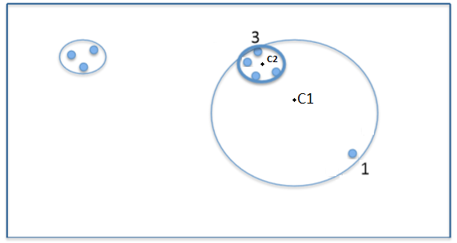
PROBLEM DOMAIN
Cluster centers are not accurately placed
Setup Locations for -
Telephone tower
School
Hospital

Slide 3
PROPOSED METHOD
We propose a method for simultaneous outlier detection and clustering.
Here we introduce a relative distance factor termed as “Outlier Factor“
Outlier Factor –
Defines outlying-ness of each data point in cluster
Depends on distance of point from the cluster centroid
It’s value will lie between 0 & 1

Slide 4
OUTLIER FACTOR - EVALUATION
Calculating dmax
calculated for every cluster
dmax = distance of point farthest from centre.
Outlier Factor = Distance of a Point from cluster centroid
d_{max}

Slide 5
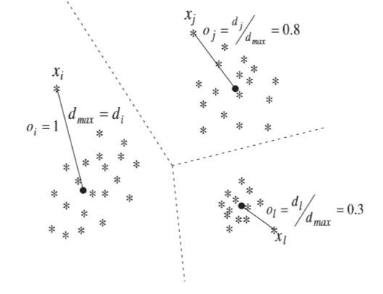
Notes:
Outlier factor for a point p is determine as ratio of distance of point p from its centroid to dmax i.e distance of farthest point from centroid

Slide 6
THRESHOLD AND NO. OF ITERATIONS
Threshold
Compared with outlier factor
Act as Bounding value for Outlier Factor
Magnitude lies between 0 and 1
Iterations
Determines number of times, user wants to compare outlier factor with threshold

Slide 7
CLUSTERING USING OUTLIER FACTOR
1. Run K-means until convergence, pick best Cluster Centroids C
2. For no. of iterations
2.1 For every Cluster Ci
a. Calculate outlier factor for each point
b. Remove all data points with Outlier Factor > Threshold, and update the dataset
2.2 Run K-Means over the updated dataset and update C
Notes:
Threshold is numerical value with magnitude lying between 0 and 1.
Threshold value is used to determine the points that will be regarded as outliers and removed from the datasets.
Act as a bounding value for outlier factors
Points with outlier factor greater then threshold are treated as outliers and thus removed from datasets.
Every new set cluster centroids is fine tuned solution for the reduced dataset.

Slide 8
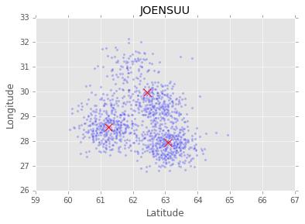
PRACTICAL OVERVIEW
Original Clustered Data –
C1 = (61.24048782, 28.57907706)
C2 = (62.45291409, 29.98969893)
C3 = (63.09106467, 27.93085731)
Inertia = 725.097273378

Slide 9
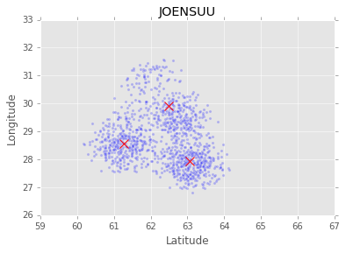
PRACTICAL OVERVIEW
After 5 iterations –
C1 = (61.27119879, 28.55349699)
C2 = (62.48589537, 29.90403648)
C3 = (63.07285294, 27.93593997)
Inertia = 739.293227297

Slide 10
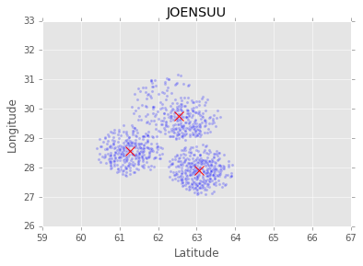
PRACTICAL OVERVIEW
After 10 iterations –
C1 = (61.26480168, 28.55532924)
C2 = (62.54391747, 29.76397809)
C3 = (63.07163807, 27.8992316)
Inertia = 457.184761499

Slide 11
LIMITATIONS
How to determine threshold T?
T may differ from cluster to cluster
Slow performance for very large datasets

Slide 12
LITERATURE SURVEY
1. Research issues on K-means Algorithm: An Experimental: Trial Using Matlab - Joaquín Pérez Ortega, Ma. Del Rocío Boone Rojas, María J. Somodevilla García
Clustering Problem and the k-means Algorithm
Sensitivity of K-Means towards outliers (noise).
2. Outlier Detection: A Clustering-Based Approach - Vijay Kumar, Sunil Kumar, Ajay Kumar Singh
Absolute Distance between the Medoids and Point

Slide 13
LITERATURE SURVEY
3. k-means--: A unified approach to clustering and outlier detection - Sanjay Chawla, Aristides Gionisy
Multivariate Outlier Detection
4. “Identification of Outliers”. Chapman and Hall, London - D. Hawkins.
Taxonomy of Outlier Detection Methods
Multivariate Outlier Detection
5. Outlier Detection in Clustering - Svetlana Cherednichenko
Distance-based approach

Slide 14
CONCLUSION
Improving clustering by nullifying effects of outliers.
Better positioning of Mobile Towers.
Improves Efficiency.
Have broad implementation.

