Slide 1
Facebook Marketplace Analysis
Insights into User Engagement and Post Clustering

Slide 2
Introduction: Diving into Social Media Data
This analysis explores a rich dataset from Facebook Marketplace, offering a closer look at how users interact with content and how posts can be categorized for better performance.
Dataset Overview:
Source: UCI Machine Learning Repository, a valuable resource for data analysis projects.
Context: Data collected from Facebook pages of 10 Thai fashion & cosmetics sellers, providing real-world business insights.
Size: Initially 7050 instances, a robust sample size for statistical analysis.
Attributes: 16 initial attributes, refined to 12 after thorough cleaning to ensure data quality.
Objective: To analyze key engagement metrics and identify natural clusters within post data to inform content strategy.

Slide 3





Data Preprocessing: Refining Raw Data for Insight
Before any meaningful analysis can begin, raw data must be meticulously cleaned and prepared. Our process involved several crucial steps to transform the dataset into an actionable format.
Dropped Redundant Columns
Removed 'Column1' - 'Column4' due to excessive null values, streamlining the dataset.
DateTime Conversion
Transformed 'status_published' into datetime objects for precise temporal analysis of posting trends.
Handling Missing Values
Applied SimpleImputer with a Mean strategy to numerical columns, ensuring data completeness without skewing results.
Feature Engineering
Extracted 'Hour' from the timestamp, a critical feature for analyzing time-based engagement patterns.
Encoding & Scaling
Utilized OneHotEncoder for 'status_type' and StandardScaler for clustering, preparing data for machine learning models.

Slide 4
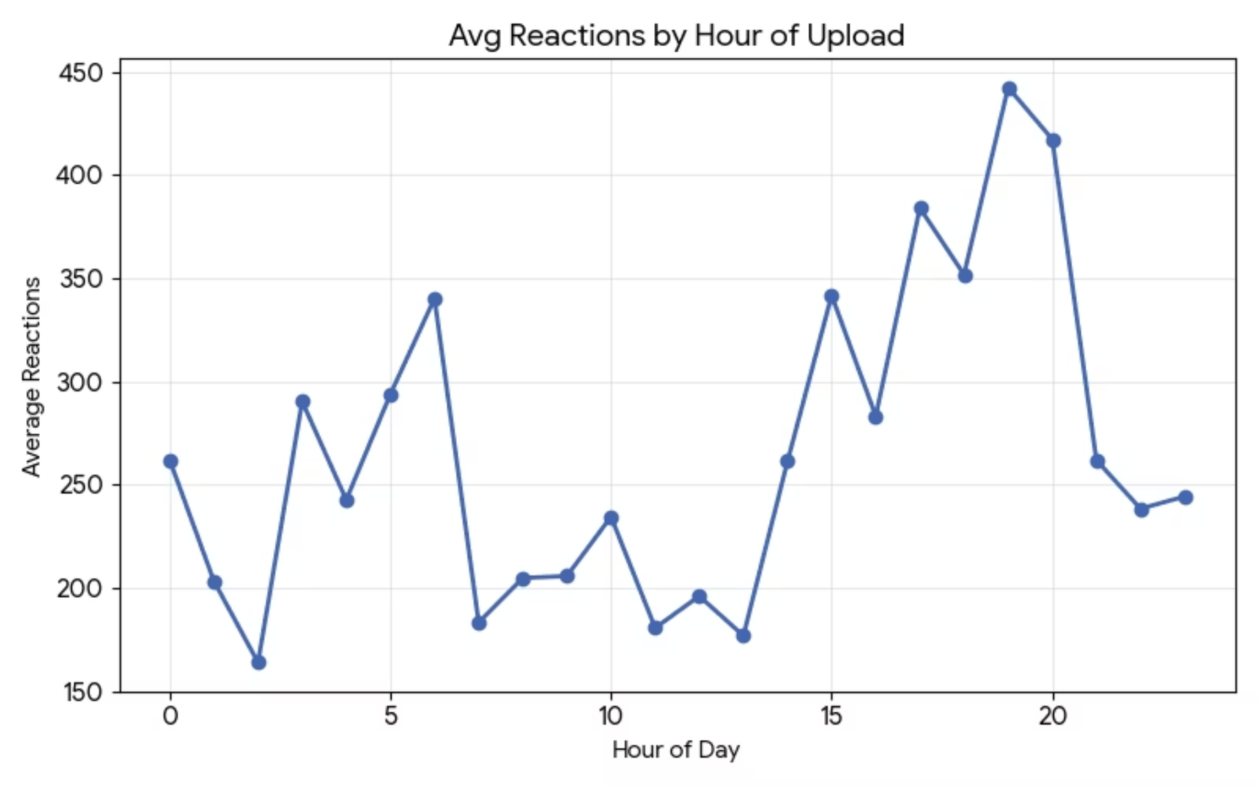
Q1: How Time Affects Reactions
Insight - Optimal Posting Times for Engagement
Peak Reactions: Our analysis reveals that posts published in the early morning hours (approximately 6 AM - 8 AM) consistently achieve higher average engagement rates.
Strategic Implication: By aligning post schedules with these identified peak windows, content creators can significantly maximize the visibility of their content and enhance overall user reactions.
This strategic timing ensures content reaches the audience when they are most active and receptive.

Slide 5
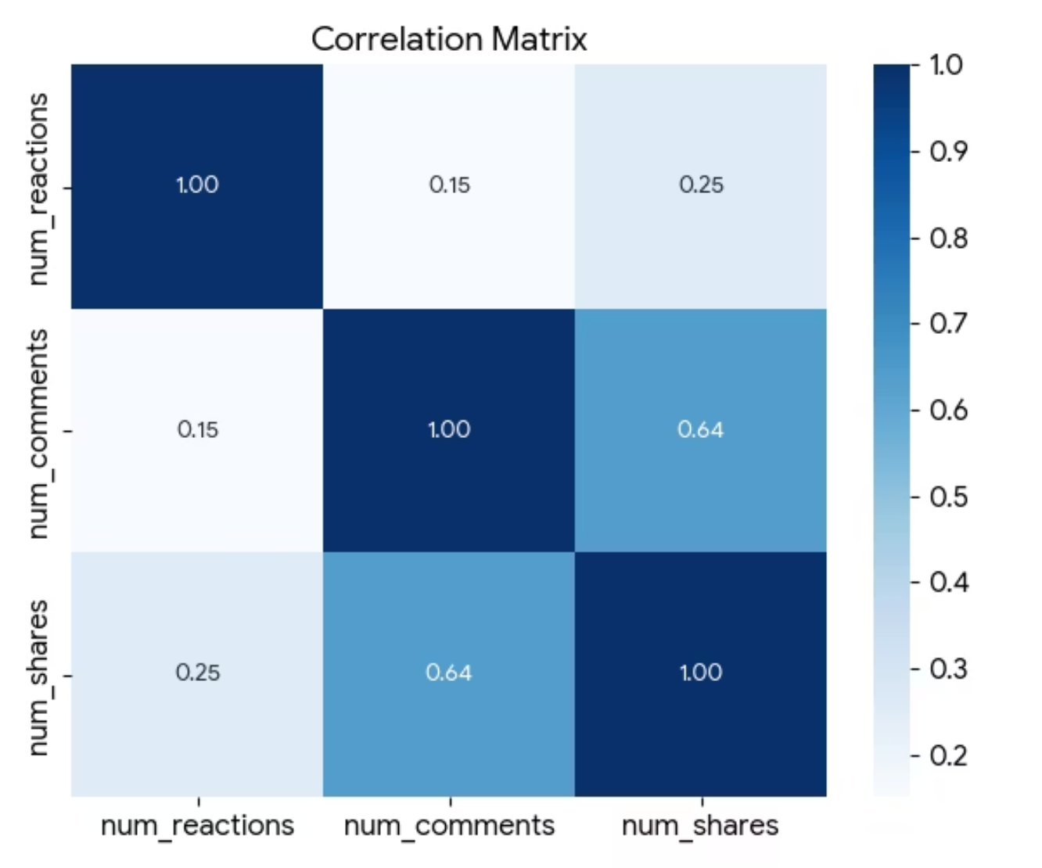
Q2: Correlation between Key Engagement Metrics
Insight - The Interconnectedness of Engagement
Understanding how different engagement metrics relate to each other is crucial for developing effective social media strategies.
Comments & Shares: A particularly strong positive correlation (approximately 0.64) exists between comments and shares. This suggests that highly shareable content often sparks more discussion.
Reactions & Shares: We also observed a moderate positive correlation between overall reactions (likes, loves, etc.) and shares, indicating that emotionally resonant content is more likely to be spread.
Conclusion: Posts that achieve high shareability tend to generate a greater volume of comments. This highlights the "viral potential" of content that encourages users to both spread the message and interact with it.

Slide 6
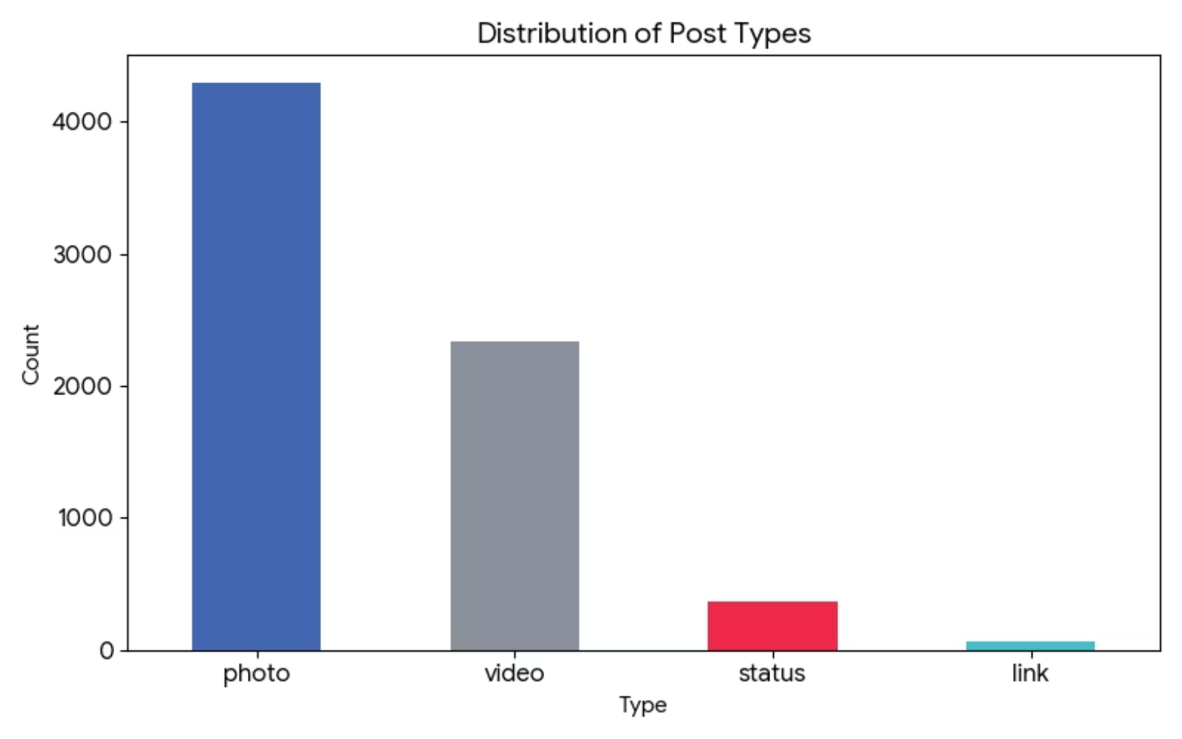
Q5: Distribution of Post Types on Facebook Marketplace
Insight - Visual Content Dominates the Landscape
The type of content published significantly impacts its prevalence and potentially its engagement on Facebook Marketplace.
Photos: By far the most dominant content type, with 4288 posts. This underscores the importance of high-quality imagery.
Videos: Ranking as the second most common, with 2334 posts, videos also play a critical role in content strategy.
Status & Links: These post types appear significantly less frequently, indicating a preference for rich media content over text-only updates or external links.
Strategy: The platform is unequivocally visual. A strong content strategy should prioritize compelling images and engaging videos to capture audience attention and drive interactions.

Slide 7
Q6: Average Engagement Across Different Post Types
A deeper dive into the average reactions, comments, and shares reveals nuanced performance differences between various post formats.
Post Type
Avg Reactions
Avg Comments
Avg Shares
link
370.1
5.7
4.4
photo
181.3
16.0
2.6
status
438.8
36.2
2.6
video
283.4
642.5
115.7
Video Dominance in Comments & Shares
Status Posts for Reactions
Link Posts for Broad Reach
Interestingly, 'status' posts show the highest average reactions, suggesting that direct, concise textual updates can still resonate strongly with the audience.
Link posts generate substantial reactions, making them effective for directing traffic while maintaining a decent level of passive engagement.
While photos are frequent, videos lead by a wide margin in average comments and shares, indicating their powerful ability to drive active interaction and virality.

Slide 8
Clustering Methodology: Segmenting Posts for Targeted Strategies
To uncover distinct patterns in post performance, we employed K-Means Clustering, a powerful unsupervised machine learning technique.
01
02
03
Feature Selection
Data Scaling
Optimal 'K' Determination
Selected features included 'status_type' (one-hot encoded) and all engagement metrics: reactions, comments, shares, likes, loves, wows, hahas, and angrys. This comprehensive set ensures a holistic view of engagement.
A Standard Scaler was applied to normalize the broad range of numerical engagement figures. This prevents features with larger values from disproportionately influencing the clustering algorithm.
The Elbow Method was utilized to identify the most appropriate number of clusters ('K'). This method helps in finding a balance where adding more clusters doesn't significantly improve the model fit.

Slide 9
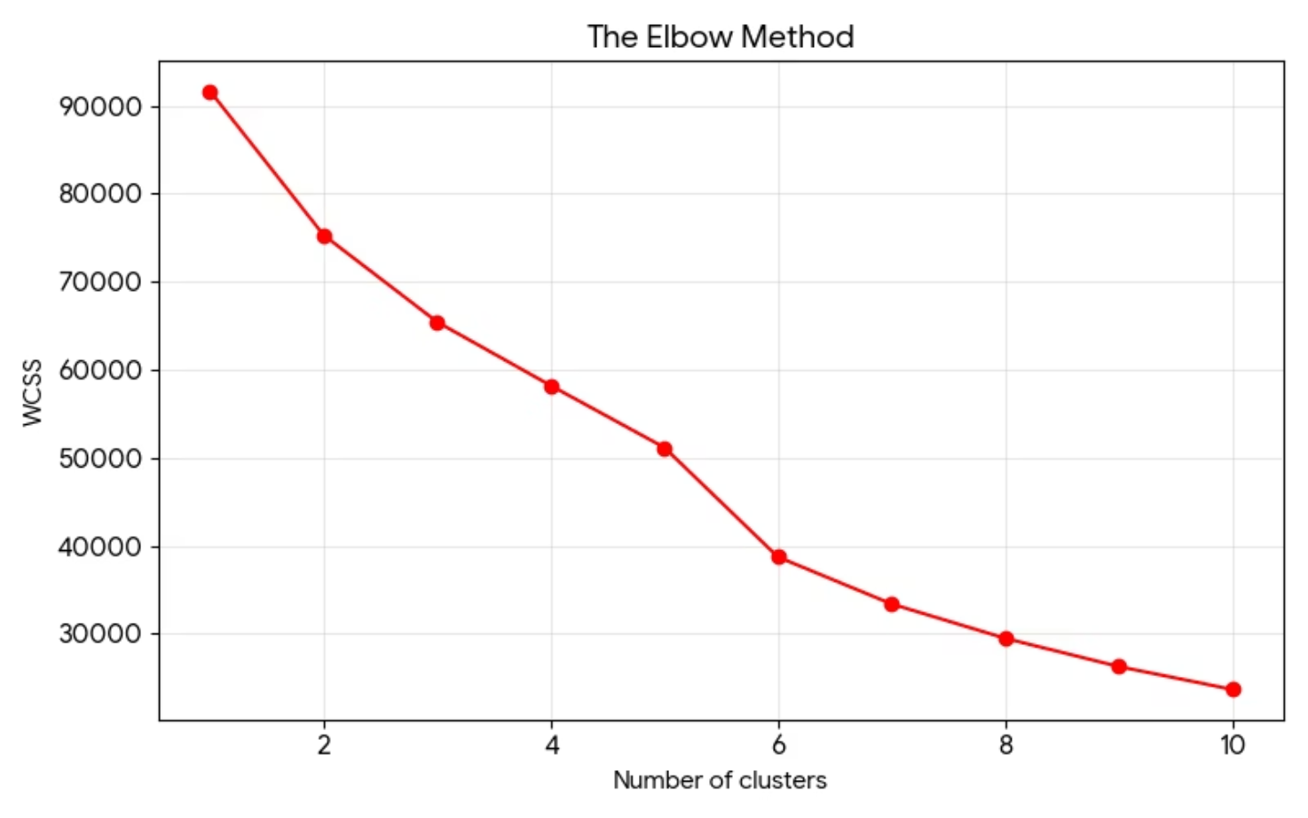
Clustering Results: Identifying Optimal Segments with the Elbow Method
Optimal Clusters: Visualizing the Elbow Point
The Elbow Graph is a key visualization for determining the ideal number of clusters in K-Means. It plots the Within-Cluster Sum of Squares (WCSS) against the number of clusters (K).
The 'Elbow' Point: Observing the graph, the most significant bend, or 'elbow,' appears to be around K=3 or K=4. Beyond this point, the decrease in WCSS becomes marginal, suggesting diminishing returns for adding more clusters.
Interpretation: This indicates that dividing posts into 3 to 4 distinct clusters—for instance, representing Low, Medium, and High engagement categories—provides the most meaningful and efficient segmentation for this dataset. This segmentation allows for tailored content strategies based on distinct engagement patterns.

Slide 10





Conclusion: Key Takeaways for Enhanced Social Media Strategy
Our comprehensive analysis of Facebook Marketplace data yields actionable insights for optimizing content and engagement.
Content Dominance
Strategic Timing
Photos and Videos are the primary content drivers, highlighting the need for visually rich and engaging media in your strategy.
Posting in the early morning hours (6-8 AM) directly correlates with higher average reactions, suggesting optimal times for content distribution.
Interaction Synergy
Audience Segmentation
Shares and Comments are closely linked; focusing on shareable content can significantly boost discussion and overall virality.
Posts naturally group into approximately 3 distinct clusters based on engagement performance, enabling highly targeted content creation.
By leveraging these insights, marketing managers and data analysts can refine their Facebook Marketplace strategies to achieve superior engagement and business outcomes.

