Slide 1
Sales Prediction Analysis
Advertising Expenditures on TV, Radio, and Newspaper
A Data Science Project Report

Slide 2


Dataset Overview
1
2
3
Key Data Columns
Project Objective
Feature Focus
TV: Advertising spend on television.
To accurately predict product sales based on the allocated advertising budget across different media channels.
Analyzing the impact of traditional media (TV) versus more targeted approaches (Radio, Newspaper) on sales performance.
Radio: Advertising spend on radio.
Newspaper: Advertising spend in newspapers.
Sales: Units sold.

Slide 3
Average Advertising Spend
Our analysis reveals that TV advertising commands the largest share of the overall marketing budget.
$147.04
Average TV Expenditure
This significant investment highlights television's perceived importance in reaching a broad audience.
Understanding the distribution of advertising spend is crucial for optimizing future campaigns and resource allocation.

Slide 4
Correlation Analysis: Unveiling Impact
A deep dive into the correlation coefficients reveals the true drivers of sales performance across different advertising mediums.
0.9012
0.3497
0.0863
TV Correlation Index
Radio vs. Sales
Newspaper vs. Sales
TV advertising demonstrates an exceptionally strong positive correlation with sales, indicating its dominant influence.
Radio advertising shows a moderate positive correlation, contributing to sales but to a lesser extent than TV.
Newspaper advertising exhibits a very weak correlation, suggesting a minimal direct impact on sales in this dataset.
This analysis conclusively demonstrates that TV spend is the strongest predictor of product sales, making it a critical component of any successful advertising strategy.

Slide 5
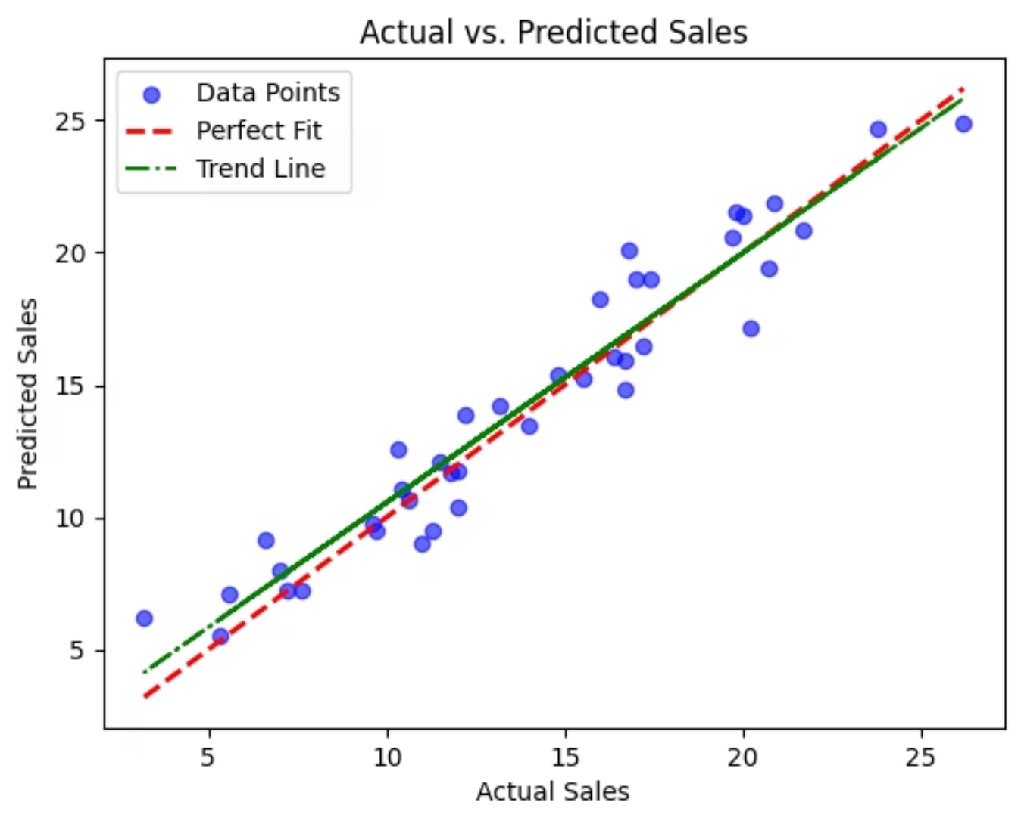
Model Performance: Actual vs. Predicted Sales
Our linear regression model demonstrates strong predictive capabilities, with predicted sales closely aligning with actual figures.
Visualizing the model performance: The scatter plot effectively illustrates the relationship between actual and predicted sales.
Strong linear relationship: The clear trend line indicates that the model has successfully captured the underlying patterns in the data.
High clustering around the 'Perfect Fit' line: The close proximity of data points to the ideal diagonal line underscores the model's accuracy and reliability.

Slide 6
Building the Predictive Model
To accurately forecast sales, we employed a robust statistical modeling approach.
01
02
Approach: Multiple Linear Regression
Data Split: 80% Training, 20% Testing
Leveraging the power of multiple variables to predict sales, accounting for the combined influence of advertising channels.
Ensuring the model is trained on a substantial portion of the data while reserving a distinct set for unbiased performance evaluation.
03
04
Preprocessing: Imputation for Missing Values
Feature Scaling: Standardization
Addressing data incompleteness by filling in gaps to maintain dataset integrity and model accuracy.
Transforming features to a common scale to prevent any single variable from disproportionately influencing the model due to its magnitude.

Slide 7
Predicting New Scenarios: What if?
Leveraging our trained model, we can now simulate sales outcomes for hypothetical advertising investments, providing actionable insights for strategic planning.
New Scenario Input
Predicted Sales
TV: $200
19.8162 Units
Radio: $40
Newspaper: $50
By adjusting these input values, businesses can explore various advertising strategies and their potential impact on sales before committing resources.
This forecast indicates the expected sales volume given the specified advertising budget across the three channels.

Slide 8


Scaling Impact Comparison
While feature scaling is often critical for model performance, our analysis revealed a unique outcome in this specific dataset.
MSE (Mean Squared Error)
Standardization: 2.1711
Normalization: 2.1711
Observation: In this particular scenario, both Standardization and Normalization methods yielded identical Mean Squared Error values. This suggests that the inherent distribution and relationships within our advertising expenditure data were not significantly altered by these scaling techniques in terms of predictive accuracy.
While scaling is generally a best practice, its impact can vary depending on the dataset characteristics. Our findings emphasize the importance of empirical evaluation.

Slide 9

Key Takeaways & Future Directions
Overall Model Accuracy (R²): 0.9259
TV: The Primary Sales Driver
Our comprehensive model provides a highly accurate prediction of sales based on advertising expenditures, with over 92% of variance explained.
Television advertising stands out as the most influential factor impacting sales in this dataset, a critical insight for strategic investment.
Robust Predictive Model
Scaling for Consistency
Combining all advertising mediums (TV, Radio, Newspaper) yields the most effective and reliable sales forecasting tool.
While standardization and normalization produced similar results in this specific case, feature scaling remains important for model consistency and generalization across diverse datasets.

