Slide 1
Knowledge Graph Fraud Intelligence
How Advance-RAG explains, prioritizes, and operationalizes fraud risk
Presentation scope: Research Chat, Knowledge Map, and Social Registry Dashboard
Fraud backbone: structured registry data (srsdb.dump -> PostgreSQL -> Neo4j)
Presentation deck with live frontend screenshots | April 2026

Slide 2
Data Source Clarity
Unstructured pipeline: uploaded documents -> Research Chat + Document KG
Structured pipeline: social registry dump -> graph intelligence -> fraud operations dashboard
Current fraud detection and triage are primarily powered by the structured pipeline
Advance-RAG | KG Fraud Intelligence

Slide 3
End-to-End Intelligence Flow
Source
Systems
Ingestion
Knowledge
Graph
Rules +
Features
APIs
Operations
UI
Advance-RAG | KG Fraud Intelligence

Slide 4
How Each Module Helps Users
Research Chat: converts graph/document context into grounded investigative narratives
Knowledge Map: visualizes suspicious entity topology and evidence paths
Social Registry Dashboard: turns graph signals into triage-ready operational workflows
Advance-RAG | KG Fraud Intelligence

Slide 5
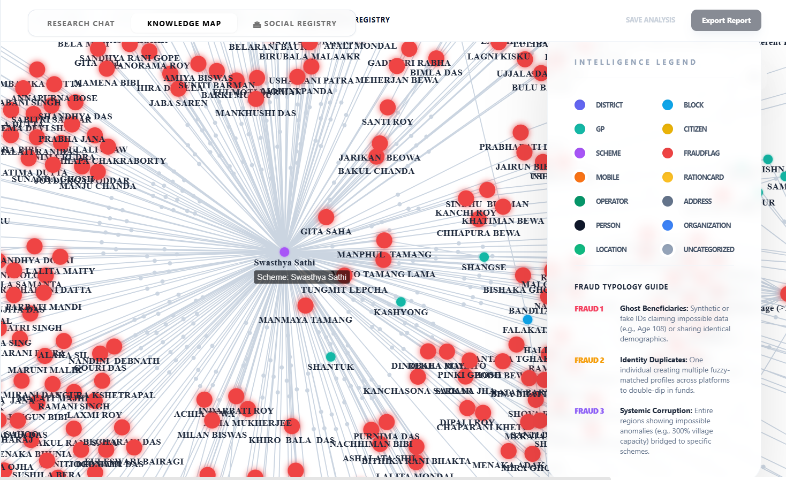
Knowledge Map: Graph Explainability in Action
Live KG Screenshot
Red FraudFlag nodes highlight suspicious entities and clusters
Analysts can visually inspect hub patterns around schemes and beneficiaries
Advance-RAG | KG Fraud Intelligence

Slide 6
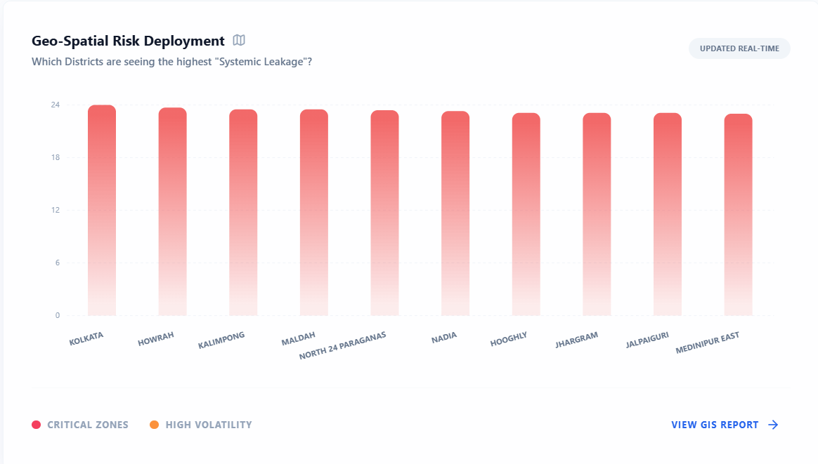
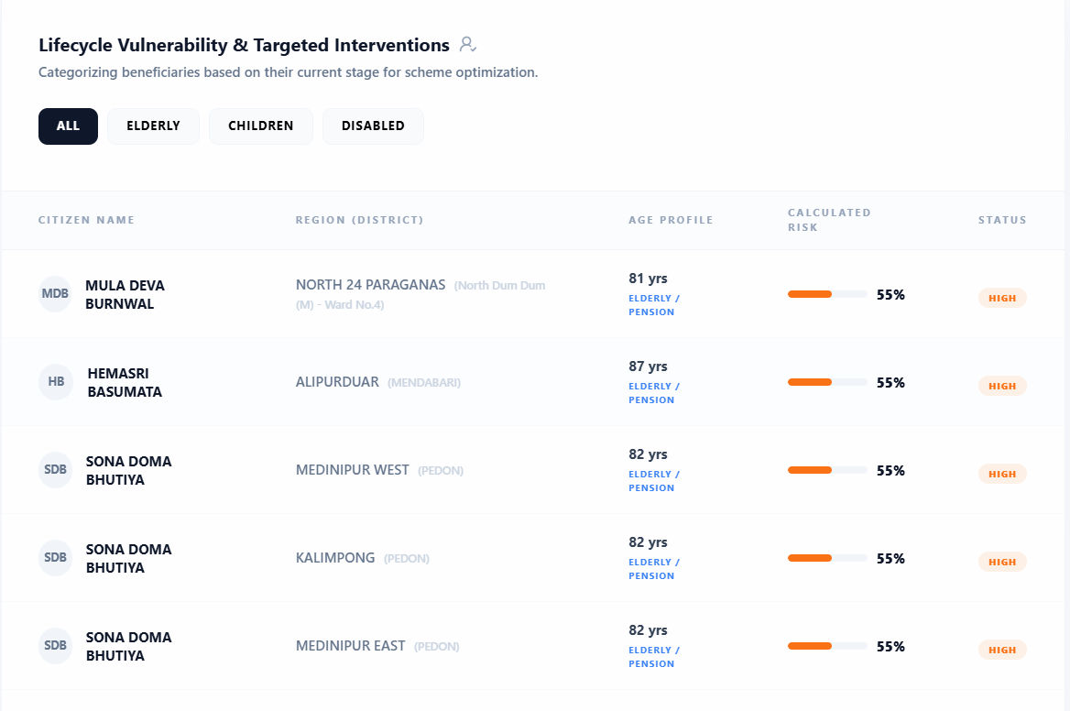
Dashboard Analytics: Risk Targeting and Segmentation
Geo-Spatial Risk Deployment
District-level risk distribution for last-mile targeting
Beneficiary segmentation by lifecycle and vulnerability profile
Lifecycle Vulnerability Table
Advance-RAG | KG Fraud Intelligence

Slide 7
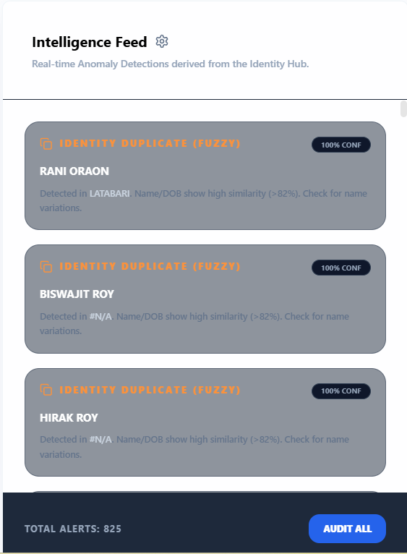
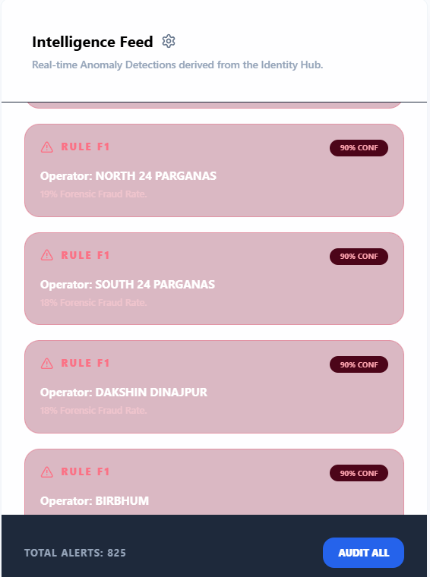
Intelligence Feed: Real-Time Fraud Signals
Duplicate Identity Alerts
Unified feed surfaces confidence-tagged anomaly alerts
Supports rapid prioritization via fraud type and severity
Operator Corruption Alerts (Rule F1)
Advance-RAG | KG Fraud Intelligence

Slide 8
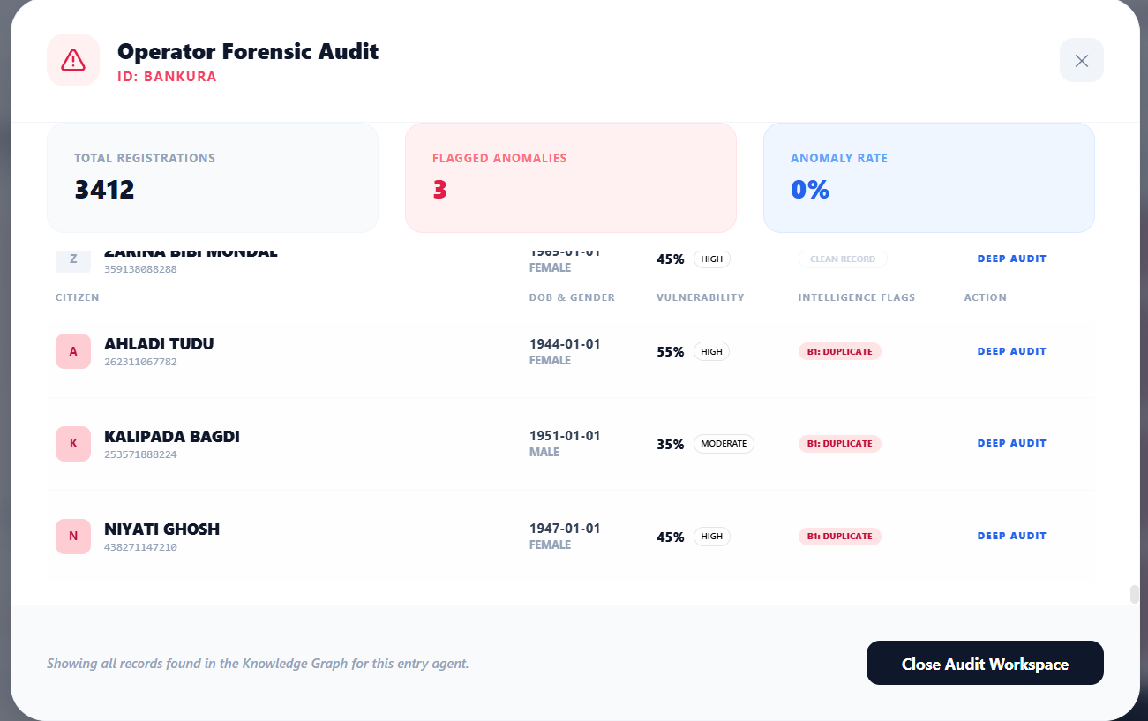
Forensic Drill-Down: Operator Audit Workspace
Operator Forensic Audit Modal
Advance-RAG | KG Fraud Intelligence

Slide 9
How Knowledge Graph Improves Fraud Prediction
Graph features: duplicate edges, DOB clusters, shared identity hubs, operator anomaly rates
Prediction here is graph-enhanced risk estimation, not opaque black-box only scoring
Result: stronger precision, better explainability, and lower false-positive operational burden
Advance-RAG | KG Fraud Intelligence

Slide 10
Operational Decision Flow
Alert
Detected
Evidence
Check
Triage
Assign
Field
Verify
Close/
Escalate
Advance-RAG | KG Fraud Intelligence

Slide 11
What Users and Leadership Get
Investigators: explainable evidence paths and faster case triage
Program teams: district and operator-level risk visibility
Leadership KPIs: precision, false-positive rate, time-to-triage, SLA closure, platform reliability
Advance-RAG | KG Fraud Intelligence

Slide 12
Closing Statement
Advance-RAG uses Knowledge Graph as the core explainable intelligence layer for fraud operations.
The platform unifies detection, visualization, and field-audit action in one workflow.
Advance-RAG | Knowledge Graph Fraud Intelligence

