Slide 1
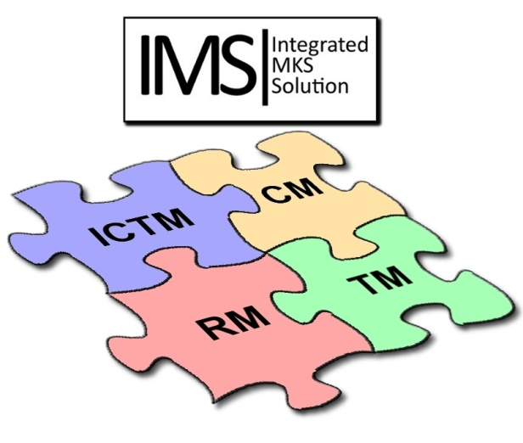

Change Management in IMS
for
Process Methods and Tools

Slide 2


Content
How to access IMS for change management on PMT subjects
How to create Issues (change requests) in IMS
Procedure to access the Global Web Interface
Using and creating Queries in IMS
Issue (Change Request) Lifecycle
How to create a Release item in IMS
How to create a Realization Order in IMS

Slide 3
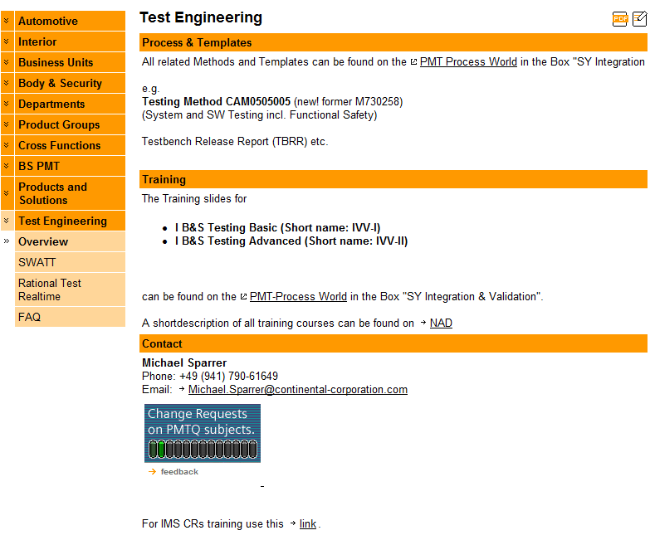
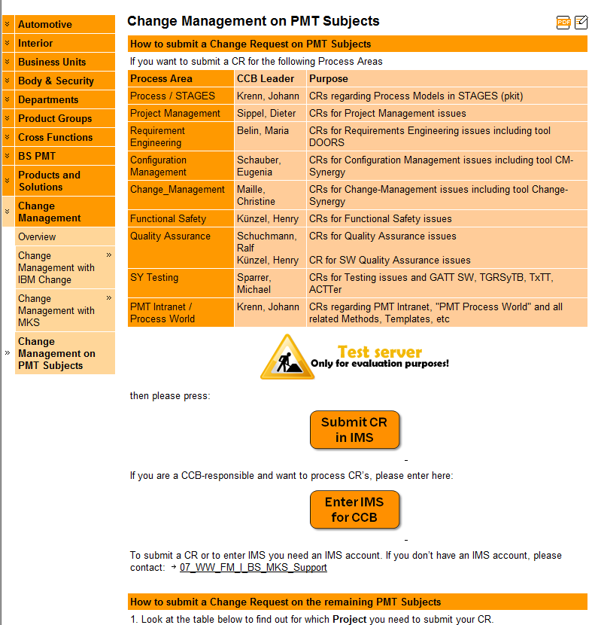
How to enter IMS for change manag. on PMT subjects (training only)

Slide 4
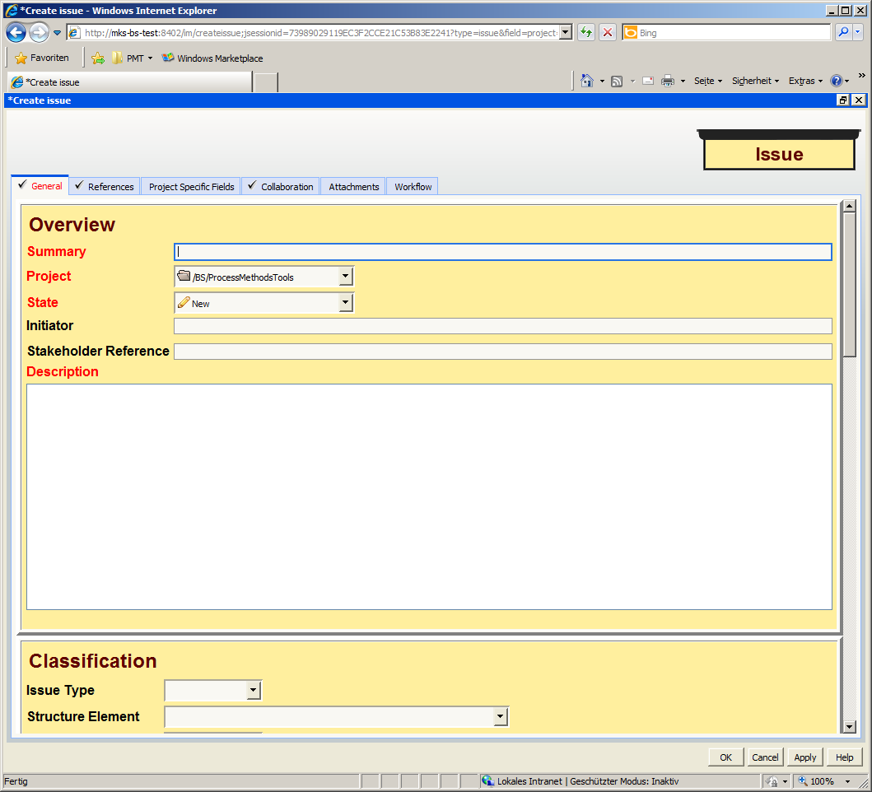
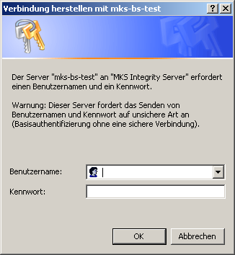
How to create Issues (change requests) in IMS
Note: Red fields are mandatory
Enter your Windows login data to enter IMS
Enter here a Summary which enables easy categorization of the issue and gives an idea about the contents
The name of the Project will be prefilled in the tool.
Enter here a Description what has to be changed or what is the problem:
Current behavior / Requested behavior
or
Expected behavior / Observed behavior
Press OK to create the issue

Slide 5
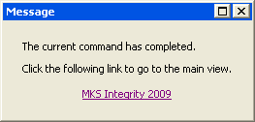
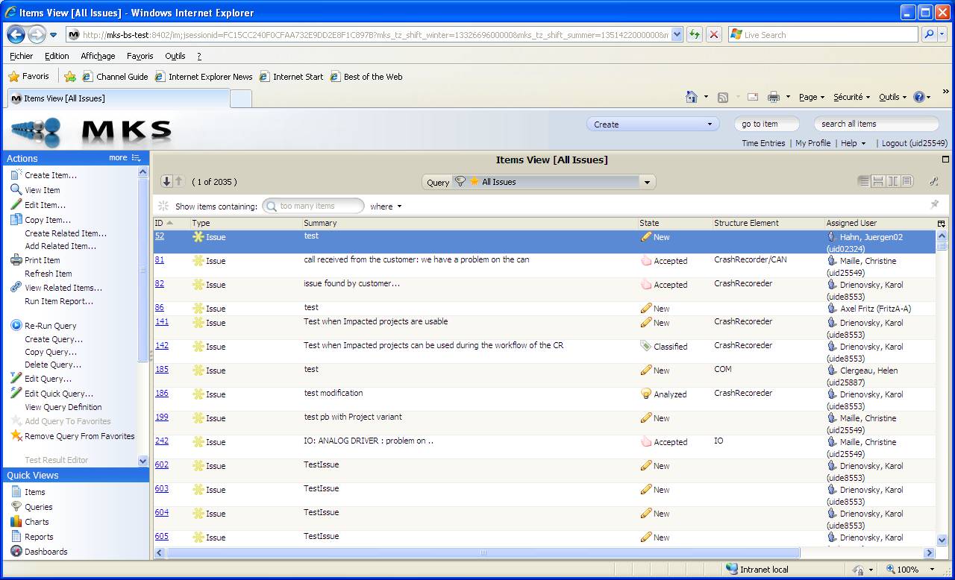
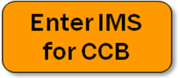
Procedure to access the global web interface
when the Issue is created, the user gets the following message:
Click on the link “MKS Integrity 2009” to access the global IMS Web Interface:
Or directly enter via PMT page by:
Then, select Queries

Slide 6
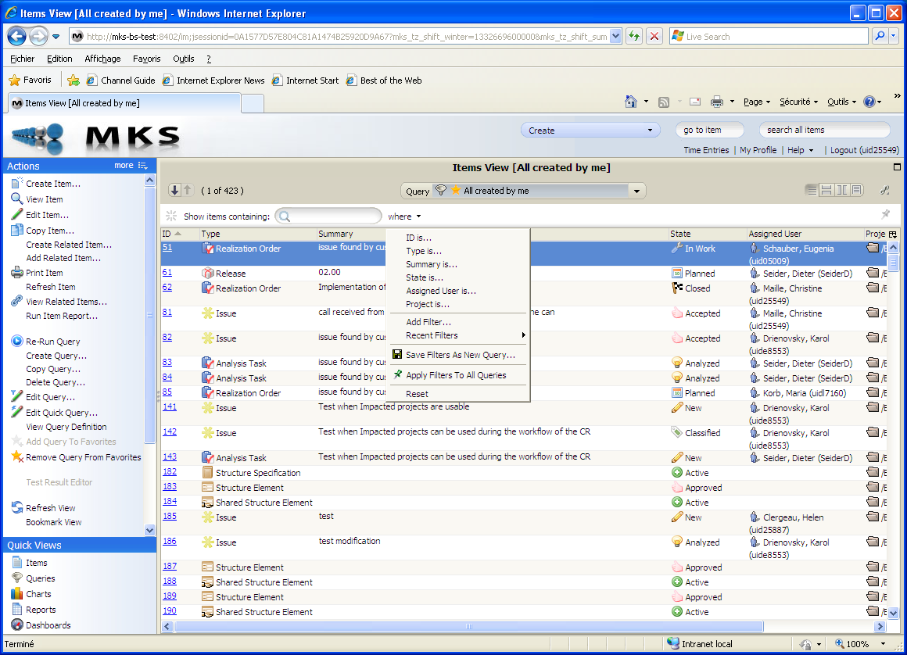
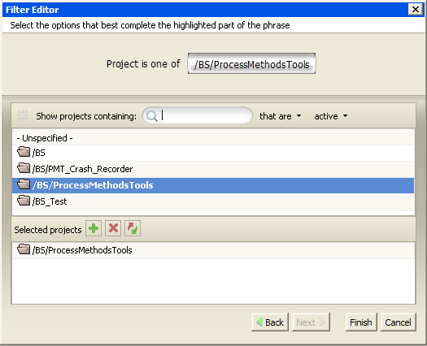
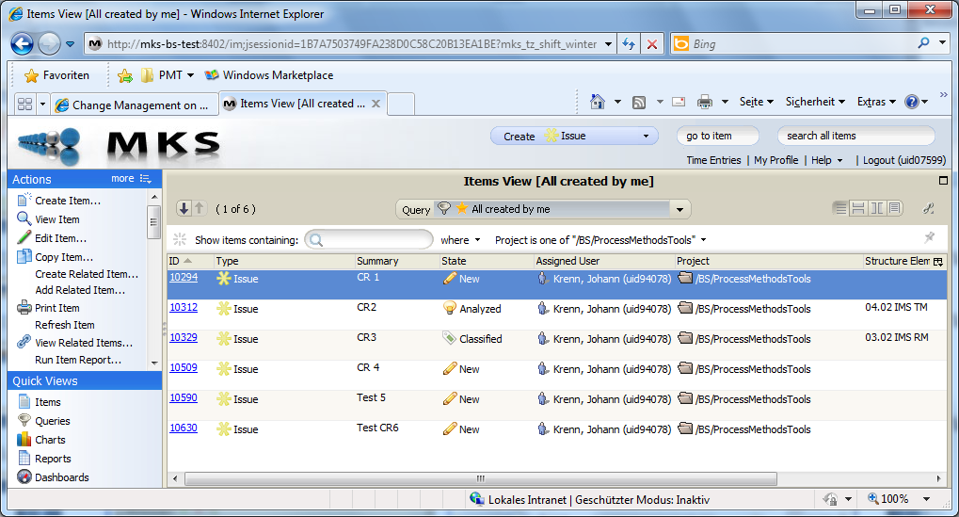
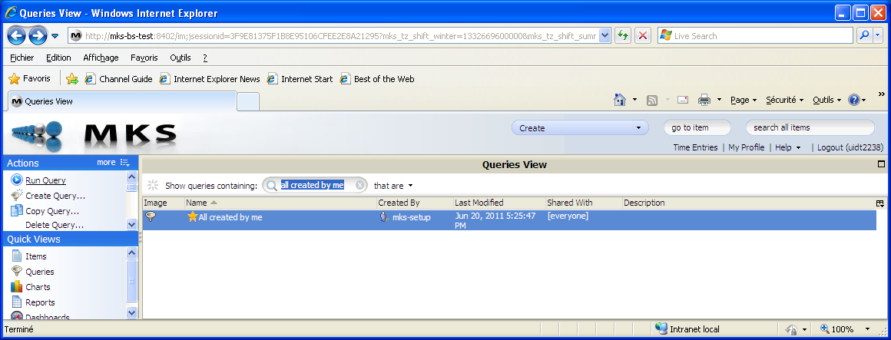
How to find your created Issues
In “Show Queries containing”, search for the Query “All created by me”
Select the proposed query and Run the Query (double-klick)
Apply the Filter “where” “Project is…”
In the Filter Editor search for the “ProcessMethodsTools”, add it by “+” and press “Finish” button
Only Issues created on that project are now being displayed

Slide 7
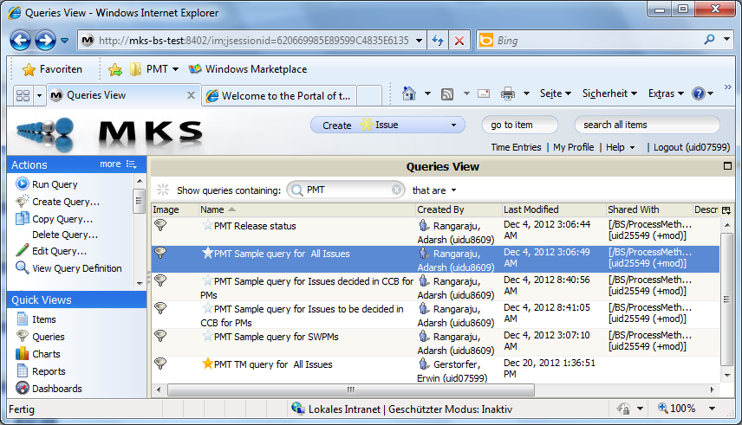
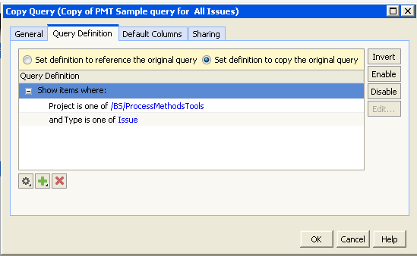
How to create or copy Queries
A new Query can be created in Queries View by “Create Query…” or by “Copy Query…”
As an exercise, select “PMT Sample query for all Issues” and press “Copy Query…”
Change the name of the Query in Tab “General” according to your process area and add in “Query Definition” the corresponding Structure Element using the “+” button

Slide 8
Issue (Change Request) Lifecycle
New
Classified
Analyzed
Accepted
Realized
Closed
IMS: Issue
Duplicate
Canceled
On Hold
States of standard flow
Synergy Change

Slide 9
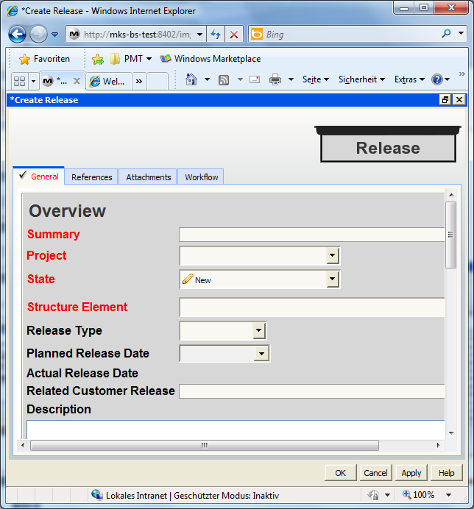
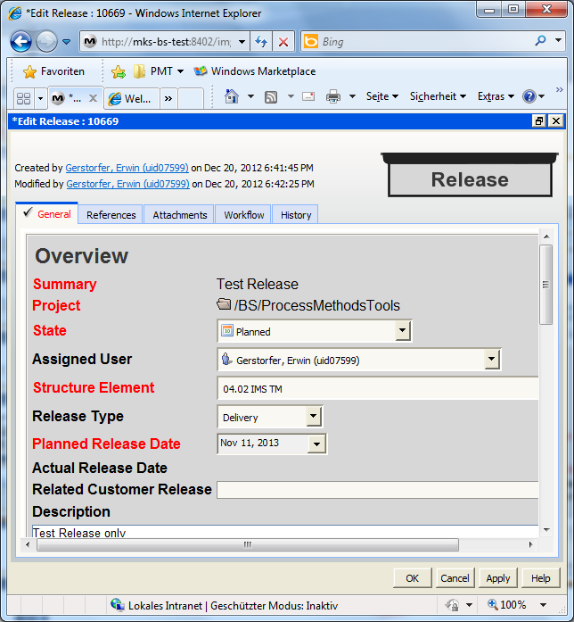
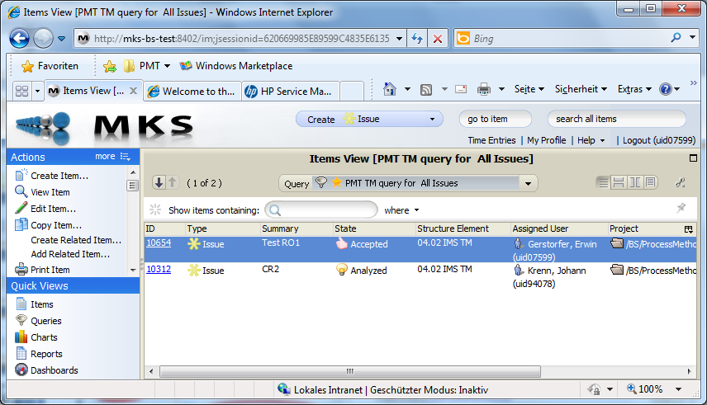
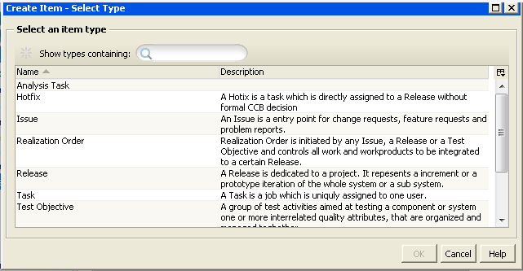
How to create a Release item in IMS
To create a new Release item, first the Items View has to be selected
In Items View select “Create Item”
In “Create Item – Select Type” window select “Release”
Fill out the mandatory attributes, the “Planned Release Date”, “Description” and set “Release Type” to “Delivery”
Save the Release by pressing “Apply” button, change “State” to “Planned” and save again to make it accesible for other items

Slide 10
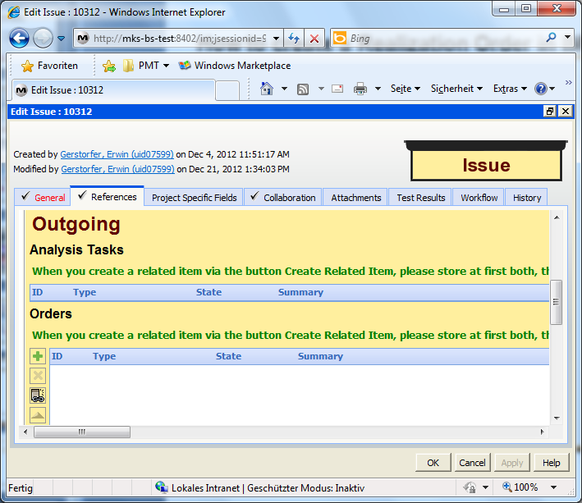
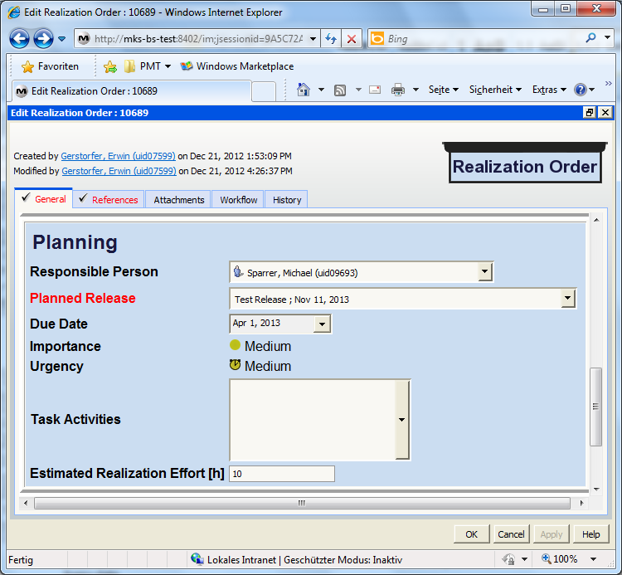
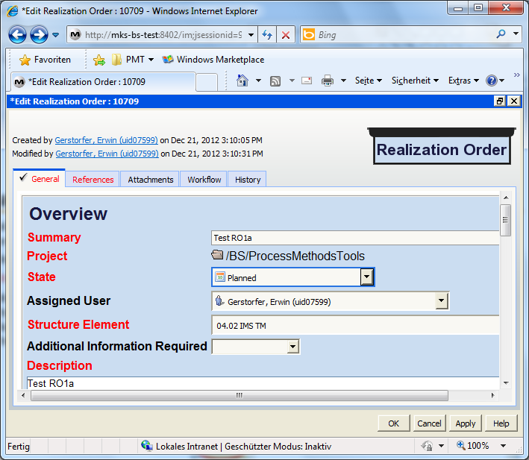
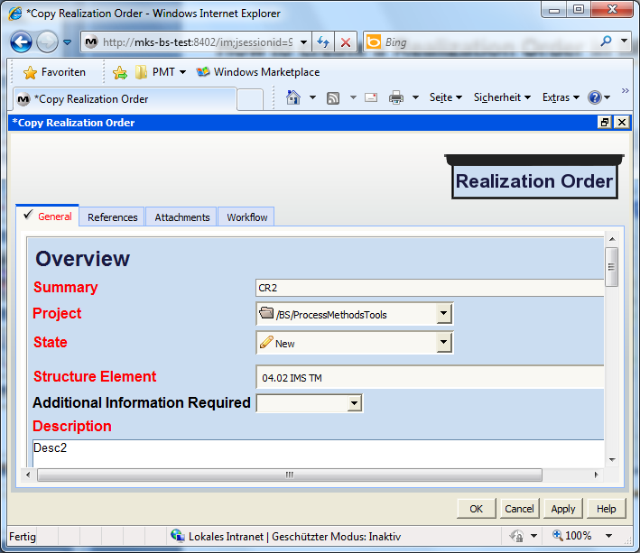
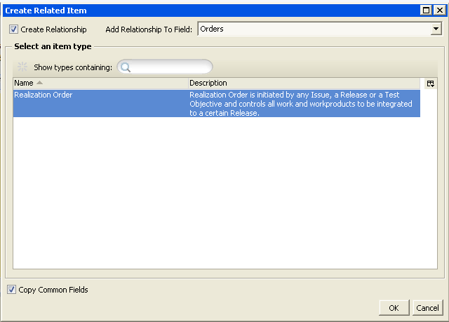
How to create a Realization Order in IMS
To create a Realization Order ordered by an Issue in State “Accepted”, open that Issue in Edit Mode, select the “References” Tab and there, in the “Outgoing” section under “Orders”, select the chain symbol
In “Create Related Item” window select “Realization Order”
Edit the mandatory attributes and press the “Apply” button to save
Change the State of the Realization Order to “Planned” and set the correct “Assigned User” (The Assigned User is automatically notified by an eMail)
Select the “Planned Release”, set “Due Date” and “Estimated Realization Effort [h], save the Realization Order and then save the related Issue too

Slide 11
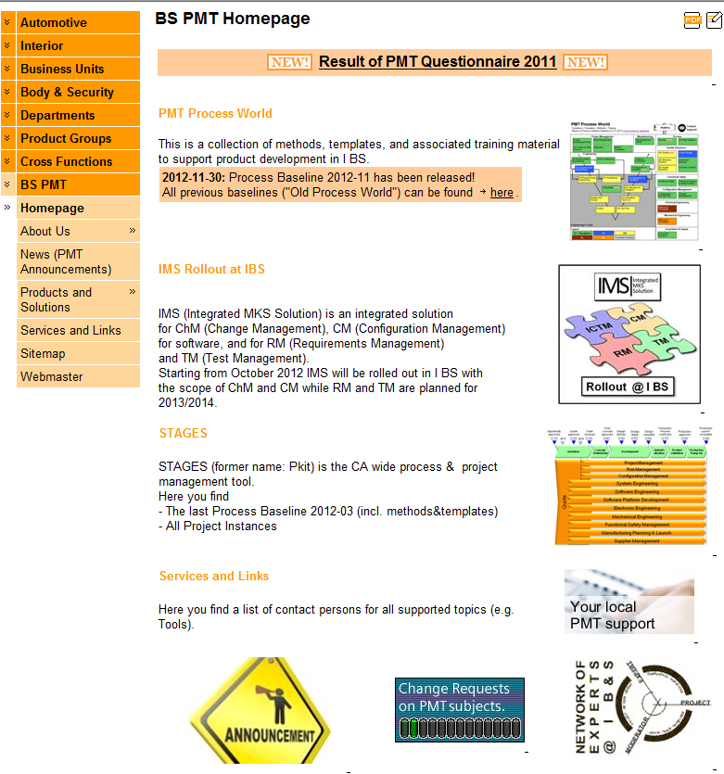
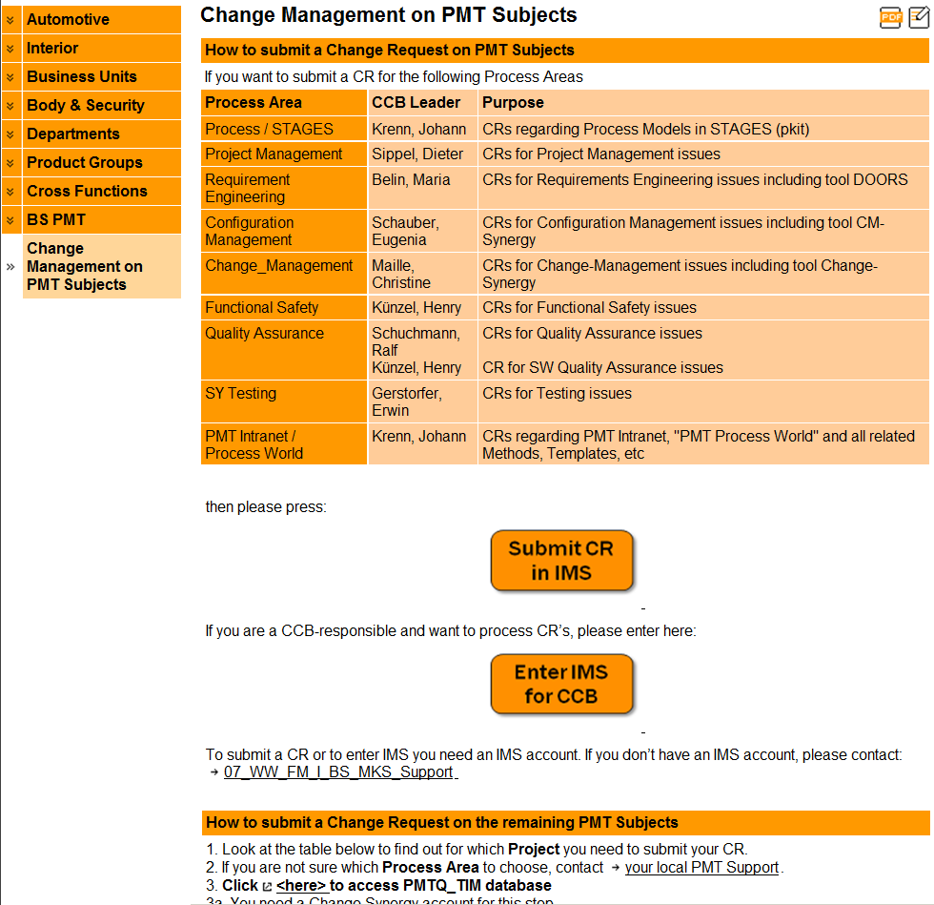
How to enter IMS for change manag. on PMT subjects (productive)

Slide 12

MKS Support
Support Mailbox: 07_WW_FM_I_BS_MKS_Support
Support Phone number: +40 (256) 25-2000
Thank you for your attention!

