Slide 1
Body & Security
MKS API Presentation - Bhagyashree Hebbar

Slide 2
Contents
MKS Java API
MKS API Integration Model
MKS Java API Viewer
Java MKS API Building blocks
Environment for Java API Program
Java API program
3/16/2016
Bhagyashree Hebbar/ I BS PMT
2

Slide 3
MKS Java API
A set of java functions and procedures that allow the creation of applications which access the features or data of an operating system, application, or other service
Why go for MKS API:
Faster
Effective(No incompatible issues, Response objet model)
Direct access to the data
No parsing required
3/16/2016
Bhagyashree Hebbar/ I BS PMT
3

Slide 4
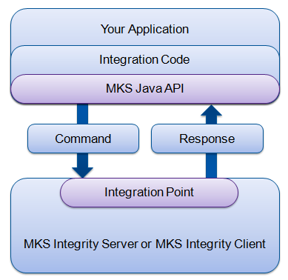
MKS API Model – Generic Overview
The MKS API is bundled into a library that you link to your application. Your application calls the functions within the library to have workflows and documents perform work and respond directly within your source code.
Integration point can be done directly to the server or through the installed client to the server.
3/16/2016
Bhagyashree Hebbar/ I BS PMT
4

Slide 5
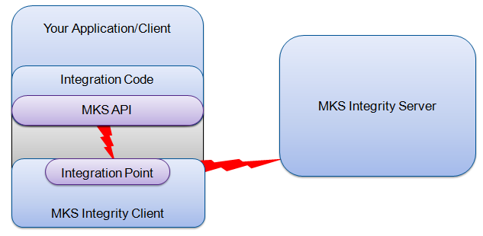
MKS Integrity Client integration
An MKS Integrity Client integration is the most common integration; it is used by all IDE and developer productivity tool integrations.
Why need access to client features ?
Local file system access
Access to client user preferences
GUI interaction for status

Slide 6
MKS API viewer
The MKS APIViewer is a helpful tool that allows you to run commands through the API and see the format of the response
The syntax is: mksapiviewer <configuration> <application> <command>
configuration = options for integration point
application = im/si/aa/integrity
command = suitable command and arguments
For example, to return a list of fields in XML format:
mksapiviewer --iplocal --xml im fields
Note:
The API Viewer is intended as a tool for API programmers to preview and learn about the structure of responses to API commands
It should not be used as an output formatter for the CLI in scripts which parse the XML or text output
3/16/2016
Bhagyashree Hebbar/ I BS PMT
6

Slide 7
MKS API Building Blocks
IntegrationPointFactory – creates and manages integration points
IntegrationPoint – a connection point to MKS Integrity (client or server)
Session – the authenticated session under which commands are run
Can be shared/reused for multiple commands
CmdRunner – manages the sequential execution of commands through a session and returns the response
Command – object used to represent a command as would be run from the CLI
May have options and a selection
Response – structured output of a command
3/16/2016
Bhagyashree Hebbar/ I BS PMT
7

Slide 8
Command
Command class is used to represent a command. Each command object may have various options and a selection.
Commands in the command prompt/shell
im command –option1="spaced value" –option2=value selection
im viewissue --hostname=myhost --port=7001 issueId
Commands in the command prompt/shell
Command myCmd = new Command(Command.IM, "command");
Command myCmd = new Command(Command.IM, "viewissue");
Option – used to represent the concept of a CLI option, which takes the form of:
myCmd.addOption(new Option("option", "value"));
MultiValue – used when an option has multiple values that can be associated with that option such as --fields and --filter Option multiValue = new Option("fields", "ID,Type,Summary");
Selection – used to represent the concept of CLI selection, the input parameter to a command
myCmd.addSelection("selection");
3/16/2016
Bhagyashree Hebbar/ I BS PMT
8

Slide 9
Response
Response is entire output of a command this can be seen in mksapiviewer.
Work item – section of the output of the command
Item – Usually an actual line from the output
Result – The end result of the command running
For example, "Member was added to project X"
Field – A more specific part of an Item
For example, Project Revision number
Exception – if a problem was encountered with the command, this will show the exception
3/16/2016
Bhagyashree Hebbar/ I BS PMT
9

Slide 10
Environment
MKS Integrity 2009
The MKS API cannot be used with versions prior to 4.6, and there have been several advancements since the initial API release
Java Runtime Environment (JRE)
Get the latest JRE
Older versions of the JRE may work but might not include advanced data types and latest bug fixes
Eclipse IDE
The Eclipse IDE for Java open source development tool
NetBeans, other IDEs, or simple text editors can be used with minimal changes to the exercises
3/16/2016
Bhagyashree Hebbar/ I BS PMT
10

Slide 11
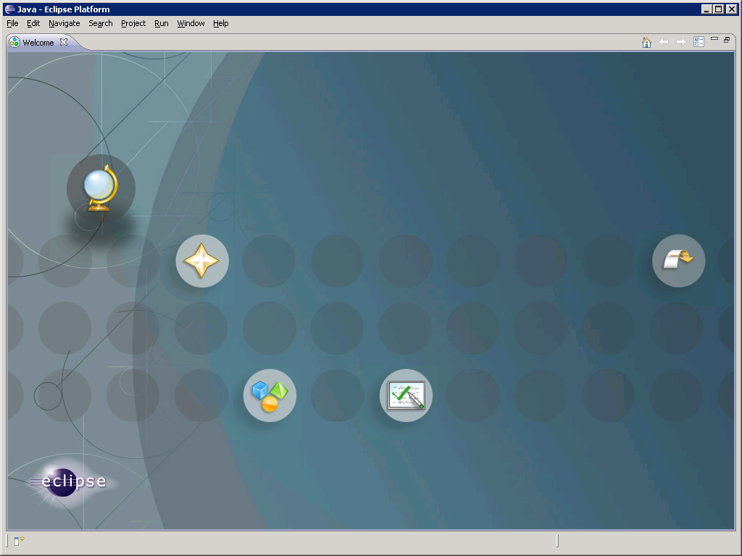
Your First Java API Program
Close the Welcome screen to expose the IDE
X
3/16/2016
Bhagyashree Hebbar/ I BS PMT
11

Slide 12
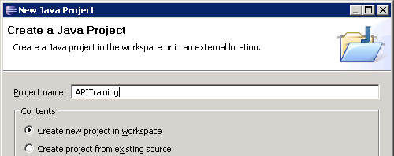
Your First Java API Program
Select File > New > Java Project from the menu and name it APITraining
Click Next to continue with the Wizard
3/16/2016
Bhagyashree Hebbar/ I BS PMT
12

Slide 13
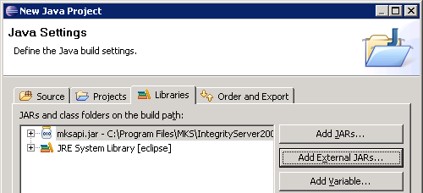
Your First Java API Program
On the Libraries tab, click the Add External JARs button and add: C:\Program Files\MKS\IntegrityServer2009\server\ mks\lib\mksapi.jar
Click Finish
3/16/2016
Bhagyashree Hebbar/ I BS PMT
13

Slide 14
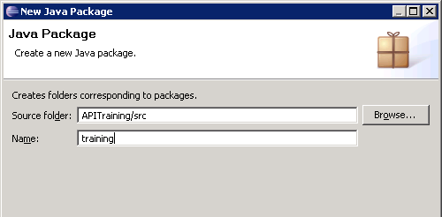
Your First Java API Program
Select File > New > Package and name it training
Click Finish
3/16/2016
Bhagyashree Hebbar/ I BS PMT
14

Slide 15
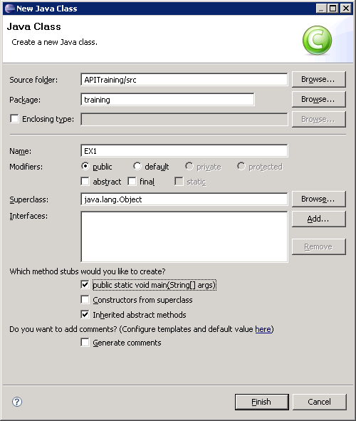
Your First Java API Program
Select File > New > Class, and name it EX1 with package name training
Check the public static void main… method stub to create box toward the bottom
Click Finish
3/16/2016
Bhagyashree Hebbar/ I BS PMT
15

Slide 16
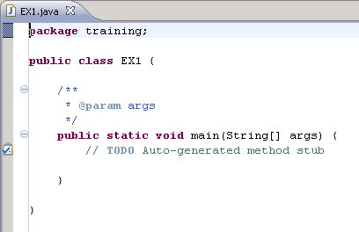
Your First Java API Program
Your EX1.java file has been created and mksapi.jar is included in the project classpath
3/16/2016
Bhagyashree Hebbar/ I BS PMT
16

Slide 17
MKS Java API – Exercise 1
Begin by importing the necessary Java and MKS API classes, after the package declaration
Note: We will import some extra classes to be used in later exercises, so you can ignore the Eclipse messages about them not being used
package training; import com.mks.api.*; import com.mks.api.response.*; import com.mks.api.util.ResponseUtil; import java.io.*;
3/16/2016
Bhagyashree Hebbar/ I BS PMT
17

Slide 18
MKS Java API – Exercise 1
Add some comments for your class, and declare the session variable
. . . /** * MKS API Training class. */ public class EX1 { /** * The API session. */ private static Session mySession = null;
3/16/2016
Bhagyashree Hebbar/ I BS PMT
18

Slide 19
MKS Java API – Exercise 1
Add some comments for the main( ) function of your class, and start a try – catch - finally block to trap exceptions and create an integration point and session
. . . /** * Setup the MKS API connection framework and run a command. * Args are ignored. */ public static void main(String[] args) { try { // Create integration point IntegrationPointFactory ipf = IntegrationPointFactory.getInstance(); IntegrationPoint ip = ipf.createIntegrationPoint("localhost",7001,4,10); // Create session mySession = ip.createSession("student","password");
3/16/2016
Bhagyashree Hebbar/ I BS PMT
19

Slide 20
MKS Java API – Exercise 1
Continue by creating a command runner and a command
. . . // Create a command runner CmdRunner myCmdRunner = mySession.createCmdRunner(); // Set defaults so they need not be added to every command myCmdRunner.setDefaultHostname("localhost"); myCmdRunner.setDefaultPort(7001); myCmdRunner.setDefaultUsername("student"); myCmdRunner.setDefaultPassword("password"); // Create a command Command myCmd = new Command(Command.IM, "fields");
3/16/2016
Bhagyashree Hebbar/ I BS PMT
20

Slide 21
MKS Java API – Exercise 1
5. Continue by executing the command and displaying the result
. . . // Run the command and capture the response Response myRes = myCmdRunner.execute(myCmd); // Create a WorkItemIterator to iterate through results WorkItemIterator wii = myRes.getWorkItems(); // While there are items left, print them out while (wii.hasNext()) { WorkItem wi = wii.next(); System.out.println(wi.getField("name").getValue()); // shortcut: System.out.println(wi.toString()); }
3/16/2016
Bhagyashree Hebbar/ I BS PMT
21

Slide 22
MKS Java API – Exercise 1
6. Close up our try block and catch any exceptions
. . . } catch (APIException ae) { System.out.println("--[ Exception ]----------------------------"); // Use the ResponseUtil.printXXXX tool (like MKSAPIViewer) ResponseUtil.printAPIException(ae, 1, System.out); System.out.println("--[ Response In Which It Occurred ]--------"); ResponseUtil.printResponse(ae.getResponse(), 1, System.out);
3/16/2016
Bhagyashree Hebbar/ I BS PMT
22

Slide 23
MKS Java API – Exercise 1
7. Close up our catch block, and add the finally block to release the session
. . . } finally { try { if(mySession != null) { // Release the Session mySession.release(); } } catch (APIException ae) { System.out.println("--[ Exception ]-------------------------"); // Use the ResponseUtil.printXXXX tool (like MKSAPIViewer) ResponseUtil.printAPIException(ae, 1, System.out); System.out.println("--[ Response In Which It Occurred ]-----"); ResponseUtil.printResponse(ae.getResponse(), 1, System.out); } catch (IOException ioe) { System.out.println(ioe.getMessage()); } } } }
3/16/2016
Bhagyashree Hebbar/ I BS PMT
23

Slide 24
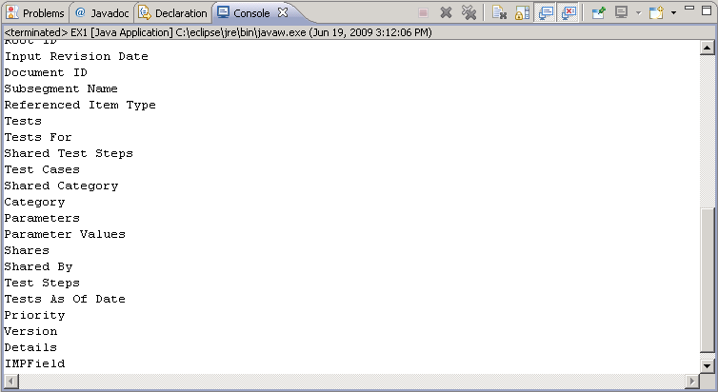
MKS Java API – Exercise 1
8. Run your class! (as Java application)
Congratulations!
3/16/2016
Bhagyashree Hebbar/ I BS PMT
24

