Slide 1

Short Introduction to IMS and ICTM

Slide 2
Issues in IMS
Change Requests in IMS are called Issues
Issues in IMS have three sub types
Feature Requests: new Features
Change Requests: changes to existing Features
Problem Reports: Bug Reports
You create Issues in IMS via the following link:
http://ims-bs:7002/im/createissue?type=issue

Slide 3
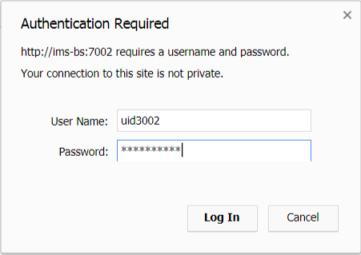
Login to IMS
Enter your Windows login data to enter IMS
Note: In case you don‘t have access, request one with a mail to the : 07_WW_FM_I_BS_MKS_Support support mailbox
with the subject: Access request for Change Management on <YOUR_PROJECT>

Slide 4
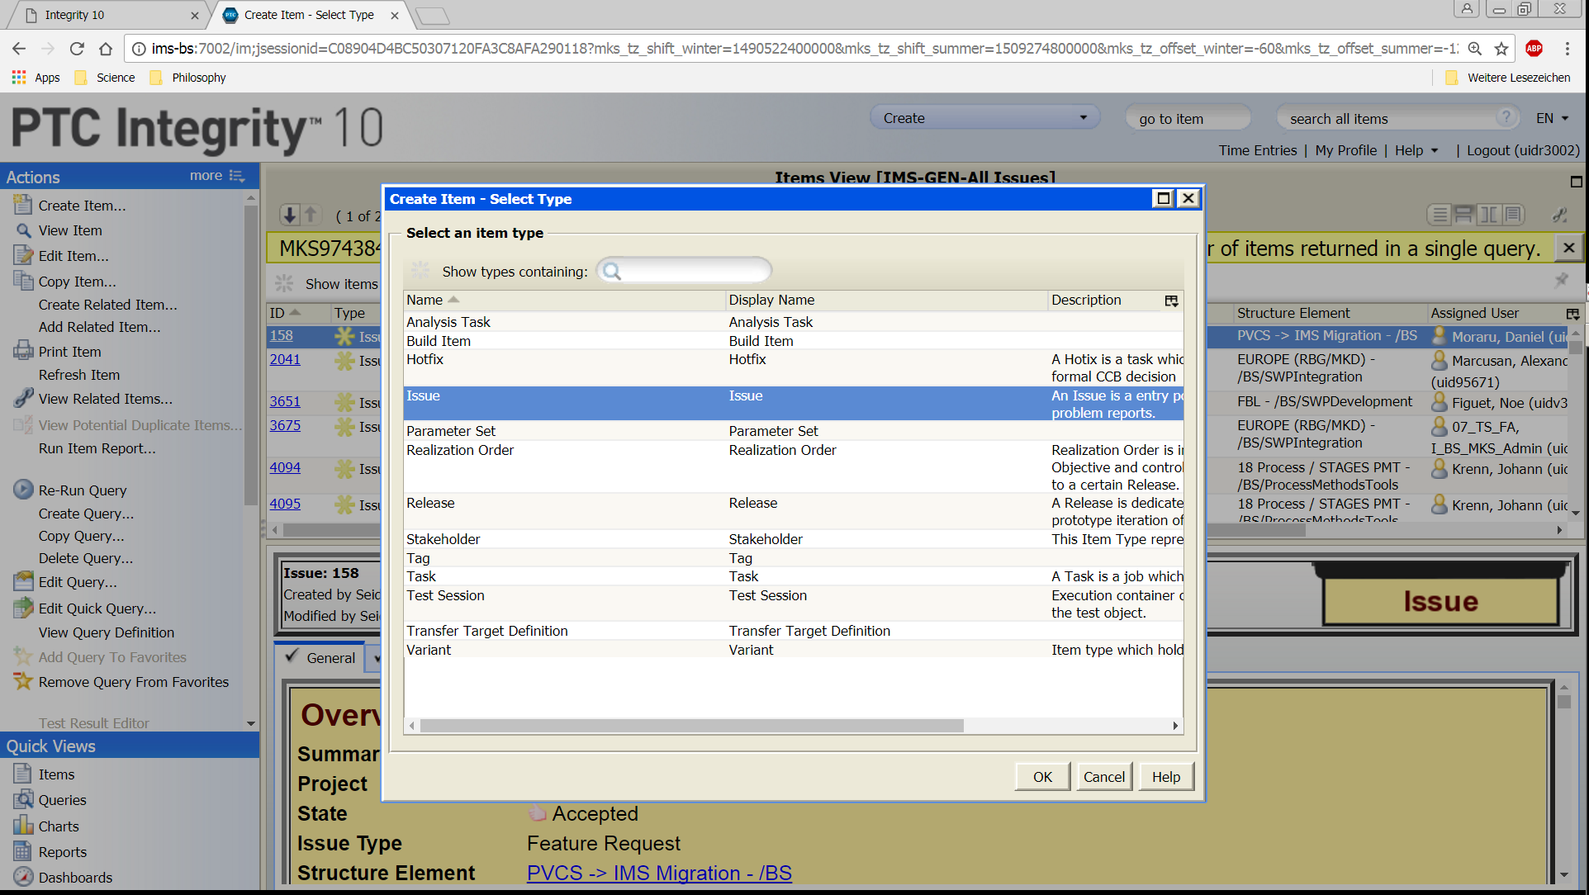
How to enter an IMS Item
Create any available IMS Element by invoking „Create Item“

Slide 5
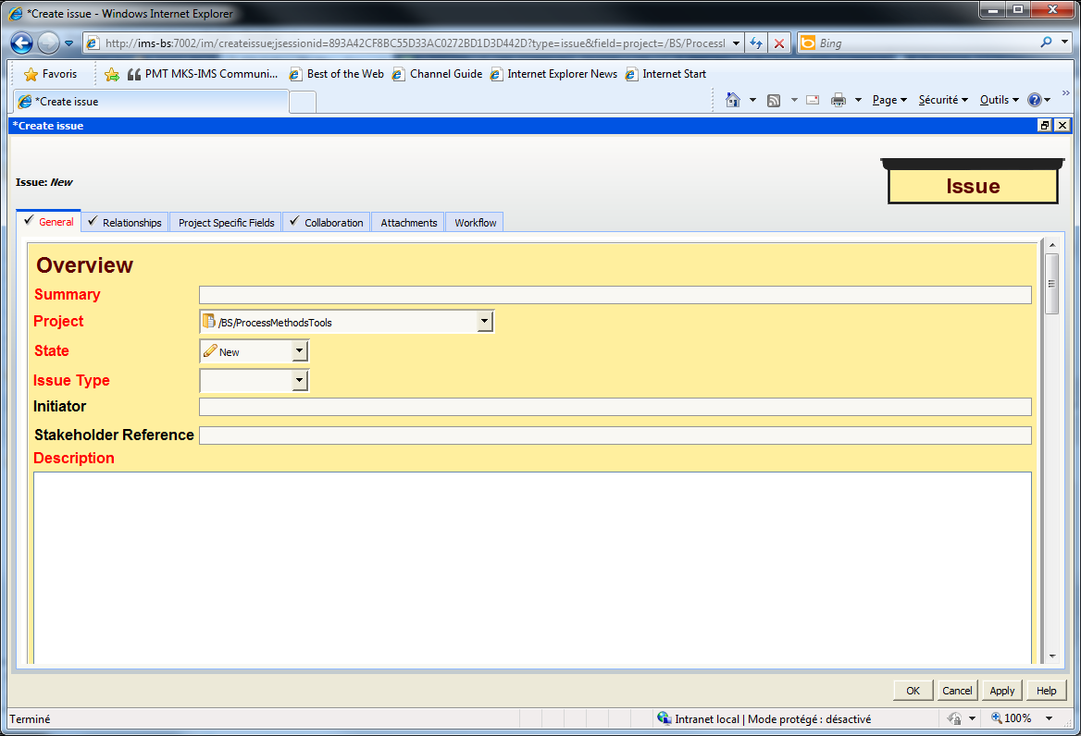
How to enter an Issue
Enter here a Summary which enables easy categorization of the issue and gives an idea about the contents
Select <YOUR_PROJECT> for the
field “Project”
The Issue Type is “Problem Report”,
“Change Request” or “Feature Request”
Note: Red fields are mandatory
Enter here a Description what has to be changed or what is the problem i.e. the clear difference between the current state and the desired state
Press OK to create the issue
June 20, 2017
Frank Lippert, © Continental AG

Slide 6
Red Flag Issues
From severe findings in the PCC we will generate so-called RED_FLAG issues in IMS.
The Summary of such an issue will look like this:
#FULL_PCC: <short description of the non-conformance>
The Description of such an issue will look like this:
ASPICE_severity: RED_FLAG
ASPICE_reference: ENG.3
Work_Product_name: System Architecture
Work_Product_link:
Work_Product_rating: N
Weakness: The system architecture does not exist, yet.

Slide 7
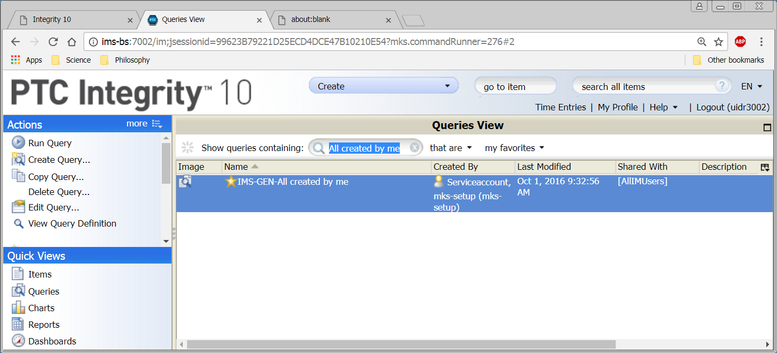

How to find your created Issues
Click on “Queries”
Search for appropriate query by typing first characters

Slide 8
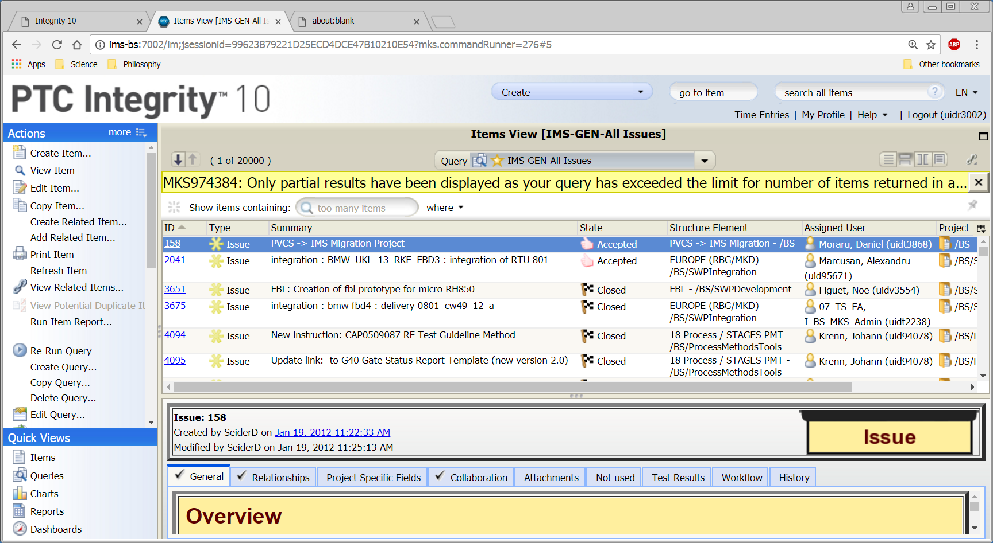
How to find your created Issues, 2
The result page potentially shows too many found items
You can restrict the result further by invoking filters

Slide 9
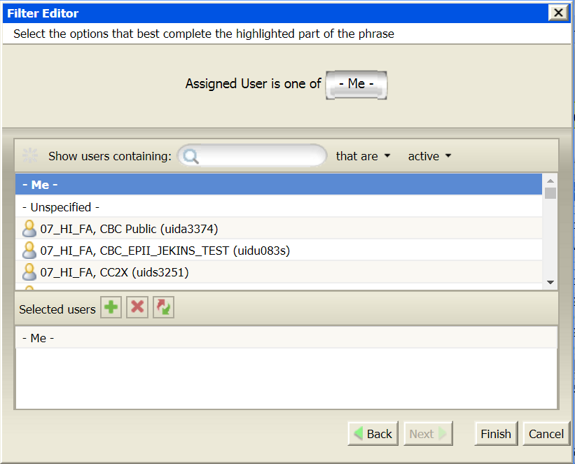
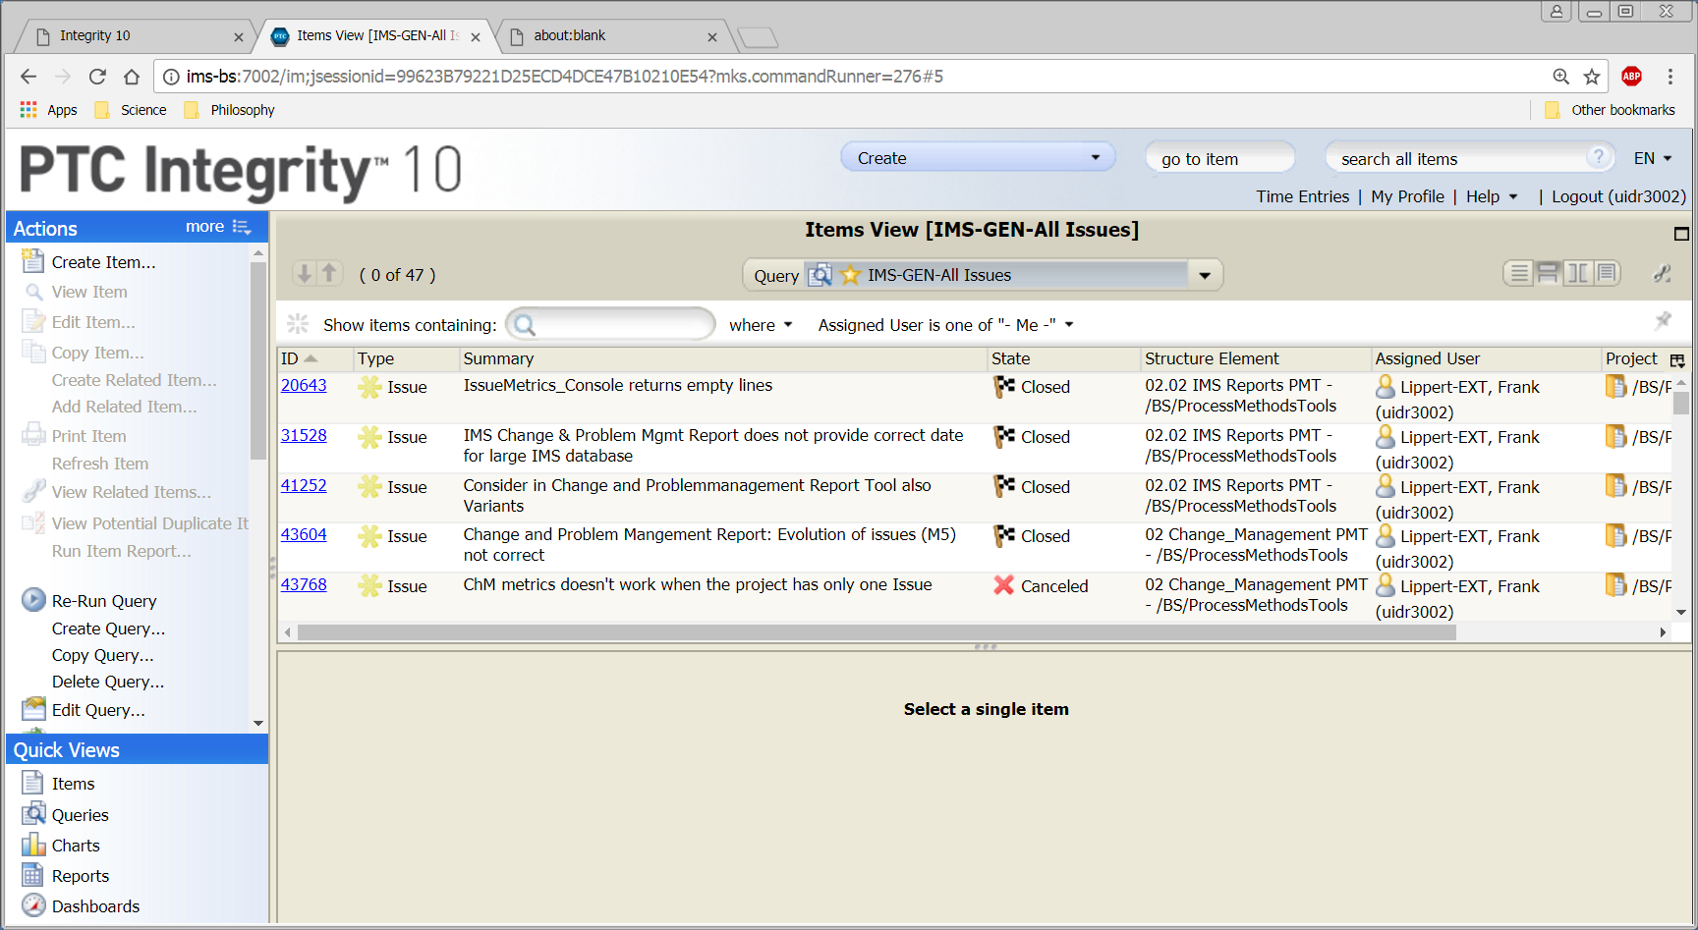
How to find your created Issues, 3
Search e.g. for „Assigned User is –me-“ to show only
Issues, where you are the assigned user
In the “where” box, search for “project is” and select your project

Slide 10
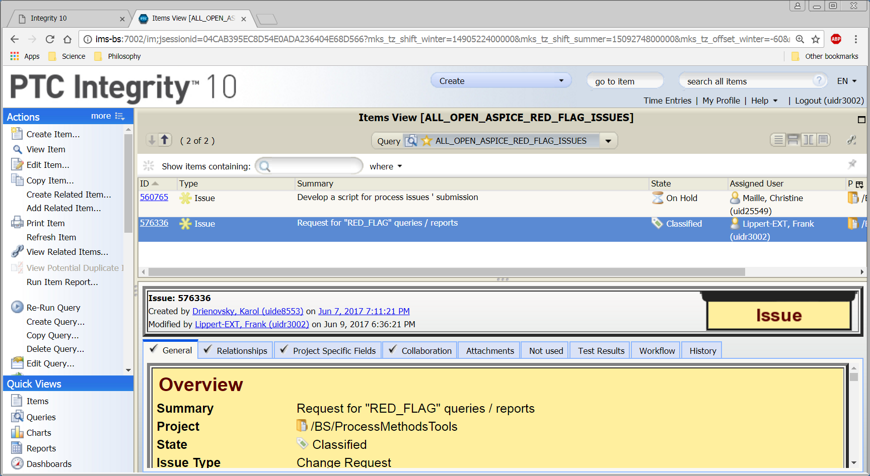
ASPICE Red Flags
Go to „Queries“, search for „ALL_OPEN_ASPICE_RED_FLAG_ISSUES “

Slide 11
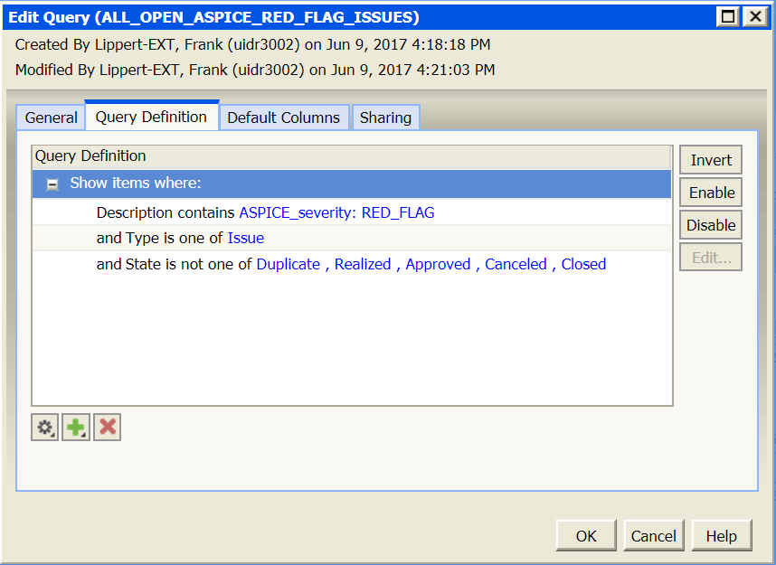
ASPICE Query Definition

Slide 12

IMS Support
Support Mailbox: 07_WW_FM_I_BS_MKS_Support
Support Phone number: +40 (256) 25-2000
Thank you for your attention!

