Slide 1
Data Structures and Algorithms -3 (25CS2103E)
Title:EVENTORA – EVENT MANAGEMENT SYSTEM
Team 14 (Section 6)
2520030385 P.Tanvitha
2520030132 – N.Tejasri
2520030018 – P.Laxmikanth
Under the Esteemed Guidance of
Dr. V. Sireesha, Professor, Department of CSE

Slide 2
Contents
Abstract
Introduction
Literature survey
Problem Statement and Objectives
Course Outcomes (CO1–CO6)
Results
Hardware and Software requirements
Conclusion
Future Scope

Slide 3
Abstract
Eventora is a web application to explore, search, book and schedule events.
Pattern Matching (KMP, Z-function, Rabin–Karp) finds exact keywords in event information.
Fuzzy Search (Levenshtein edit distance) finds results even with spelling mistakes.
Similarity and Ranking order events by relevance, favorites and featured status.
Built with React.js, JavaScript, HTML, CSS and Vite.
The project demonstrates practical applications of DSA-3 concepts.

Slide 4
Introduction
Eventora makes event searching, booking and scheduling easier, faster and more efficient.
It stores event name, category, date, venue, price and description in an organized way.
Pattern matching, fuzzy search and similarity give accurate results even for misspelled queries.
Users can favorite events, book tickets, create events and use a calendar.

Slide 5
Literature Survey
Existing Approach | Technique | Limitation
Basic Event Search | Exact Matching | Cannot handle spelling errors
Keyword Search | Pattern Matching (KMP, Z, Rabin–Karp) | Requires correct keywords
Fuzzy Search Systems | Edit Distance | More computationally expensive
Recommendation Systems | Similarity Algorithms | Requires comparison between records
Proposed System | Pattern + Fuzzy + Similarity | Provides flexible event discovery

Slide 6
Course Outcomes (CO1–CO6)
CO | Topics Covered | Used in Eventora
CO1 | Problem signatures & choosing an algorithm strategy | Search → string algorithms; schedule → DP; capacity → flow
CO2 | KMP, Z-function, Rabin–Karp; suffix array, LCP, suffix automaton | KMP / Z / Rabin–Karp in event search (implemented)
CO3 | Interval, bitmask, subset DP; DP on trees | Edit-distance DP in fuzzy search (implemented)
CO4 | Ford-Fulkerson, Edmonds-Karp, Dinic; max-flow / min-cut | Ticket capacity & attendee allocation (design)
CO5 | P, NP, NP-complete, NP-hard; reductions; approximation | Event selection under budget (design)
CO6 | Las Vegas / Monte Carlo; parallel prefix sum, reduce, work-span | Hash-and-verify search; totals via reduce (partial)

Slide 7
Problem Statement and Objectives
Problem:
Users find it difficult to find suitable events in large event lists. Exact keyword search cannot handle spelling mistakes or incomplete queries.
Proposed Solution:
Develop Eventora, an event system that uses pattern matching, fuzzy search and similarity algorithms to search, compare and recommend events.
Objectives
• Create an event repository with booking and calendar features.
• Implement KMP, Z-function and Rabin–Karp for exact search.
• Use edit distance for fuzzy search and similarity for comparison.
• Rank events by relevance, favorites and featured status.

Slide 8
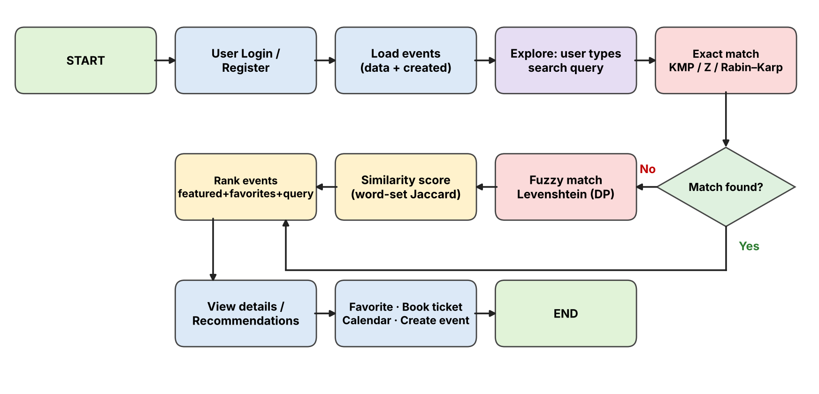
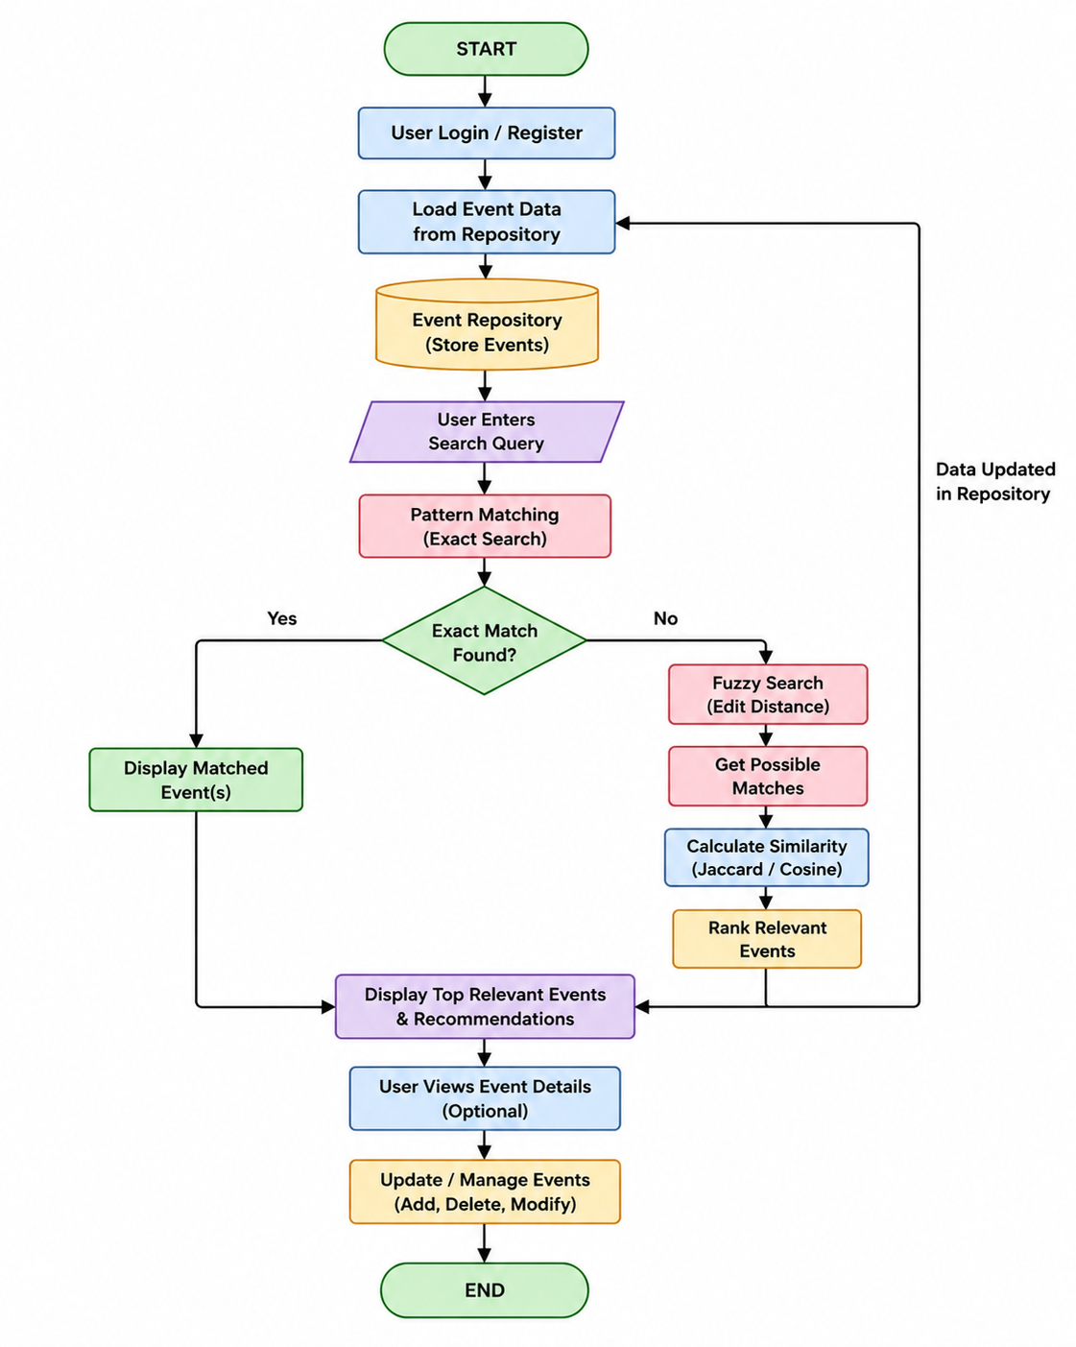
Flow Chart

Slide 9
Results
Successfully created the Eventora event management application.
Events can be explored, searched, favorited, created and booked.
Pattern Matching identifies exact keywords in event information.
Fuzzy Search finds relevant events even with spelling mistakes.
Similarity and Ranking compare events and show the best results first.

Slide 10
Hardware and Software requirements
Hardware Requirements
Processor: Intel i3 or above
RAM: 4 GB minimum
Storage: 10 GB available
Keyboard and Mouse
Monitor
Software Requirements
Operating System: Windows / Linux
Language: JavaScript (React.js), HTML, CSS
Build Tool: Vite
IDE: VS Code
Node.js and npm
Git and GitHub

Slide 11
Conclusion
Eventora provides an efficient and user-friendly way to manage, search and book events.
It shows how Data Structures and Algorithms solve real-world problems using pattern matching, fuzzy search, similarity and ranking.
Booking and calendar features make event management simple and organized.

Slide 12
Future Scope
Online payment gateway
User authentication with backend
Event reminders and notifications
AI-based event recommendations
Location-based event search
Calendar sync
Network flow for ticket allocation
Advanced ranking algorithms
Mobile application
Database integration

Slide 13
Thank you

