Slide 1

Pulp
Juicy Software Repository Management
PRESENTED BY:
Jason Connor & Jay Dobies
Red Hat

Slide 2
Agenda
Overview
Demo: Repository Management
Demo: Consumers
Demo: Remote Package Installation
Advanced Features
Parting Thoughts

Slide 3
Overview

Slide 4
What is Pulp?
Software Repository Management
  Packages, Errata, Distributions
  Custom repositories or synchronized from a feed
Consumer Management
  Repository Subscription Management
  Package Profile Tracking
  Remote Package Installation

Slide 5
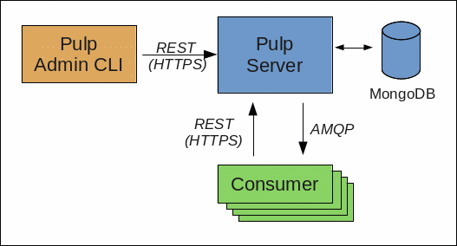
What is Pulp?

Slide 6
Technologies
Web Application (HTTPS)
REST API
Python CLIs (consumer and admin)
Qpid (AMQP)
MongoDB
Platforms
  Fedora 13 i386, x86_64
  Fedora 14 i386, x86_64
  Red Hat Enterprise Linux 5 & 6 (soon)

Slide 7
Repository Management
Create, delete, update Pulp repositories
Synchronize content immediately or at scheduled intervals
  Feed Types: Yum, RHN, Local
Custom repositories and package upload
Global package search

Slide 8
Consumer Management
Subscribe (bind) to Pulp repositories
  Accessible through Yum
  Remote installation through Pulp admin API
Package profile tracking
Operation history auditing

Slide 9
Demo
Repository
Management

Slide 10
Demo
Consumers

Slide 11
Demo
Remote
Package
Installation

Slide 12
Advanced Features
Batch Operations
  Repository Groups
  Consumer Groups
LDAP Integration
Repository Cloning
Distributions & Errata
Consumer Key/Value Pairs
REST API

Slide 13
Parting Thoughts
Roadmap
  Maintenance Windows
  Scheduled Consumer Installations
  External Content Delivery Servers
  Repository Clone Filters
  High Availability and Fail Over
  Internationalization
  <Your Feature Here>

Slide 14

Pulp
Project Site
  http://pulpproject.org
User Guide
  http://pulpproject.org/ug
Freenode: #pulp
  jdob (Jay Dobies), linear (Jason Connor)
Mailing List
  pulp-list@redhat.com

Slide 15
Questions?
CONTACT:
pulp-list@redhat.com

