Slide 1
Creating .Net Modules

Slide 2
Creating .Net Modules
You can do a lot of stuff with the csc command-line compiler tool…
csc /help will list the possibilities...

Slide 3
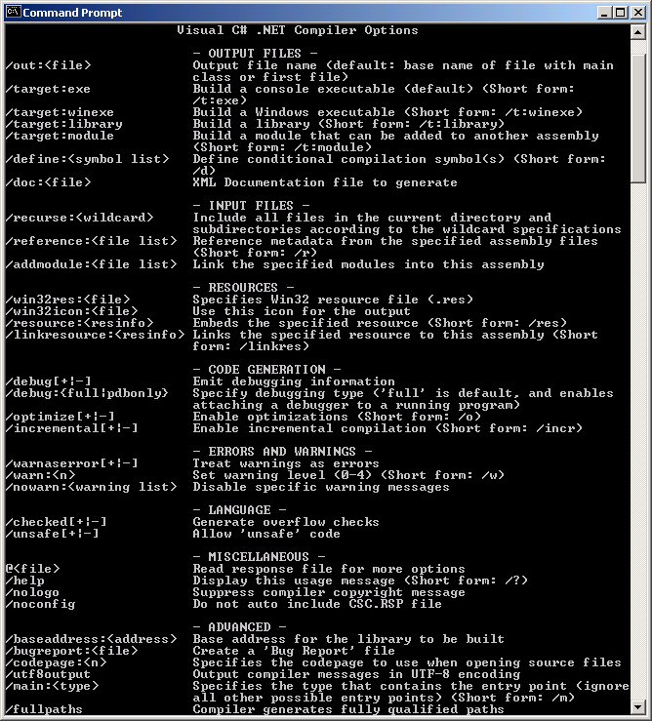

Slide 4
Creating .Net Modules
We are concerned with two compiler options:
  /target:module
  /addmodule:<file list>
The /target:module option is used to compile one or more source files into a code module.
The code module can then be added to other modules or executable images. (.exe)

Slide 5
Creating .Net Modules
The /addmodule:<file list> option is used to add a module to the module or executable image being compiled.
Example:
  Given two source files: Dog.cs and MainApp.cs we will first compile the Dog.cs source file into a module using the /targer:module option.
  We will then compile the MainApp.cs source file into an execute image and add the Dog module to it in the process...

Slide 6
Creating .Net Modules
From the command-line, first create the Dog module:
  csc /target:module Dog.cs
The name of the file that’s created is
  Dog.netmodule
Next, create the MainApp executable file using the /addmodule option:
  csc addmodule:Dog.netmodule MainApp.cs

Slide 7
Creating .Net Modules
That’s it!
  Any questions?

