Slide 1
Mobile Application Development Project Books2Go
Project Team - 12

Slide 2
Team Members
Danna Liu (Project Head)
Ethan Cernok
Jishnu Pradeep
Venkatesh Tahiliani

Slide 3


Slide 4

Introduction
Books2Go App is a android application that serves as a portal where Illinois Tech students could quickly and easily sell or buy used books locally. This app would mainly help the outgoing students in selling off their used books before they leave. Books2Go would serve as an innovative way for IIT students to save a lot of money during college.

Slide 5

Target Users
Books2Go is a community marketplace for all the students of Illinois Institute of Technology, Chicago. The applications will mainly help those students,
Who are in need of books for their courses/research.
Who have completed courses and would like to sell off their text books.
Who are leaving IIT after completion of their degree and would like to sell all their text books before they leave.

Slide 6

Android Technologies Used
Activity and fragment
Define a main activity to communicate with several different fragments through the interfaces. This helps us reuse the fragment UI components and make the fragments communicate with each other through the activity.
Intent
Use intent in startService to communicate with our background service. Use intent in startActivity to launch an activity and sent it back to main activity for uploading images.
Custom Theme
Define a style with setting a dark theme color for the status bar

Slide 7
App Icon
Beautiful and memorable icon to attract user’s attention in the Google play store.
Splash screen
Show our app logo for a couple of second before the app loads completely.
Button to upload image
Click “add image” to upload a book image or a profile picture to server.
Service
Start the service after launching the app and check the updated data every 5 seconds.

Slide 8
GridView
Display the selling books in a two-column and scrollable grid.
Customed ListAdapter
The default look and feel of the Android ListView is not very attractive. It only renders a simple String in every ListView row using the internal TextView control. We created an interface that is more graphically rich and visually pleasing to the user for message, sale history and book list.
Sharereference
This allow us to store and retrieve application specific persistent data for offline testing before using MongDB.
EditText with OnKeyListener
This allows users to press “Enter” on keyboard to start searching with keyword rather than pressing “search” button on the screen.

Slide 9
Notification
The app online users are able to receive a notification with sounds when a new book is posted.
Linkify
Add links in text (such as email in our app) and make it clickable. We manually made email address linkable rather than using autoLink. This is used for buyer who want to contact to seller by email.
LongClickListener
Use OnLongClickListener to remove item from listview to help admin easily to delete a bad message.
Comparator and sort
Sorting the books by date in descending order with using Comparator and reverseOrder so that users are able to see the newest book and message in the list.

Slide 10

Member Contributions

Slide 11
DANNA LIU (Project Head)
Handled data storage related to user, book detail and message by using sharedPreference.
Made use of MongoDB for handling data requests, data access management and background management so that the app could work online.
Coding part for basic features including login, registration, user profile, book list, posting, detail, biding and message.

Slide 12
ETHAN CERNOK
Coding for posting a book to the marketplace.
Worked with SQL to save information about books in the marketplace.

Slide 13
JISHNU PRADEEP
Designed User Interface and layouts for the application. Created mockups and overall UX Design. Optimized UI for faster performance.
Coding for Splash screen.
Designed logo/icons used in application + marketing material.

Slide 14
VENKATESH TAHILIANI
Coding for login and registration elements of the application.
Worked with MySQL and MongoDB for storage of user information such as profile containing user information and photo

Slide 15

Future Enhancements
The ability to pay for books through the application using Credit/Debit Cards or PayPal.
Integrating local community marketplaces around Illinois Institute of Technology with our app.
Direct messaging option between buyers and sellers.
Extend the applications to a broader markets where students could sell any used items, not just books.

Slide 16
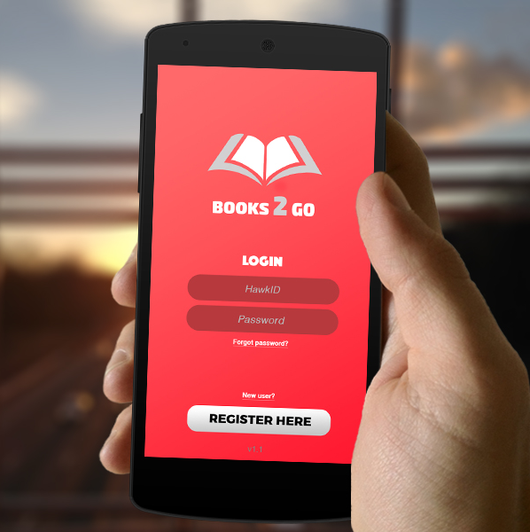
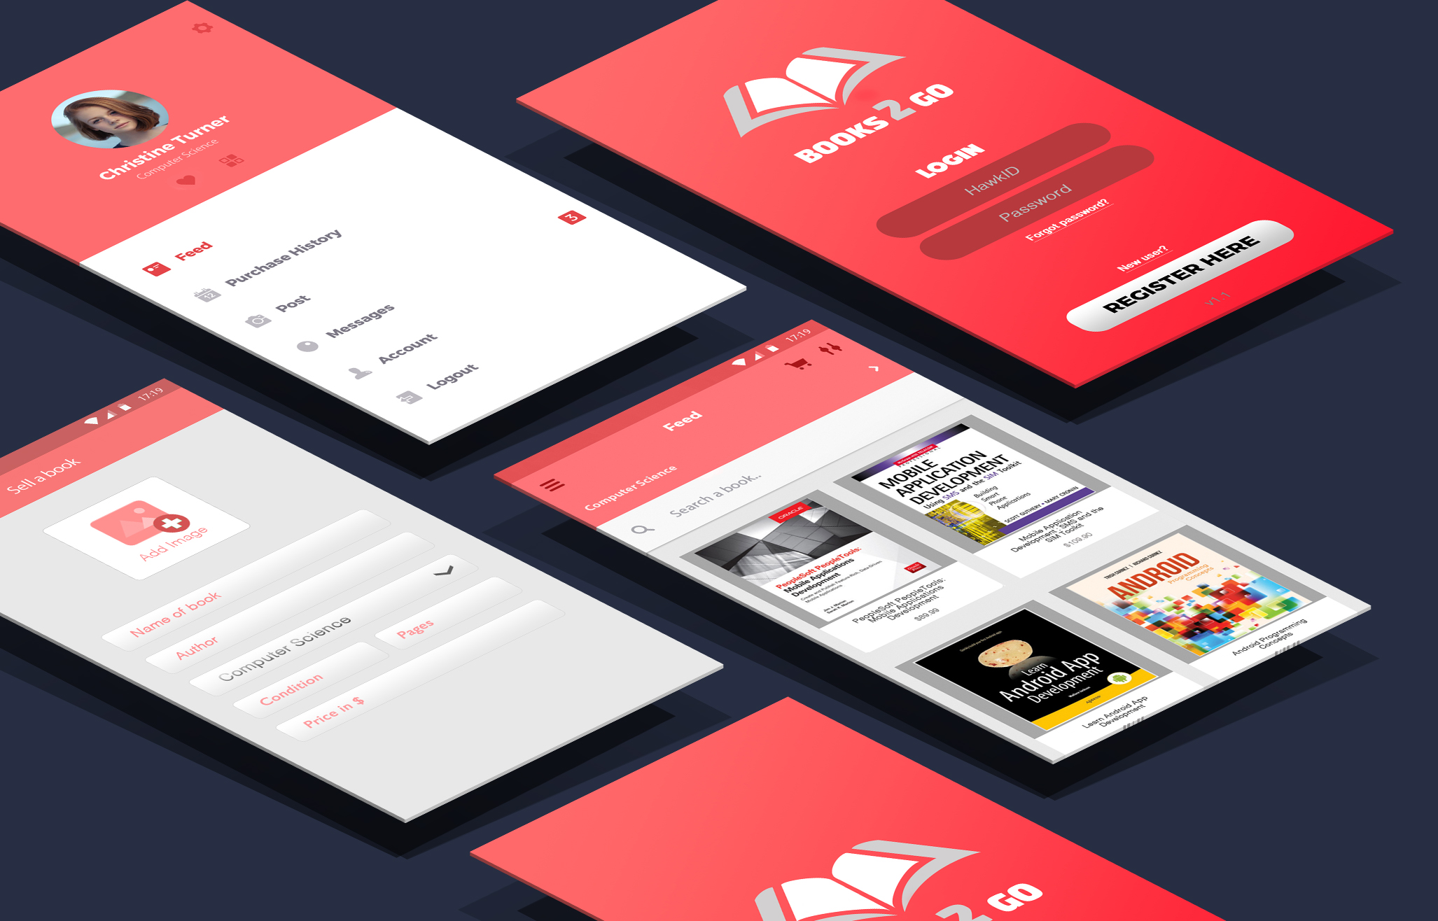
USER GUIDE

Slide 17
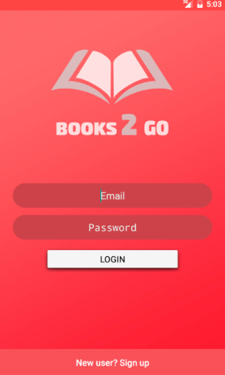
1. Login
Login using a registered account.
If you are a new user, click on
to sign up.

Slide 18
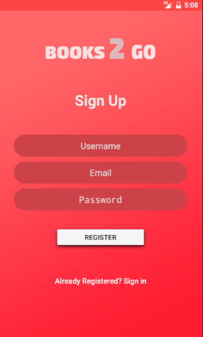
2. Sign Up
Fill out username, email and password in the corresponding fields and click on button.

Slide 19
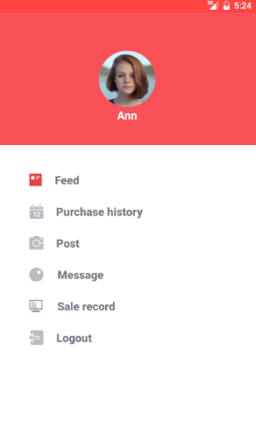
3. User profile
Click on any of following items:
Feed
Purchase history
Post
Message
Sale record
Logout
To go to corresponding page/to perform action.

Slide 20
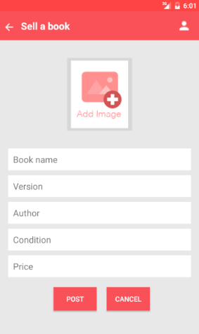
4. Post Book
Clicking on in the user profile screen brings you to this page.
Fill out all information about the book you would like to sell and click on to add your book to the marketplace.

Slide 21
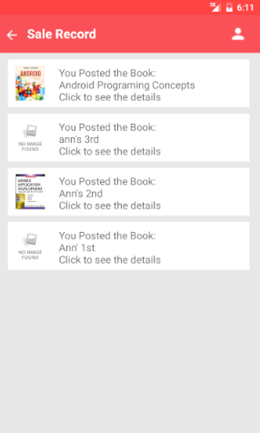
5. Sale Record
Clicking on in the user profile screen takes you to this screen.
Click on an item to view the sale details.

Slide 22
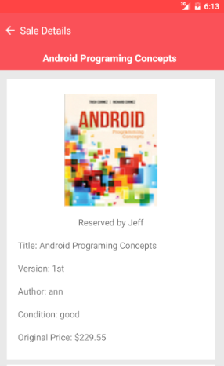
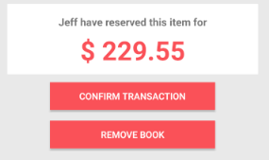
6. Sale Details
Click on to confirm the transaction.
Click on to remove the book from the marketplace.

Slide 23
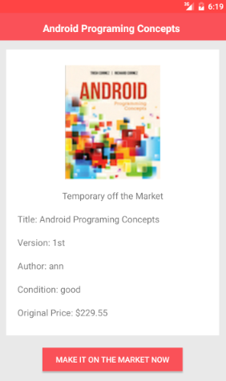
7. Repost to Market
Click to repost the book to the marketplace.

Slide 24
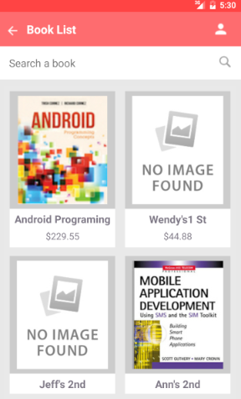

8. Feed
Clicking on in the user profile page takes you to this page.
Use the search box to find the book you are looking for / choose any book from the grid.

Slide 25
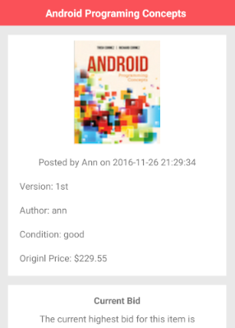
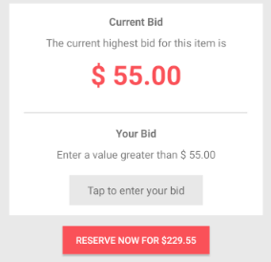
9. Book Detail
All information regarding the book will be given here. It includes the Name, Edition, Author, Condition and Original Price of book.
You can also find the current bidding price of the book here. Enter a price above current bid if you are interested in buying this book.
If you are interested in buying the book for original price, click on

Slide 26
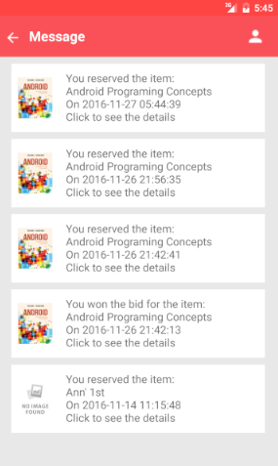
10. Messages
Clicking on in the user profile screen takes you this screen. When you reserve or win the bid for an item, you will receive a message here.
Clicking on a message will show your more details about it.

Slide 27
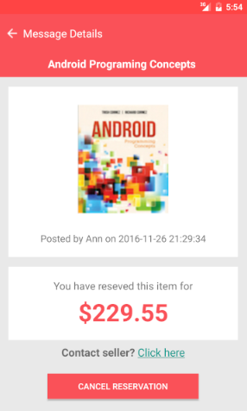
11. Message Details
Click on to contact seller by email.
Or, Click on to cancel the reservation for your book.

Slide 28
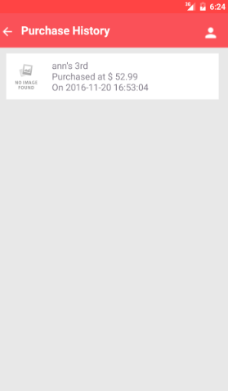
12. Purchase History
Clicking on in the user profile screen takes you to this page.
This page contains a record of all the sales and purchases you have done.

Slide 29


