Slide 1
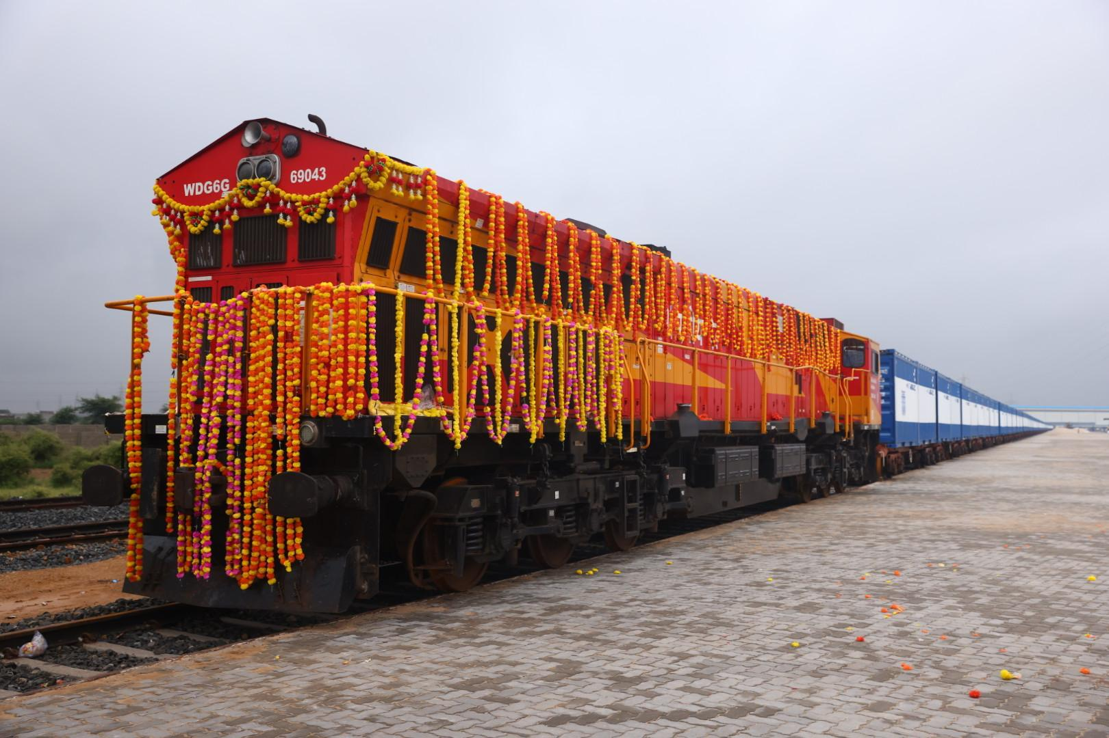

KALYANI CAST TECH LIMITED
From proven manufacturing
toward an integrated rail, cargo
and EXIM logistics platform
Rewari proved the manufacturing base.
Shivlakha introduces the next platform layer.
Rewari, Haryana | Shivlakha, Kachchh, Gujarat
BSE 544023 | SEPTEMBER 2026

Slide 2
01 | INVESTMENT STORY
The company today — with a new platform under construction
A fast-read view of the proven base, current assets and financial starting point.
FY26 REVENUE
FY26 OPERATING EBITDA
FY26 PAT
NET WORTH
₹149.99 Cr
₹21.82 Cr
₹17.05 Cr
₹82.37 Cr
Audited / verified
14.55% margin
11.37% margin
31 Mar 2026
PROVEN / COMMISSIONED / IN DEVELOPMENT
REWARI
SHIVLAKHA
GCT
ICD
6,000–7,000 TEUs / year
≈150 acres
Commissioned Aug 2026
30 acres • under development
PROVEN
PLATFORM
COMMISSIONED
TARGET / BUILD
Kalyani Cast Tech | September 2026
01

Slide 3

02 | LEADERSHIP
Railway experience behind the innovation
The relevant experience is operational: rail systems, containerisation, product development and manufacturing.
Served Indian Railways | CONCOR | PRCL
RAILWAYS
CONTAINERISATION
Operating understanding
Double-stack + cargo solutions
PRODUCT DEVELOPMENT
MANUFACTURING
Specialised containers + wagon concepts
Rewari + Shivlakha
Operating lens
Rail + cargo + manufacturing experience informs the platform direction.
NARESH KUMAR
DIRECTOR | EX-IRSME
Kalyani Cast Tech | September 2026
02

Slide 4
03 | FINANCIAL PERFORMANCE
FY24–FY26: revenue scaled, margins remained positive
Historical standalone / reported figures in ₹ crore. CAGR figures below are derived from FY24–FY26.
HISTORICAL TRAJECTORY
FY26 KEY RATIOS
Revenue
Operating EBITDA
PAT
EBITDA MARGIN
160
149.99
14.55%
139.22
120
PAT MARGIN
94.48
11.37%
80
OPERATING CASH FLOW
40
₹19.38 Cr
14.12
20.39
14.24
21.82
17.05
9.59
0
CAGR FY24–FY26
FY24
FY25
FY26
Revenue 26.0% | EBITDA 24.3% | PAT 33.3%
Source: current investor presentation / financial analysis | Derived CAGR uses FY24–FY26 reported values
03

Slide 5
04 | FINANCIAL HEALTH
FY26 operating cash flow exceeded PAT; balance sheet carries low debt
Derived ratios are calculations from reported FY26 values — not management guidance.
BALANCE-SHEET CONTEXT
CASH CONVERSION
PAT
OPERATING CASH FLOW
NET WORTH
TOTAL DEBT
₹17.05 Cr
₹19.38 Cr
₹82.37 Cr
₹1.87 Cr
CASH
CASH LESS DEBT
113.7%
₹4.50 Cr
₹2.63 Cr
CFO / PAT
Derived indicators
Debt / net worth 2.27% • Cash / debt 2.41×
Derived calculations use FY26 reported values; cash less debt = ₹4.50 Cr − ₹1.87 Cr
04

Slide 6
05 | STRATEGIC TRANSITION
Rewari proved the manufacturing base. Shivlakha adds the next platform layer.
The transition is architectural: manufacture → rolling stock → rail access → EXIM interface.
REWARI | PROVEN
Container manufacturing • design • development • testing
SHIVLAKHA | BUILDING
Containers • wagons • GCT • ICD / EXIM
COMMERCIAL SYSTEM
Cargo generation → rail → customs / EXIM → destination
INVESTOR LOGIC
Existing earnings base → asset creation → cargo acquisition → utilisation → future commercial scale
Kalyani Cast Tech | September 2026
05

Slide 7
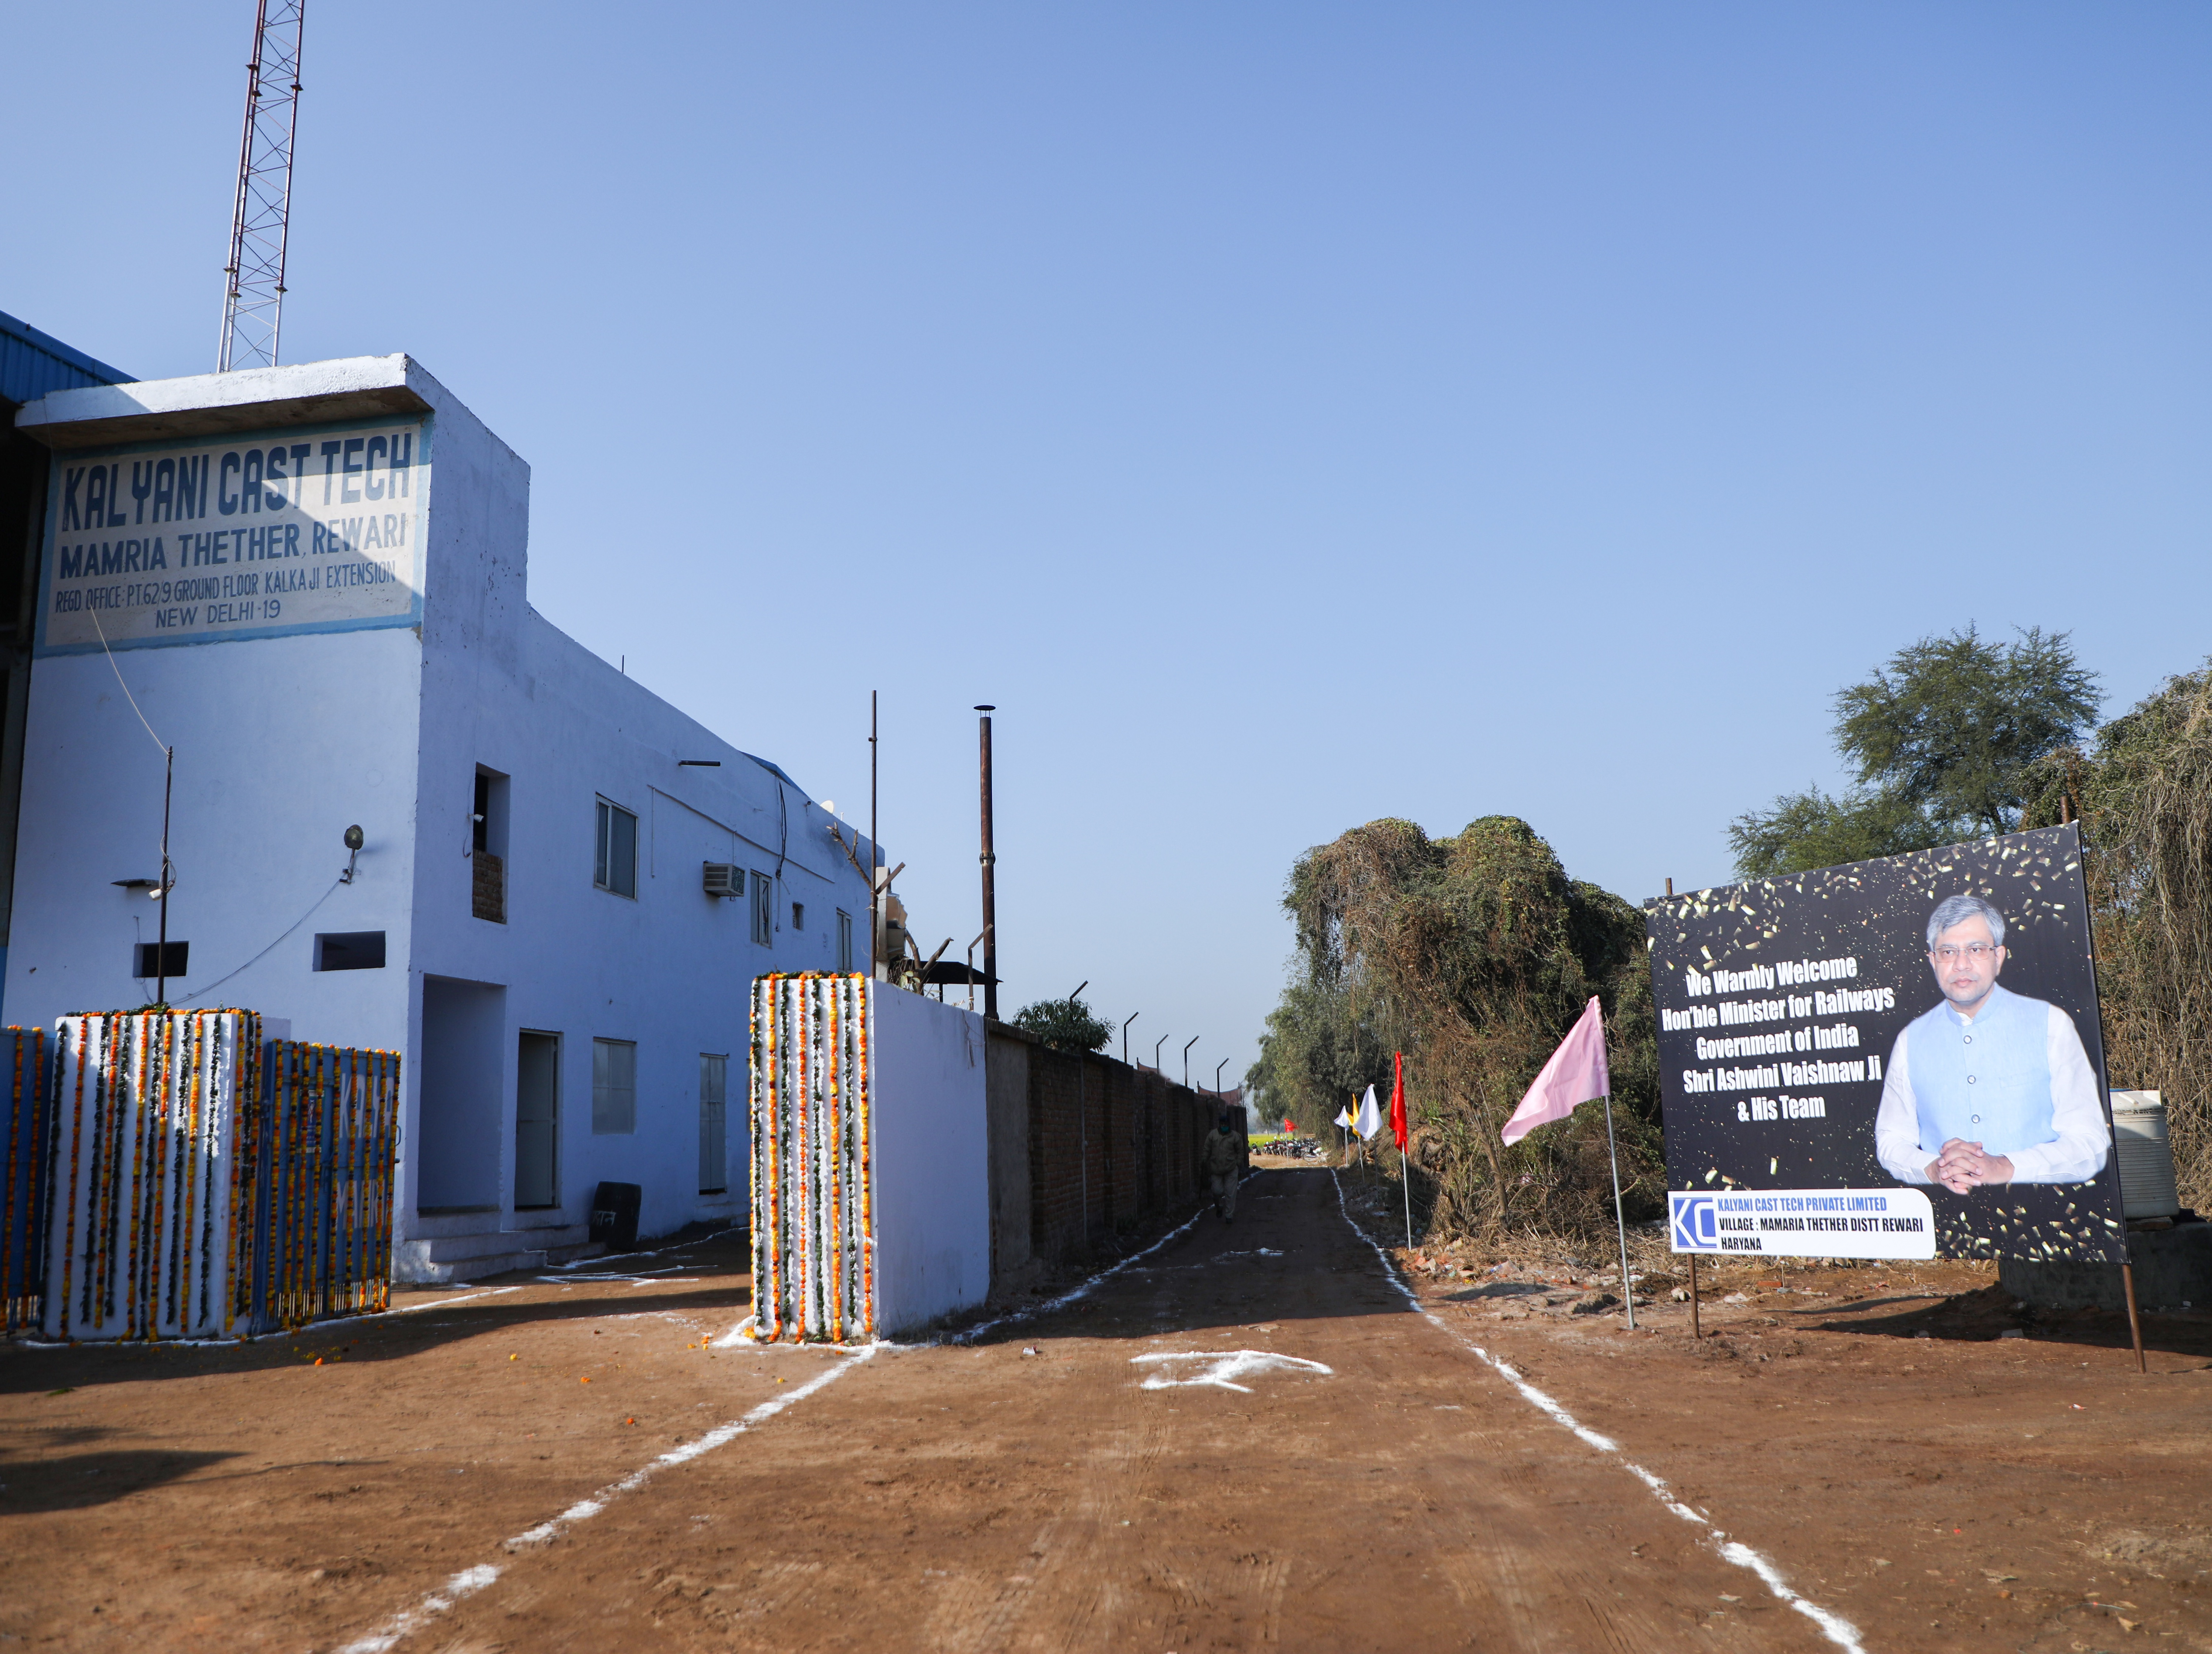
06 | REWARI
Rewari: the proven manufacturing base
Mamaria Thethar, District Rewari, Haryana.
PROVEN OPERATING FOUNDATION
SITE
>5 acres
COVERED AREA
>10,000 sq. m
STATED CAPACITY
6,000–7,000 TEUs / year
CAPABILITIES
Design • Development • Testing
Investor relevance
An operating manufacturing base exists before the Shivlakha expansion.
Company / project materials | Status: September 2026
06

Slide 8
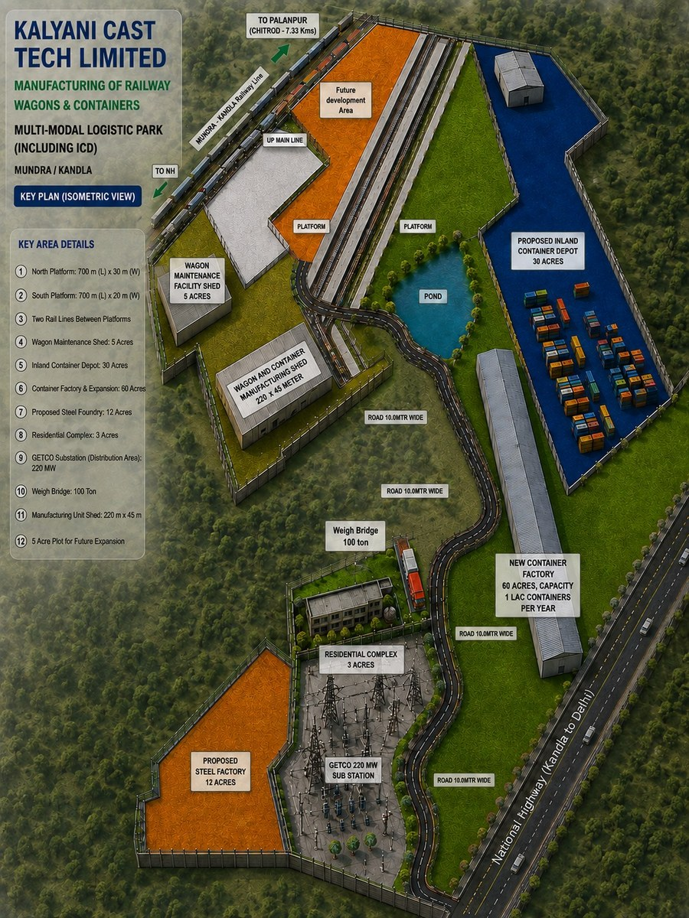
07 | SHIVLAKHA PLATFORM
Shivlakha: a ~150-acre integrated development platform
One physical campus brings manufacturing, rail infrastructure, GCT and an ICD under development.
PLATFORM AREA
≈150 acres
RAIL INFRASTRUCTURE
720 m × 30 m
CONTAINER MANUFACTURING
10,000 TEUs / year stated
GCT
Commissioned Aug 2026
WAGON FACILITY
Operations targeted Jan 2027
ICD
30 acres • under development
Master-plan visual: supplied project drawing | Status labels reflect current project information
07

Slide 9
08 | CAPACITY
Stated container capacity expands from Rewari into Shivlakha
Capacity is stated capacity — not actual production.
16,000–17,000
REWARI
6,000–7,000
TEUs / YEAR
COMBINED STATED CAPACITY
SHIVLAKHA
10,000
COMBINED
16,000–17,000
CAPABILITY BANDS
STANDARD
SPECIALISED
RAIL-OPTIMISED
Stated capacity ≠ production ≠ utilisation ≠ revenue.
INVESTOR CAUTION
ISO containers
Dwarf / HC / purpose-built
Cargo-specific formats
Kalyani Cast Tech | September 2026
08

Slide 10
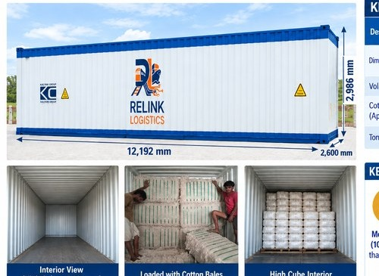
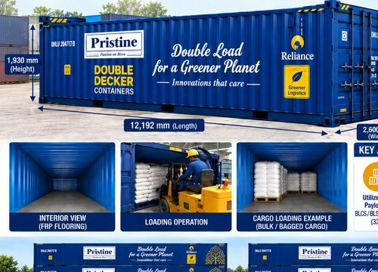
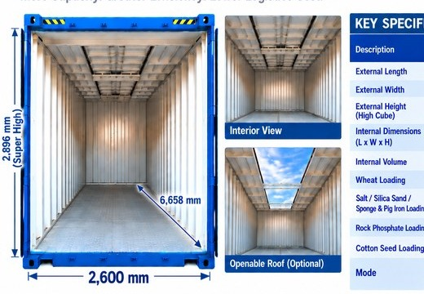
09 | PRODUCT ENGINEERING
Specialised containers are designed around cargo — not one box format
Examples shown from supplied product material; specifications are source-derived examples.
SUPER HIGH VOLUME 20 FT
SUPER HIGH CUBE 40 FT
DWARF / SPECIALISED
Bulk / lower-density cargo
Light / high-volume cargo
Rail-optimised / commodity-specific
≈40.5 m³ internal volume | 33.5 MT max loading example
≈84 m³ volume | 34 T approx. tonnage
2,600 mm width | 1,930 mm height | 33 T payload
Source: supplied Kalyani special-container material
09

Slide 11
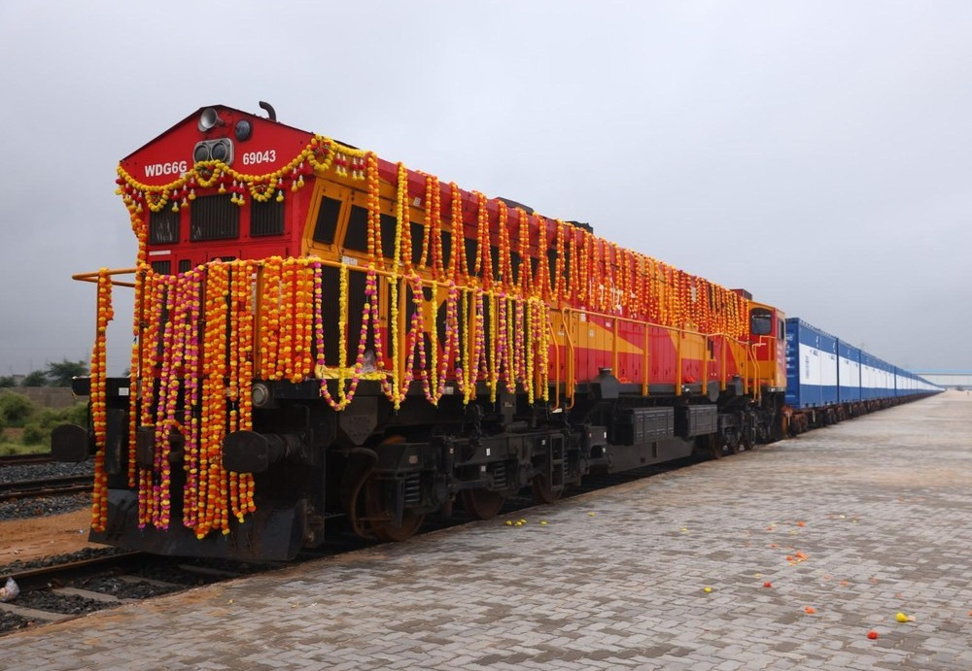
10 | GCT
GCT is the rail-access layer — commissioned, with ramp-up still ahead
Current practical capability is separated from the future target.
CARGO → GCT → RAIL
COMMISSIONED
August 2026
INAUGURAL COMMERCIAL ACTIVITY
September 2026
CURRENT PRACTICAL CAPABILITY
2–3 rakes / day
FUTURE TARGET
4–5 rakes / day
Future target subject to signalling / EOL upgrade.
Kalyani Cast Tech | September 2026
10

Slide 12
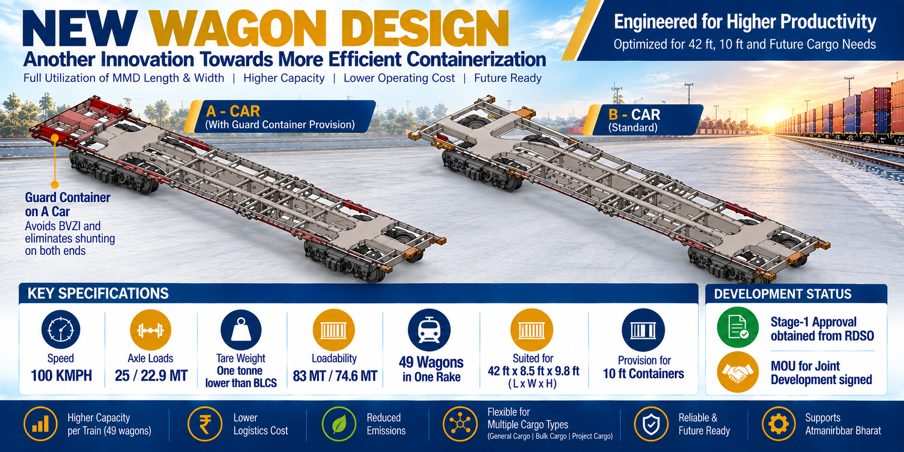
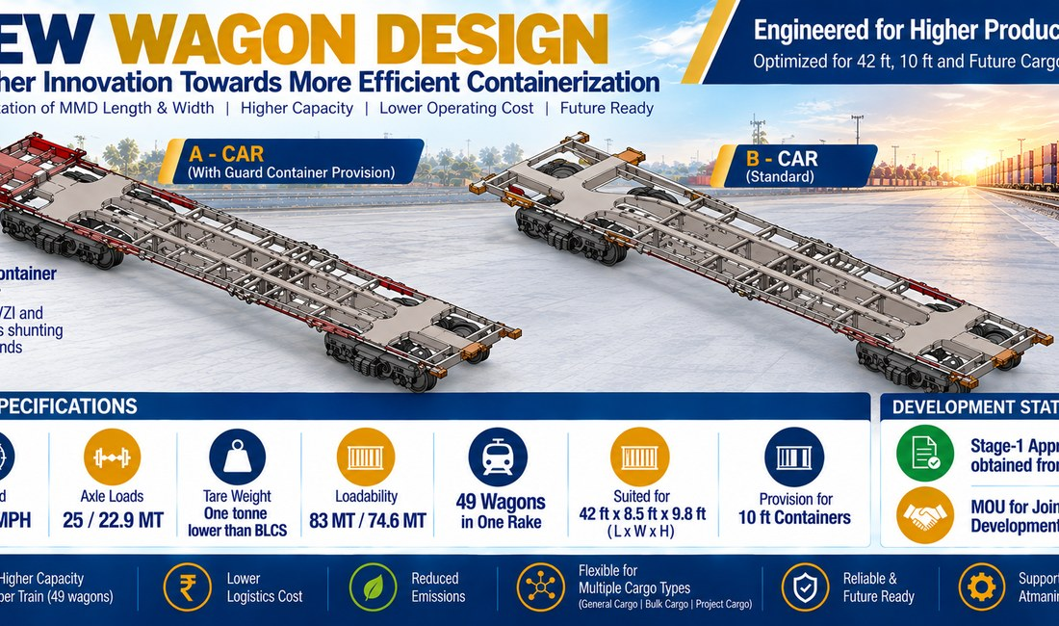
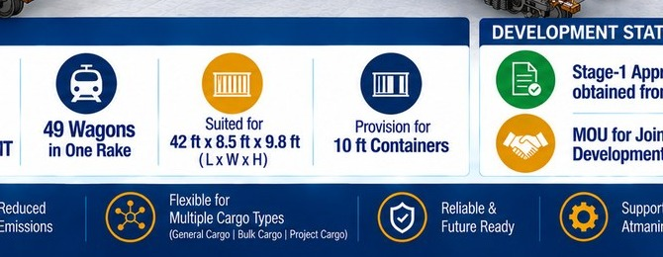
11 | WAGON PLATFORM
Wagon manufacturing extends Kalyani into rolling stock
Phase-1 capacity and selected engineering points from supplied wagon material.
NEAR COMPLETION
SELECTED ENGINEERING
2,400
• 49-wagon configuration
• 11 × 3 + 4 × 4 units
WAGONS / YEAR
• 42-ft compatibility
Operations targeted January 2027
• 100 km/h design speed
RDSO Stage-1 approval
• 83 / 74.6 MT loadability
Private freight / specialised cargo platform
• Guard + 10-ft container provision
Source: supplied wagon engineering / special-container material | Status: September 2026
11

Slide 13
12 | ICD / EXIM
ICD is the EXIM gateway layer under development
Provisioned architecture is distinguished from formal regulatory approval.
CARGO ARRIVAL
GATE
WEIGHMENT
YARD
CUSTOMS
STUFFING / DESTUFFING
RAIL
PORT
ICD AREA
REGULATORY STATUS
MANAGEMENT TARGET
STATUTORY BACKSTOP
30 acres
CBIC LoI obtained
1 Apr 2027
10 Sep 2027
Provision for DPD/DPE-enabled EXIM cargo flows — not a statement of formal DPD/DPE approval.
Project / regulatory information | Status: September 2026
12

Slide 14
13 | INTEGRATED COMMERCIAL ENGINE
One platform connects manufacture, cargo access, rail and EXIM
System view only — no utilisation or revenue assumption is embedded.
MANUFACTURING
CARGO GENERATION
AGGREGATION
GCT / RAIL
ICD / EXIM
PORT / DESTINATION
CUSTOMER
Containers
Customer cargo
Yard / handling
Rail access
Customs / yard
Export / domestic
Service outcome
ASSETS UNDER THE FLOW
CONTAINERS
WAGONS
GCT
ICD
Manufacturing → cargo access → aggregation → rail → customs / EXIM → destination
Kalyani Cast Tech | September 2026
13

Slide 15
14 | COMMERCIAL CATCHMENT
Catchment is a research boundary — not an addressable-market claim
Distance is one input to cargo conversion; route, cargo, mode and willingness to shift matter.
≈35–75 KM
DISTANCE ≠ ADDRESSABLE MARKET
→ Distance
≈35 KM
→ Cargo
→ Current route
SHIVLAKHA
→ Current mode
→ Competing infrastructure
→ Rail suitability
→ First / last-mile economics
PRIMARY COMMERCIAL
RESEARCH BOUNDARY
EXTENDED / STRATEGIC
CATCHMENT
→ Customer willingness to shift
Morbi: extended / strategic catchment — not primary.
Commercial research framework | No cargo volumes inferred
14

Slide 16
15 | OPERATING LOGIC
Why co-location matters — without inventing a savings claim
Strategic operating logic only; no quantified cost or service savings are assumed.
FRAGMENTED MODEL
SHIVLAKHA MODEL
Container factory
Container manufacturing
Road movement
Wagon platform
External yard
Cargo aggregation
External terminal
GCT / rail
Rail
ICD / EXIM
Port
Port / destination
Potential operating logic
Fewer hand-offs • cargo aggregation • equipment availability • rail access • EXIM interface
Kalyani Cast Tech | September 2026
15

Slide 17
16 | COMMERCIAL MODEL
The platform creates multiple commercial touchpoints
Potential commercial interactions — not a revenue forecast.
MANUFACTURING
HANDLING
STORAGE
Containers / wagons
Lift-on / lift-off
Yard / warehouse
CARGO OPERATIONS
RAIL / TERMINAL
EXIM SERVICES
Stuffing / destuffing
GCT / siding
ICD / customs
CARGO OWNER
SHIVLAKHA
RAIL / PORT
CUSTOMER
Kalyani Cast Tech | September 2026
16

Slide 18
17 | CAPITAL DEPLOYMENT
₹110 Cr Phase-1 investment is building the Shivlakha platform
The ₹450–500 Cr figure is presented as a multi-year strategic framework — not a single current funding requirement.
PHASE-1 INVESTMENT / CAPEX
LONG-TERM STRATEGIC PLAN
₹110 Cr
₹450–500 Cr
BUILD
MULTI-YEAR
FRAMEWORK
Rail / terminal
infrastructure
Manufacturing
infrastructure
ICD / equipment /
enabling assets
FUTURE
PLATFORM
EXPANSION
No detailed ₹110 Cr allocation or capex-to-revenue forecast is presented because the source set does not establish one.
Project / management inputs | September 2026
17

Slide 19
18 | CAPITAL STRUCTURE
Current equity base and outstanding warrants
Outstanding warrants are not converted equity; fully diluted potential is shown separately.
CURRENT EQUITY
OUTSTANDING WARRANTS
FULLY DILUTED POTENTIAL
71,80,500 shares
3,23,123
75,03,623 shares
WARRANT TERMS
OWNERSHIP
Issue price
Issue size
Payment
59.48%
₹582 / warrant
≈₹18.81 Cr
25% / 75%
Promoter holding
Allotment: 23 Sep 2026
0 converted as of 25 Sep 2026
0% promoter pledge
Source: current presentation / project information | Warrants shown as outstanding, not converted
18

Slide 20
19 | FINANCIAL BRIDGE
The next financial question is utilisation — not a forecast invented today
Historical earnings are known; the new platform requires cargo, utilisation and service economics before future outcomes can be modelled.
FY26 BASE
CAPITAL
ASSETS
COMMERCIAL DRIVERS
FUTURE OUTCOME
₹149.99 Cr
Revenue
₹21.82 Cr EBITDA
₹110 Cr
Phase-1
investment
Containers
Wagons
GCT
ICD
Cargo acquisition
Customer adoption
Rail movement
EXIM volumes
Revenue
EBITDA
Cash flow
NOT YET FORECAST
NEXT ANALYTICAL STEP → translate asset capacity into utilisation, revenue, EBITDA and cash-flow assumptions.
Kalyani Cast Tech | September 2026
19

Slide 21
20 | EXECUTION ROADMAP
Asset readiness must precede commercial scale
Completed events are separated from management targets and statutory backstops.
MAY 2026
AUG 2026
SEP 2026
JAN 2027
1 APR 2027
10 SEP 2027
Container manufacturing
started
GCT
commissioned
Inaugural commercial
GCT activity
Wagon operations
targeted
ICD management
target
ICD statutory
backstop
COMPLETED
COMPLETED
RAMP-UP
TARGET
TARGET
BACKSTOP
WHAT MUST HAPPEN NEXT
Cargo acquisition
Customer adoption
Rail / first-mile economics
Customs / regulatory execution
Timeline does not imply guaranteed commercial scale
20

Slide 22
KALYANI CAST TECH LIMITED
Rewari proved the manufacturing base.
Shivlakha introduces the next platform layer.
MANUFACTURING
→ RAIL → CARGO → ICD / EXIM
INTEGRATED PLATFORM
TODAY
Proven manufacturing
BUILDING
Integrated Shivlakha platform
Kalyani Cast Tech Limited
kalyanicasttech.com
NEXT
Cargo acquisition → utilisation → commercial scale
Rewari, Haryana | Shivlakha, Kachchh, Gujarat
For information purposes only. Project status and forward-looking items are subject to applicable approvals, execution and commercial conditions.
21

