Slide 1
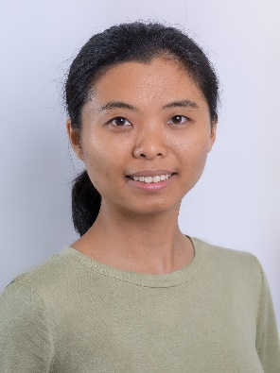
Qingping Chen and Maxim Zaitsev May 11, 2025, Hawaii
Offline Open Source Data Reconstruction
Educational course: Surfing School: Hands-On Open-Source MR: From Pulse Sequence Programming to Reconstruction & Analysis
Division of Medical Physics, Dept. of Radiology,
University Medical Center Freiburg, Germany
Notes:
Good afternoon everyone, my name is Qingping Chen, from University Medical Center Freiburg, Germany. In the following I will give a brief introduction and a detailed hands-on tutorial on the offline open source data reconstruction.

Slide 2
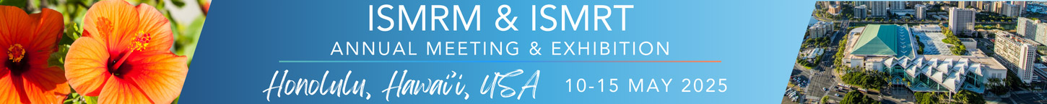
Declaration of Financial Interests or Relationships
Speaker Name: Maxim Zaitsev
I have the following financial interest or relationship to disclose with regard to the subject matter of this presentation:
Company Name: Siemens Healthineers (Erlangen, Germany)
Type of Relationship: Research collaboration
Notes:
We have research collaboration with Siemens Healthcare in Erlangen, Germany.

Slide 3

Motivation
Open science and open innovation
To foster collaboration, accelerate scientific discovery, and streamline clinical translation.
Figure created with ChatGPT
Notes:
A global effort is underway to promote open science and open innovation in the field of magnetic resonance research, aiming to foster collaboration, accelerate scientific discovery, and streamline clinical translation.

Slide 4
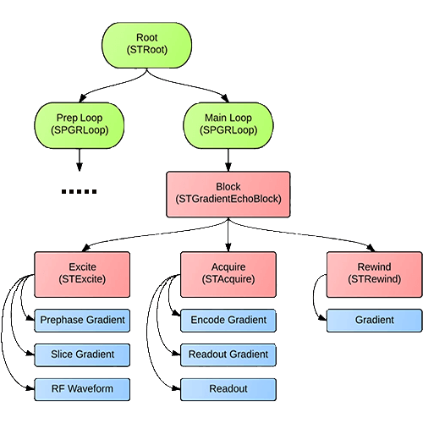


Motivation
Open science and open innovation
To foster collaboration, accelerate scientific discovery, and streamline clinical translation.
Various open-source sequence development tools, such as Pulseq, gammaSTAR, and SequenceTree.
Figure created with ChatGPT
SequenceTree
Notes:
As part of this movement, various sequence development tools have emerged for open-source, vendor-neutral, reproducible MR data acquisition, such as Pulseq, gammaSTAR, and SequenceTree.

Slide 5
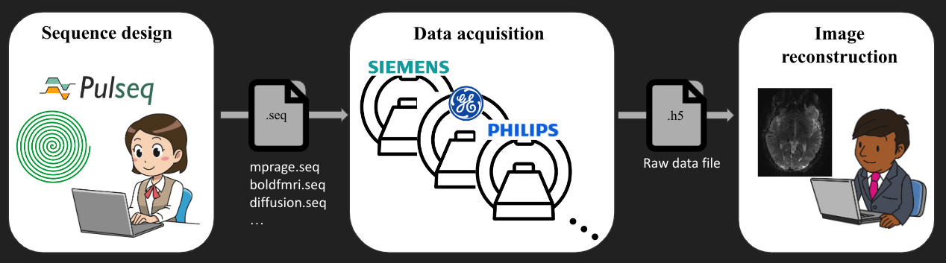
Motivation
Challenges for data reconstruction
Limited integration with vendor-provided online reconstruction
Time-consuming, complex, or even infeasible.
Sequence design
Data acquisition
Vendor-based
online recon
Figure adapted from https://harmonizedmri.github.io/
Notes:
However, despite these advancements, there are several practical challenges remain in reconstructing data acquired using open-source, vendor-independent sequence development tools. The first one is the limited integration with vendor-provided online reconstruction. Implementing vendor-specific online reconstruction using open-source pulse sequences is often time-consuming, complex or even infeasible.

Slide 6
Motivation
Challenges for data reconstruction
Limited integration with vendor-provided online reconstruction
Time-consuming, complex, or even infeasible.
Closed-source vendor-integrated reconstruction environments
Often operate as a black box → difficulty in debugging and optimization.
Limited support for novel pulse sequences.
???
Parameters
Vendor-integrated recon
Images
Notes:
The second one is the closed-source vendor-integrated reconstruction environments. Most vendor-integrated online reconstruction frameworks operate as a black-box system, only providing packaged software solutions. This results in great difficulty in debugging and optimization for image reconstruction. In addition, these environments may not readily support online reconstruction for novel pulse sequences, such as those using non-Cartesian readout trajectories.

Slide 7
Motivation
Challenges for data reconstruction
Limited integration with vendor-provided online reconstruction
Time-consuming, complex, or even infeasible.
Closed-source vendor-integrated reconstruction environments
Often operate as a black box → difficulty in debugging and optimization.
Limited support for novel pulse sequences.
Inconsistent data formats across vendors
Depend on proprietary, vendor-specific knowledge.
Data A
Data B
Data N
…
Vendor A
Vendor B
Vendor N
Notes:
The third challenge is the inconsistent data format across vendors. Intergrating open-source pulse sequences with scanner consoles, pulse sequence parameters, and image reconstruction settings heavily depends on proprietary, vendor-specific knowledge, leading to substantial format inconsistencies among different manufacturers.

Slide 8
Motivation
Challenges for data reconstruction
Limited integration with vendor-provided online reconstruction
Time-consuming, complex, or even infeasible.
Closed-source vendor-integrated reconstruction environments
Often operate as a black box → difficulty in debugging and optimization.
Limited support for novel pulse sequences.
Inconsistent data formats across vendors
Depend on proprietary, vendor-specific knowledge.
Lack of harmonization across platforms
Achieving consistent and reproducible reconstruction is challenging.
…
Recon 1
Recon 2
Recon N
Notes:
And the last challenge is the lack of harmonization across platforms. Achieving consistent and reproducible reconstruction across different platforms remains a challenge, complicating data comparability and standardization.
These challenges can slow down innovation cycles in both research and clinical applications. Furthermore, they may negatively affect data comparability and statistical power in studies that rely on multi-platform datasets. Offline, open-source, vendor-independent, reproducible reconstruction is essential to overcoming these barriers.

Slide 9
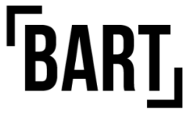



Offline open-source data reconstruction
Overview
Manual reconstruction with Matlab, Python, etc
Semi-automatic demo reconstruction provided by, e.g., Pulseq
Open-source reconstruction software
Berkeley Advanced Reconstruction Toolbox (BART)
Michigan image reconstruction toolbox (MIRT)
Gadgetron with ISMRMRD data fortmat
…
Notes:
There are many offline open-source data reconstruction approaches available. We can manually reconstruct data offline with Matlab, Python, and so on. We can also perform semi-automatic demo reconstruction provided by sequence development tools, such as Pulseq. We can also perform offline open-source data reconstruction using some existing software tools, such as Berkeley Advanced Reconstruction Toolbox, Michigan image reconstruction toolbox, Gadgetron reconstruction framework with the use of open-source, vendor-independent ISMRMRD data format, etc.
In the live demo session, we will show an offline recon demo based on the BART toolbox in the Google Colab environment, because it is convenient to install BART directly in Jupyter Notebook in the Google Colab environment.

Slide 10
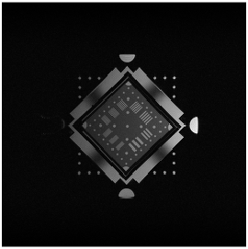
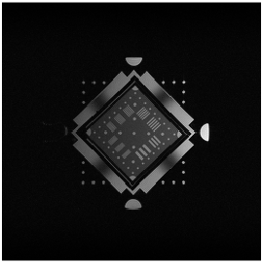
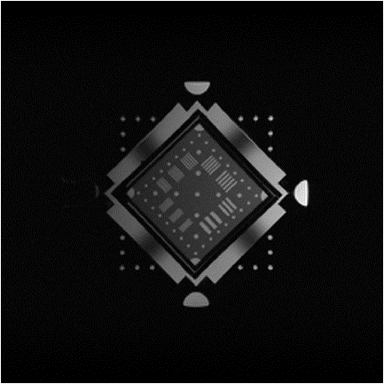
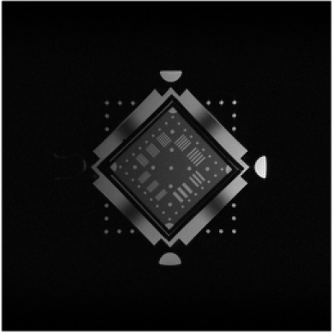

Offline open-source data reconstruction
Example recon: 2D GRE
Manual recon
Pulseq demo recon
Gadgetron
BART
All materials are available online:
Gadgetron installation
Scripts
Example data
ISMRMRD conversion
…
Notes:
This slide shows the example reconstruction of the fully-sampled 2D GRE raw data acquired from a Siemens 3T scanner: the manual reconstruction, Pulseq demo reconstruction, Gadgetron reconstruction, and BART reconstruction. All of the related materials are available online, including Gadgetron installation, all scripts, example raw data, ISMRMRD conversion, and so on.

Slide 11

Tutorial
Prerequisites
Jupyter Notebooks in the Google Colab environment
No additional software installation is required.
Prerequisites:
Basic prior knowledge of MR physics and image reconstruction.
A Google account to access Google Colab.
A laptop or tablet with an active internet connection to run the Jupyter Notebooks.
Link to Google Colab
https://github.com/pulseq/ISMRM-2025-Surfing-School-Hands-On-Open-Source-MR
Notes:
The tutorial is based on the Jupyter Notebooks in the Google Colab environment. You don’t need to install any additional software in your local computer. However, we would expect you to have basic prior knowledge of MR physics and image reconstruction. A google account is required to access Google Colab. And you would need a laptop or tablet or phone with an active internet connection to run the Jupyter Notebooks. You can scan the QR code to get access to the tutorials.

Slide 12
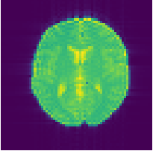
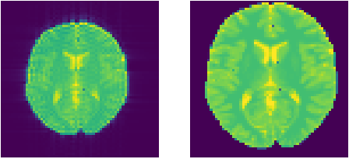
Tutorial
1_GRE2D_manual_BART_reconstruction
Pulseq-based 2D fully-sampled GRE
Simulation with MRzero
Manual reconstruction
Detailed instructions for BART
BART command structure:
bart + command + options + input/output
2D inverse (-i) unitary (-u) FFT:
bart fft -u -i $(bart bitmask 0 1) ksp img
Manual recon
(2D FFT)
BART recon
(2D FFT)
Digital phantom
for simulation
Notes:
The first tutorial demo is 2D FFT reconstruction of the fully-sampled GRE data using manual approach and BART. In the demo, 2D fully-sampled GRE sequence is built using Pulseq and simulated with the MRzero simulator. Manual reconstruction is performed for the simulated k-space data. And there are detailed instructions for 2D FFT reconstruction using BART. The middle figure is the BART-based image, which agrees well with the digital phantom for simulation.
The typical BART command is like this: bart + command + options + input/output. For example, you can perform a 2D inverse unitary FFT by executing this command.

Slide 13
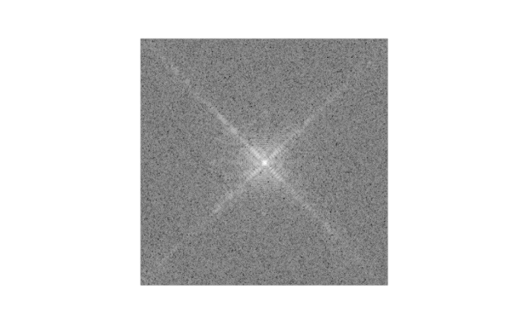
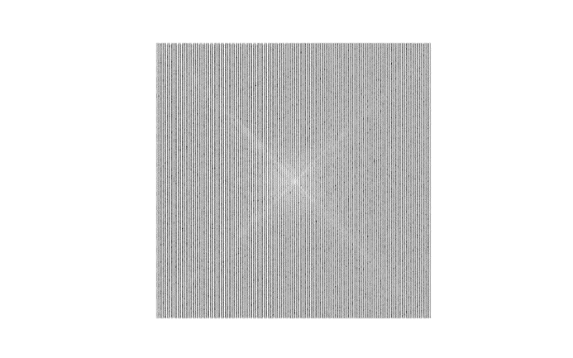
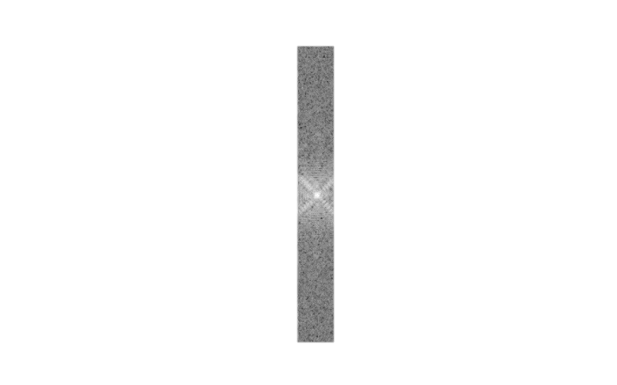
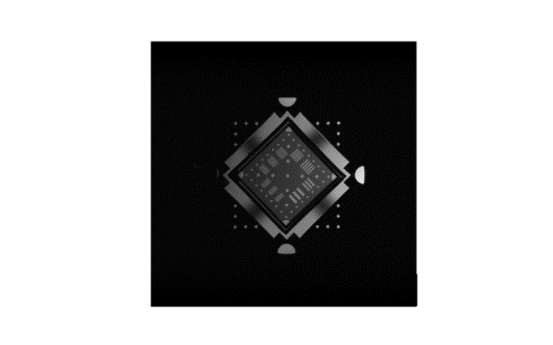
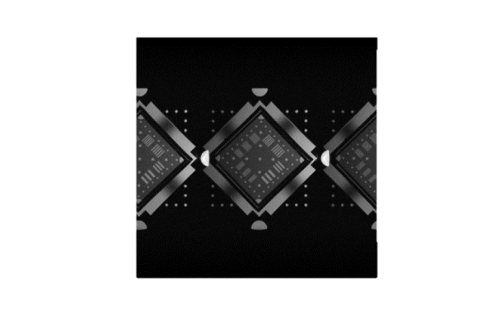
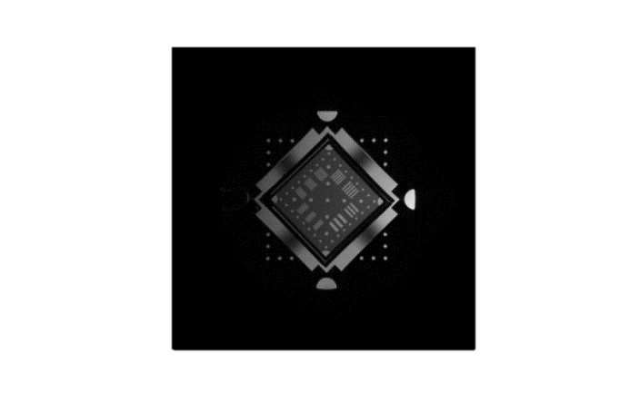

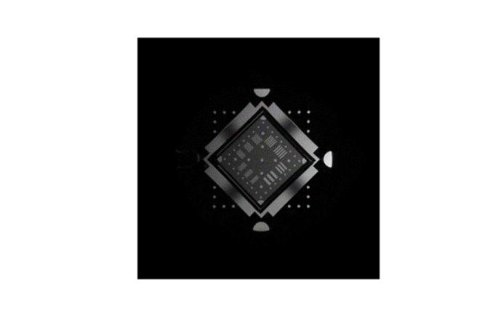
Tutorial
2_GRE2D_PICS_BART_Cartesian_undersampling
Nx = 256, Ny = 256, #coil = 18
2-fold undersampling, 32 auto-calibration lines
PICS recon with L2 regularization:
bart pics -w 90 -R Q:1e-4 -S ksp coil_sens img
-w 90: inverse scaling of the k-space data
-R Q:1e-4: L2-norm with regularization value of 1e-4
-S: rescale the image after recon
k-space
L2 regularization
L1 wavelet
image
FS (FFT)
Calib (FFT)
US (FFT)
US (PICS)
US (PICS)
Notes:
The tutorial also includes more advanced demos. The second demo is to reconstruction 2D GRE raw data with Cartesian undersampling using Parallel imaging compressed sensing (PICS) command in BART. The GRE data is 256*256 with 18 coil channels. It is retrospectively undersampled by a factor of two, with 32 auto-calibration lines. “FS (FFT)” is the fully-sampled 2D GRE image reconstructed with FFT command in BART. ”Calib (FFT)” is the low-resolution FFT-based image of the reference scans. “US (FFT)” is the aliased high-resolution image of the undersampled k-space, reconstructed by FFT in BART. “US (PICS)” is the image of the undersampled k-space reconstructed with PICS in BART using L2 regularization. “US (PICS)” in right is the image of the undersampled k-space reconstruction with PICS in BART using L1 wavelet regularization.
The block shows the PICS command for L2 regularization, including inverse scaling of the k-space data, L2-norm, and rescaling the image after reconstruction. The coil_sens is the coil sensisitive map obtained from the low-resolution calibration image.
Note: bart pics command typically scales the k-space data so that the Root-sum-of-square (RSS) image has maximum value close to one. This is so that the regularization factor is more consistent across different input datasets. The scale factor is chosen based on the RSS reconstruction of a fully sampled auto-calibration region in the data.

Slide 14
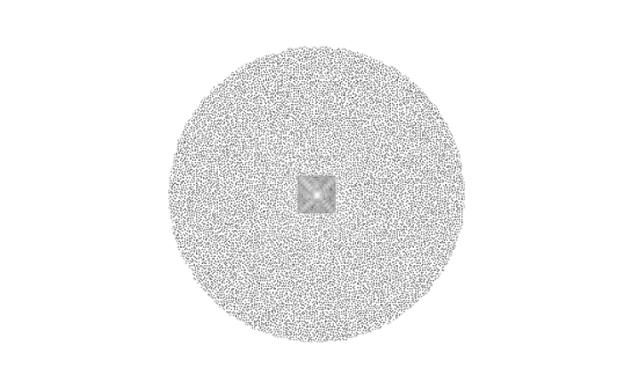

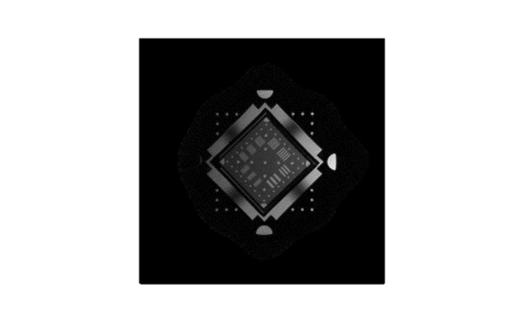

Tutorial
3_GRE2D_PICS_BART_Poisson_undersampling
Nx = 256, Ny = 256, #coil = 18
2*2 in-plane acceleration, Auto-calibration: 32*32
PICS recon with L1 Wavelet regularization:
bart pics -w 90 -S -R W:3:0:1e-5 ksp coil_sens img
-w 90: inverse scaling of the k-space data
-R W:3:0:1e-5: L1 Wavelet over the first two dims with regularization value of 1e-5
-S: rescale the image after recon
k-space
L2 regularization
L1 wavelet
image
FS (FFT)
US (FFT)
US (PICS)
US (PICS)
Notes:
The third demo is to reconstruction 2D GRE raw data with Non-Cartesian Poisson undersampling using PICS. The GRE data is retrospectively performed 2*2 in-plane acceleration, with auto calibration region of 32*32. “FS (FFT)” is the fully-sampled 2D GRE image reconstructed with FFT command in BART. “US (FFT)” is the low-resolution image of the undersampled k-space, reconstructed by FFT in BART. “US (PICS)” is the image of the undersampled k-space reconstructed with PICS in BART using L2 regularization. “US (PICS)” in right is the image of the undersampled k-space reconstruction with PICS in BART using L1 wavelet regularization.
The block shows the PICS command for L1 wavelet regularization, including inverse scaling of the k-space data, L1-norm, and rescaling the image after reconstruction. The coil_sens is the coil sensisitive map obtained from the low-resolution undersampled FFT-based image.
Note: bart pics command typically scales the k-space data so that the Root-sum-of-square (RSS) image has maximum value close to one. This is so that the regularization factor is more consistent across different input datasets. The scale factor is chosen based on the RSS reconstruction of a fully sampled auto-calibration region in the data.

Slide 15
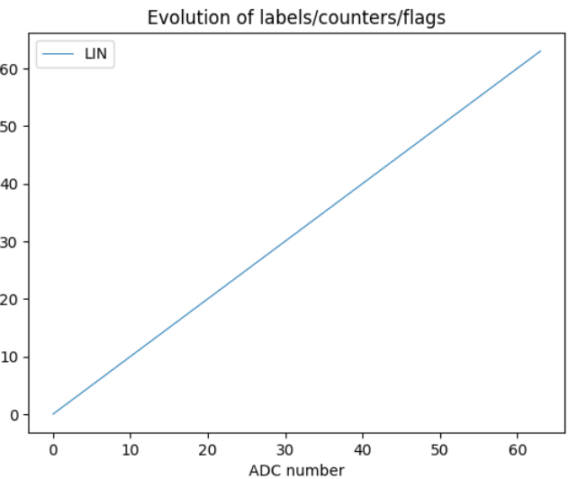
Tutorial
4_GRE2D_ISMRMRD_conversion
LABEL
Pulseq-based data
ISMRMRD data
Gadgetron recon etc.
seq.add_block(gxPre, mr.scale_grad(gy, peScales[i]), gzReph, mr.make_label(type='SET',label='LIN', value=PElbl[i]))
Labels for the 2D GRE data
Notes:
In the last demo, we briefly show how to convert the Pulseq-based data to ISMRMRD data using the “LABEL” extension provided by Pulseq. The open-source, vendor-independent ISMRMRD data can be used for data format harmonization, and reconstruction with some software tools, such as Gadgetron. The block shows how to implement labels for an ADC event. The figure shows the labels for the 2D GRE data.

Slide 16
Related links
Pulseq: https://github.com/pulseq
MRzero: https://mrzero-core.readthedocs.io/en/latest/intro.html
gammaSTAR: https://gamma-star.mevis.fraunhofer.de/#/
SequenceTree: https://www.opensourceimaging.org/project/sequencetree/
BART: https://mrirecon.github.io/bart/
MIRT: https://github.com/JeffFessler/mirt
Gadgetron: https://github.com/gadgetron/gadgetron
ISMRMRD: https://github.com/ismrmrd/ismrmrd
Notes:
This slide lists all related links mentioned in this lecture.

Slide 17
References
Layton KJ, Kroboth S, Jia F, et al. Pulseq: a rapid and hardware-independent pulse sequence prototyping framework. Magn Reson Med. 2017;77(4):1544-1552.
Nielsen JF, Noll DC. TOPPE: a framework for rapid prototyping of MR pulse sequences. Magn Reson Med. 2018;79(6):3128-3134.
Cordes C, Konstandin S, Porter D, Günther M. Portable and platform-independent MR pulse sequence programs. Magn Reson Med. 2020;83(4):1277-1290.
Magland JF, Li C, Langham MC, Wehrli FW. Pulse sequence programming in a dynamic visual environment: SequenceTree. Magn Reson Med. 2016;75(1):257-265.
Loktyushin A, Herz K, Dang N, et al. MRzero - Automated discovery of MRI sequences using supervised learning. Magn Reson Med. 2021;86(2):709-724.
Hansen MS, Sørensen TS. Gadgetron: an open source framework for medical image reconstruction. Magn Reson Med. 2013;69(6):1768-1776.
KomaMRI.jl: An open-source framework for general MRI simulations with GPU acceleration. Magn Reson Med. 2023;90(1):329-342.
Uecker M, Ong F, Tamir JI, et al. Berkeley Advanced Reconstruction Toolbox. In: Proceedings of the 24th International Society for Magnetic Resonance in Medicine (ISMRM). ; 2015.
Fessler J: https://www.opensourceimaging.org/project/mirt/. Accessed 29 April 2025.
Inati SJ, Naegele JD, Zwart NR, et al. ISMRM Raw data format: a proposed standard for MRI raw datasets. Magn Reson Med. 2017;77(1):411-421.
Notes:
These are the references.

Slide 18





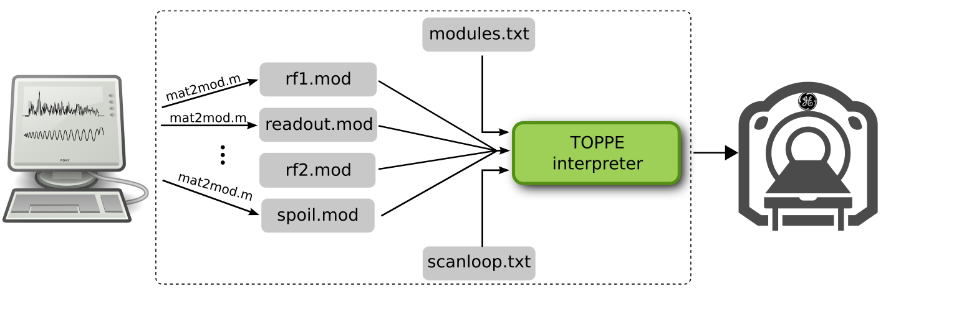



Acknowledgements:
Berkin Bilgic
Julia Pfitzer
Jon-Fredrik Nielsen
Moritz Zaiss
Qiang Liu
Sebastian Littin
Borjan Gagoski
Xiaoqing Wang
Juergen Hennig
Naveen Murthy
Maxim Zaitsev
Will Grissom
Douglas Noll
Jeff Fessler
Mojtaba Shafiekhani
Niklas Wehkamp
Scott Peltier
Yogesh Rathi
Thank you for your attention!
TOPPE
MATLAB
Python
Supported by NIH U24-NS120056 (Nielsen, Zaitsev) and R01-EB032378 (Rathi, Bilgic)
Notes:
Thanks for your attention! Any questions?

