Slide 1

FREE PLAYBOOK — PULSEWAVE LABS
The 5-Pair
Playbook
How We Turned $10K Into $218K Trading
5 Crypto Pairs — The Exact Framework
624
40.7%
1.52
$218K
Trades
Win Rate
Profit Factor
From $10K
pulsewavelabs.io

Slide 2
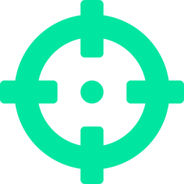
01
Why We Only Trade 5 Pairs
Most traders spread across 20+ pairs and master none of them. We picked 5 and went deep.
BTC
Bitcoin
Highest liquidity, cleanest S/R levels
The Key Insight
ETH
Ethereum
Strong trending behavior, great for momentum
Mastery beats coverage.
By trading only 5 pairs, we know their behavior intimately — the support zones that hold, the resistance that rejects, the time-of-day patterns.
We don't need to scan 200 charts. We watch 5. We know them like old friends.
SOL
Solana
High volatility = high R:R opportunities
AVAX
Avalanche
Mean-reverting, excellent for range plays
XRP
Ripple
News-driven moves create sharp entries
02

Slide 3
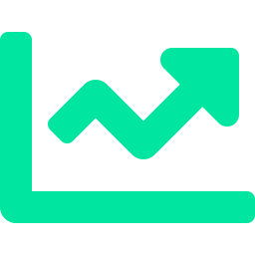
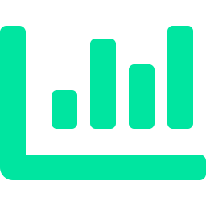
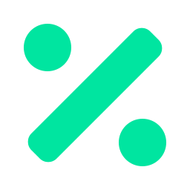
02
The Confluence Scoring System
We don't trade on one signal. Every trade must pass a multi-factor confluence test scored 0–100. Here are the 3 core pillars:
S/R Proximity
Regime Alignment
RSI + Volume
35 pts
20 pts
25 pts
How close is price to a proven support or resistance zone? Zones with 7+ touches score highest. We only enter AT the zone — never in no-man's land.
Is the market trending, ranging, or volatile? We detect regime using ATR, ADX, and EMA position. Long signals in uptrends score high. Longs in downtrends get penalized.
RSI below 30 on a long setup = maximum points. Volume 1.5x above average on a breakout = confirmation. Both must align with direction or the score drops.
Remaining 20 points: trend alignment (EMA position) + multi-timeframe agreement. Full system scores every setup before we risk a dollar.
03

Slide 4
03
How To Read S/R Like Institutions
Forget drawing lines. Institutions don't care about your trendlines. They care about zones — areas where enough orders sit to move price.
1
Find Pivot Clusters
We detect pivot highs and lows with a 10-bar lookback. Then we cluster pivots that fall within the same price zone. More pivots in a zone = stronger level. We need at least 3 touches to consider it valid.
2
Classify: Support or Resistance
If the zone is below current price, it's support (buyers are there). Above price = resistance (sellers). The same zone can flip — resistance that breaks becomes support. Watch for these role reversals.
3
Measure Strength
Strength = number of times price has touched the zone. A zone with 3 touches is okay. A zone with 10+ touches is institutional. We rank all zones by strength and only trade the strongest.
4
Enter at the Zone, Not Before
The #1 mistake: entering BETWEEN zones. If support is at $95K and price is at $97K, you wait. Enter when price reaches the zone — not when you think it might go there.
04

Slide 5
04
Trade Walkthrough: The Win
BTC/USDT — 4H Chart
February 12, 2026
Confluence Breakdown
Direction
LONG
S/R Proximity
18/20
0.4% from 10-touch support
Entry
$96,420
S/R Strength
12/15
10 pivot touches in zone
Stop Loss
$95,180 (-1.29%)
Regime
16/20
Trending up, 78% confidence
Take Profit
$99,650 (+3.35%)
RSI
10/15
RSI at 38 — near oversold
Confluence Score
74 / 100
Volume
7/10
1.3x average volume
Risk:Reward
2.60
Trend
8/10
Price above 50 EMA
Result
+3.35% WIN
MTF
3/10
Single timeframe mode
Why It Triggered:
TOTAL: 74/100 — GOOD
05

Slide 6

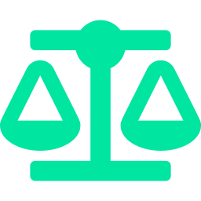
05
Trade Walkthrough: The Loss
ETH/USDT — 4H Chart
Why We Show Losses
Direction
SHORT
This trade hit stop loss. It happens.
We lose about 60% of our trades. And we're still profitable.
The math: a 40% win rate with 2.5:1 average R:R gives a profit factor of 1.52. That means for every $1 we risk, we make $1.52 back over time.
Any service that only shows wins is lying to you. We publish every single trade — wins and losses — because that's how trust actually works.
Entry
$2,845
Stop Loss
$2,912 (+2.35%)
Take Profit
$2,710 (-4.74%)
Confluence Score
52 / 100
Result
-2.35% LOSS
The Profit Factor Equation
(Avg Win × Win Rate) ÷ (Avg Loss × Loss Rate) = 1.52 profit factor. Above 1.0 = profitable. We're at 1.52 across 624 trades.
06

Slide 7

06
Position Sizing: How Much to Risk
The golden rule: never risk more than 1-2% of your account on a single trade. Here's what that looks like:
Account Size | 1% Risk | 2% Risk | Max Position (2% SL) | Recommended
$1,000 | $10 | $20 | $500-1,000 | 1% risk
$5,000 | $50 | $100 | $2,500-5,000 | 1% risk
$10,000 | $100 | $200 | $5,000-10,000 | 1-2% risk
$25,000 | $250 | $500 | $12,500-25,000 | 1% risk
$50,000 | $500 | $1,000 | $25,000-50,000 | 0.5-1% risk
$100,000 | $1,000 | $2,000 | $50,000-100,000 | 0.5% risk
Pro Tip: Start Conservative
Start with 0.5-1% risk until you trust the system with your own money. You can always size up later. You can never un-blow an account.
07

Slide 8
07
The Results: 624 Trades, Full Transparency
$10K → $218K
624
40.7%
1.52
Total Growth
Total Trades
Win Rate
Profit Factor
Key Statistics
Average Winning Trade
+3.2%
Sharpe Ratio
2.1
Average Losing Trade
-1.4%
Expectancy per Trade
+0.47%
Average Trades/Day
2.8
Longest Winning Streak
8 trades
Maximum Drawdown
-12.4%
Longest Losing Streak
11 trades
Every trade is published in real-time. No cherry-picking. No editing history. Verify anytime.
08

Slide 9

Want This Done For You?
You now know the framework. The 5 pairs. The confluence system.
The position sizing. The math behind why it works.
PulseWave Signals runs this exact system 24/7.
Real-time signals on all 5 pairs — entry, SL, TP, position size
Delivered to Telegram and email — trade from anywhere
Every trade published — wins AND losses, full transparency
Private community of 347+ traders using the system
30-day money-back guarantee — risk-free to try
Learn More at pulsewavelabs.io

Slide 10
RISK DISCLOSURE
Trading cryptocurrency and other financial instruments carries significant risk and may not be suitable for all investors. Past performance is not indicative of future results. The information in this playbook is for educational purposes only and does not constitute financial advice.
You should never trade with money you cannot afford to lose. Always do your own research and consider seeking advice from a qualified financial advisor before making trading decisions.
PulseWave Labs publishes all trades transparently — wins and losses. A 40.7% win rate means the system loses more often than it wins. Profitability comes from risk management and favorable risk:reward ratios, not win rate alone.
© 2026 PulseWave Labs — pulsewavelabs.io

