Slide 1
Hack the Epidemic
Team pulverizing dragons

Slide 2
How can we incentivize rehab centers to act in the long-term interest of the patient?

Slide 3
Current state
Solution
100%
70%
Distributed over time
10%
10%
10%
Transactional Model
Long-term Model
Notes:
Current state = competitive state we are dealing with

Slide 4







How it Works
Checkpoint #3
Checkpoint #2
Checkpoint #1
100%
70%
10% Payer
10% Patient
10% R.C.
End of rehabilitation
30%
Self-funded: 30% Charity
3rd party funded: 30% back to 3rd party

Slide 5
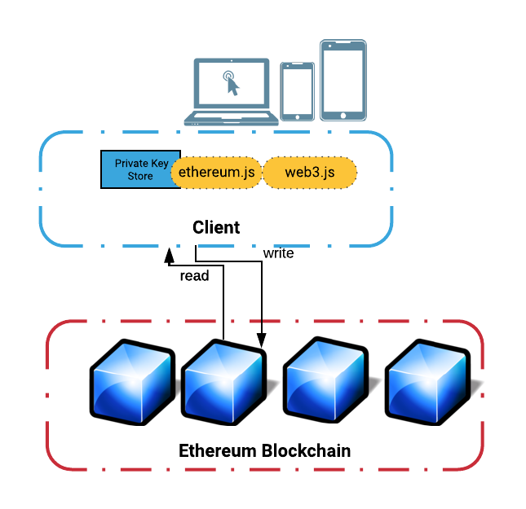
High Level Architecture

Slide 6
Demo

Slide 7
Next Steps
Expand the validation actors (law enforcement, schools, psychiatrist, etc.)
Fine-tune the parameters of the payer and patient model (price & contract length) based stakeholder feedback and market studies
Enable a self-policing ecosystem that exposes bad actors
Scale use to other chronic conditions (alcohol addictions, gambling addictions, etc.)

Slide 8
Questions?

Slide 9
Paradigm shift:
Current state –100% payment upfront with no post-rehab follow-up incentive
Our solution – 70% payment upfront; remaining 30% distributed to stakeholders based the patients post rehabilitation
Our Smart Contract
Will hold all stakeholders accountable
Will reward the patient’s positive behavior
Will add credibility to the rehabilitation centers

Slide 10
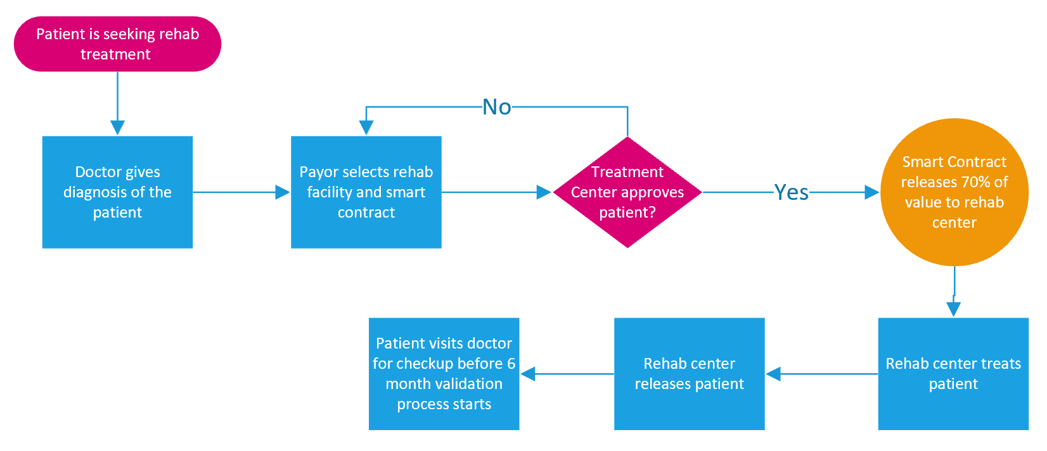

Slide 11
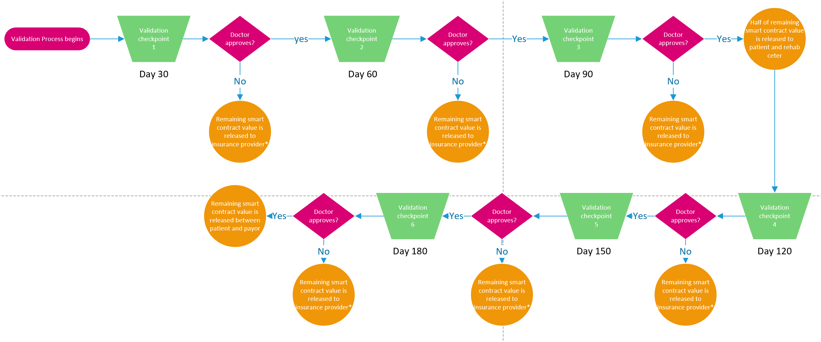

Slide 12
Proposed Solution
Leveraging smart contracts to incentivize stakeholders in the long-term care of the patient.
Smart contracts will be used to release money after a patient has been released from a rehabilitation center based on validation of treatment goals.

Slide 13
Who Benefits and How?
Rehabilitation Centers
The Patient
Insurance Providers

