Slide 1
Psychetrack
Ccat 88

Slide 2
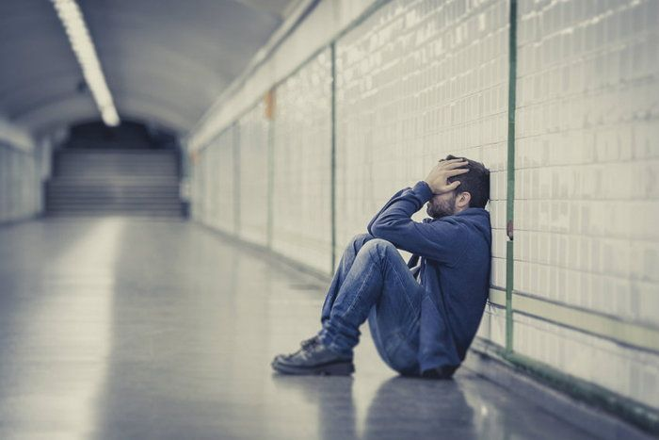
They want to be alone that how hard we can track his symptom and help him

Slide 3
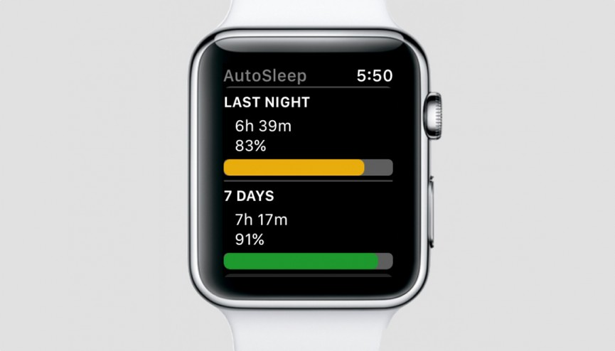
Watch is one of everyday use thing that can mount with patient all day

