Slide 1
CMAC in NVDLA
Pumpkin Pan

Slide 2
First, the big picture…

Slide 3
CMAC
Parallel in group level:
16 MACs -> 16 kernels
64 multipliers/MAC -> 64 channels/kernel;
Multiplier:
radix-4 booth multiplier;
shared for fp16/ int16/ int8;
Adder tree for accumulation (DC, WG)
Additional exp & nan module for fp16 op;

Slide 4


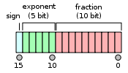
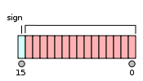
CMAC
Step0. prepare the data
int16: default
int8: reorder
fp16: 1.exp_max & exp_sft (done in exp module);
2.NaN detect (done in nan module);
3. Format change (would be recovered at final step);

Slide 5
multiplier
Step1. multiply data with weight
Input operands are 16-bit-wide;
3-bit exp_sft signals for fp16 mul;
Combinational logic
Radix-4 booth algorithm
CSA tree (2 level for int16/fp16, 1 level for int8)

Slide 6

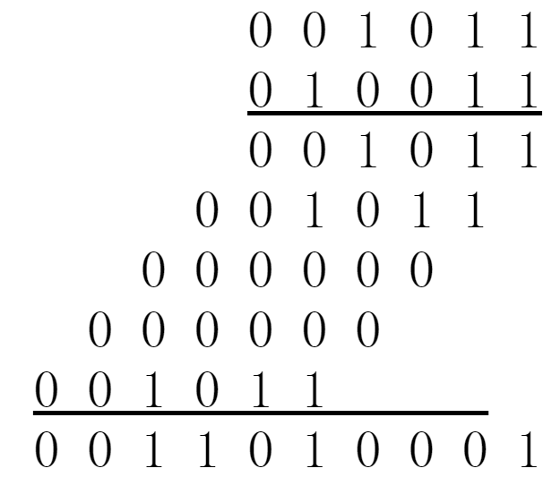
Radix-4 booth
Block | Partial Product
000 | 0
001 | 1 * Multiplicand
010 | 1 * Multiplicand
011 | 2 * Multiplicand
100 | -2 * Multiplicand
101 | -1 * Multiplicand
110 | -1 * Multiplicand
111 | 0

Slide 7
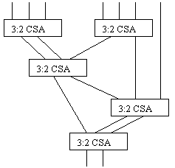
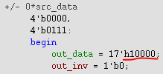


CSA tree
Level0_n0~1 (5 -> 2)
Level1 _n0 (4 -> 2)

Slide 8


multiplier
Outputs
int16: default;
int8: splice 2 partial products together;
fp16: right shift according to exp_sft;

Slide 9
Adder tree
Step2. sum up the partial products
5-level adder tree
Level0_n0~15 (8 -> 2)
Level1_n0~8 (4 -> 2)
Level2_n0~8 (4 -> 2)
Level3_n0~3 (4 -> 2)
Level4_n0~3 (6 -> 2)
Sign tree compensation for fp/wg operation
Sign patch
Output 4 partial products (sop_0/1/2/3)
Notes:
Level0 (8个36bit，输出2个) 16个， 位宽+4bit
Level1 (4个42bit，输出2个) 8个， 位宽+6bit
Level2 (4个42bit，输出2个) 8个
Level3 (4个42bit，输出2个) 4个，还有sign tree的4个*2
level4 (6个46bit，输出2个) 4个
还有Sign tree for float-point compensation
Level0 (res_tag每个mul8bit，分成8组，每组对应不同组的相同bit，然后每四个bit累加成2bit，同权重的单bit加)
Level1 (4个16bit，输出2个) 16个
Level2 (8个38bit，输出2个) 4个
× 数据一起给到adder tree部分
计算时每个bit分n0～n3，（n1～n3是给fp & wg用的）
取反，1变5做减法，里面还差的补码+1在patch里面包括了
最终patch也分四部分，对于非wg，只有patch0有效

Slide 10
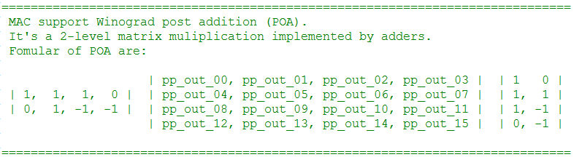
Adder tree
Tree reuse for WG post addition
Notes:
Level0 (8个36bit，输出2个) 16个， 位宽+4bit
Level1 (4个42bit，输出2个) 8个， 位宽+6bit
Level2 (4个42bit，输出2个) 8个
Level3 (4个42bit，输出2个) 4个，还有sign tree的4个*2
level4 (6个46bit，输出2个) 4个

Slide 11
Q&A

Slide 12
Thanks

