Slide 1
Introduction to NVDLA

Slide 2
Outline
What`s NVDLA
Highlights
What NVDIA offers
System integration
Architecture
Software
Power & performance
Flow

Slide 3
Outline
What`s NVDLA
Highlights
What NVDIA offers
System integration
Architecture
Software
Power & performance
Flow
NVDIA Deep Learning Accelerator
For inference only
int8/int16/fp16 data
Speeding up operations like conv, activation, pooling, normalization
Highly configurable
A SW + HW solution

Slide 4
Outline
What`s NVDLA
Highlights
What NVDIA offers
System integration
Architecture
Software
Power & performance
Flow
CMAC organization: C * K
Winograd support
Weight compression
Batched convolution
Closely coupled with SW
Flow control (3 modes, tiling)
Data format

Slide 5
Outline
What`s NVDLA
Highlights
What NVDIA offers
System integration
Architecture
Software
Power & performance
Flow
http://nvdla.org
Documentations
Verilog files
Verification env. & basic tests
System-C models
Virtual platform
Drivers (UMD, KMD)

Slide 6
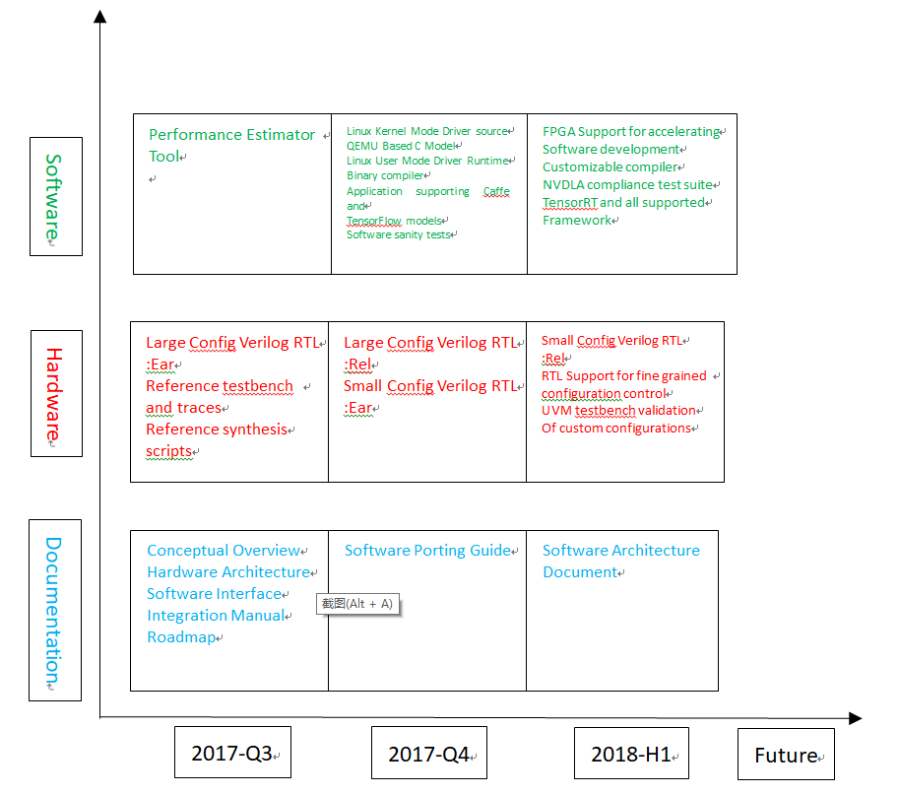
Outline
What`s NVDLA
Highlights
What NVDIA offers
System integration
Architecture
Software
Power & performance
Flow

Slide 7
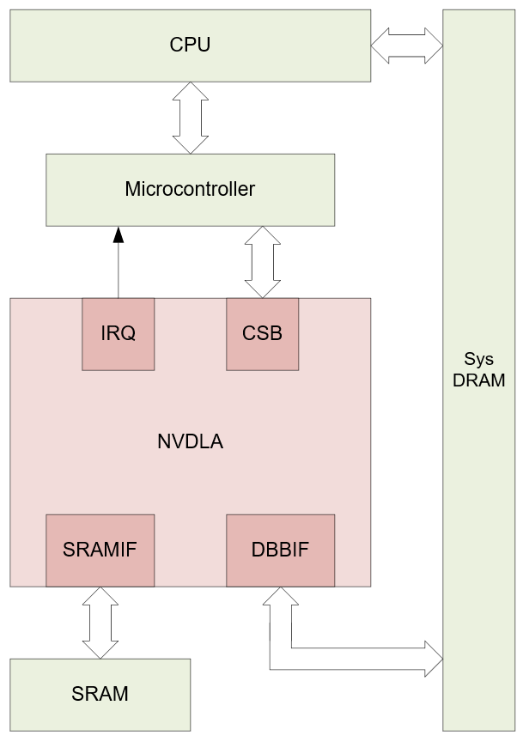
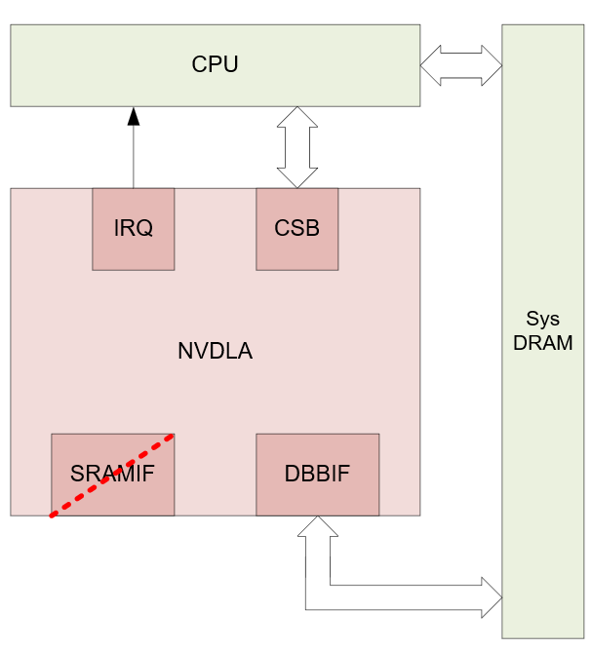
Outline
What`s NVDLA
Highlights
What NVDIA offers
System integration
Architecture
Software
Power & performance
Flow
big or small

Slide 8
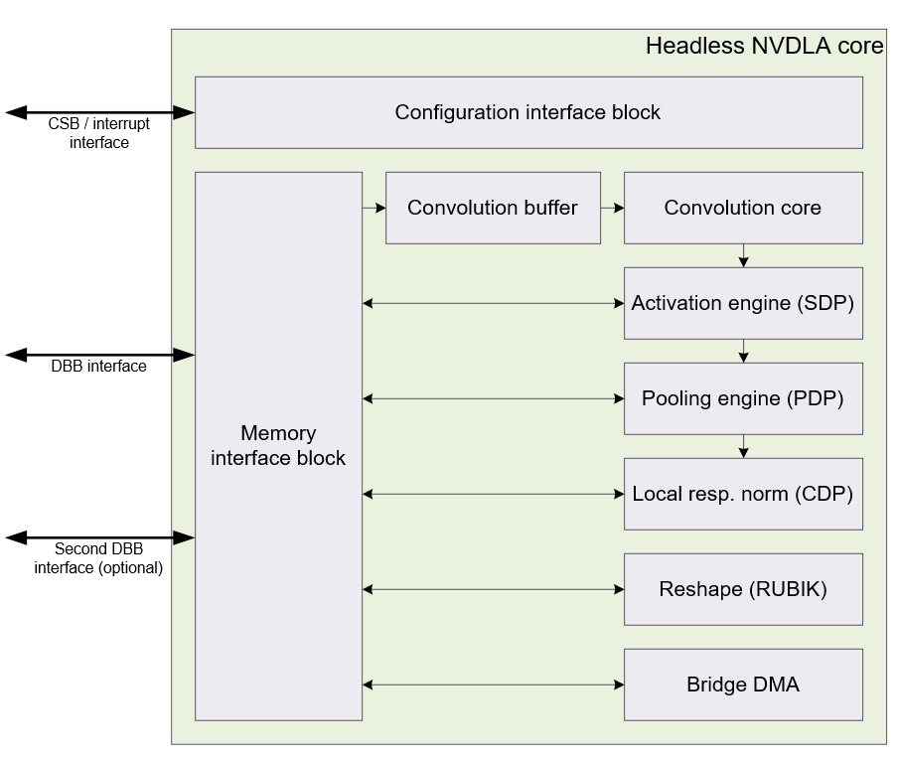
Outline
What`s NVDLA
Highlights
What NVDIA offers
System integration
Architecture
Software
Power & performance
Flow
Notes:
BDMA is just for data transfer from memory to SRAM;
Function modules have their own DMAs;

Slide 9
Outline
What`s NVDLA
Highlights
What NVDIA offers
System integration
Architecture
Software
Power & performance
Flow
Conv. core
tf.nn.conv2d
SDP
tf.nn.batch_normalization
tf.nn.bias_add
tf.nn.elu/tf.nn.relu/tf.nn.sigmoid/tf.nn.tanh
PDP
tf.nn.avg_pool/tf.nn.max_pool/tf.nn.pool
CDP
tf.nn.local_response_normailization
RUBIK
tf.nn.conv2d_transpose
tf.concat/tf.slice/tf.transpose

Slide 10
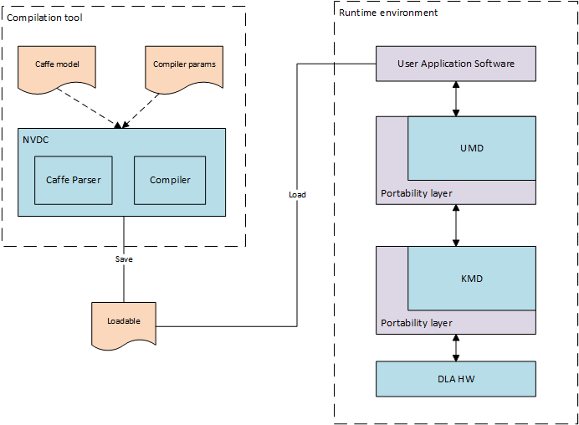
Outline
What`s NVDLA
Highlights
What NVDIA offers
System integration
Architecture
Software
Power & performance
Flow

Slide 11
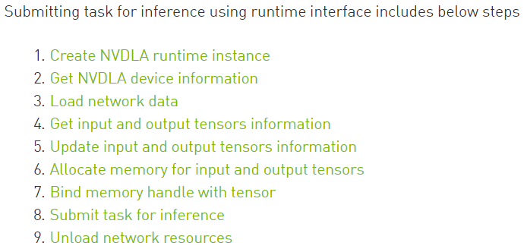
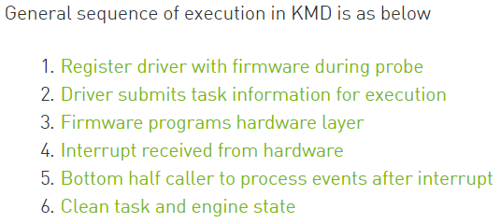
Outline
What`s NVDLA
Highlights
What NVDIA offers
System integration
Architecture
Software
Power & performance
Flow

Slide 12
Outline
What`s NVDLA
Highlights
What NVDIA offers
System integration
Architecture
Software
Power & performance
Flow
Highly configurable
# MACs | Conv. buffer size (KB) | SDRAM bandwidth (GB/s) | Silicon Cell Area (mm^2, 28nm) | Silicon Cell Area (mm^2, 16nm) | Int8 ResNet-50 (frames/sec) | Power Estimate Peak/Average (mW, 16nm)
2048 | 512 | 20 | 5.5 | 3.3 | 269 | 766 / 291
1024 | 256 | 15 | 3.0 | 1.8 | 153 | 375 / 143
512 | 256 | 10 | 2.3 | 1.4 | 93 | 210 / 80
256 | 256 | 5 | 1.7 | 1.0 | 46 | 135 / 48
128 | 256 | 2 | 1.4 | 0.84 | 20 | 82 / 31
64 | 128 | 1 | 0.91 | 0.55 | 7.3 | 55 / 21
32 | 128 | 0.5 | 0.85 | 0.51 | 3.6 | 45 / 17
* Freq. = 1GHz

Slide 13
Outline
What`s NVDLA
Highlights
What NVDIA offers
System integration
Architecture
Software
Power & performance
Flow (conv_8x8_int16)

Slide 14
Flow (conv_8x8_int16)
feature map: 8*8*32
kernel number: 16
Direct convolution
conv only, no activation, no pooling, no LRN

Slide 15
Flow (conv_8x8_int16)

Slide 16
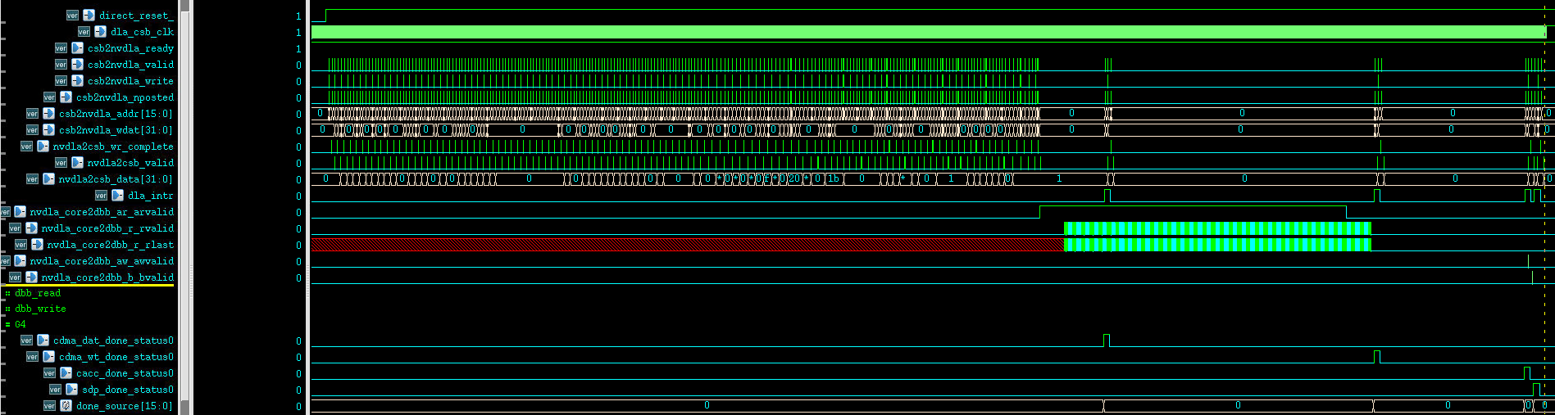
Flow (conv_8x8_int16)

Slide 17
Thanks!

Slide 18
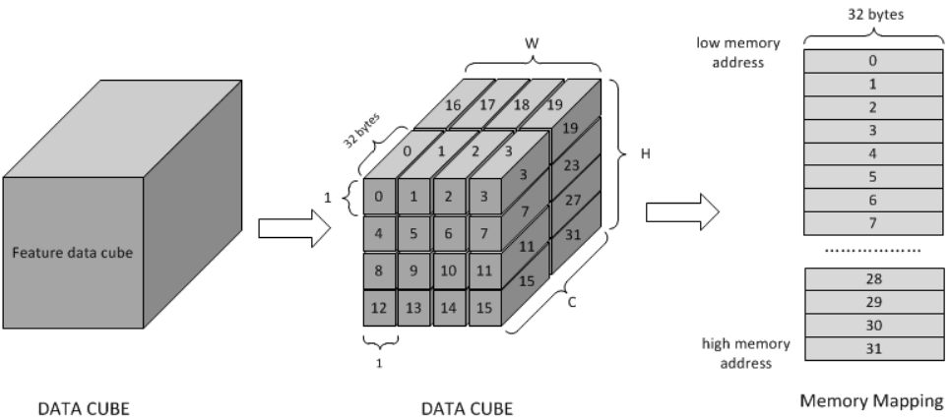
Flow (conv_8x8_int16)
feature map: 8*8*32
kernel number: 16
Direct convolution

Slide 19
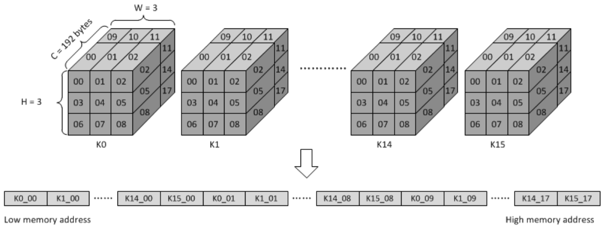
Flow (conv_8x8_int16)
feature map: 8*8*32
kernel number: 16
Direct convolution

