Slide 1
01
Introduction
Group Details
02
Department wise Avg attrition rate
03
Avg Hourly Rate of Male Research Scientists
HR ANALYTICS
04
Attrition Rate vs Monthly Income Stats
05
Avg working years for all Departments
06
Job Role vs Work-Life Balance
07
Attrition rate vs Year since last promotion
08

Slide 2
INTRODUCTION
What is HR analytics?
HR analytics is the process of collecting and analysing Human Resource (HR) data in order to improve an organization’s workforce performance. The process can also be referred to as talent analytics , people analytics or even workforce analytics.
What is role of HR analytics?
HR analytics aim to provide insight into how best to manage employees and reach the business goals because lot of data is available ,it is important for HR teams to first identify which data is most relevant.

Slide 3
GROUP DETAILS
Miss. NISHIGANDA
Mr. MAHESH
Miss. GIRIJA
Mr. ARSHAD
Miss. PUNAM
Mr. PRATIK
MENTOR
Mr. SHUBHAM KABRE

Slide 4
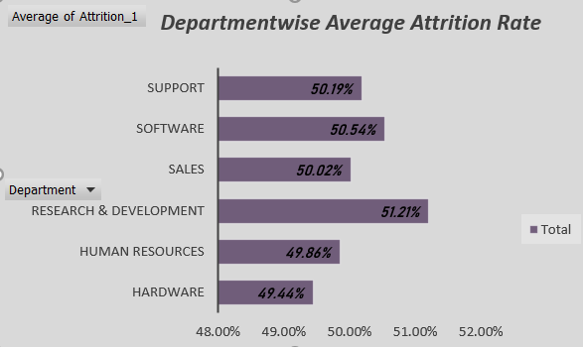
KPI 1 : Average Attrition rate for all Departments

Slide 5

KPI 2: Average Hourly rate of Male Research Scientist

Slide 6
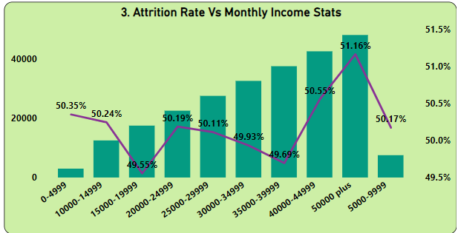
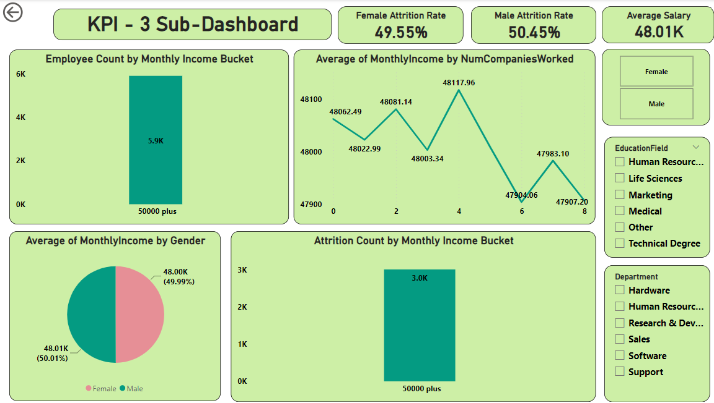
KPI 3 : Attrition Rate vs Monthly Income stats
The Employees whose monthly income is greater than 50000:-
Employee Count is 5901.
Attrition count is 3019.
Attrition rate is highest i.e. 51.16%.
The average monthly income of females and males is 48003 & 48013 respectively.
The Employees who worked in four companies whose average monthly income is highest i.e. 48117.

Slide 7
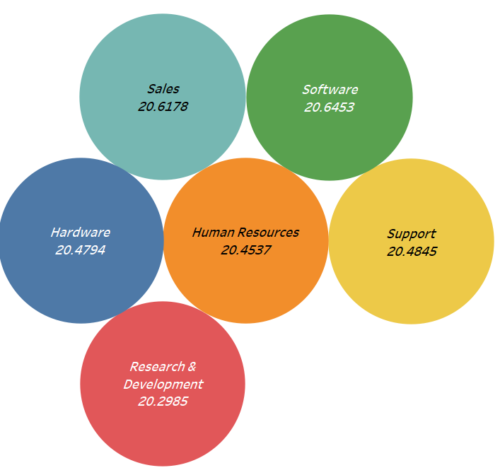
KPI 4 : Average Working Years for each Department

Slide 8
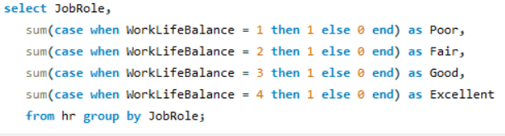
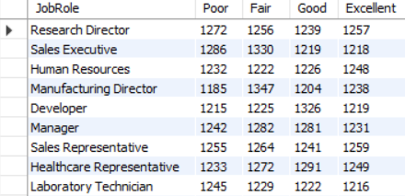
KPI 5 : Job Role vs Work Life Balance

Slide 9
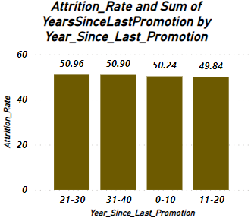
KPI 6 : Attrition Rate vs Year Since Last Promotion Relation

