Slide 1
Generic in java
They allow "a type or method to operate on objects of various types while providing compile-time type safety.“
A common use of this feature is when using a Java Collection that can hold objects of any type, to specify the specific type of object stored in it.

Slide 2
Java Generic
Using Java Generic concept we might write a generic method for sorting an array of objects, then invoke the generic method with Integer arrays, Double arrays, String arrays and so on, to sort the array elements.

Slide 3
Generics (Cont’d)
A class definition with a type parameter is stored in a file and compiled just like any other class.
Once a parameterized class is compiled, it can be used like any other class.
The class type plugged in for the type parameter must be specified before it can be used in a program.
Sample<String> object = new Sample<String>();
Notes:
‹#›

Slide 4
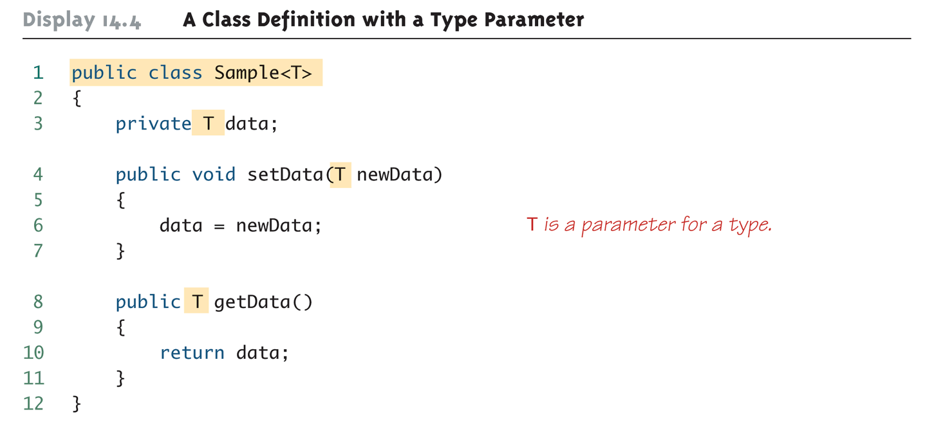
A Class Definition with a Type Parameter
Notes:
‹#›

Slide 5
A Class Definition with a Type Parameter (Cont’d)
A class that is defined with a parameter for a type is called a generic class or a parameterized class
The type parameter is included in angular brackets after the class name in the class definition heading.
By convention, the parameter starts with an uppercase letter.
The type parameter can be used like other types used in the definition of a class.
Notes:
‹#›

Slide 6
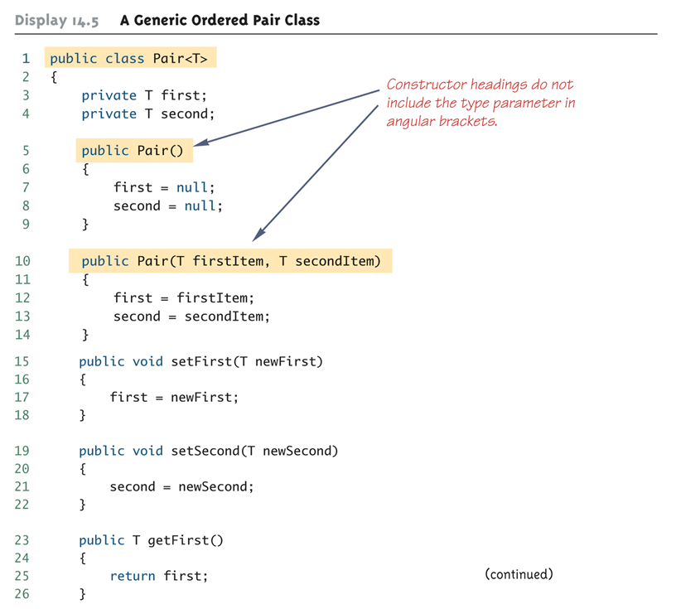
Generic Class Definition: An Example
Notes:
‹#›

Slide 7
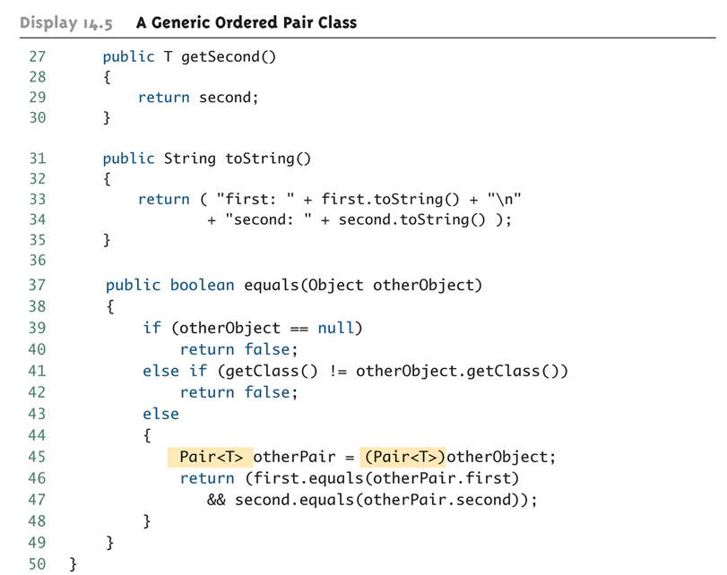
Generic Class Definition: An Example (Cont’d)
Notes:
‹#›

Slide 8
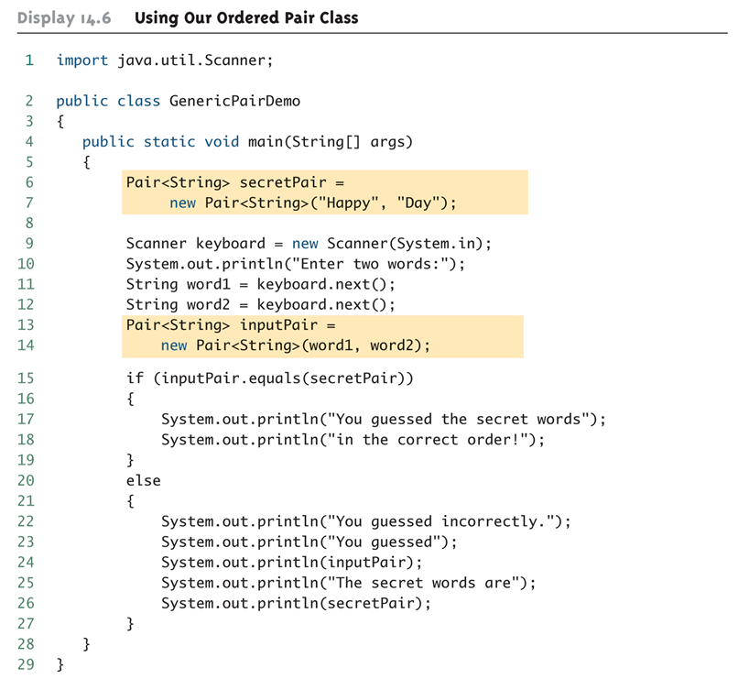
Generic Class Usage: An Example
Notes:
‹#›

Slide 9
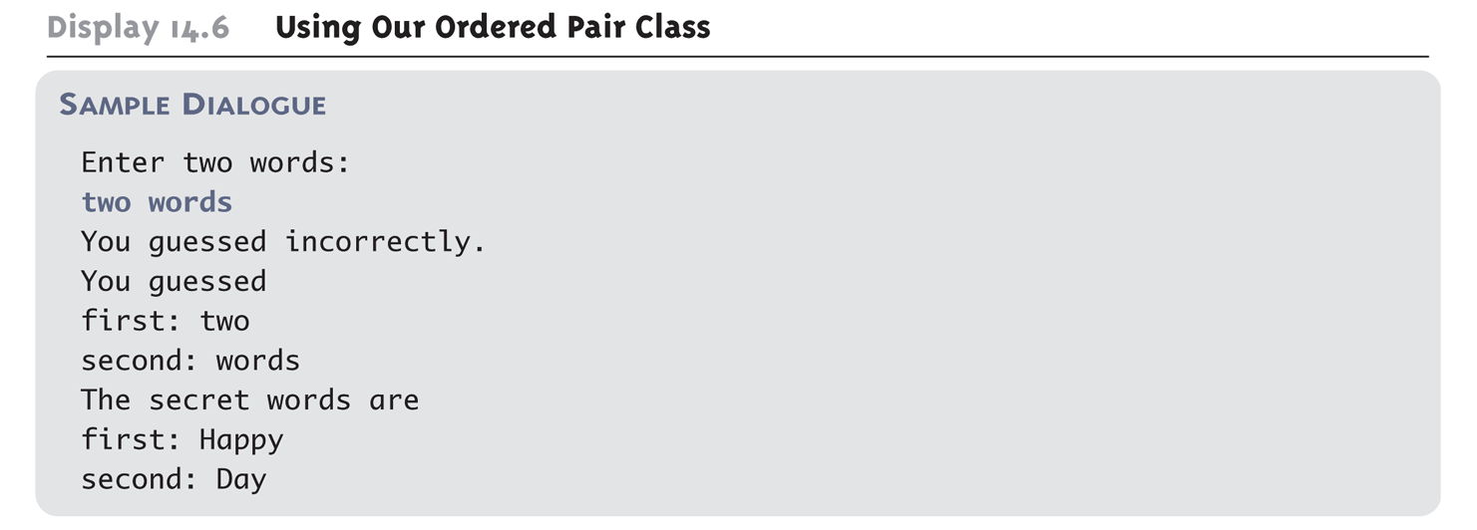
Generic Class Usage: An Example (Cont’d)
Program Output:
Notes:
‹#›

Slide 10
Example
class generic1<t>
{
t a,b;
public t sum(t x, t y) { return x ; }
public generic1() { System.out.println("default");}
public static void main(String ar[])
{
generic1 <Float> c[]= new generic1[3];
c[0]=new generic1();
c[1]=new generic1();
System.out.println(c[0].sum(20.22f,30.22f));
}}

Slide 11
A Generic Constructor Name Has No Type Parameter!!!
Although the class name in a parameterized class definition has a type parameter attached, the type parameter is not used in the heading of the constructor definition:
public Pair<T>()
A constructor can use the type parameter as the type for a parameter of the constructor, but in this case, the angular brackets are not used:
public Pair(T first, T second)
However, when a generic class is instantiated, the angular brackets are used:
Pair<String> pair = new Pair<STring>("Happy", "Day");
Notes:
‹#›

Slide 12
Limitations on Generic Class Instantiation
Arrays such as the following are illegal:
Pair<String>[] a =new Pair<String>[10];
Although this is a reasonable thing to want to do, it is not allowed given the way that Java implements generic classes
Notes:
‹#›

Slide 13
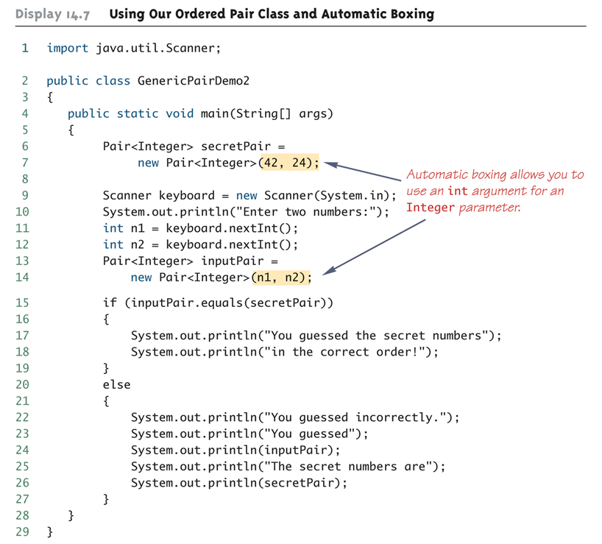
Using Generic Classes and Automatic Boxing
Notes:
‹#›

Slide 14
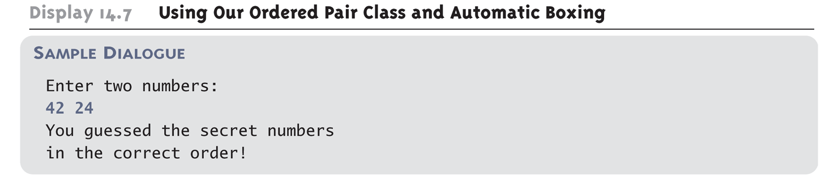
Using Generic Classes and Automatic Boxing (Cont’d)
Program Output:
Notes:
‹#›

Slide 15
Multiple Type Parameters
A generic class definition can have any number of type parameters.
Multiple type parameters are listed in angular brackets just as in the single type parameter case, but are separated by commas.
Notes:
‹#›

Slide 16
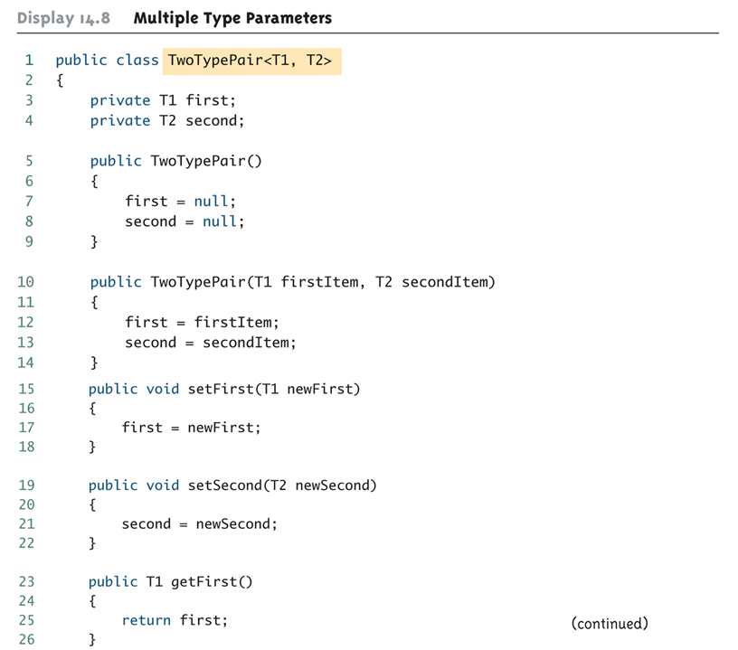
Multiple Type Parameters (Cont’d)
Notes:
‹#›

Slide 17
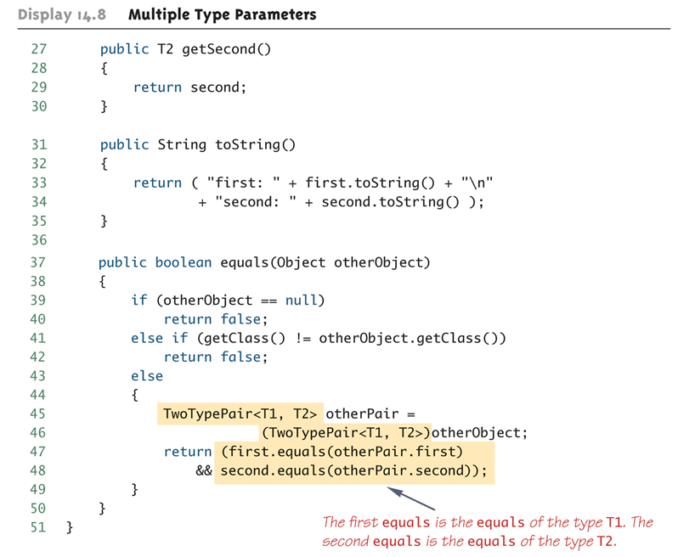
Multiple Type Parameters (Cont’d)
Notes:
‹#›

Slide 18
A Generic Classes and Exceptions
It is not permitted to create a generic class with Exception, Error, Throwable, or any descendent class of Throwable
A generic class cannot be created whose objects are throwable
public class GEx<T> extends Exception
The above example will generate a compiler error message
Notes:
‹#›

Slide 19
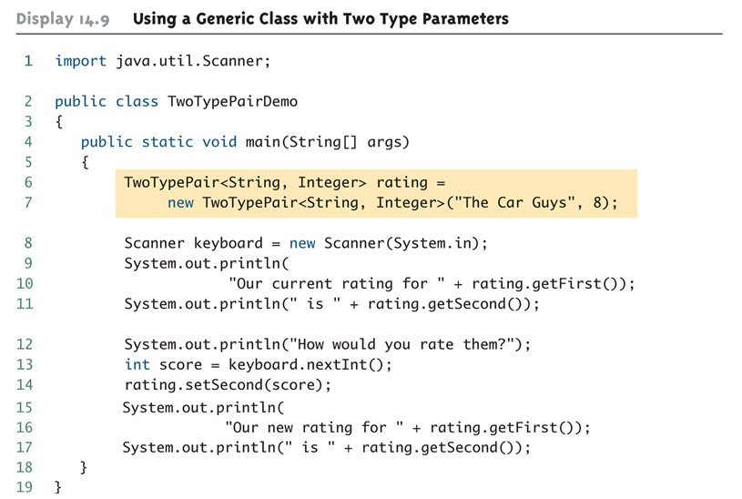
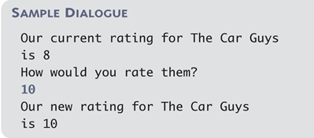
Using a Generic Class with Two Type Parameters
Program Output:
Notes:
‹#›

Slide 20
Bounds for Type Parameters
Sometimes it makes sense to restrict the possible types that can be plugged in for a type parameter T.
For instance, to ensure that only classes that implement the Comparable interface are plugged in for T, define a class as follows:
public class RClass<T extends Comparable>
"extends Comparable" serves as a bound on the type parameter T.
Any attempt to plug in a type for T which does not implement the Comparable interface will result in a compiler error message.
Notes:
‹#›

Slide 21
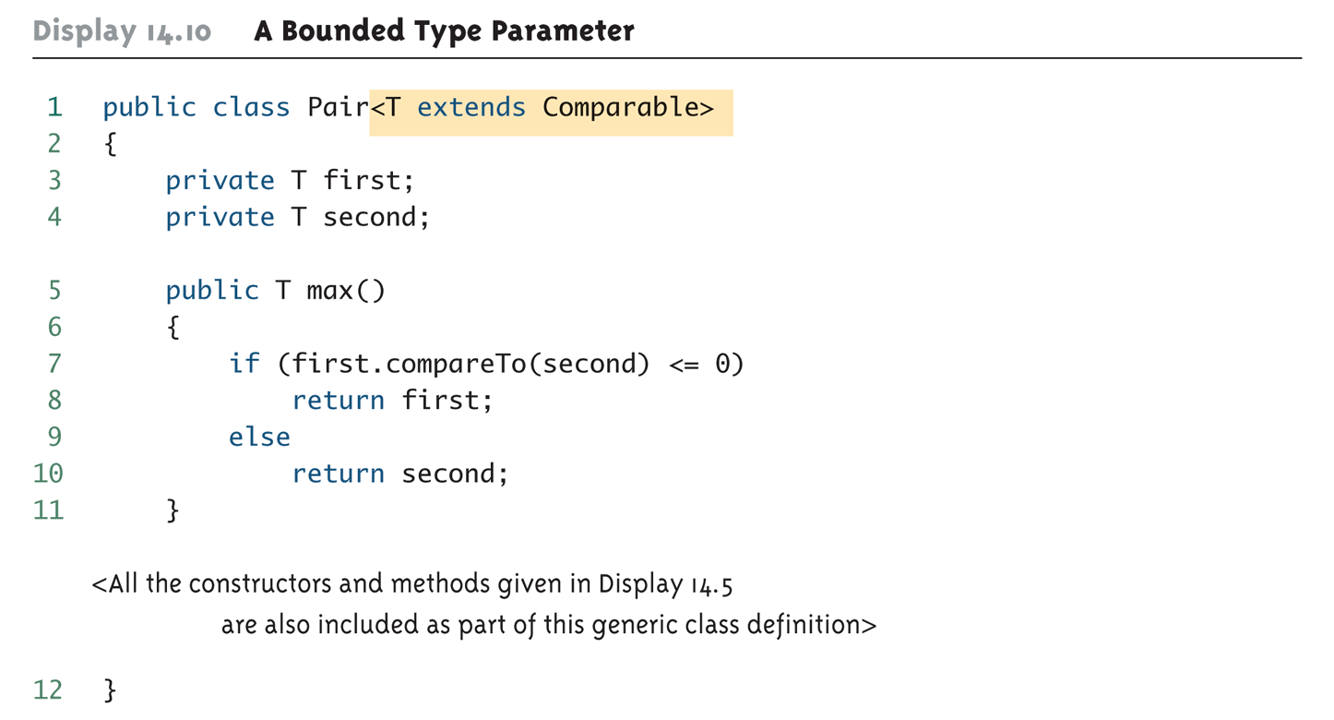
Bounds for Type Parameters (Cont’d)
Notes:
‹#›

Slide 22
Generic Methods
When a generic class is defined, the type parameter can be used in the definitions of the methods for that generic class.
In addition, a generic method can be defined that has its own type parameter that is not the type parameter of any class
A generic method can be a member of an ordinary class or a member of a generic class that has some other type parameter.
The type parameter of a generic method is local to that method, not to the class.
Notes:
‹#›

Slide 23
Generic Methods (Cont’d)
The type parameter must be placed (in angular brackets) after all the modifiers, and before the returned type:
public static <T> T genMethod(T[] a)
When one of these generic methods is invoked, the method name is prefaced with the type to be plugged in, enclosed in angular brackets
String s = NonG.<String>genMethod(c);
Notes:
‹#›

Slide 24
Generic Interface Example
interface a<T> { public void add(T t); }
public class Box implements a<Integer>
{ int t;
public void add(Integer t) { this.t = t; }
public int get() { return t; }
}
public class Main {
public static void main(String[] args) {
Box a=new Box();
a.add(10);
System.out.print(a.get());
} }

Slide 26
REFLECTION IN JAVA

Slide 27
Reflection
In computer science, reflection is the ability of a computer program to examine and modify the structure and behavior (specifically the values, meta-data, properties and functions) of an object at runtime.^{[1]}

Slide 28
Reflection
Every object is either a reference or primitive type. Reference types all inherit from java.lang.Object. Classes, enums, arrays, and interfaces are all reference types
Examples of reference types include java.lang.String, all of the wrapper classes for primitive types such as java.lang.Double, the interface java.io.Serializable, and the enum javax.swing.SortOrder.

Slide 29
Java reflection is the capability of retrieving some metadata about the objects at runtime.
This capabilities are usually used in creating programming tools, like IDE, JavaBeans, and so forth.
To implement this capability, Java creators defined a couple of classes like: Class , Package, Field, Method, Constructor, Array

Slide 30
Retrieving Class Objects
The entry point for all reflection operations is java.lang.Class.
With the exception of java.lang.reflect.ReflectPermissionWith the exception of java.lang.reflect.ReflectPermission, none of the classes in java.lang.reflect have public constructors.

Slide 31
Retrieving Fields
import java.lang.reflect.*;
public class trail {
public static void main(String a[]) throws Exception
{
Class <?> c =Class.forName("java.awt.Dimension");
Field v[]= c.getFields();
for(int i=0;i<v.length;i++)
{ System.out.println(v[i]);
}}}
Other methods :
String fieldName = field.getName();
Field field = aClass.getField("someField");
Object fieldType = field.getType();

Slide 32
Reteriving constructor
import java.lang.reflect.*;
public class trail {
public static void main(String a[]) throws Exception
{
Class <?> c =Class.forName("java.awt.Dimension");
Constructor v[]= c.getConstructors();
for(int i=0;i<v.length;i++)
{
System.out.println(v[i]);
}}}

Slide 33
Retrieving Methods
import java.lang.reflect.*;
public class trail {
public static void main(String a[]) throws Exception
{
Class <?> c =Class.forName("java.awt.Dimension");
Method v[]= c.getMethods();
for(int i=0;i<v.length;i++)
{
System.out.println(v[i]);
}}}

Slide 34
getDeclaredMethods ()
Method v[]= c.getDeclaredMethods();

Slide 35
Reflection is most commonly used in high-level virtual machine programming languages like Smalltalk and scripting languages and also in manifestly typed or statically typed programming languages such as Java, ML, Haskell, C# and Scala.

Slide 36
What exactly is a class?
It’s a collection of different things, such as:
Fields
Methods
Constructors
We define these different things with names, types, parameters, values, expressions, etc while programming, but in reflection all of this already exists.

Slide 37
Programming vs Reflecting
We use reflection to manipulate things that already exist and, normally, are set.
But unlike programming, we are not tied to specific names, types or views.
We have the ability to dynamically change what things are, regardless of how they were written!
More specifically, we are modifying objects at runtime.

Slide 38
What do you mean Runtime?
Normally you program something like this:
Write/Modify the class, methods, etc
Compile it
Run it
If you want to make any changes you have to recompile and rerun that class.

Slide 39
What do you mean Runtime?
With reflection, we can manipulate a class without ever recompiling it:
Write/Modify the class, methods, etc
Compile it
Run it
Modify the class here!
It is important to note that another class is the one doing the modification.

Slide 40
Uses of Reflection
Some common uses of reflection:
To load and use classes unknown at compile time, but have set methods.
Example: The Critters assignment
Test programs by forcing specific states
By debuggers to inspect running programs
Malicious things
Hacking

Slide 41
Programming Reflection
To program with reflection, we must put on our meta-thinking caps.
We are going to modify classes from classes with classes!
To do this we have a great set of classes in the following package:
java.lang.reflect.*;

Slide 42
Java.lang.reflect.*
Some classes we will go over,
Method
Describes a method for a class and gives access to it.
Field
Describes a field for a class, its type, name, etc.
Constructor<T>
Provides information about constructors and the ability to execute a constructor and get a new class instance

Slide 43
Java.lang.reflect.*
AccessibleObject
Describes the accessibility of an object, i.e. its view public, private, protected, default.
Array
A special class created just for reflecting with Arrays, since Arrays are such odd objects in Java we must use this class to manipulate them.

Slide 44
So where do we start?
To start manipulating a class we must first get a hold of that class’s “blueprint”.
Using the java.lang.Class class
There are two ways to do this, if the class is already loaded:
Class<? extends Object> theClass = ClassName.class;
Or if we need to cause it to load:
Class theClass = Class.forName(“class.package”);
We won’t use this second one, its rather complex at times.
Example Package: “java.lang.String”

Slide 45
So where do we start?
So now we have the definition of a class.
This is like the blueprint to the entire thing, it lists where everything is and how to get to it.
It is important to point out that this class has information that pertains to the structure of the class, not specific instance information, but hold that thought for a little later.
For now lets look at how to get some information from the class

Slide 46
The Parts of the Class
Fields
Methods
Constructors
Miscellaneous

Slide 47
Getting those sweet fields
There are two ways to get class fields:
getFields();
Returns an array of Field objects, specifically all the fields that are public for this class and its super classes.
getDeclaredFields();
Returns an array of Field objects, regardless of view.
Optionally if you know the field name:
getField(String name);
Returns a Field with the given name

Slide 48
The Parts of the Class
Fields
Methods
Constructors
Miscellaneous

Slide 49
Calling all methods, report for duty
Like Fields there are two ways to get Methods
getMethods();
Returns all the public methods for this class and any it inherits from super classes.
getDeclaredMethods();
Returns all the methods for this class only regardless of view.
Like Fields you can also get a specific method, but it takes more information.

Slide 50
Calling all methods, report for duty
To get a specific method you call
getMethod(String name, Class<?>… parameterTypes);
The name parameter is pretty straight forward, but does Class<?>… mean?
This means you can pass any number of Class<?> parameters after the name.
The Class<?> parameters you pass reference the types of parameters the method takes.

Slide 51
Calling all methods, report for duty
For example, say we have this method:
public int doSomething(String stuff, int times, int max){}
If we were trying to get this specific method we would have to call getMethod like this:
getMethod(“doSomething”, String.class, int.class, int.class);
We are directly passing the types, and this is because the reflection will use the method “fingerprints” to track it down and return it to us.

Slide 52
The Parts of the Class
Fields
Methods
Constructors
Miscellaneous

Slide 53
Building blocks
To get the constructos we have the methods:
getConstructors()
Returns all public constructors for the class
getDeclaredConstructors()
Returns all constructors for the class, regardless of view
We can again get specific constructors with:
getConstructor(Class<?>… parameterTypes);
Returns the constructor that takes the given parameters

Slide 54
The Parts of the Class
Fields
Methods
Constructors
Miscellaneous

Slide 55
The others
For this session we will only focus on variables and methods, but there are a number of other useful methods:
getEnclosingMethod()
Gets the method that declared an anonymous class
getName()
Returns the class name
newInstance()
Creates a new instance of the class

Slide 56
The Classes of Reflection
Field
Method
Constructor
????????????

Slide 57
The Field Class
Some useful methods:
get(Object obj)
Gets the value of this field in the given object
getPrimitiveType(Object obj)
set(Object obj, Object value)
Sets the value of this field in the given object, if possible
setPrimitiveType(Object obj, PrimitiveType value)
getType()
Returns the type of this field
getName()
Returns the name of this field

Slide 58
The Field Class
You may have noticed the two methods getPrimitiveType(..) and setPrimitiveType(..)
Here PrimitiveType is replaced with a real primative type, so if a field represents an int you would say, getInt() or setInt().
This is done because primitive types are not classes and so we need a special way to get and set them

Slide 59
The Field Class
The first parameter to all of those methods was Object obj
This parameter is a specific instance of the class.
a constructed version of the class
Like I mentioned before the Field object represents a generic version of a field for a class, it holds no value, its just a blueprint as to where it would be in the class.
To get a value we must provide a class that has been constructed already.

Slide 60
The Field Class
Don’t forget we can have two types of fields, static/non-static
If we want to get the value of a static field, we can pass null as the Object obj parameter.

Slide 61
The Classes of Reflection
Field
Method
Constructor
????????????

Slide 62
The Method Class
Some useful methods
getName()
Gets the methods name
getReturnType()
Gets the type of variable returned by this method
getParameterTypes()
Returns an array of parameters in the order the method takes them
invoke(Object obj, Object… args)
Runs this method on the given object, with parameters.

Slide 63
The Method Class
The main method of this class that we will use is invoke(Object obj, Object... params)
The first parameter is exactly like the Field class methods, it is an instantiated class with this method that we can invoke.
The second parameter means we can pass as many parameters as necessary to call this method, usually we will have to use the result of getParameterTypes() in order to fill those in.

Slide 64
The Classes of Reflection
Field
Method
Constructor
????????????

Slide 65
The Constructor Class
Some useful methods
getParameterTypes()
Returns an array of parameter types that this constructor takes
newInstance(Object… initargs)
Creates a new class that this constructor is from using the given parameters as arguments.

Slide 66
The Constructor Class
Only two methods? Well yes, we only have an hour to work with here! And the others are not as interesting.
The method we are most concerned with is newInstance(Object… initArgs)
This is similar to invoke(..) for methods except we don’t pass an already instantiate object because we are making a new one!
Like methods we will probably call getParameterTypes() first.

Slide 67
Overview
Lets take a step back and look at all this information
We can get a class blueprint and it’s a class of type Class from java.lang.Class
For reflection we use classes like Field, Method, and Constructor to reference pieces of the class
These are generic versions and we must pass them constructed versions (except for constructors)
From each of these reflection classes we have the ability to manipulate instances of classes.

Slide 68
Lets try it out!
Whats the fun in learning something without trying it out?
Lets go!!

Slide 69
Lets try it out
So it turned out what we learned works pretty well for everything with a public visibility.
But what about those private, protected, and default views?
Java kept throwing an IllegalAccessException, we just don’t have permissions to edit those.
Well not to worry we can get permission!

Slide 70
The Classes of Reflection
Field
Method
Constructor
????????????

Slide 71
The Classes of Reflection
Field
Method
Constructor
AccessibleObject!

Slide 72
The AccessibleObject
The accessible object is a superclass that Field, Method, and Constructor extend
How convenient!
But what does it do?
It controls access to variables by checking the accessibility of a field, method, or constructor anytime you try to get, set, or invoke one.

Slide 73
The AccessibleObject
Some very useful methods:
isAccessible()
Tells whether or not the object can be accessed based on its view type
A public field, method, or constructor will return true
The other types will return false.
setAccessible(boolean flag)
This will override the accessibility setting to whatever is passed in, true or false

Slide 74
Overriding Accessibility
So how can we use this?
Well suppose we have a Field object that references a field in our class that was declared like this:
private String secretMessage;
Well as we have seen we get an Exception, but we can avoid it by overriding the accessibility
theField.setAccessible(true);

Slide 75
Overriding Accessibility
Now before you start the triangle pyramid of evil, note:
It is possible to prevent use of setAccessible()
You do this using a SecurityManager to prevent access to variables
Stuarts CritterMain does this for tournaments.

Slide 76
Applying Reflection
Now that we have learned a little bit of reflection and have some tools under our belt, lets try it out.
You can download the ATM.class from the course website
To run it you will need to go to the command line, navigate to where you downloaded the file and then type
java ATM

Slide 77
The Secure Financial Corporation
An area where security is extremely important is Banking
We trust that banks keep all of our transactions secure and money safe
Lets suppose we were just hired to check the security of Secure Financial Corporation’s new Java powered ATM
We will need to use reflection to try and leverage an attack against the machine.

Slide 78
The Secure Financial Corporation
The company has decided it would be more secure for the card to verify that an ATM is valid by having cards that can execute methods.
In particular every card must have a swipe method that takes in an ATM object that the card can use to validate is a real ATM.
The ATM has a method applyDecryption() that the card must call to determine if the ATM has the proper credentials (Security Session Tie-in!)

Slide 79
The Secure Financial Corporation
The card must pass an encrypted code to applyDecryption() which will return a decrypted code. The card can then use this code to make sure the ATM has the appropriate private keys. If it does then the swipe method returns a Data object for ATM with info.
That would be all well and good for a secure system right?
That way cards don’t give out information to bad systems!

Slide 80
The Secure Financial Corporation
Well its nice in theory, but it gives us a built ATM object!
And as we have just learned with Reflection, we can get all the framework we want, but we need an instantiated version of the class to do real damage.
Lets see what we can do!

Slide 81
Arrays
If you wish to manipulate arrays with Reflection you must use the java.lang.reflect.Array class, you cannot use the Field class
This is because Java does not handle Arrays in the same way it handles Objects or Primatives

Slide 82
Arrays
Useful Methods
get(Object array, int index)
Gets the value from the array at the given index
getPrimitiveType(Object array, int index)
set(Object array, int index, Object value)
Sets the value in the array at the index to the given value
setPrimitiveType(Object array, int index, PrimitiveType value)

Slide 83
Arrays
Just like the Field class, the PrimitiveType is replaced by an actual primitive type and you must use this type of placement when accessing a primitive array
But there are a couple more methods that are unique to this class

Slide 84
Arrays
Unique Methods
getLength(Object array)
Returns the length of the given array
newInstance(Class<?> componentType, int… dimensions)
Creates a new array of the given type and with the given dimensions
newInstance(Class<?> componentType, int length)
Creates a new array of the given type and with the given length

Slide 85
What are some practical uses of Java reflection?
One of the more common uses of Java reflection is with JUnit, which is a popular unit testing framework for Java. One commonly used feature of JUnit uses annotations to mark certain methods as test methods that which are meant to help you test your Java code. Then, when you actually decide to run your unit tests, JUnit will look for the methods which you marked with the “@Test” annotation, and will execute those methods.

Slide 86
-:: Question ::-
Determine the class of an object.
Get information about a class's modifiers, fields, methods, constructors, and super classes.
Find out what constants and method declarations belong to an interface.
Create an instance of a class whose name is not known until runtime.
Get and set the value of an object's field, even if the field name is unknown to your program until runtime.
Invoke a method on an object, even if the method is not known until runtime .

