Slide 1

A web developer's journey into Node.js
Punam Dahiya
UrbanTouch.com

Slide 2
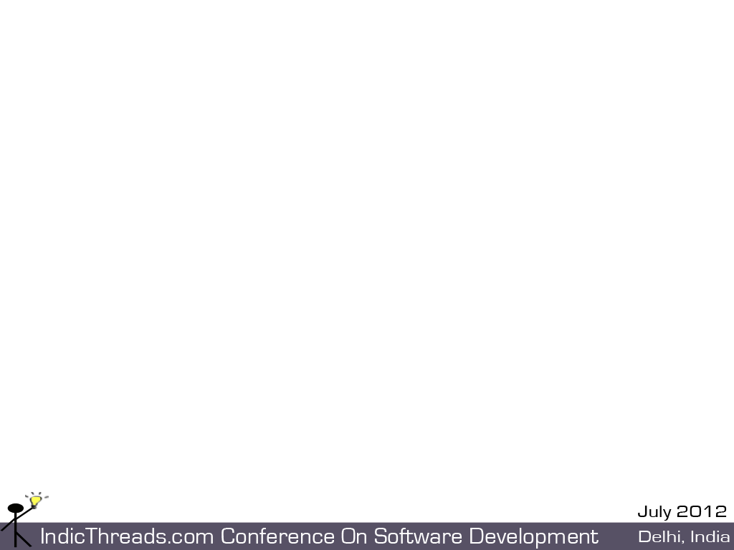
Agenda
Why move away from LAMP based Magento
Why Node.js and not Ruby, Python etc
What is Node.js
Developing website in Node.js
Tool Chain
Performance and Scalability

Slide 3
What didn't work with LAMP
Magento is an ecommerce solution on LAMP stack
Its slow, (6000+ files) and complex
Generic and complicated call stacks
Good for initial site launch in short duration but does not scale for higher load.

Slide 4
Why Node.js
Extremely fast, scalable, responsive due to its V8(chrome) underpinnings
Non-blocking I/O
Javascript on both UI and Server Side
Active and vibrant community with huge library support, vendor neutral
Notes:
and not Python, Ruby?

Slide 5
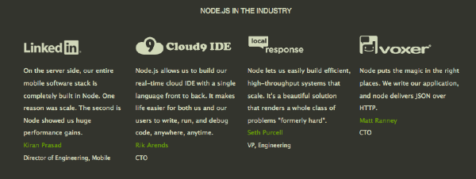
Node.js in Industry

Slide 6
What is Node.js
Event-driven I/O framework for the V8 JavaScript engine
Enables Non-Blocking I/O via callbacks
Asynchronous programming paradigm

Slide 7
Installation
Download and install Node.js
http://nodejs.org/#download
V8 comes with it
Node Package Manager (NPM) - It comes with node. Use NPM to access useful node modules for developing web sites
http://npmjs.org/doc/README.html

Slide 8
Non-Blocking I/O via callbacks
setTimeout(function() {
console.log("World");
},2000);
console.log("Hello");

Slide 9
Event driven programming on client side
$("#myButton").click(function(){
alert("Inside button click");
});

Slide 10
Handling events on Server Side
var http = require('http'); var s = http.createServer(function (request, response) { response.writeHead(200, {'Content-Type': 'text/plain'}); response.end('Hello World\n'); });
s.listen(8000);

Slide 11
Developing website in Node.js
Development Tool Chain
Testing

Slide 12
Developing website in Node.js
- MVC Framework
Most popular one is Express. http://expressjs.com
Key concepts:
Routes
Models
Views
Notes:
Node community offers host of mvc based frameworks for expressing server side on Model/View/Controller paradigm.

Slide 13
MVC Framework - Express
Web development framework for Node.js
View Rendering
Error Handling
Templating Engines
Session Support
$ npm install express
http://expressjs.com/

Slide 14
Sample Program
Basic web server with Express

Slide 15
Exploring Express
Directory Structure of an example Express site
app.js
/node_modules
package.json
/public
/routes
/views
/models
>express -t ejs myapp

Slide 16
Sample Program
Let's create a dynamic web page in node using express and templating engine EJS.

Slide 17
Development
Huge library support to enhance Node functionality. Other must have Node Modules -
Embedded JS (EJS)
redis
mysql
Sphinx

Slide 18
Testing
Debugging
node-inspector
Functional Testing
Vows - http://vowsjs.org/

Slide 19
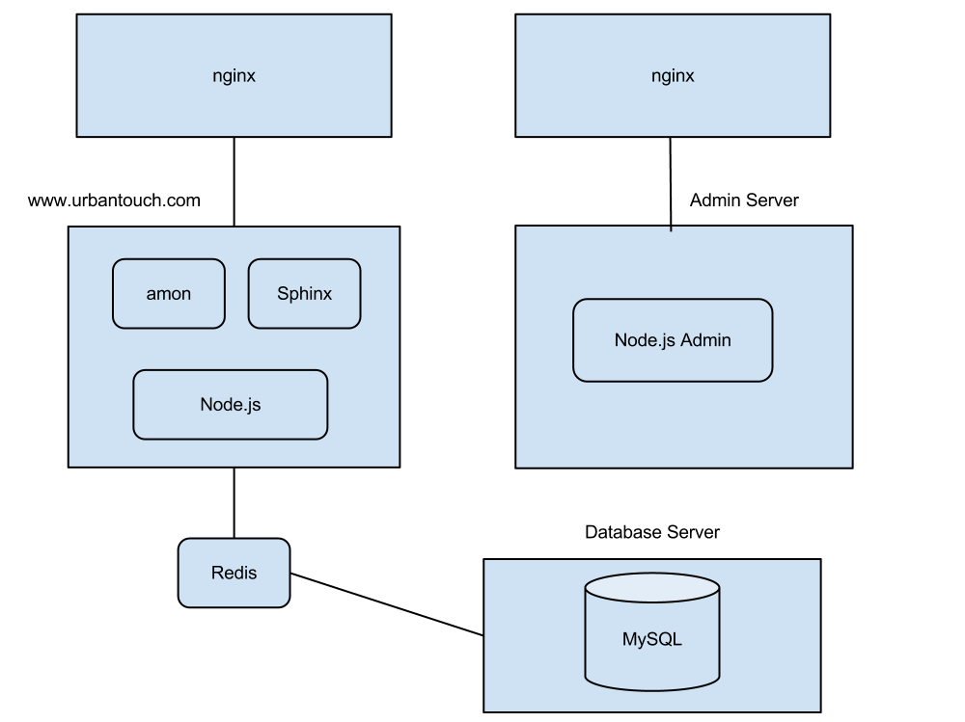
UrbanTouch architecture

Slide 20
Performance and Scale
Hardware configuration: 3 servers
1 XL 8 core Linux
2 L 4
Before Node:
8,000 users per day
After Node:
Scales upto 10X the number.
Easily serving 50,000 urbantouch users load without breaking a sweat.

Slide 21
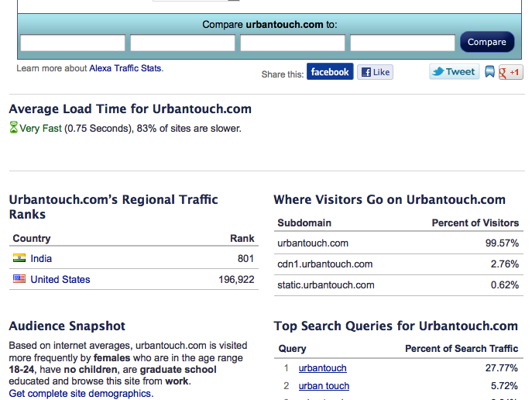
Urbantouch Load Time

Slide 22
Thank You...
You can find copy of this presentation at
http://ez2mo.com/nodejs
Questions?
Email: punamdahiya@yahoo.com

