Slide 1
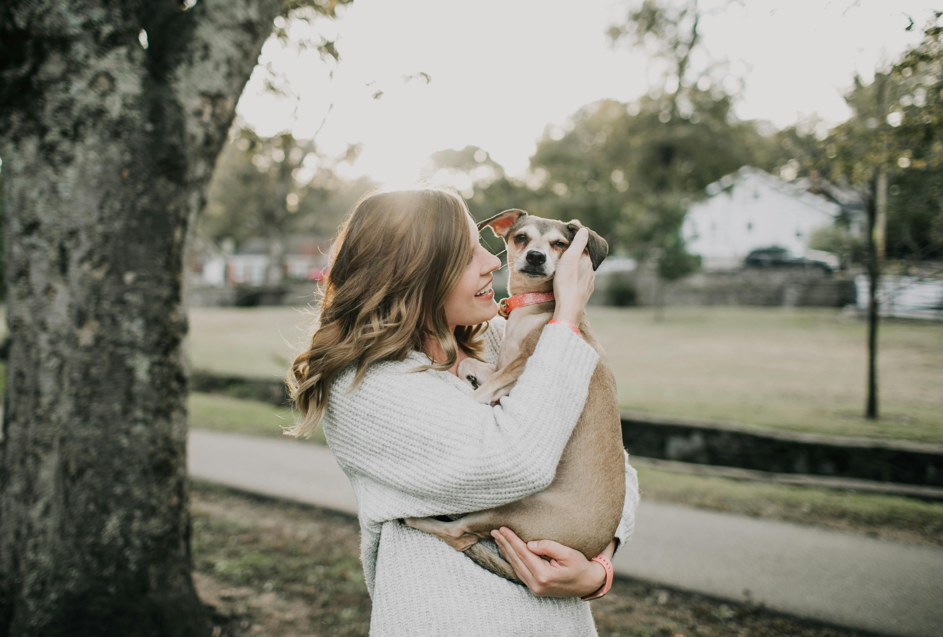
Pawsitive Futures
Presented By
Group No.41
Pratiksha Tambe & Punam Salunkhe

Slide 2
Index
Introduction
Architecture
Technology platform used for project
User roles and responsibilities
Future extensions or scope
ER diagram
DFD level 0 diagram
DFD level 1 diagram
Activity diagram
Screen Shots
Conclusion

Slide 3
Introduction
Pawsitive Futures is a web portal application developed to enhance the pet adoption process, featuring three main modules: User, Shelter, and Admin.
The User Module enables users to browse pet listings, submit adoption applications, and schedule appointments through a user-friendly interface.
The Shelter Module allows shelters to efficiently manage pet listings, track applications, and coordinate appointments.
The Admin Module provides comprehensive oversight of the platform, ensuring smooth operations and effective data management.
The system includes secure payment processing for adoption fees. The application is developed using Spring Boot for backend services, React for the frontend, and MySQL for data management, ensuring a dynamic and effective user experience.

Slide 4
Architecture
Backend (Spring boot):-Spring Boot is used to create a RESTful API that handles the business logic and data management for the application. It manages operations like user authentication, pet data retrieval, adoption request processing, and database interactions.
Frontend (React): React is used to build the user interface. It interacts with the Spring Boot backend through API calls. The frontend handles rendering the pet listings, forms for adoption requests, and user interactions.

Slide 5
Technology platform used for project
Spring boot:-For backend development, including RESTful APIs and database management.
React:-React is used for building responsive and interactive user interface.
MySQL database:-MySQL is used for storing user details, pet details, adoption requests, appointment details.

Slide 6



User roles and responsibilities
User
Admin
Shelter
A user is a visitor interested in adopting a pet. They can browse and search available pets, view detailed profiles, submit adoption requests, and manage their personal information and saved pets while tracking the status of their adoption requests.
The admin manages the platform, ensuring smooth operations and data integrity. They handle user accounts, moderate content, maintain system performance.
A shelter manages pet listings and the adoption process, creating profiles with detailed information, reviewing adoption requests, and updating pet statuses. They also communicate with potential adopters to provide information and arrange visits.

Slide 7
Future extensions or scope
Mobile App:
- Develop a mobile version of the application.
Advanced Search:
- Add more filters and sorting options for pet searches.
Notifications:
- Implement real-time notifications for adoption status updates.

Slide 8
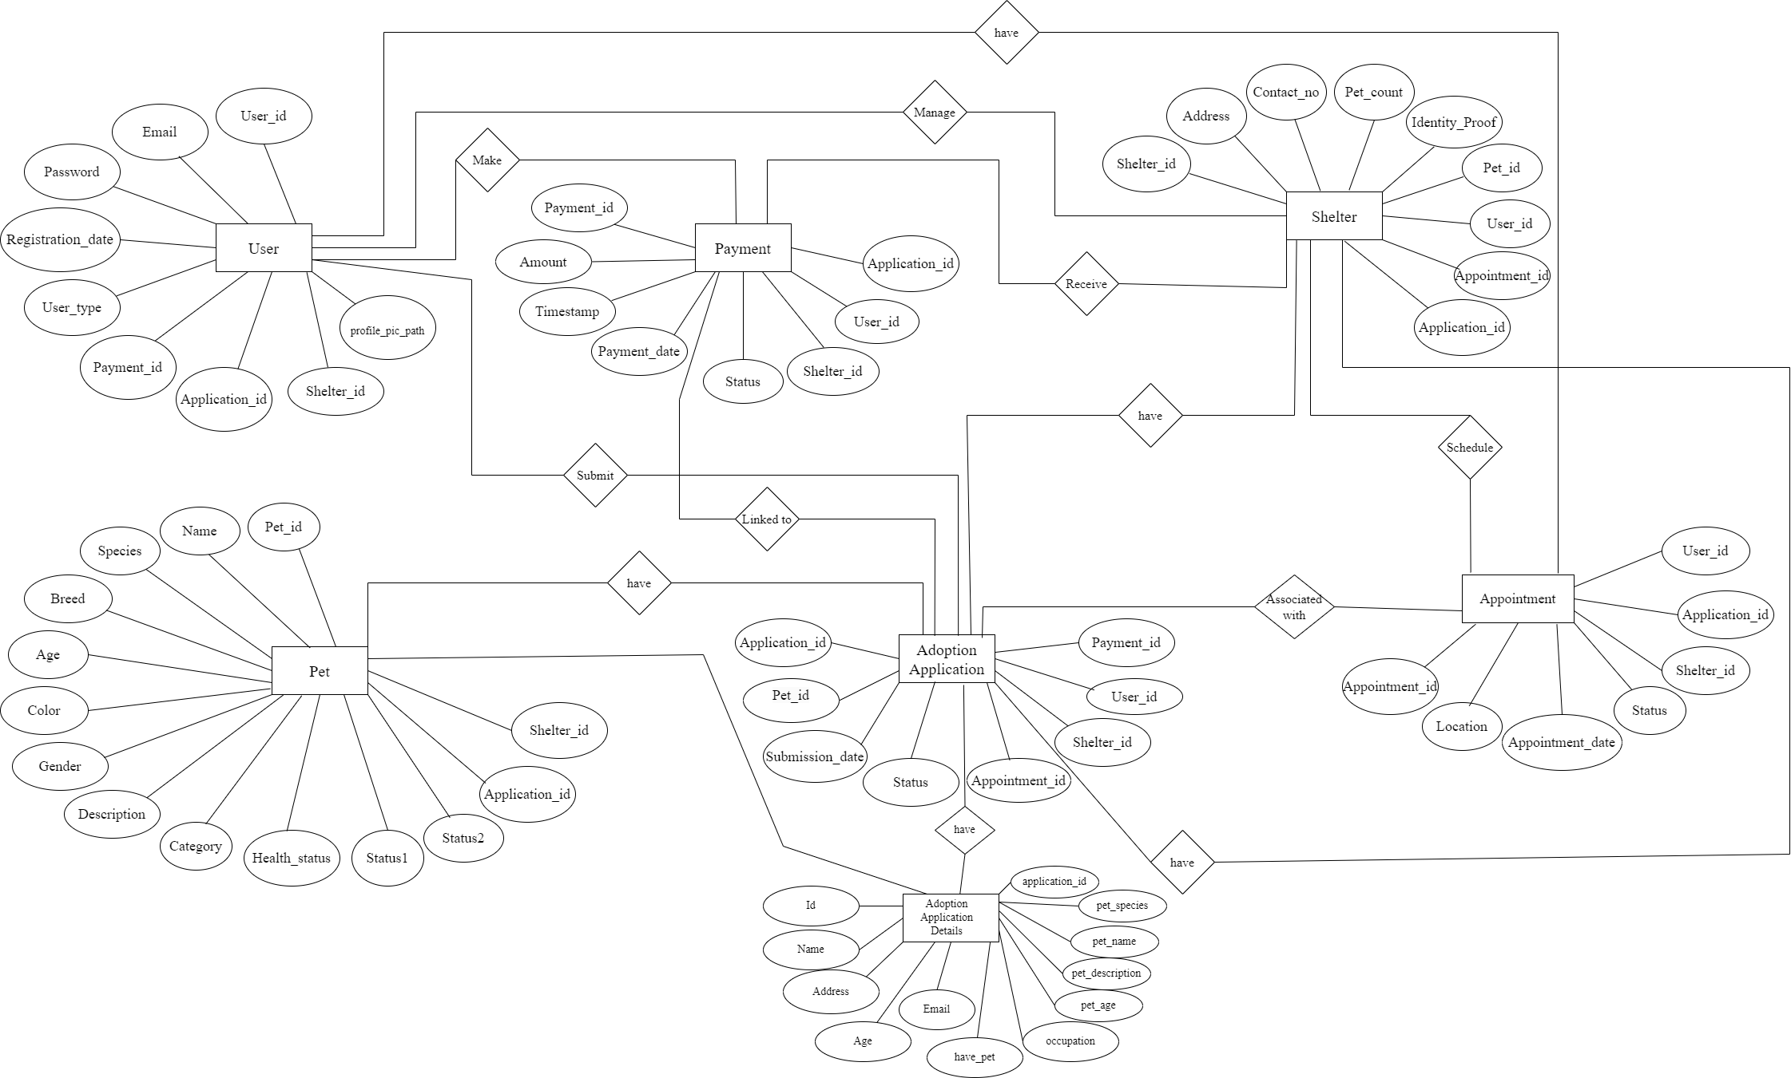
ER diagram

Slide 9
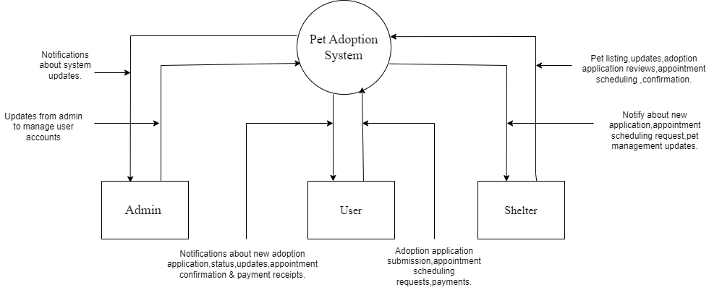
DFD level 0 diagram

Slide 10
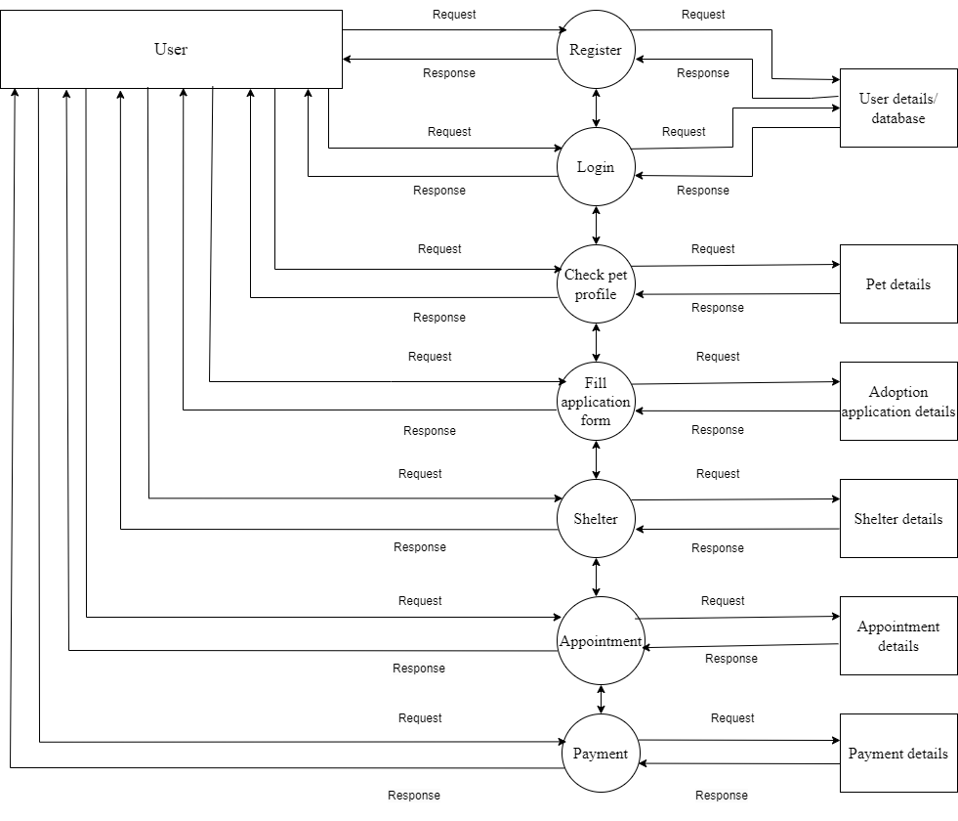
DFD level 1 diagram

Slide 11
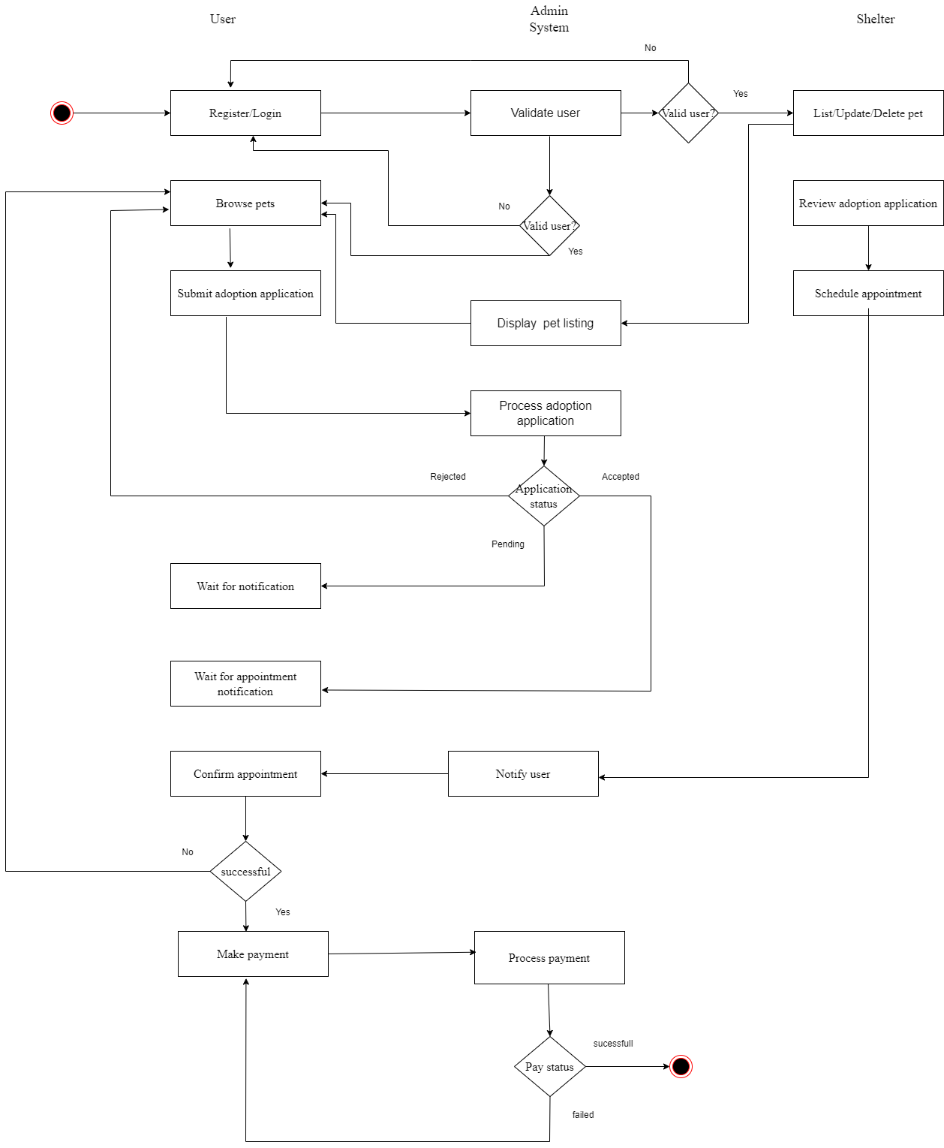
Activity diagram

Slide 12
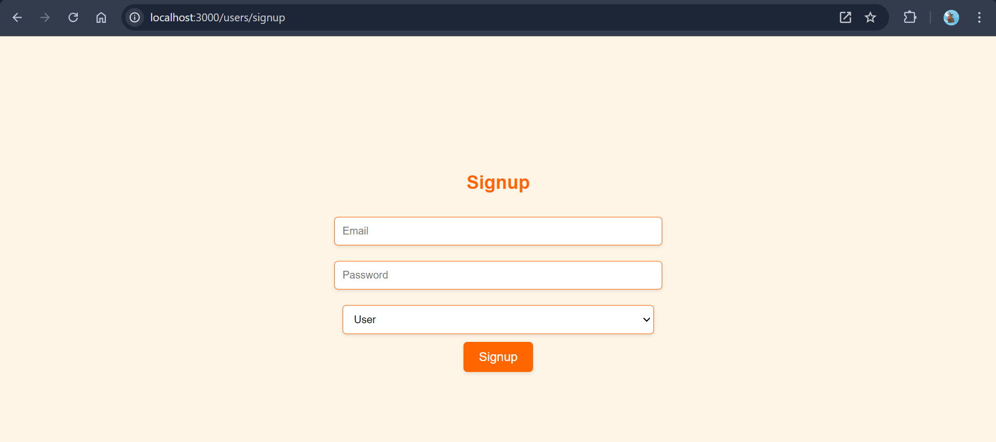
Screen Shots

Slide 13
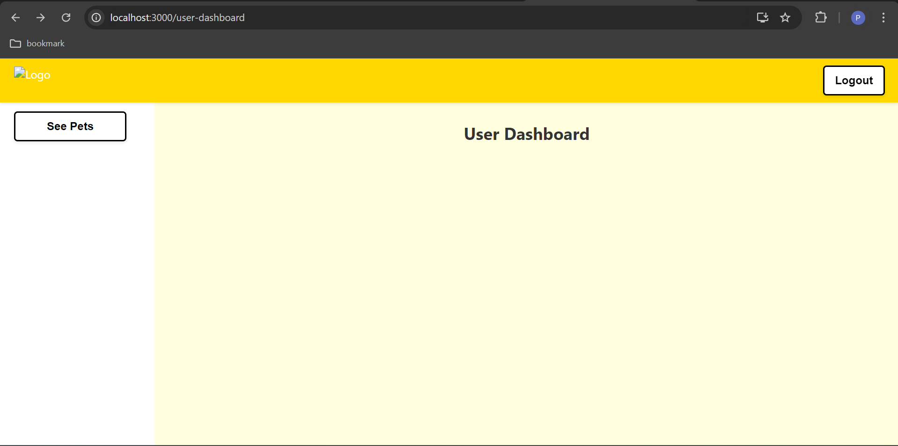

Slide 14
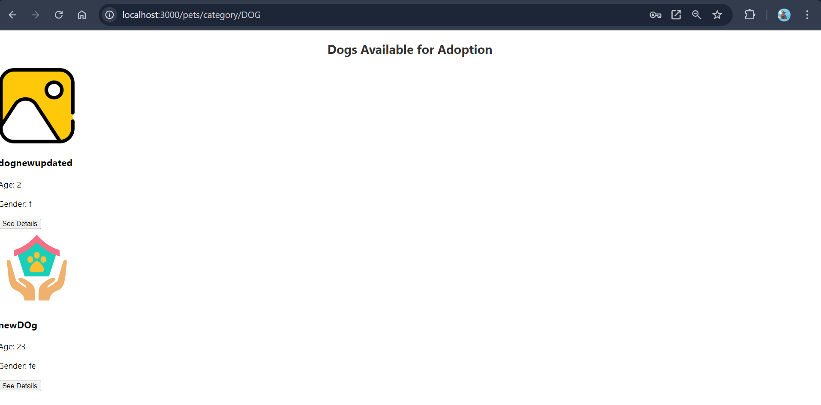

Slide 15
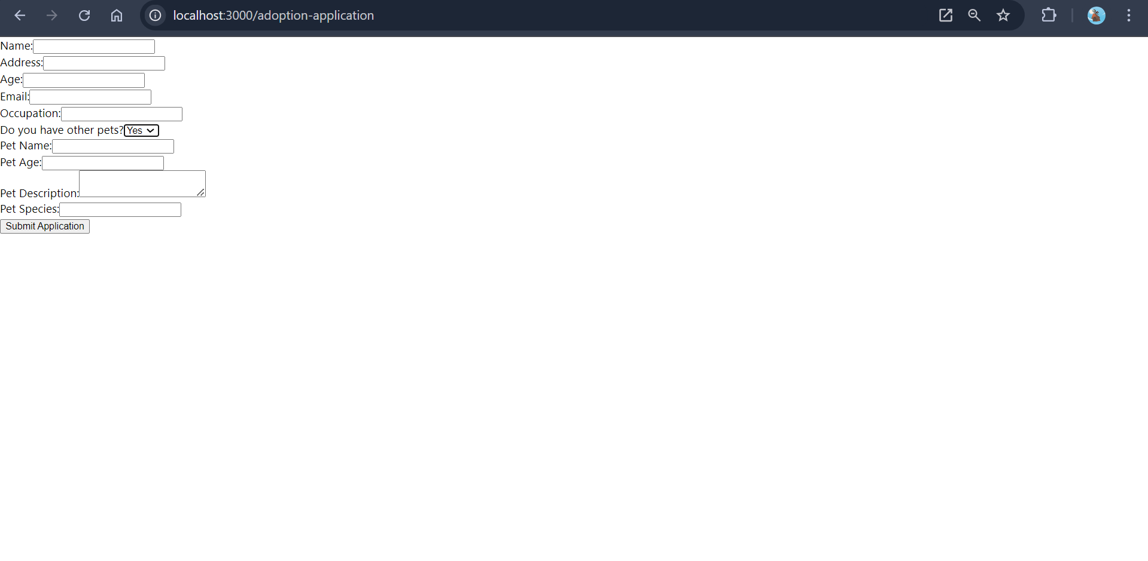

Slide 16
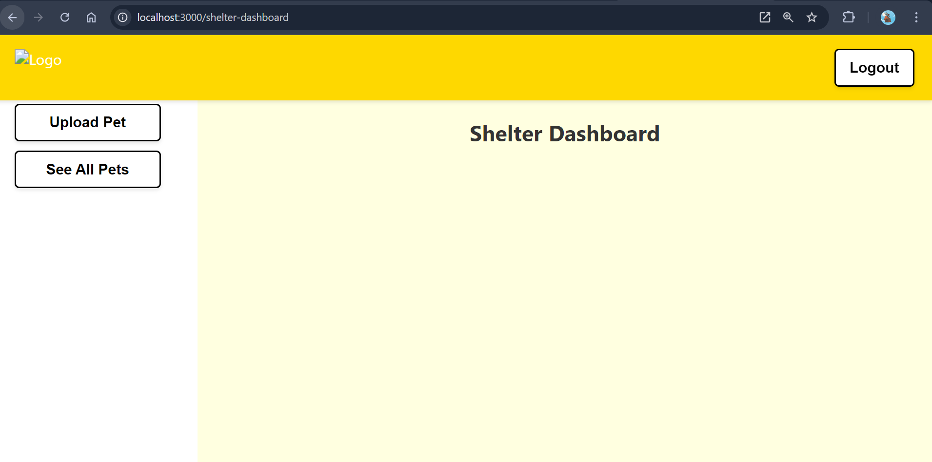

Slide 17
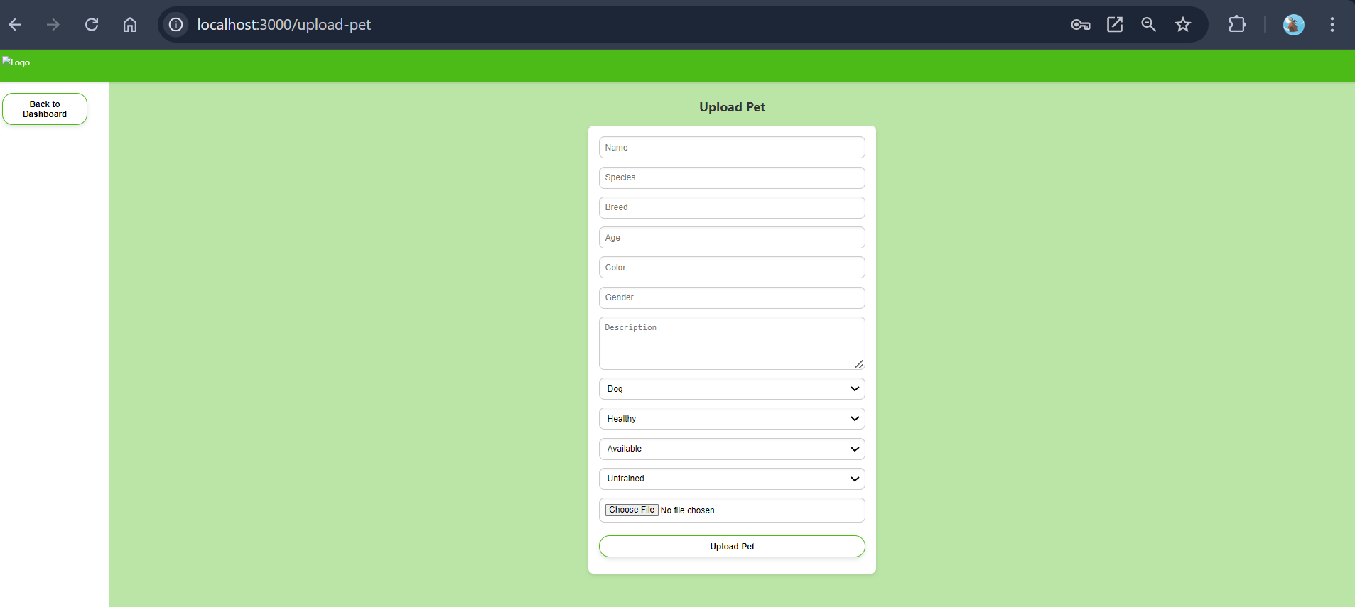

Slide 18
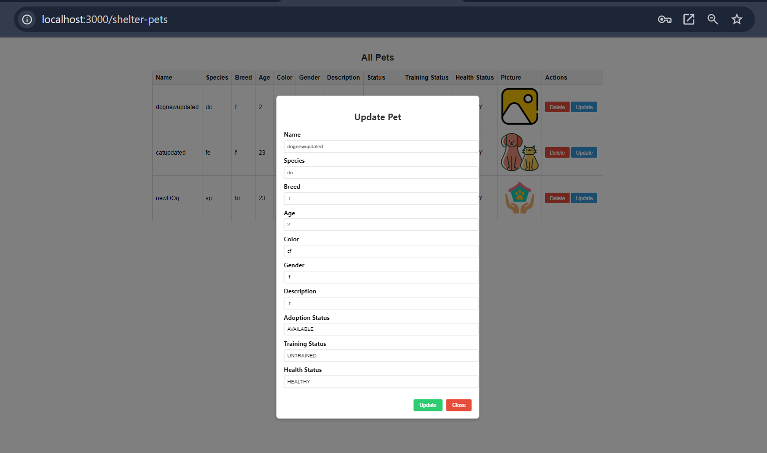

Slide 19
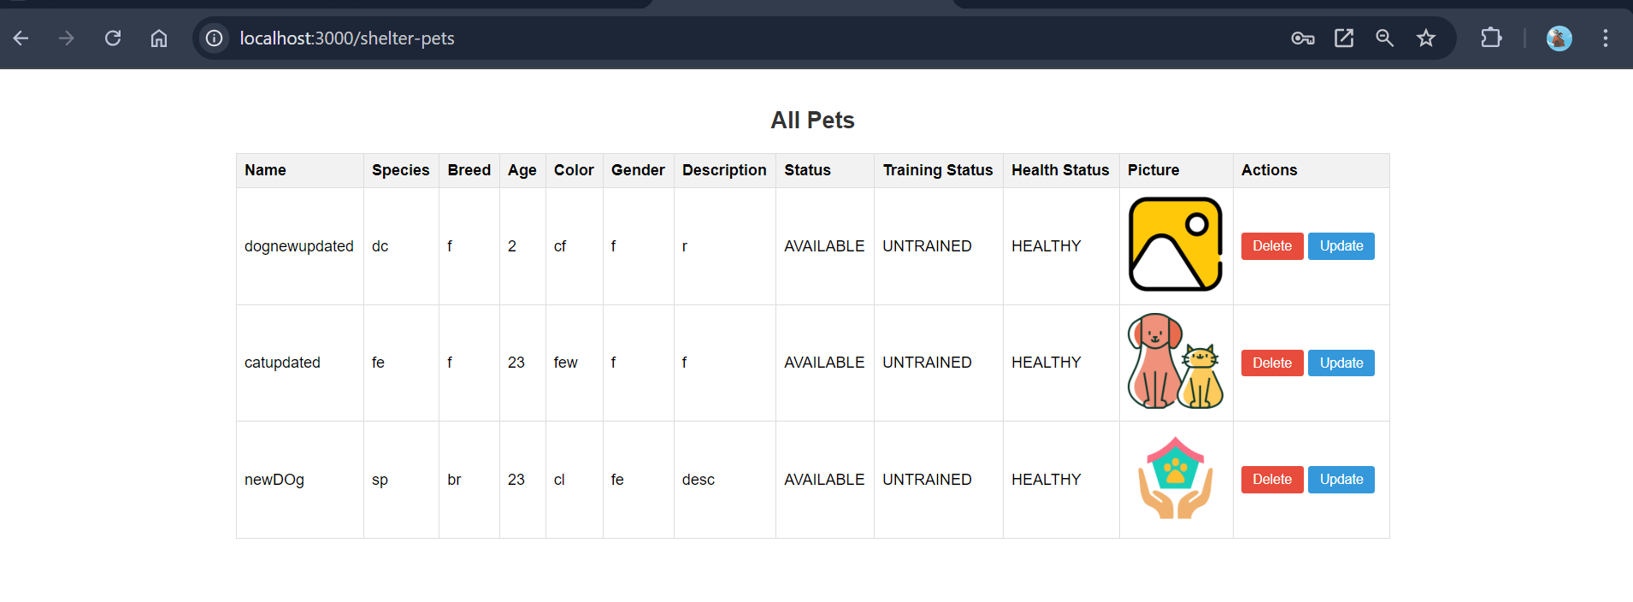

Slide 20
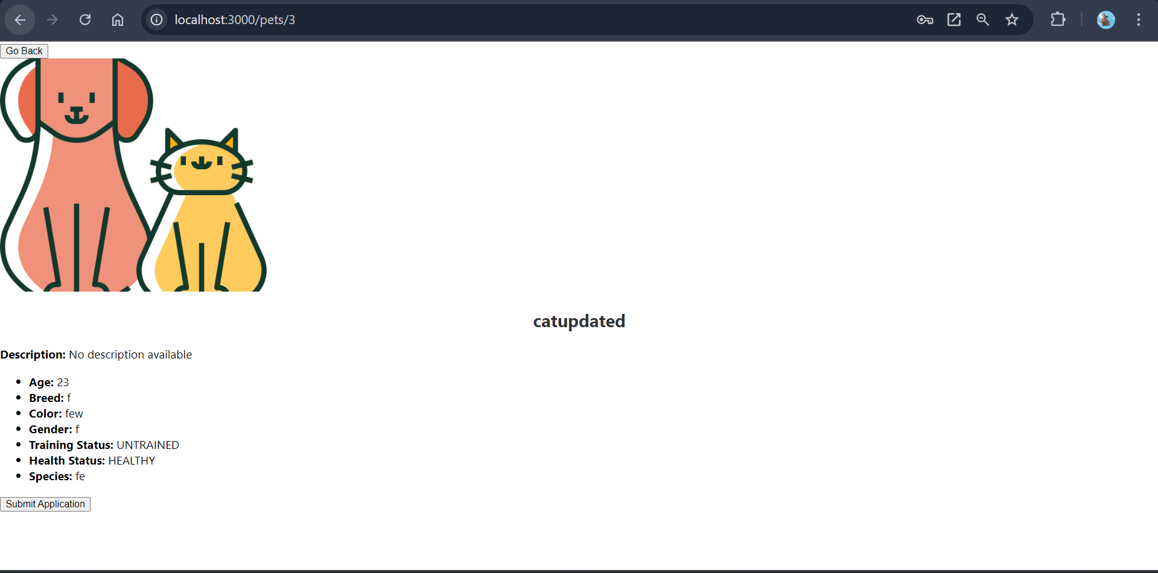

Slide 21
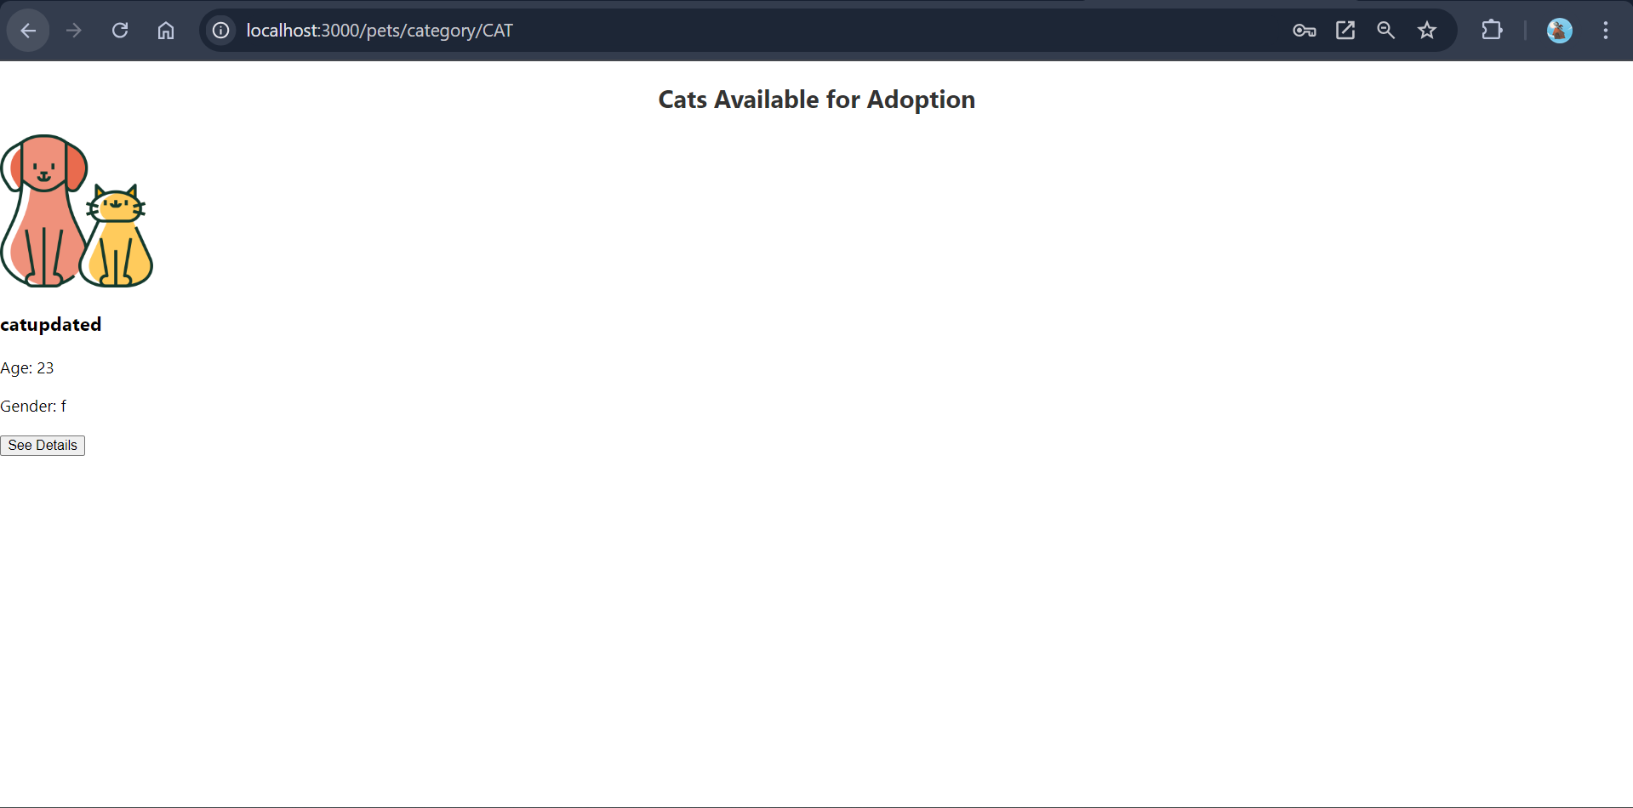

Slide 22
Conclusion
The Pet Adoption Project successfully connected many animals with caring families, increasing adoption rates and making the process easier. Through community efforts and partnerships with shelters, we helped create lasting bonds between pets and their new owners. Continued support will be key to helping more animals find their forever homes.

Slide 23
Thank You

