Slide 1

IMAGE-BASED AGE AND GENDER CLASSIFICATION WITH CONVOLUTIONAL NEURAL NETWORKS (CNN)
Group Members:
Akshay Potdar (220960925036)
Pranita Dibe (220960925037)
Pratiksha Salunke (220960925038)
Punawesh Sawant (220960925039)
Tushar Salve (220960925040)

Slide 2
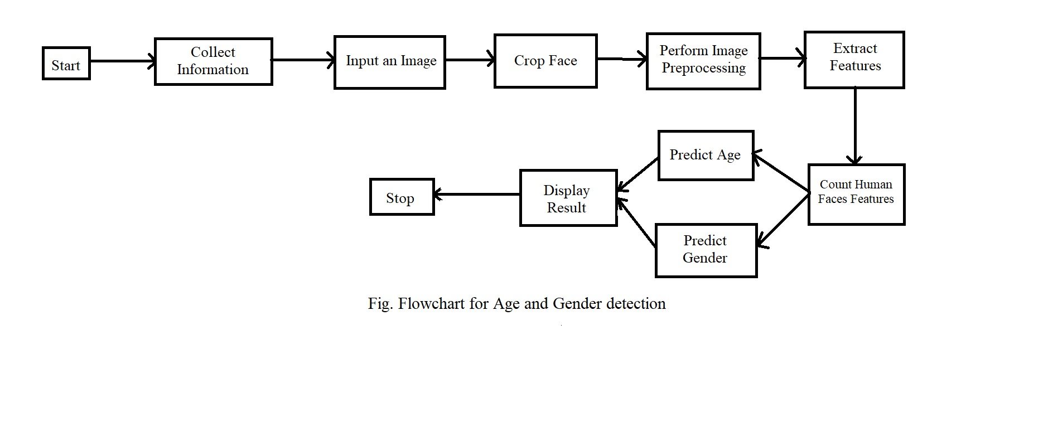
Block Diagram

Slide 3
Project Description
We used Adience dataset for age and gender classification.
We have implemented pandas, NumPy, Matplotlib, Keras, Tensorflow, Scikit-learn libraries.
Training & Testing. For age classification, our model classifies ages into 8 groups.
Similarly, gender also had to be one hot encoded for gender classification into male,female and undefined.
Trained CNN (Convolutional Neural Networks) using Adience dataset for age and gender prediction.
Created OpenCV deep learning module to perform age and gender detection.

Slide 4
Dataset
Dataset Name - Adience Benchmark Gender And Age Classification
user_id - the folder in the dataset containing the image.
original_image - image name in the dataset.
face_id - the Face ID in the original image, can be ignored.
age - age label of the face.
gender - gender label of the face.
x, y, dx, dy - bounding box of the face in the original image, can be ignored.
tilt_ang, fiducial_yaw_angle - pose of the face in the original image, can be ignored.
fiducial_score - score of the landmark detector, can be ignored.
l

Slide 5
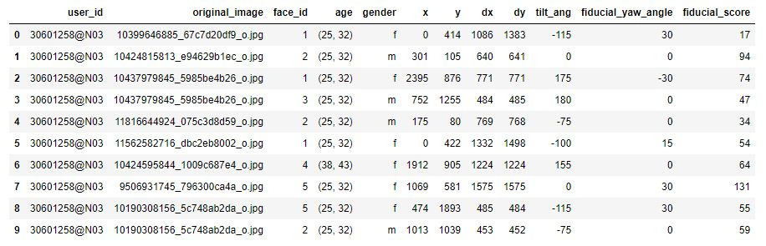
Dataset

Slide 6
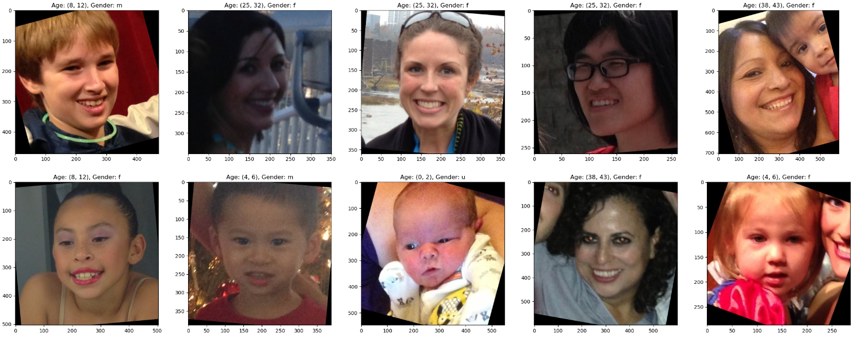
Dataset

Slide 7
Steps of Project
A) Preprocessing Data
[1] Exploratory Data Analysis
a) visualization of data using pie-chart
gender chart
age chart
b) treating missing values
checking null values
dropping null values
[2] mapping
a) age mapping
b) gender mapping
[3] setting target variable
[4] splitting the data into training and testing

Slide 8
b) Feature Extraction stage
Reading the images
Decode JPEG content into an RGB grid of pixels.
Converting into Floating points tensors taking input to neural network
Training and Validation of batches

Slide 9
c) Model creation
layers
convolutional layers
activation layer
max-pooling layer
dropout layer
Flatten layer
Dense layer

Slide 10
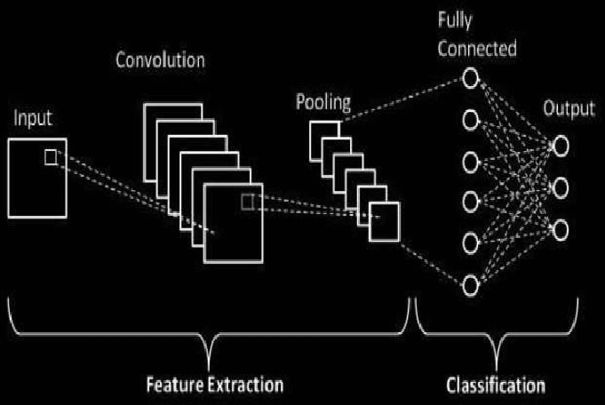
Flowchart Of Model

Slide 11
Model Evaluation measures
calculating scores for Age
accuracy
loss
validation accuracy
validation loss
calculating accuracy score of gender
accuracy
loss
validation accuracy
validation loss

Slide 12
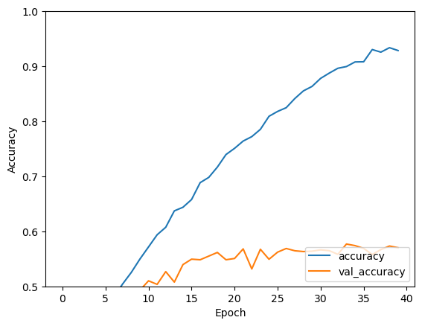
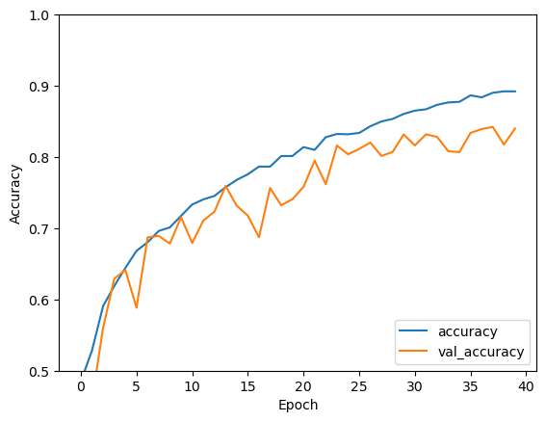
Accuracy Charts
Age Accuracy
Gender Accuracy

Slide 13
Challenges Faced
difficulties while building model
requires heavy processing power
initially facing low validation accuracy for age
difficulties in predicting gender properly

Slide 14
References
[1] Dataset -https://www.kaggle.com/datasets/ttungl/adience-benchmark-gender-and-age-classification
[2] Abhijit Das, Antitza Dantcheva and Francois Bremond Mitigating Bias in Gender, Age and Ethnicity classification.
Link:
https://www.researchgate.net/publication/328031032_Mitigating_Bias_in_Gender_Age_and_Ethnicity_Classification_a_Multi-Task_Convolution_Neural_Network_Approach
[3] Philip Smith, Cuixian Chen Transfer Learning with Deep CNNs for Gender Recognition and Age Estimation.
Link:
https://arxiv.org/pdf/1811.07344.pdf
[4] Sepidehsadat Hosseini, Seok Hee Lee, Hyuk Jin Kwon, Hyung Ii Koo and Nam Ik Cho Age and Gender Classification Using Wide Convolutional Neural Network and Gabor Filter.
Link:
https://www.researchgate.net/publication/325495265_Age_and_gender_classification_using_wid_convolutional_neur%20al_network_and_Gabor_filter

Slide 15
THANK YOU

