Slide 1
Data Visualization with Python
Pankaj Pandey
&
Puneeth Chaganti
Notes:
[toc]
level = 1
title = Interactive Plotting with Chaco
# end config

Slide 2
Demos

Slide 3
Talk outline
What and Why
First-plot
  Step by step code explanation
  A short detour into Traits & TraitsUI
An overview of Chaco's architecture
  Commonly used models and classes
More examples

Slide 4
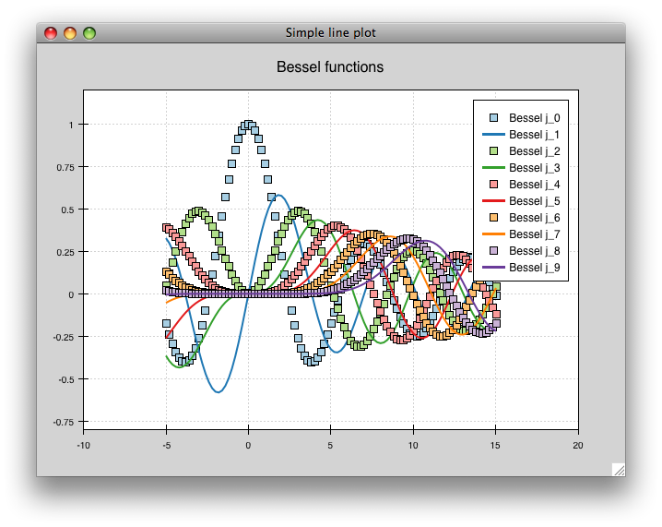
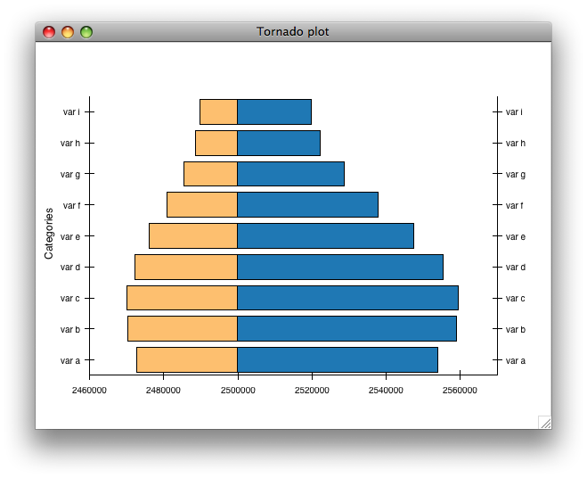
What is Chaco?
A plotting application toolkit for Python
You can build simple, static plots
But, really shines in interactive plotting

Slide 5
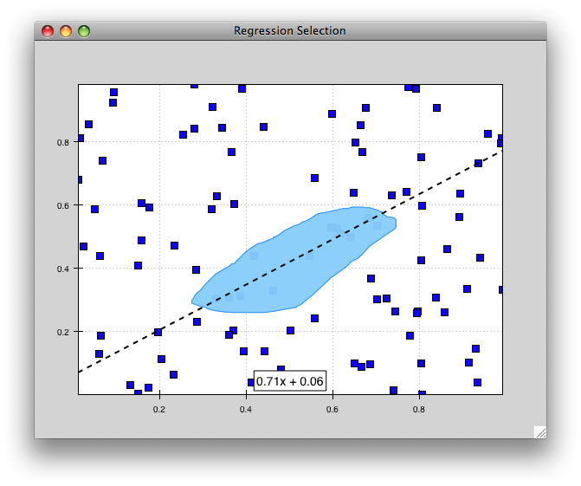
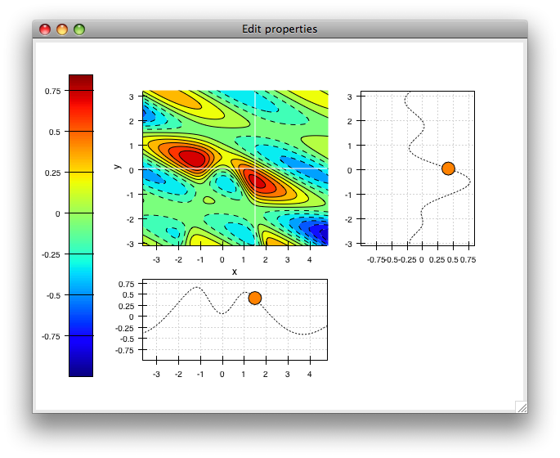
Why Chaco?
Plots update live as data changes
Linked plots
Extensible architecture
GUI toolkit agnostic

Slide 6
Shell mode
from numpy import *
from chaco.shell import *
x = linspace(-2*pi, 2*pi, 100)
y = sin(x)
plot(x, y, 'r-')
title('First plot')
ytitle('sin(x)')
show()

Slide 7
First Plot
class LinePlot(HasTraits):
plot = Instance(Plot)
traits_view = View(
Item('plot',editor=ComponentEditor(), show_label=False),
width=500, height=500,
resizable=True,
title="Chaco Plot")
def _plot_default (self):
x = linspace(-14, 14, 100)
y = sin(x) * x**3
plotdata = ArrayPlotData(x = x, y = y)
plot = Plot(plotdata)
plot.plot(("x", "y"), type="line", color="blue")
plot.title = "sin(x) * x^3"
return plot
if __name__ == "__main__":
LinePlot().configure_traits()

Slide 8
Traits & TraitsUI
Standardization
  Initialization
  Validation
  Delegation
Visualization (TraitsUI)
Notification
Documentation

Slide 9
Architecture Overview
Core Ideas
Plots are compositions of visual components
Separation between data and screen space
Modular design and extensible classes

Slide 10
Architecture Overview
Chaco
Graphics
User input & control
Kiva
Enable

Slide 11
Architecture Overview
From 20000 ft., Chaco consists of –
  Data handling classes – wrap input data, interface with application specific data sources, transform co-ordinates between data and screen space (eg., ArrayDataSource, LinearMapper)
  Visual components – render to the screen (eg. LinePlot, ScatterPlot, Legend, PlotAxis, …)
  Tools – handle keyboard or mouse events and modify other components (eg., PanTool, ZoomTool, ScatterInspector)

Slide 12
Architecture Overview
Commonly used Modules and Classes
Data Source
ArrayDataSource
DataContextDataSource
GridDataSource
ImageData
MultiArrayDataSource
PointDataSource
Data
Data Range
data_changed
bounds_changed
metadata_changed
Mapper
BaseDataRange
DataRange1D
DataRange2D
Base1DMapper
LinearMapper
LogMapper
GridMapper
PolarMapper
Screen Space
Data Objects

Slide 13
Architecture Overview
Commonly used Modules and Classes
Data Source
ArrayDataSource
DataContextDataSource
GridDataSource
ImageData
MultiArrayDataSource
PointDataSource
Data
Data Range
data_changed
bounds_changed
metadata_changed
Mapper
BaseDataRange
DataRange1D
DataRange2D
Base1DMapper
LinearMapper
LogMapper
GridMapper
PolarMapper
Screen Space
Data Objects

Slide 14
Architecture Overview
→ Make a list of examples that you plan to cover in extra time
→ Look for good exercises
→ Finish arch. Overview
→ Put in a few examples of mlab?

Slide 15
Thank You!

