Slide 1

EXECUTIVE RESEARCH BRIEF
Dr. Puntita Sae-Jia
Interactive Profile
Lecturer in Mathematics Education
School of Science, Walailak University • Ph.D. in Mathematics
Convex Bilevel Optimization
Split Variational Inclusions
Machine Learning & AI
Health Data Analytics
PUBLICATIONS
6
Peer-Reviewed (Q1 Tier)
H-INDEX
3
Scopus / Web of Science
CITATIONS
15
International Citations
Scan to visit online portfolio
and test live application.
Email: puntita.sa@wu.ac.th

Slide 2
THEORETICAL FOUNDATION
Convex Bilevel Optimization & Split Inclusions
Published in Journal of Computational and Applied Mathematics (Volume 488, 117823, May 2026 • Q1 Tier)
1. Convex Bilevel Optimization Model
Outer-Level Problem:
min { φ(x) such that x ∈ Γ }
Inner-Level Problem (Constraint Set Γ):
argmin { f(x) + g(x) over x ∈ H }
Key Properties:
• φ: H → ℝ is strongly convex and differentiable (parameter σ > 0).
• Solves hierarchical inverse decision and machine learning objectives.
• Models high-dimensional regularized sparse recovery.
2. Split Variational Inclusion Problem (SVIP)
Mathematical Formulation:
Find x* ∈ H₁ such that:
0 ∈ (A₁ + B₁)(x*) and 0 ∈ (A₂ + B₂)(Lx*)
Operator Characteristics:
• L: H₁ → H₂ is a bounded linear operator (e.g. system blur matrix).
• A₁, A₂ are inverse-strongly monotone operators.
• B₁, B₂ are maximal monotone operators (non-smooth regularization).
• Eliminates costly precomputation of operator norm ‖L‖.

Slide 3
CORE ALGORITHMIC INNOVATION
Algorithm 8: Double Inertial Viscosity Forward-Backward Scheme
A strongly convergent accelerated splitting framework for convex bilevel and split problems
Algorithm 8: Double Inertial Viscosity Forward-Backward Algorithm (DIVFB)
Initialization: Choose x₁, x₀, x₋₁ ∈ H, λₙ ∈ (0, 1/‖L‖²), {rₙ} ⊂ (0, β], {βₙ} ⊂ (0, 1). Take {ξₙ}, {μₙ} ⊂ (0, ∞) and {ρₙ} ⊂ (-∞, 0).
Iterative Steps: For n ≥ 1, compute xₙ₊₁ via:
• Step 1 (Inertial Steps): θₙ = min { μₙ, ξₙ / ‖xₙ - xₙ₋₁‖ } if xₙ ≠ xₙ₋₁ (else μₙ); δₙ = max { ρₙ, -ξₙ / ‖xₙ₋₁ - xₙ₋₂‖ } if xₙ₋₁ ≠ xₙ₋₂ (else ρₙ)
• Step 2 (Double Inertial Step): wₙ = xₙ + θₙ(xₙ - xₙ₋₁) + δₙ(xₙ₋₁ - xₙ₋₂)
• Step 3 (Forward-Backward Resolvent): yₙ = J_{rₙ}^{A₁, B₁} [ wₙ - λₙ L* (I - J_{rₙ}^{A₂, B₂}) L wₙ ]
• Step 4 (Second Splitting Stage): zₙ = J_{rₙ}^{A₁, B₁} [ yₙ - λₙ L* (I - J_{rₙ}^{A₂, B₂}) L yₙ ]
• Step 5 (Viscosity Approximation): xₙ₊₁ = βₙ F(xₙ) + (1 - βₙ) zₙ
THEORETICAL CONVERGENCE THEOREM:
Under standard control conditions, the sequence {xₙ} generated by Algorithm 8 is mathematically proven to converge STRONGLY to a solution of the convex bilevel and split variational inclusion problem.

Slide 4
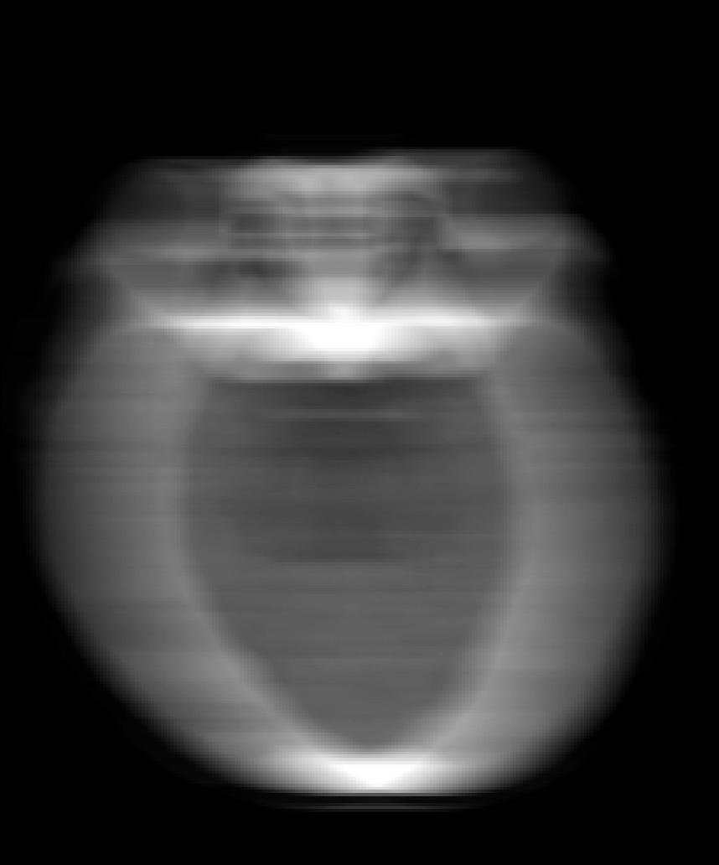
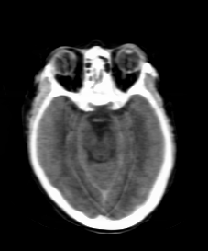
REAL-WORLD MEDICAL IMPACT
Clinical Dataset Classification & Image Restoration
Empirical evaluation proving algorithmic superiority over benchmark first-order methods
1. Hypertension Clinical Dataset
Sriphat Hospital, Chiang Mai (6,108 cases)
2. Medical Image Restoration (Deblurring)
CT Scans, MRI, and Radiology Benchmarks
TEST ACCURACY (TABLE 11)
88.03%
PSNR (TABLE 8)
26.1291
SSIM (TABLE 8)
0.8806
Key Findings & Superiority:
• Achieved 88.03% test accuracy (Table 11).
• Evaluated across multiple comprehensive metrics (Precision, Recall, and F1-Score).
• Exhibited superior diagnostic stability and noise robustness compared to existing BiG-SAM baselines.
➔
Blurred Input
Restored (Algo 9)

Slide 5
HEALTHCARE DIGITAL TRANSLATION
Hypertension Predictor Web Application
Translating mathematical modeling and machine learning into operational diagnostic software
Software Innovation & Public Health Screening
• Clinical Decision Support: Predicts hypertension risk levels in seconds based on patient vitals and health indicators.
• Intellectual Property: Registered copyright application pending for predictive diagnostic algorithm.
• Community Integration: Field-tested with Village Health Volunteers (VHVs) in northern public health programs.
• Edge Computing Ready: 100% on-device client processing ensuring strict medical patient data privacy.
• Live Deployment: https://hypertension-webapp-indol.vercel.app
Strategic Value for University Leadership
✓ Academic Excellence: Demonstrates Walailak University's high-caliber research capacity in international Q1 journals.
✓ Interdisciplinary Synergy: Bridges pure mathematics, data science, and clinical medicine to tackle National Health priorities (NCDs).
✓ Grant & Innovation Potential: Strong pipeline for commercialization, national research funding (TSRI / NRCT), and health technology patents.
✓ Educational Leadership: Empowering mathematics students with applied coding, optimization, and AI skills for the modern workforce.

