Slide 1
CAPSTORE

Slide 2
CUSTOMERDETAIL
CUSTOMERID CUSTOMERNAME EMAIL MOBILENO ADDRESS PINCODE
MERCHANTDETAIL
MERCHANTID MERCHANTNAME EMAIL ADDRESS STORENAME MOBILENO MERCHANTRATING MERCHANTFEEDBACK
USER
EMAIL PASSWORD ROLE
CART
CUSTOMERID PRODUCTID PRODUCTQUANTITY PRODUCTPRICE PROMOCODE SOFTDELETE
EMAIL
SENDER RECEIVER SUBJECT BODY
WISHLIST
CUSTOMERID PRODUCTID QUANTITY PRICE
RETURNREQUEST
RETURNID CUSTOMERID PRODUCTID ORDERID REFUNDAMOUNT RETURNSTATUS
OFFER
MERCHANTID OFFERDESCRIPTION PRODUCTID OFFERSTARTDATE OFFERENDDATE DISCOUNTOFFERED SOFTDELETE
ADMINDETAIL
ADMINID ADMINNAME EMAIL MOBILENO
PRODUCTDETAIL
PRODUCTID PRODUCTNAME PRODUCTPRICE PRODUCTQUANTITY DISCOUNTOFFERED PRODUCTCATEGORY PRODUCTTYPE PRODUCTBRAND PRODUCTMODEL PRODUCTFEATURES PRODUCTRATING PRODUCTFEEDBACK
ORDERDETAILS
ORDERID ORDERDATE CUSTOMERID MERCHANTID PRODUCTID PRODUCTQUANTITY TOTALPRICE FINALPRICE
MERCHANTPRODUCT
MERCHANTID PRODUCTID
PROMOS
PROMOCODE DISCOUNTOFFERED PROMOVALIDITY SOFTDELETE
DUMMYORDER
ORDERID

Slide 3
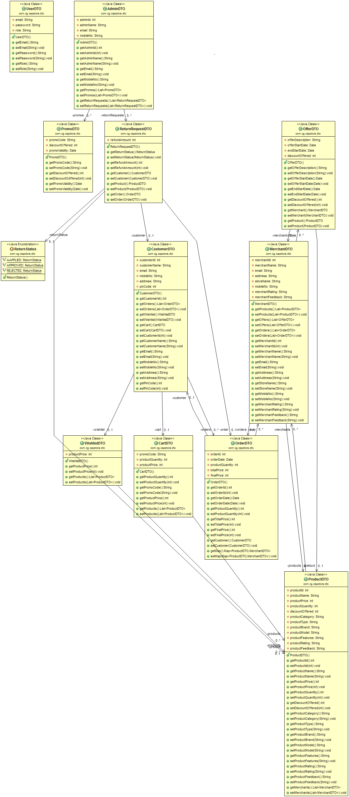

Slide 4
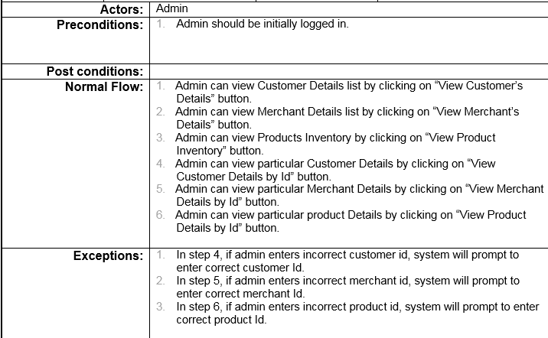
USE CASE FOR ADMIN

Slide 5
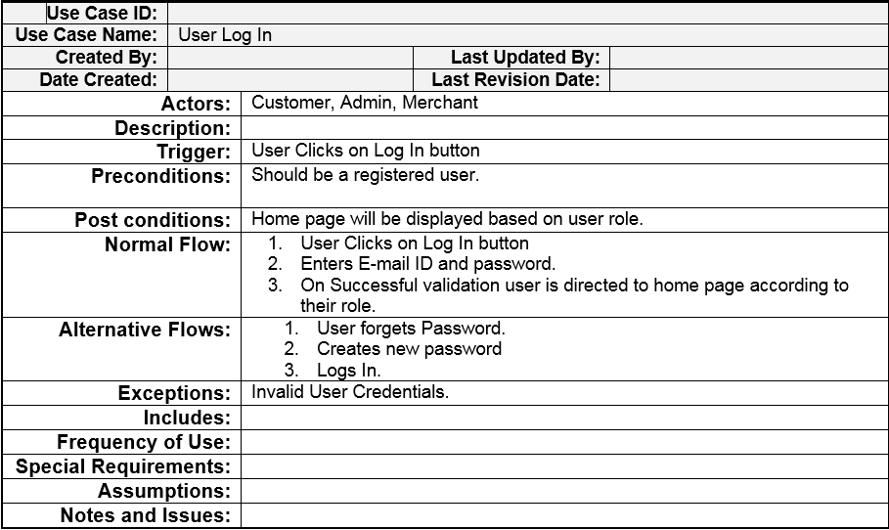
USE CASE FOR LOG-IN

Slide 6
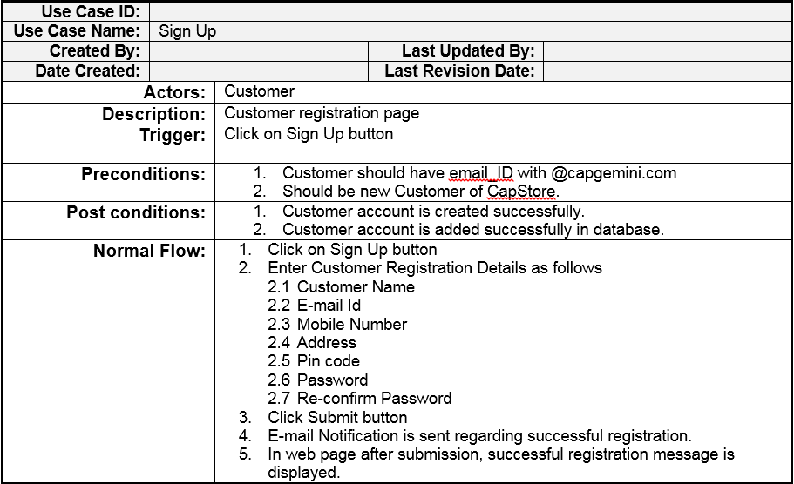
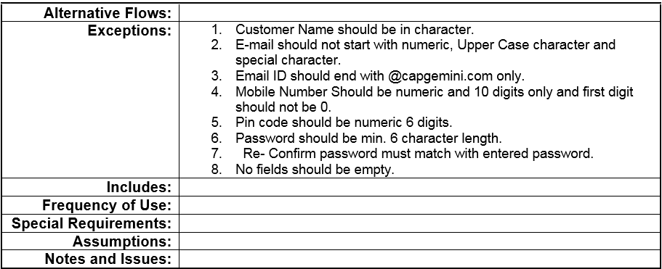
USE CASE FOR SIGN-UP

Slide 7
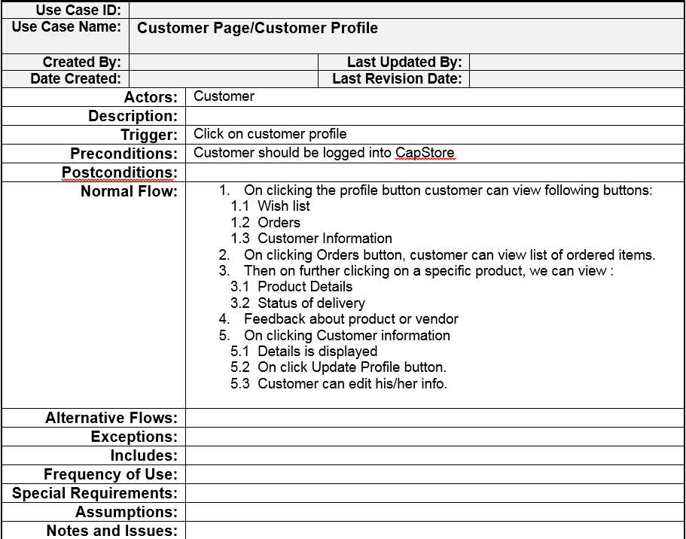
USE CASE FOR CUSTOMER PAGE

Slide 8
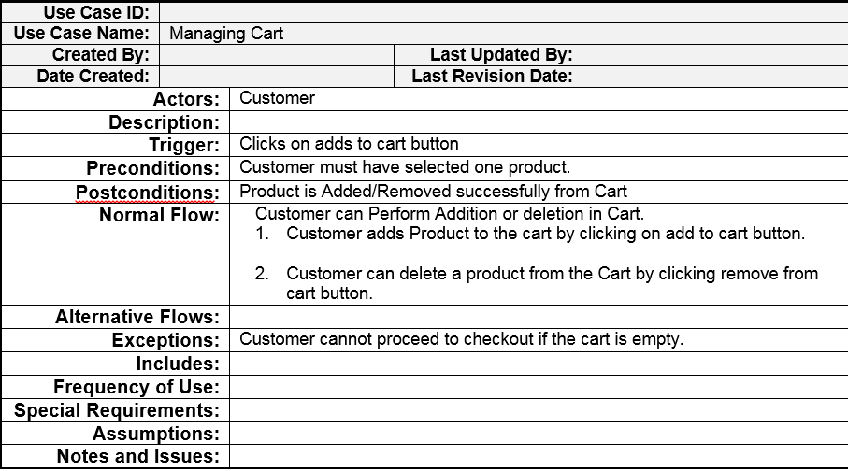
USE CASE FOR CART

Slide 9
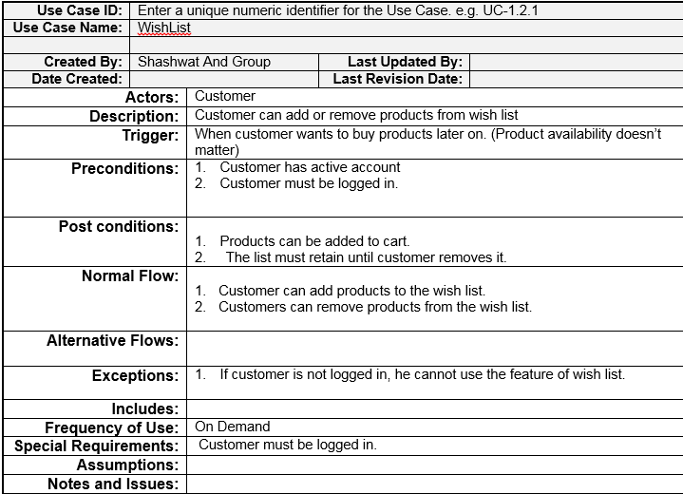
USE CASE FOR WISHLIST

Slide 10
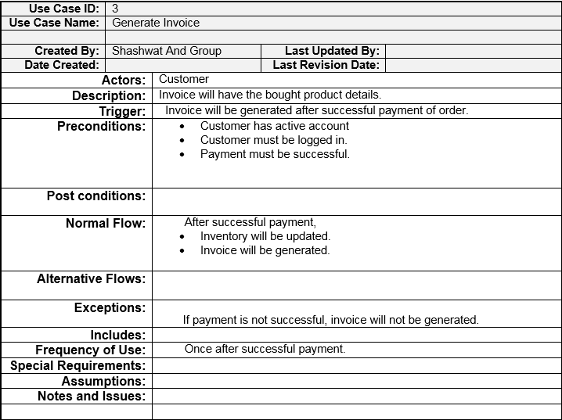
USE CASE FOR INVOICE

Slide 11
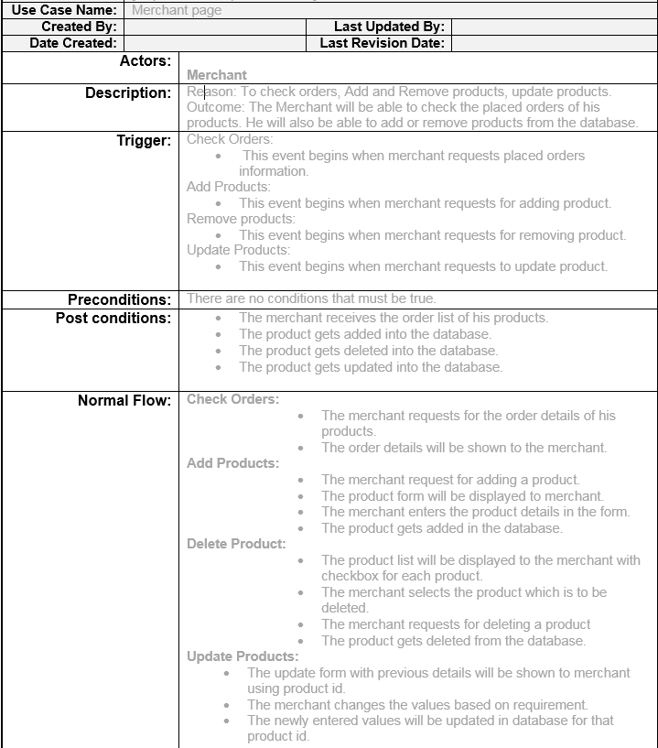
USE CASE FOR MERCHANT

Slide 12

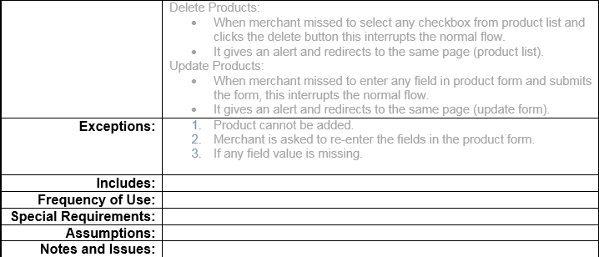

Slide 13
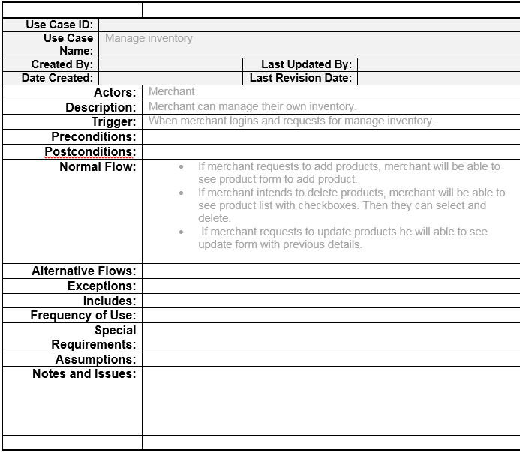
USE CASE FOR INVENTORY

Slide 14
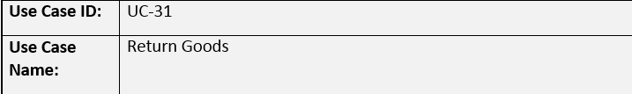
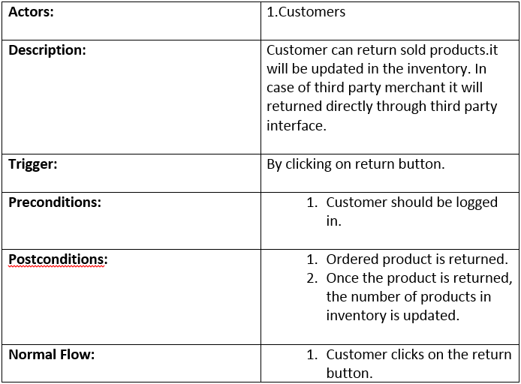
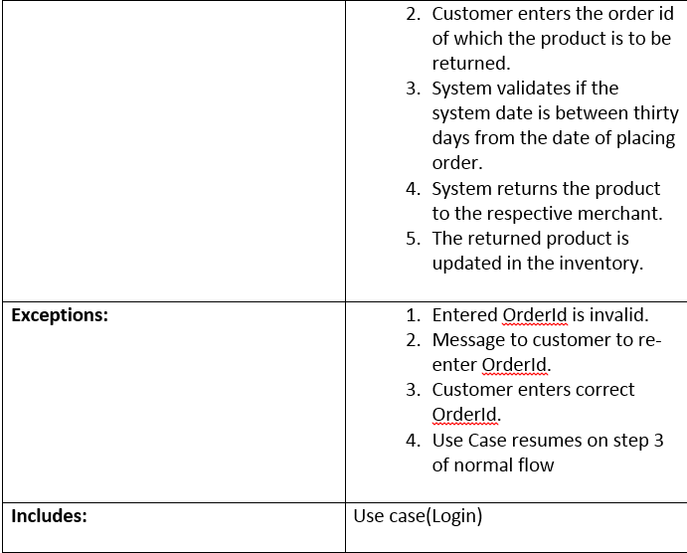
USE CASE FOR RETURN

Slide 15
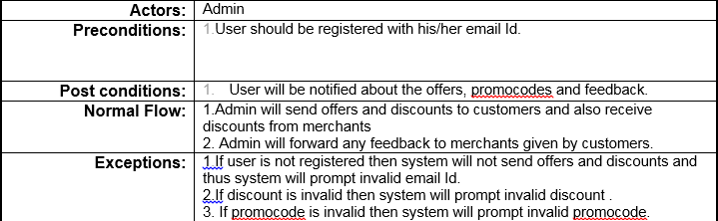
USE CASE FOR EMAIL

Slide 16
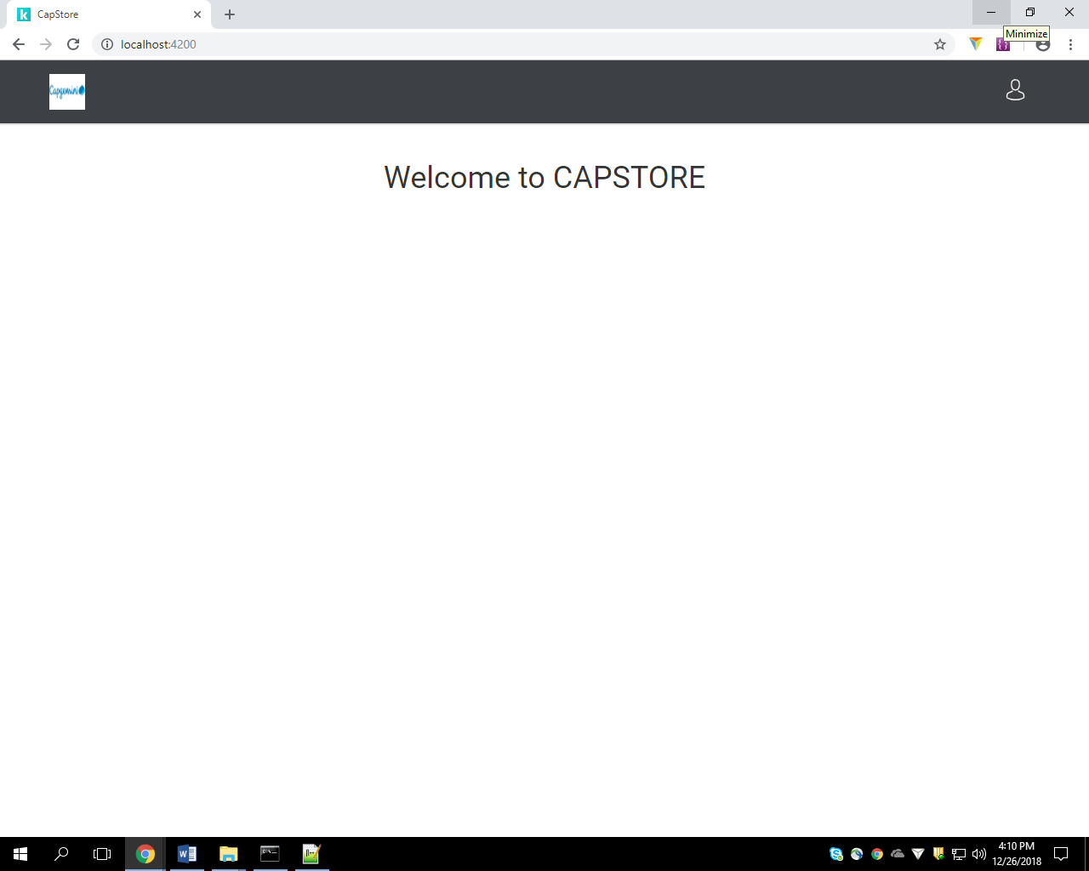
Landing Page

Slide 17
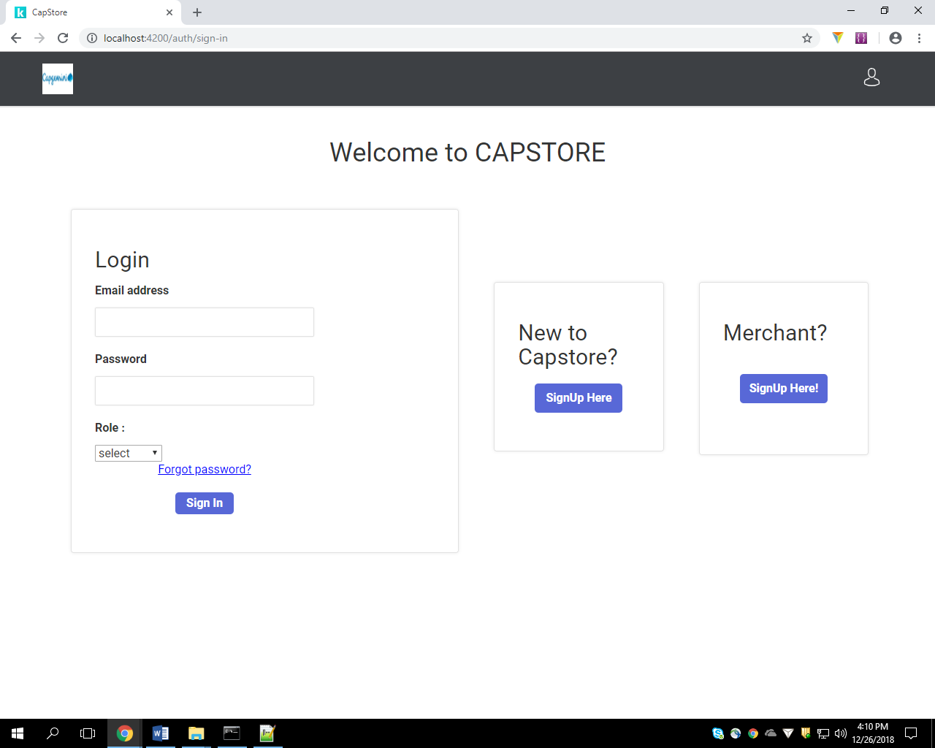
Login/Signup page

Slide 18
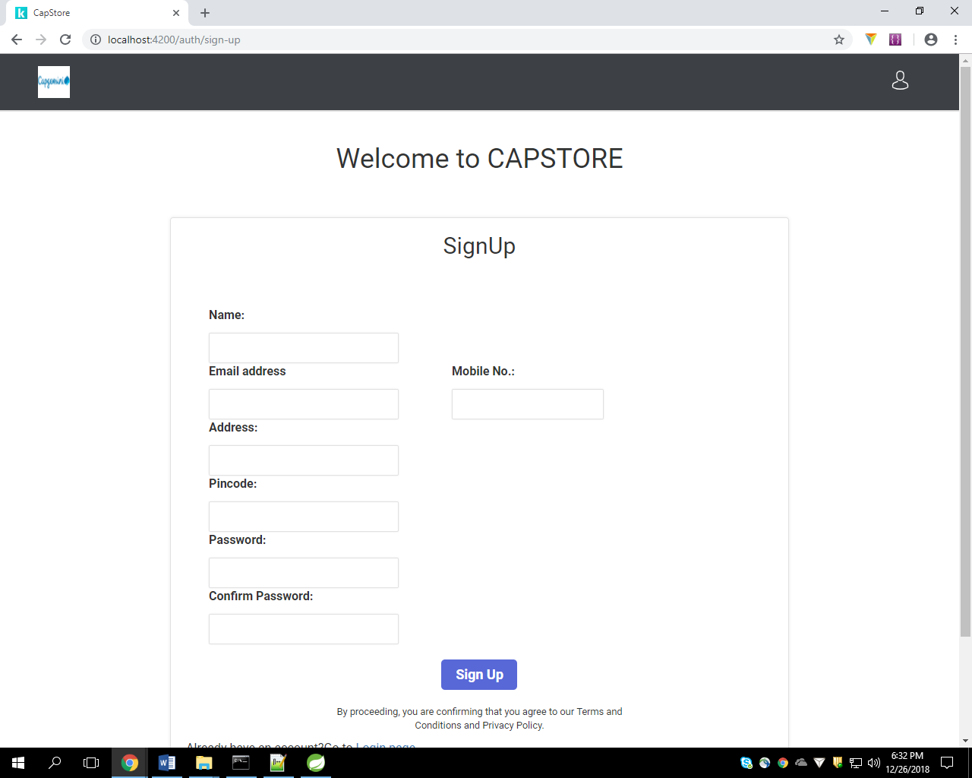
Customer Signup Page

Slide 19
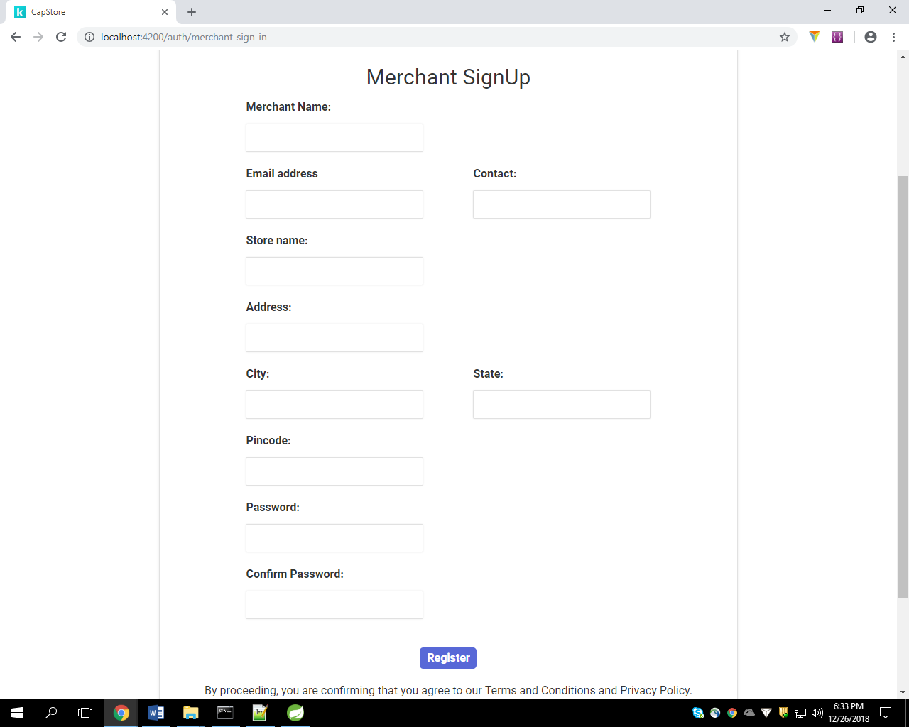
Merchant Signup Page

Slide 20
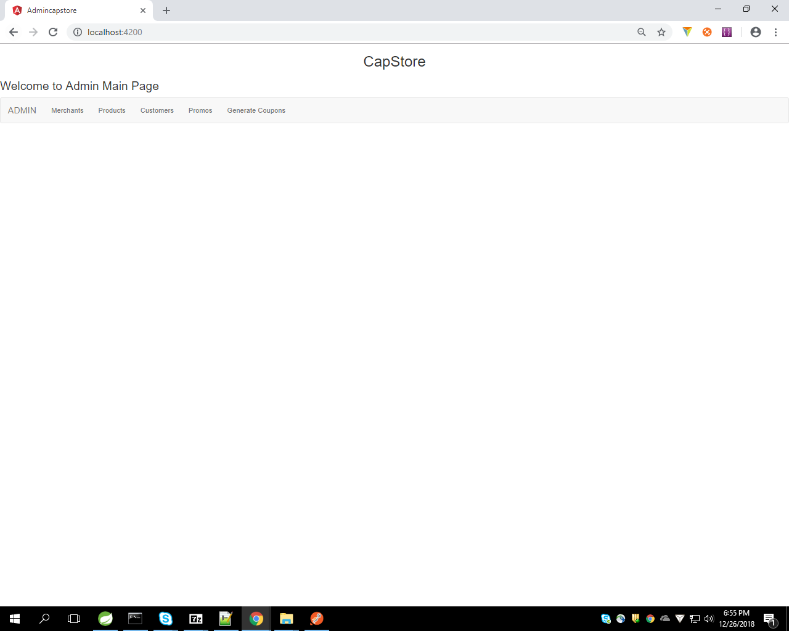
Admin Page

Slide 21
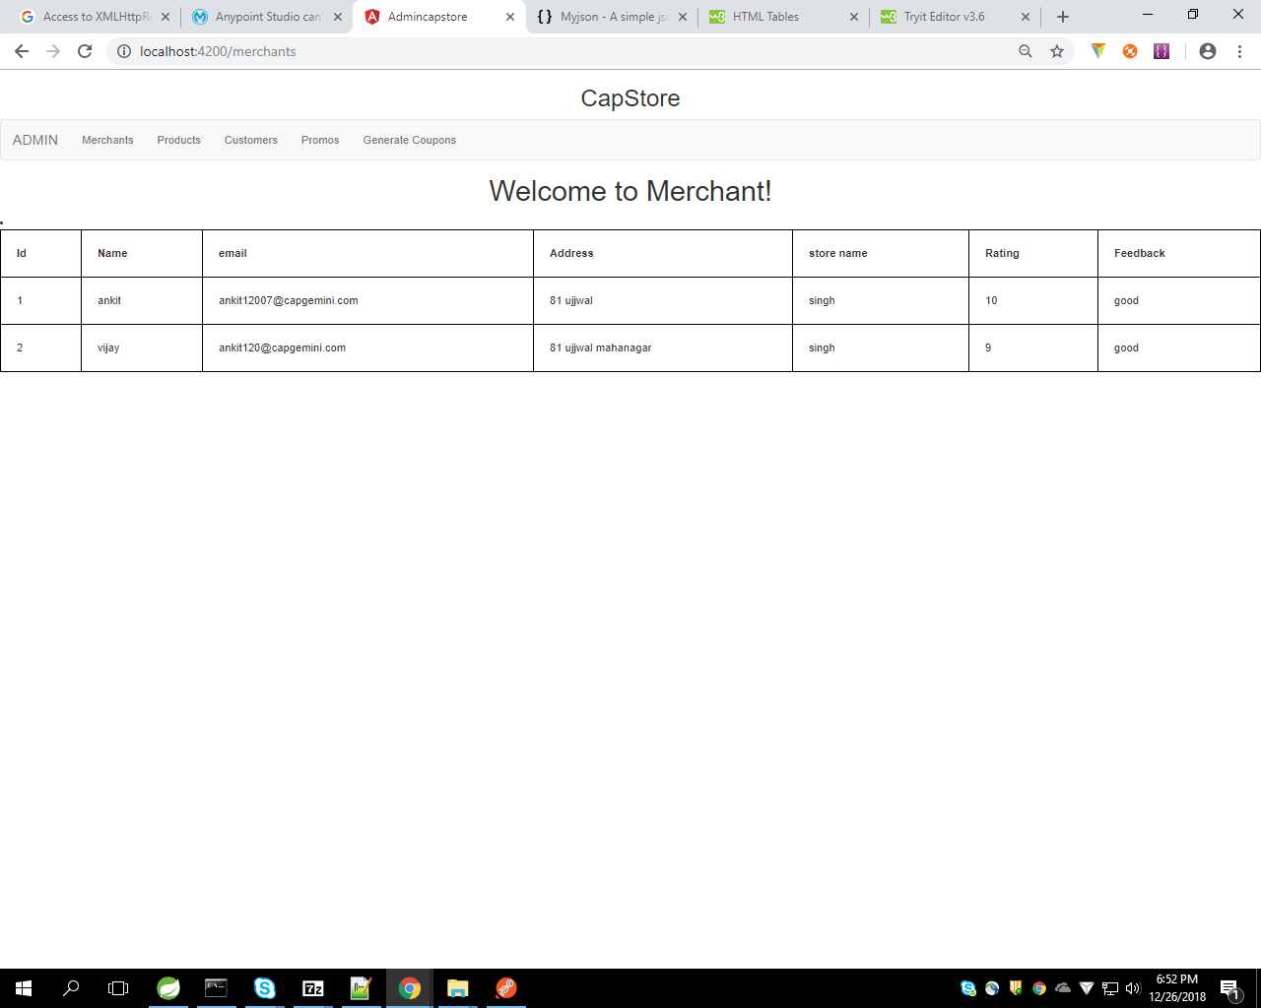

Slide 22
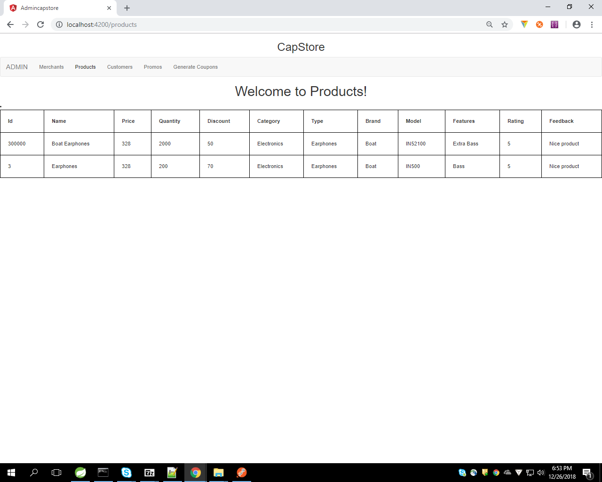

Slide 23
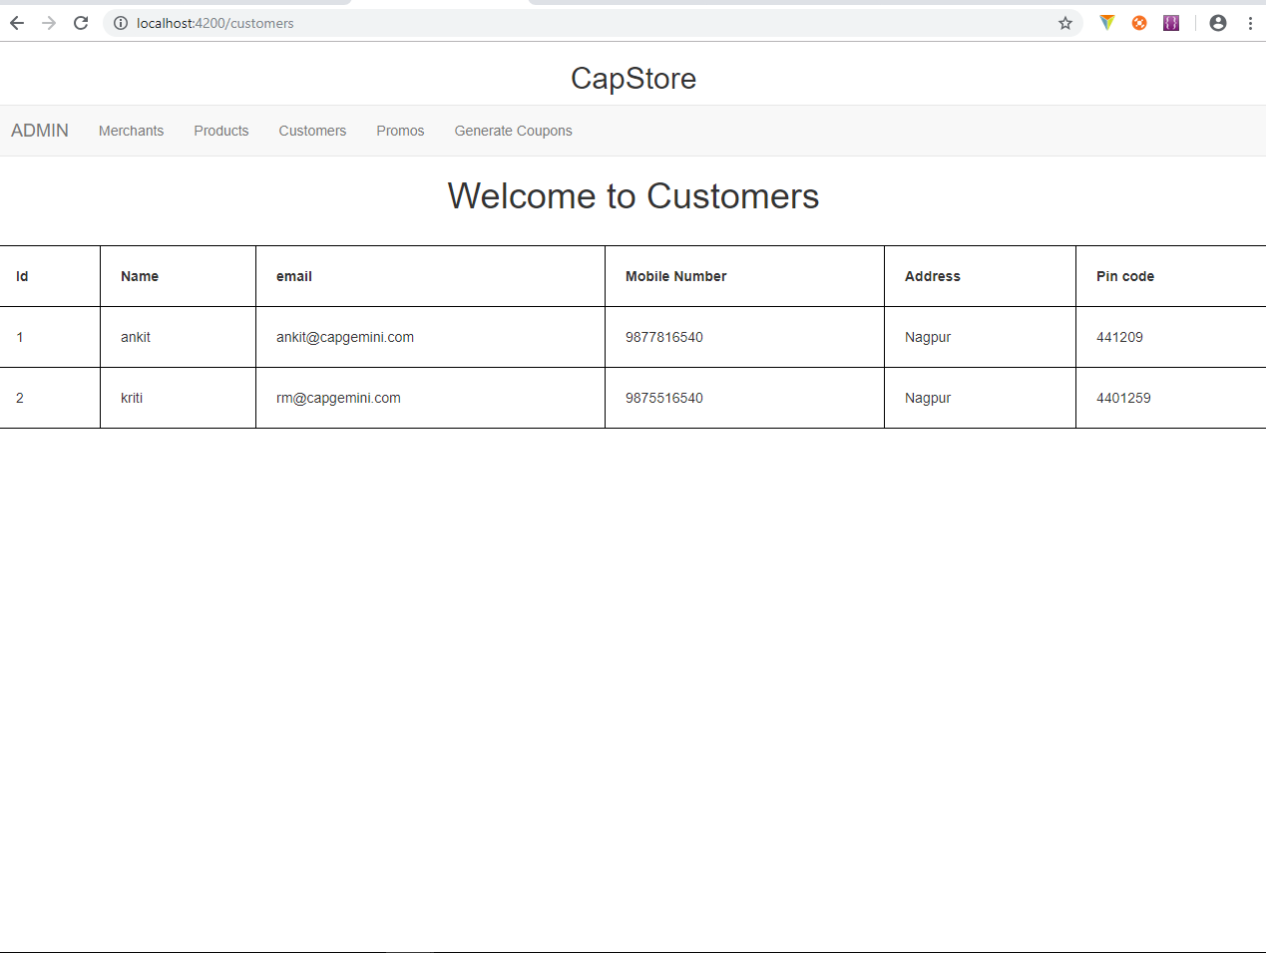

Slide 24
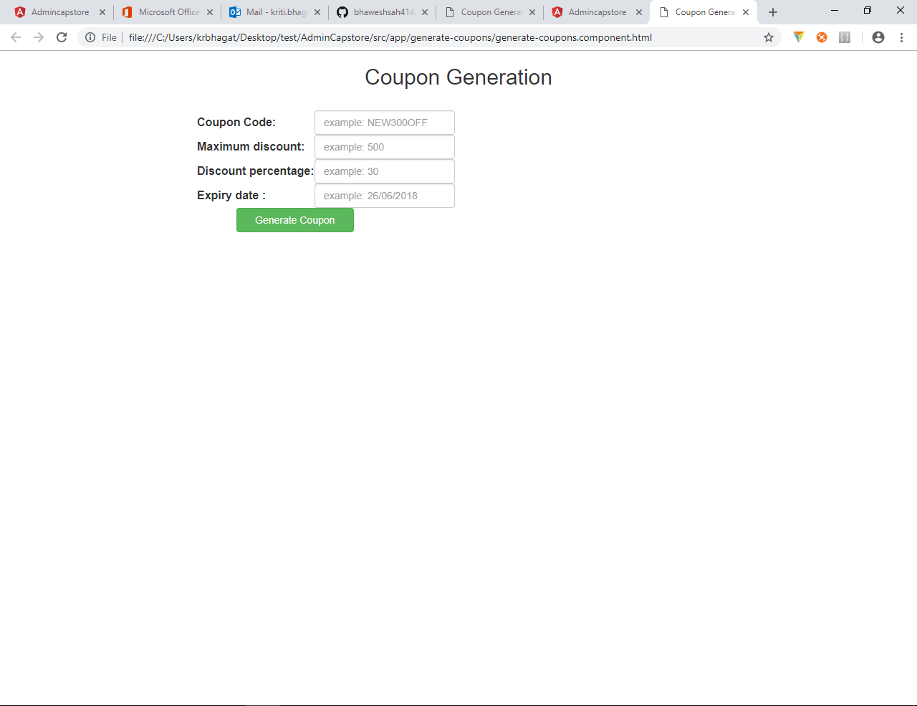

Slide 25
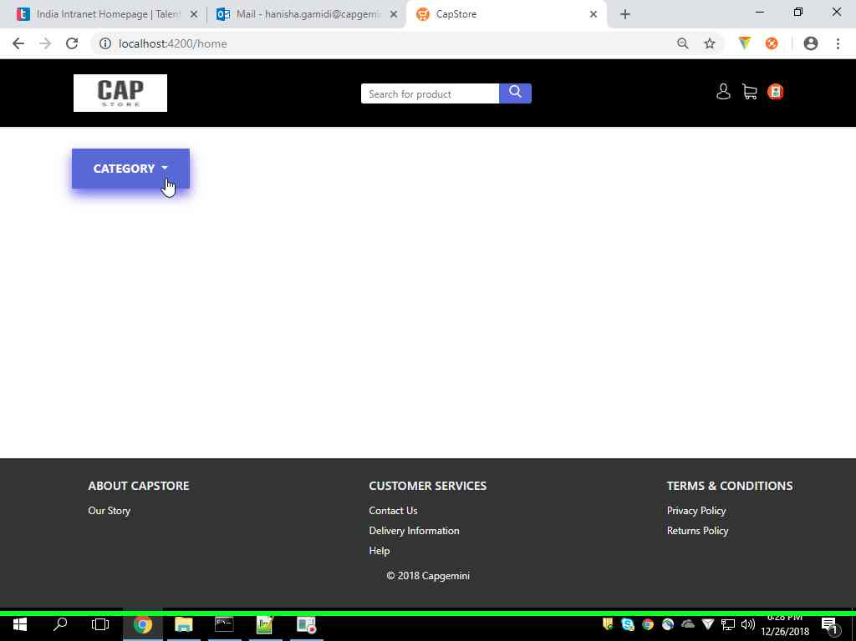
Customer Page

Slide 26
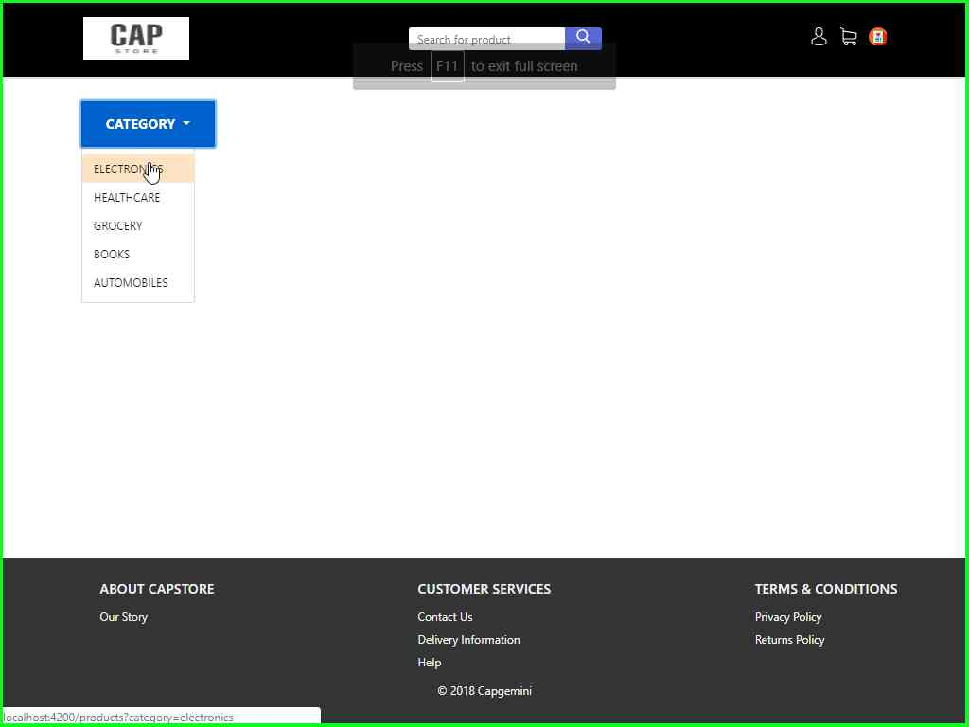

Slide 27
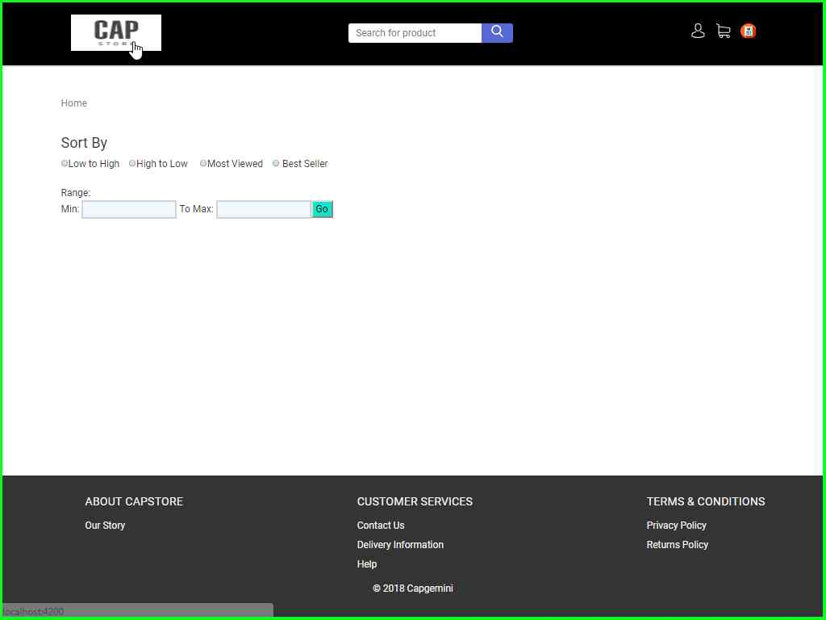

Slide 28
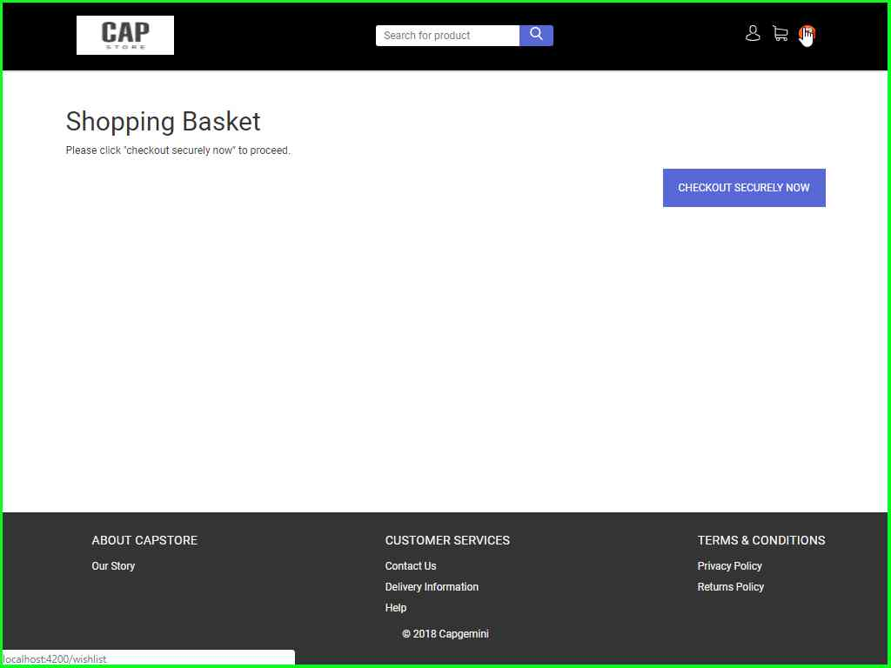

Slide 30
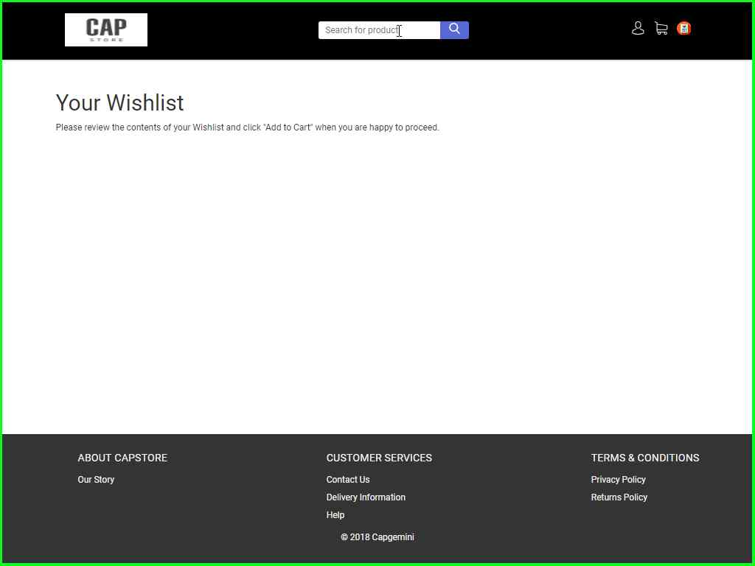

Slide 31
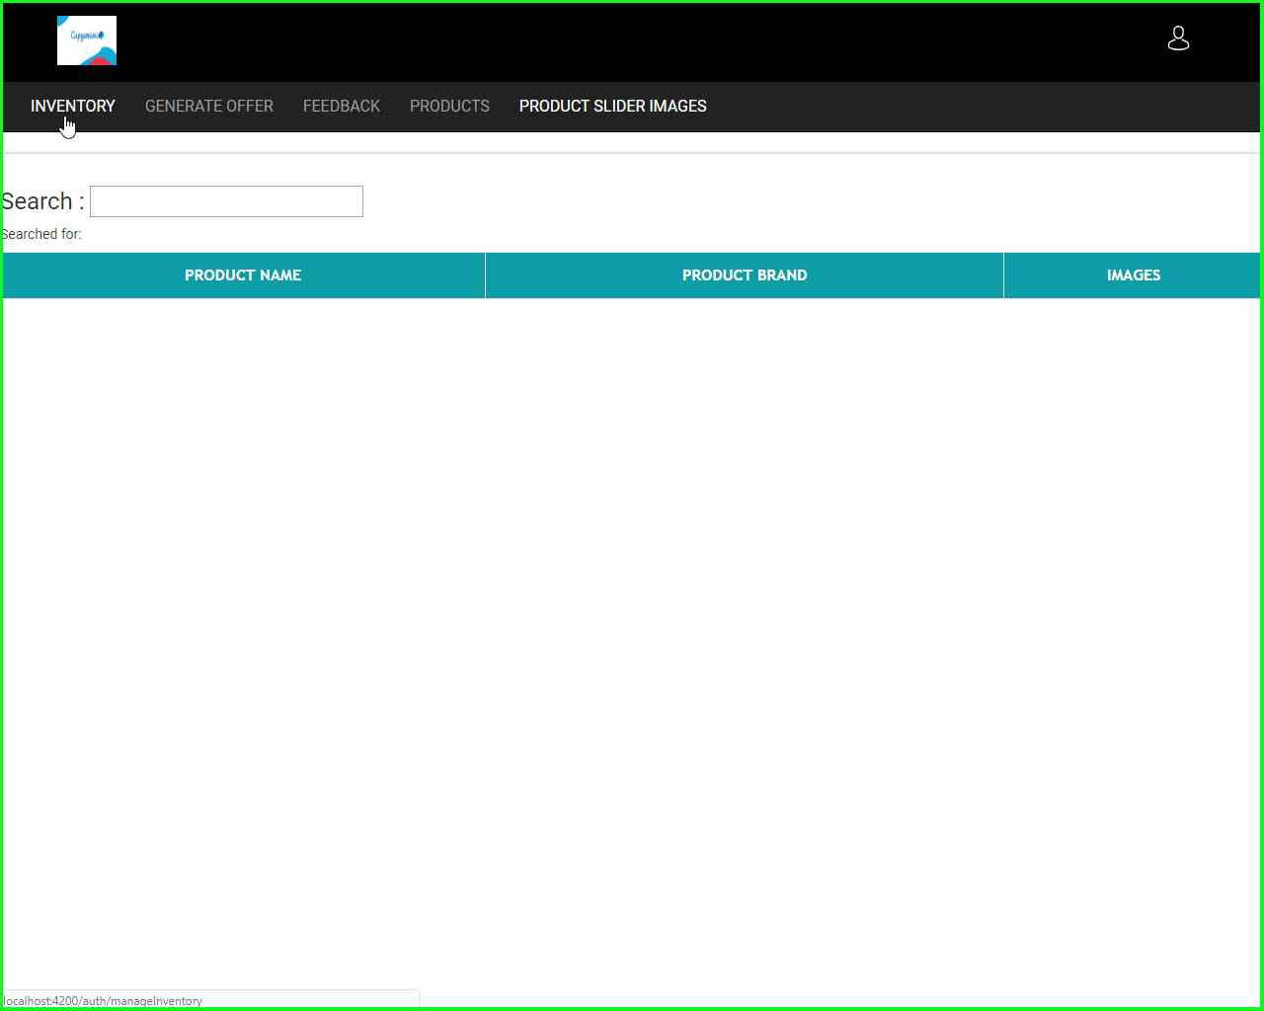
Merchant Page

Slide 32
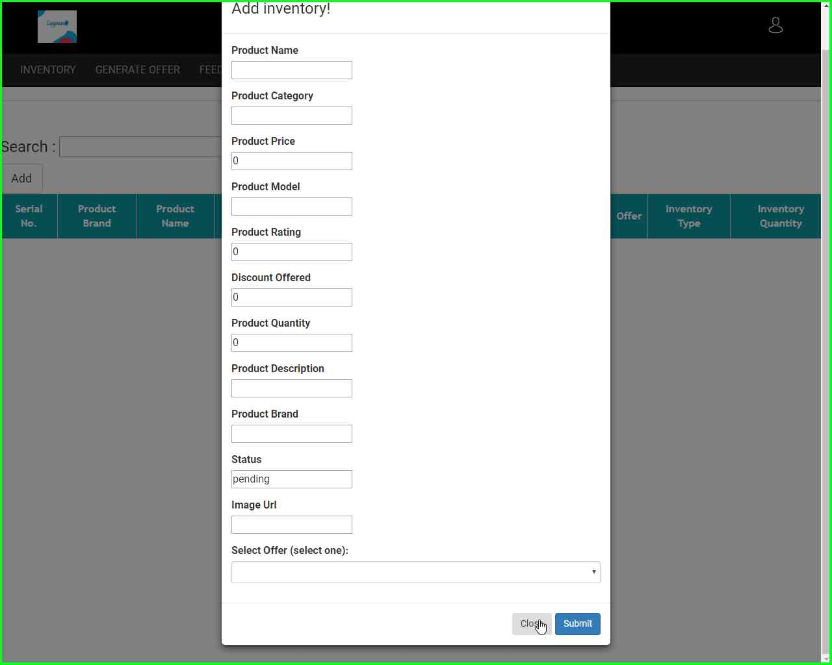

Slide 33
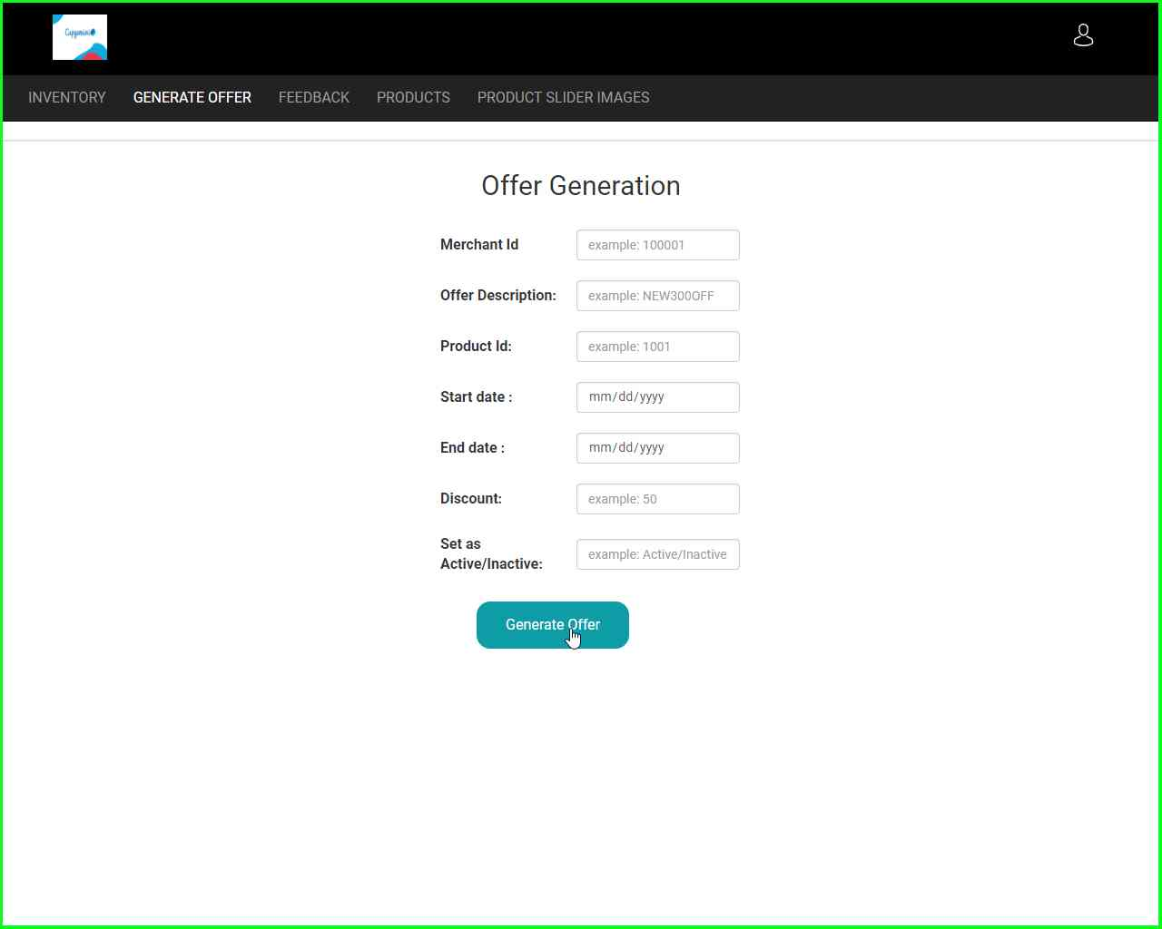

Slide 34
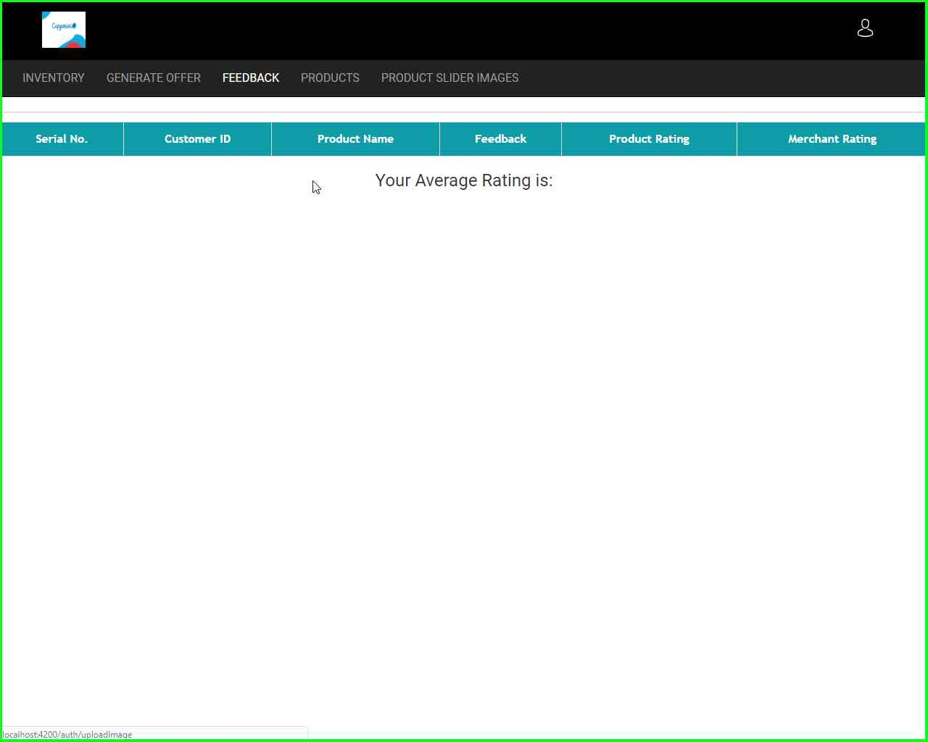

Slide 35
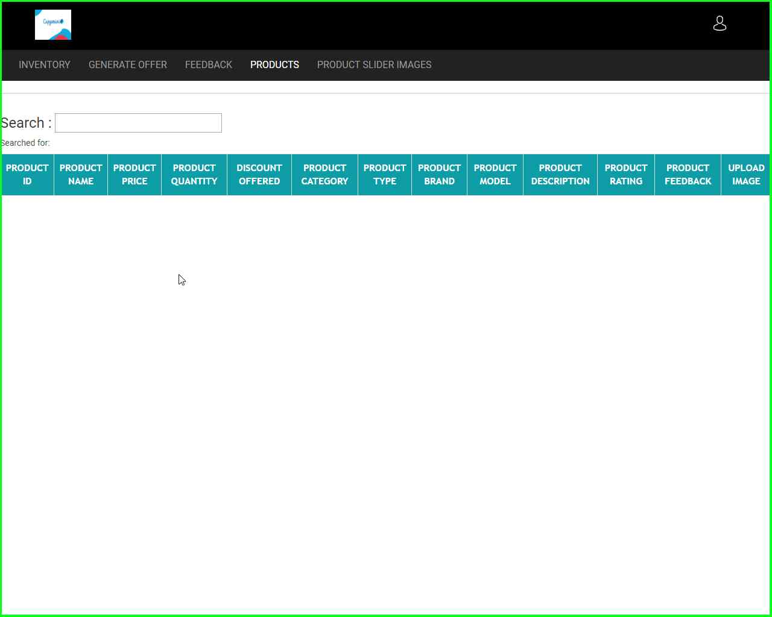

Slide 36
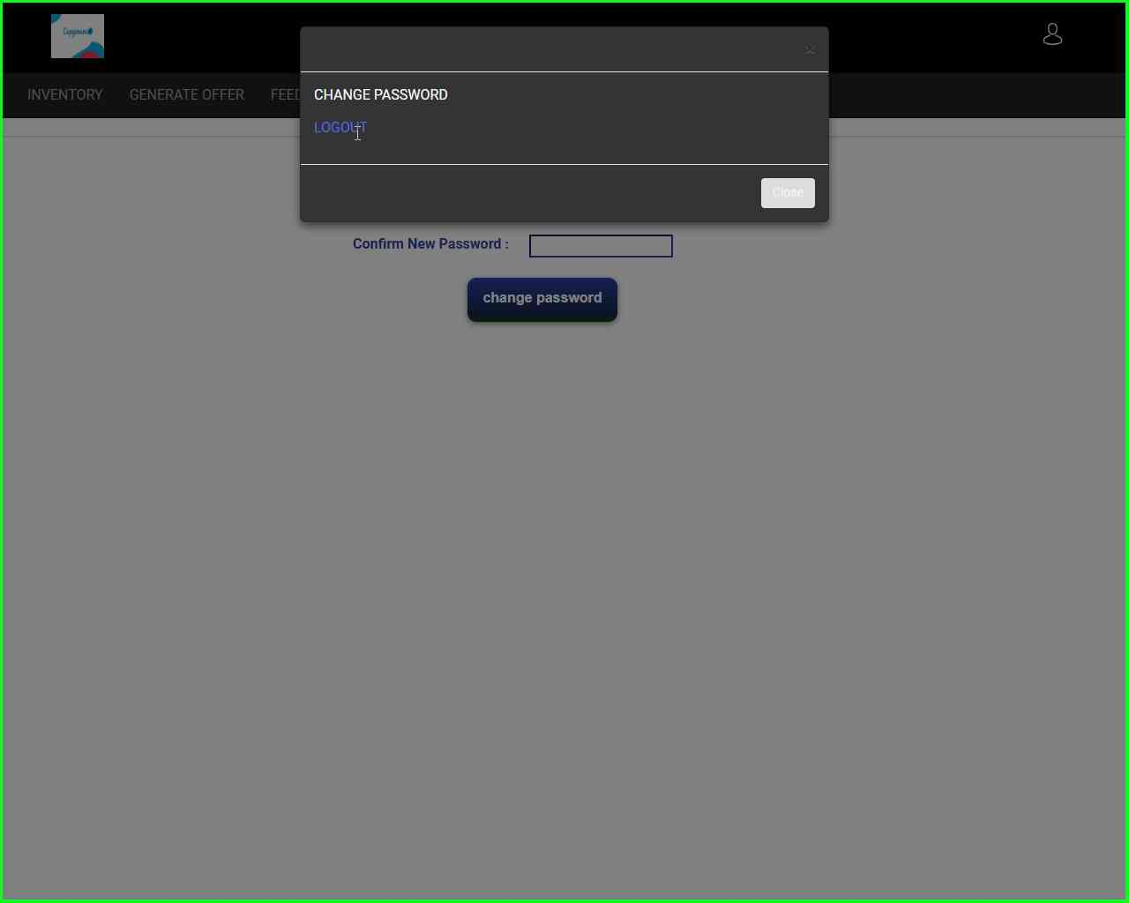

Slide 37
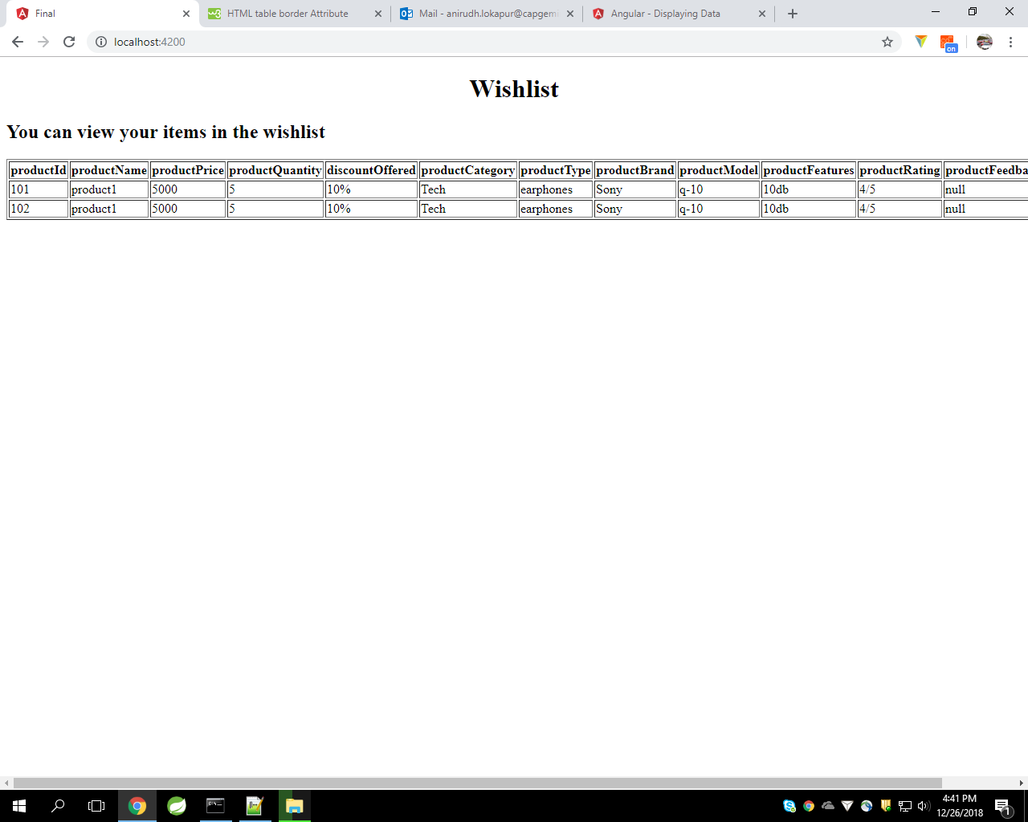

Slide 38
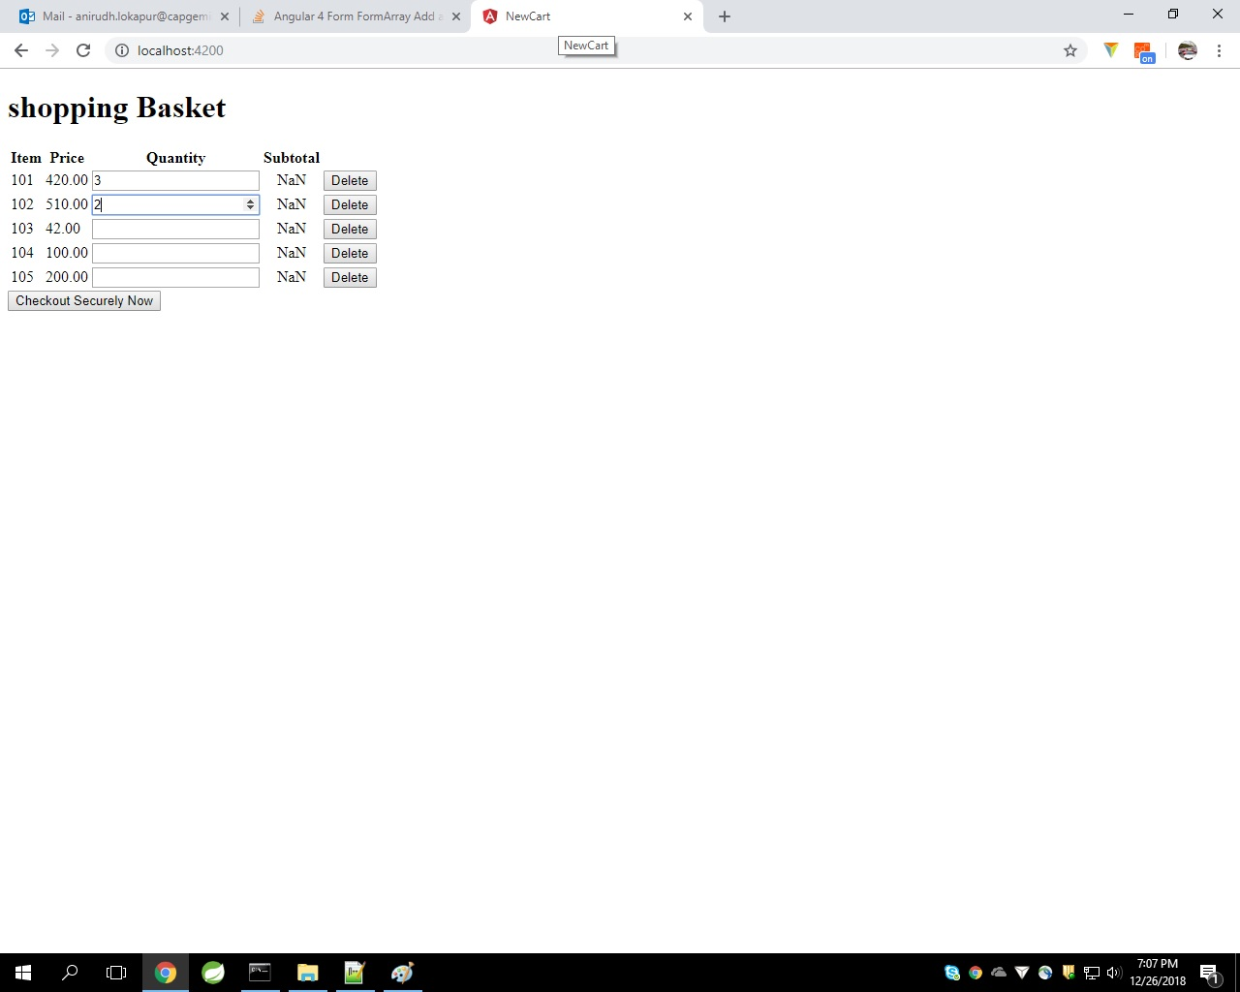

Slide 39
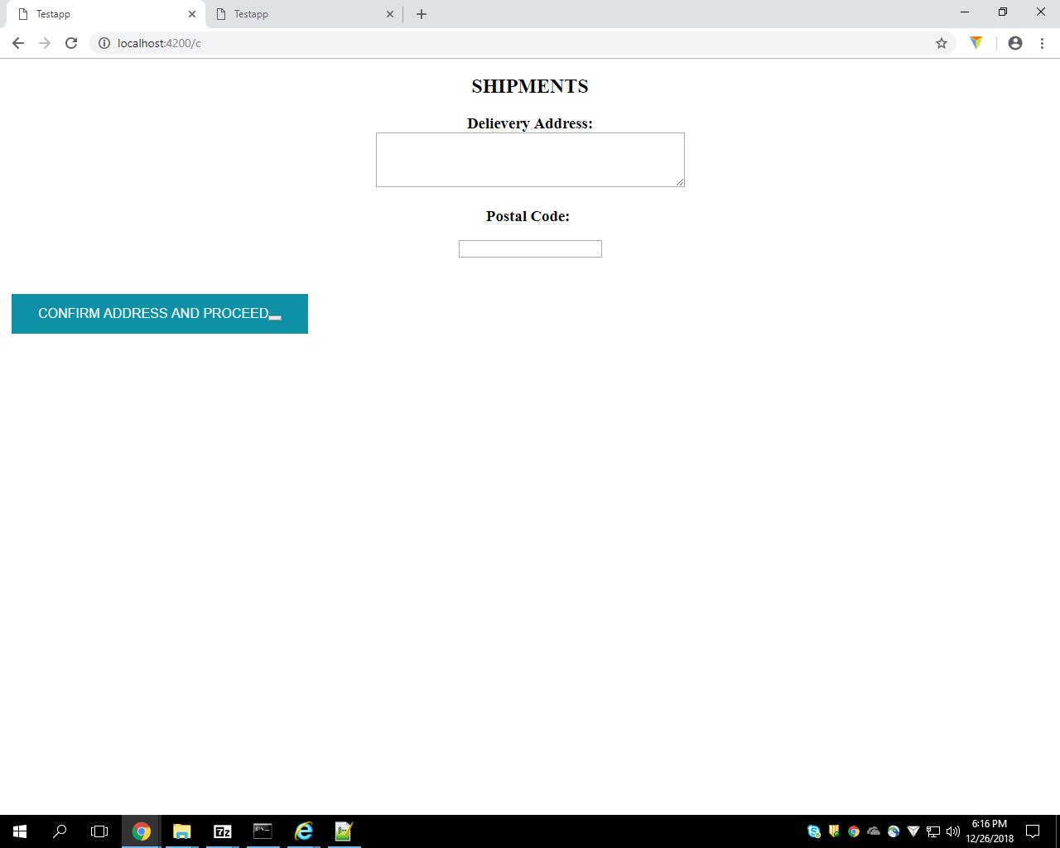

Slide 40
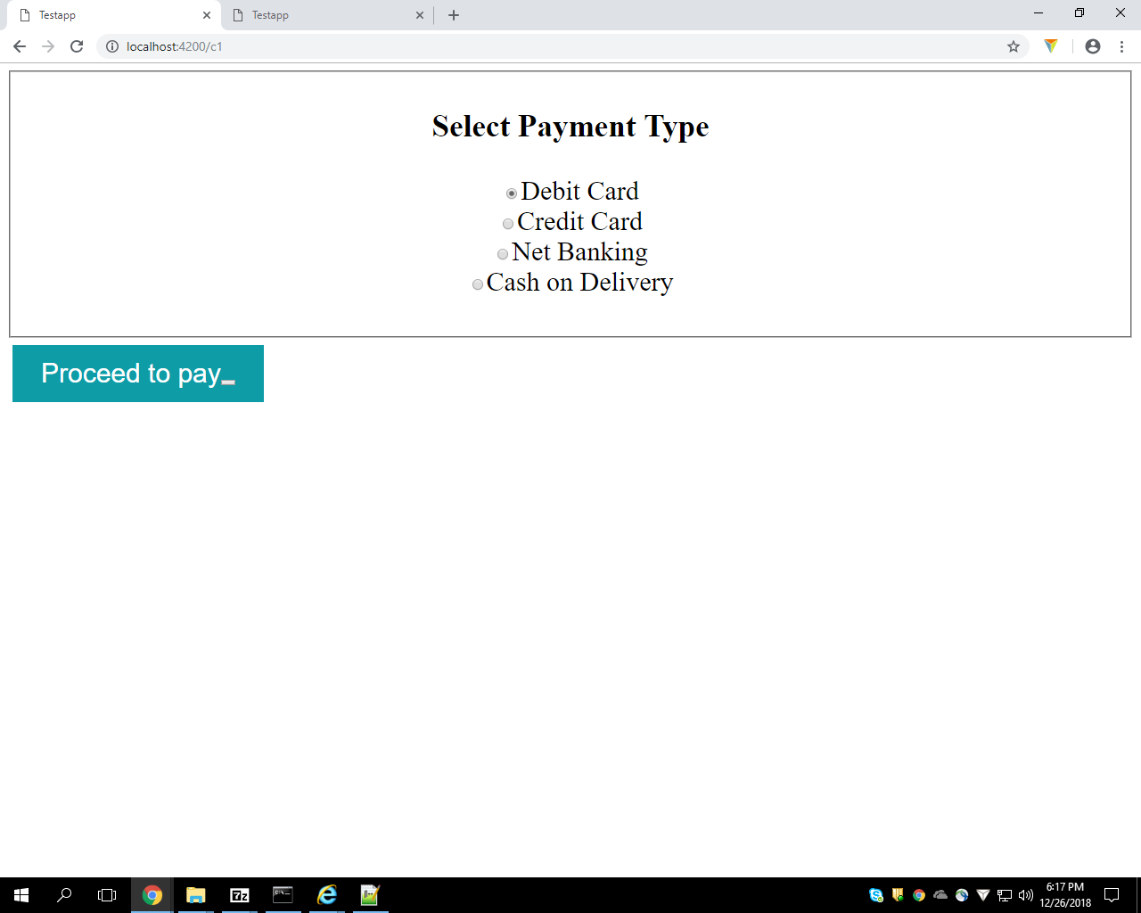

Slide 41
