Slide 1
Architecture Diagram

Slide 2
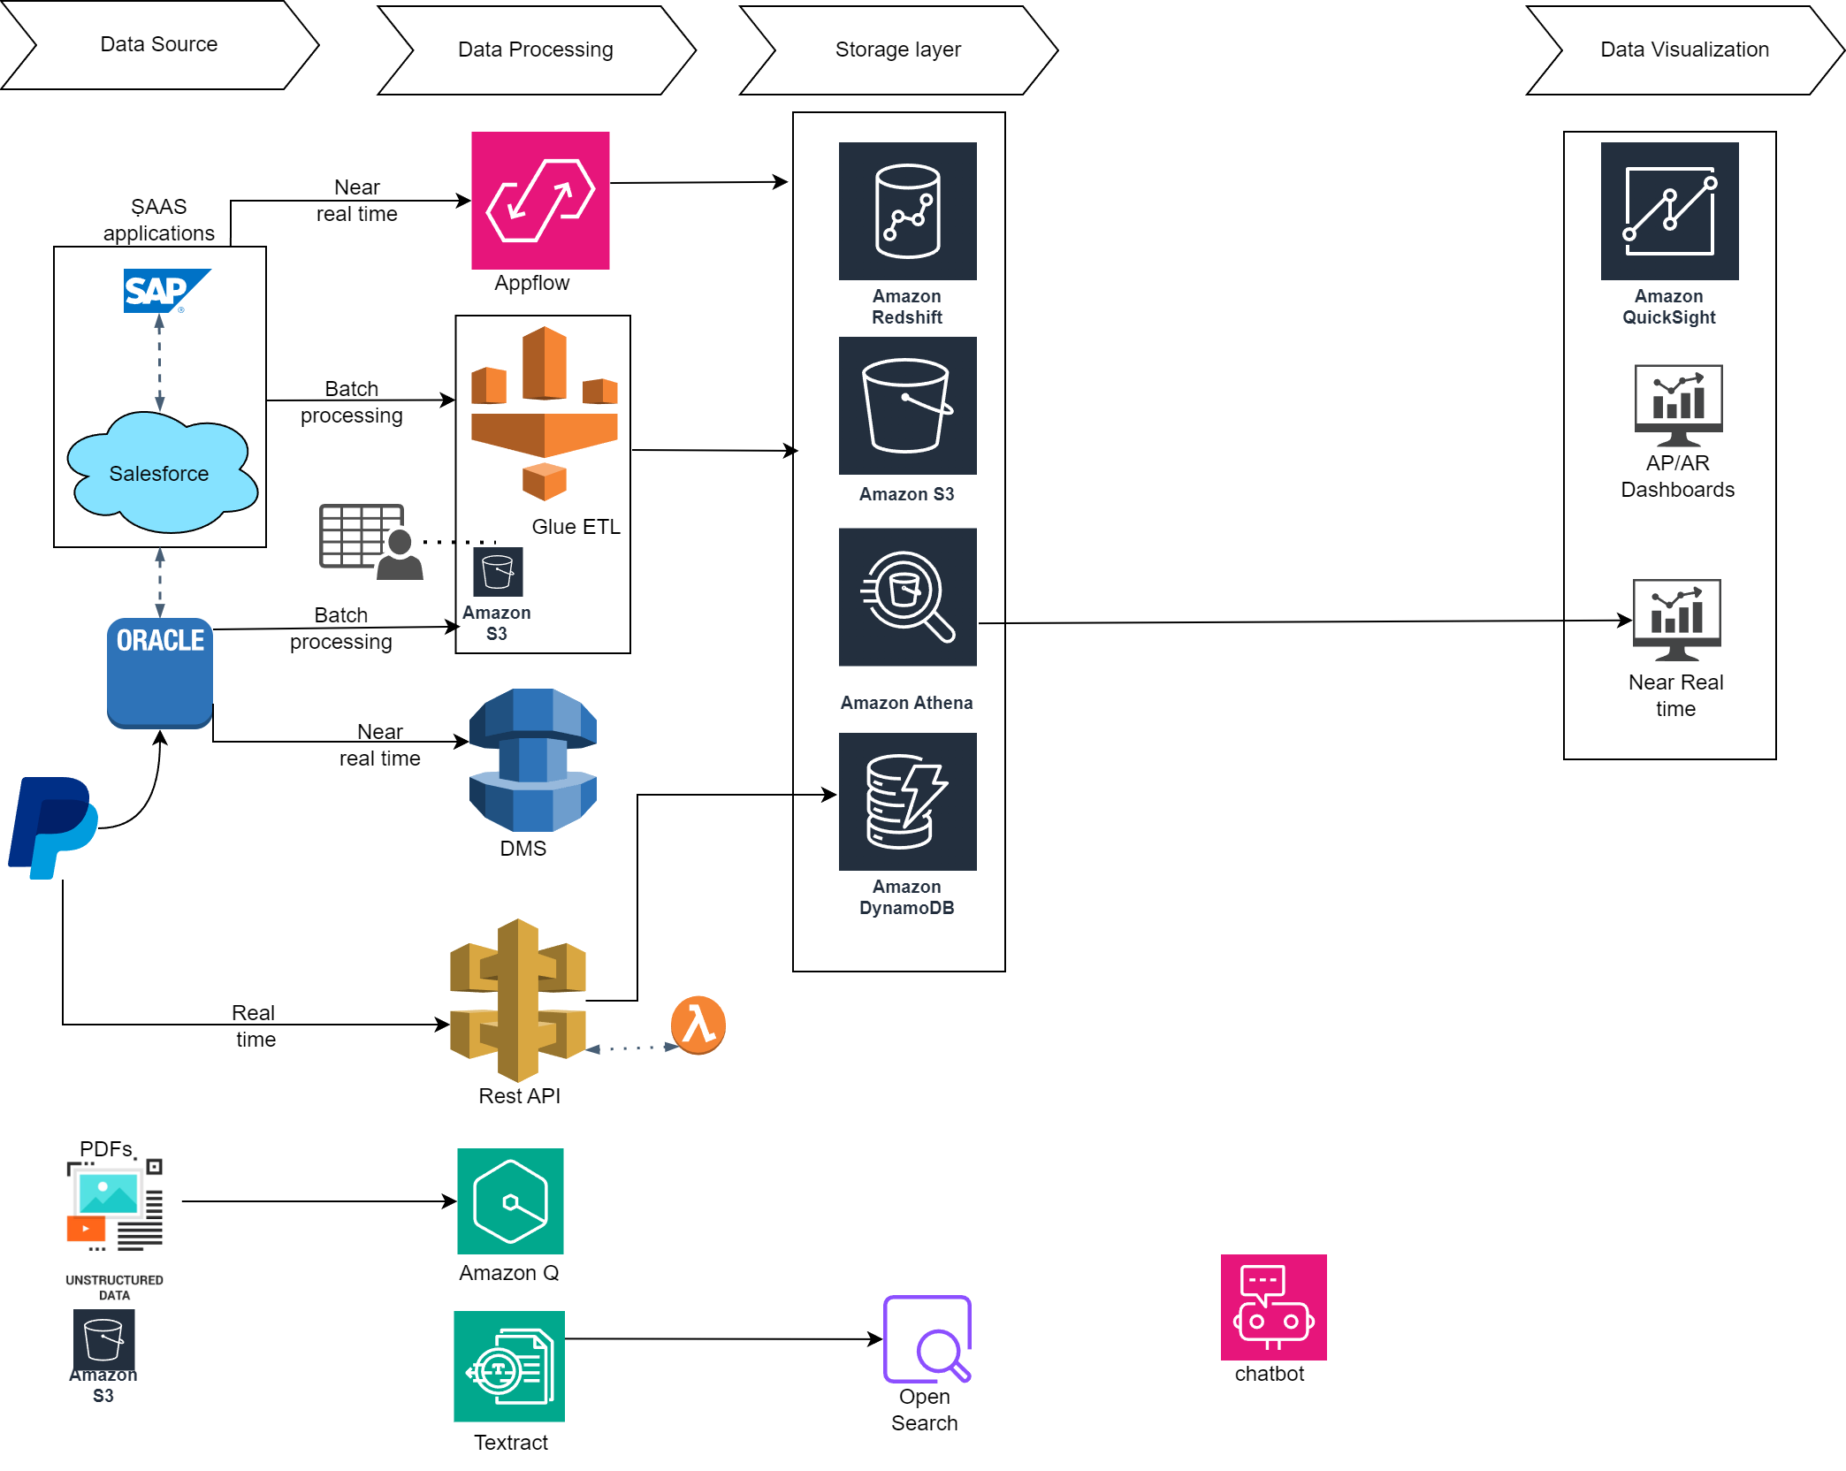

Slide 3
KPIs
(Million USD)

Slide 4
Monthly Dashboard

Slide 5
Real Time Dashboard

Slide 6
Phase | Duration | Key Activities
Requirement Gathering | 2 weeks | Workshops, technical deep dives
Solution Design | 2 weeks | Finalizing architecture, BOM, project plan
Infrastructure Setup | 3 weeks | Configuring AWS services
Data Ingestion | 3 weeks | Setting up pipelines
ETL & Transformation | 3 weeks | Developing and testing ETL jobs
Dashboard Development | 2 weeks | Creating and validating dashboards
Chatbot Implementation | 3 weeks | OCR, Bedrock integration, testing
Final Testing & Handover | 2 weeks | UAT, documentation, go-live

Slide 7
Bill of Materials
Service | Purpose | Estimated Cost/Month
Amazon S3 | Data Lake Storage | $500
AWS Glue | ETL and Data Catalog | $1,000
Amazon EMR | Large-Scale Data Processing | $1,200
Amazon QuickSight | Dashboards and Analytics | $300
Amazon MSK | Kafka Integration | $400
Amazon Textract | OCR for Scanned Documents | $200
Amazon OpenSearch Service | Document Search | $600
Amazon Bedrock | Generative AI Chatbot | $2,000
Amazon Kinesis | Real-Time Data Streaming | $700
Misc. (Lambda, API Gateway, etc.) | Auxiliary Processing Costs | $500
Total Estimated Cost |  | $7,400

Slide 8
Assumptions
Data sizing: Assume 2TB per source for non-SAP systems and a 10% annual growth.
Tables: Approx. 100 tables across sources with medium complexity.
Dashboards: 5 standard dashboards and 1 real-time dashboard requiring low-latency data ingestion.
Chatbot: OCR for scanned documents and integration with Amazon Bedrock/Amazon Q for GenAI.
SLA: Dashboards with 99.9% availability.
Kafka details: bootstrap server, port number, topic name of the Kafka producer would be provided. This will be consumed by lambda for further processing.
Language: All data sources are in common language English.

Slide 9
General Questions: -
How SalesForce is integrated with SAP FICO module? – API expose/Mulesoft/connectors?
Understanding existing 50 reports(complexity) and check if they want all those 50 reports in new Data Analytics platform.
What is the projected data growth rate for each data source (e.g., SAP, Oracle, Salesforce)?
Is there any PII data or a secured data?
What is the frequency and latency requirement for data ingestion from each source (e.g., real-time, near real-time, batch)?
Size and frequency of kafka producer.
How frequently are dashboards refreshed (e.g., real-time, daily)?
What KPIs are prioritized for the dashboards?
How frequently are the HR policy documents updated?
Any acceptable range for monthly operational costs?

Slide 10
Thank you

