Slide 1
Kubernetes

Slide 2
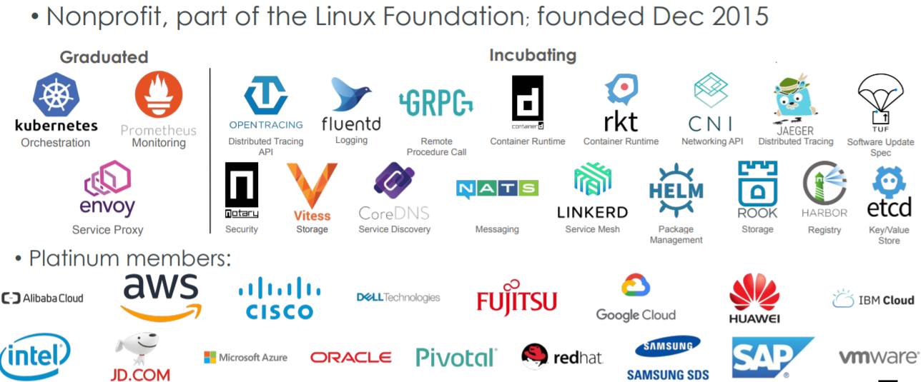
Cloud Native Computing Foundation

Slide 3
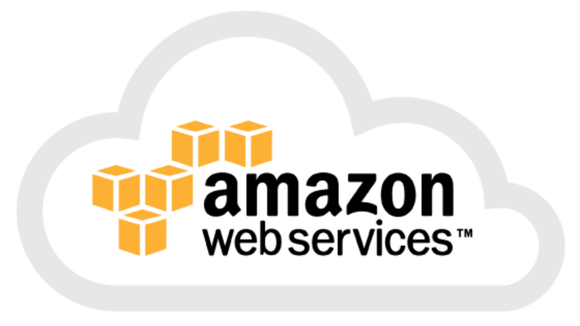
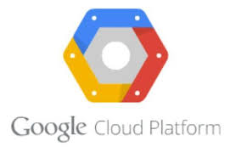
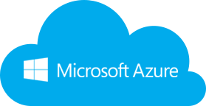
Kubernetes support on cloud
every cloud supports kubernetes
https://www.sinax.be/en/aws/
https://www.westconcomstor.com/za/en/vendors/wc-vendors/microsoft-azure-EN-UK.html
https://www.g2crowd.com/products/google-kubernetes-engine-gke/details

Slide 4
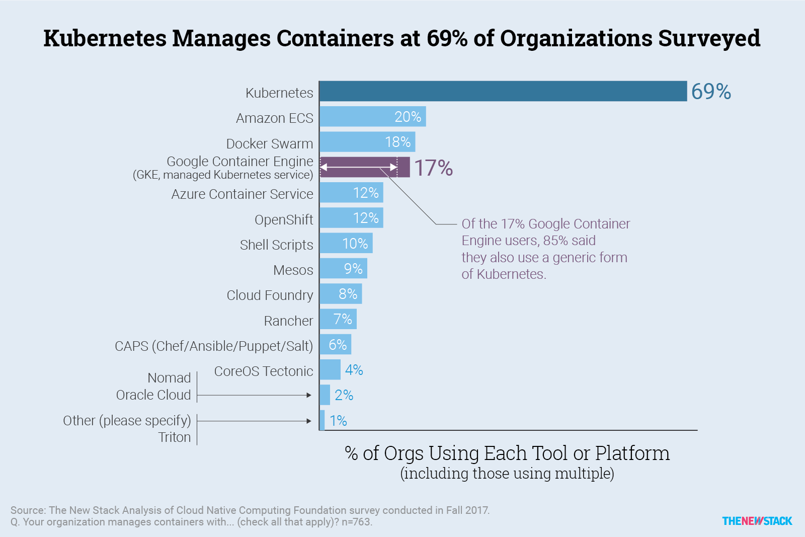
Kubernetes Market Adoption Survey

Slide 5
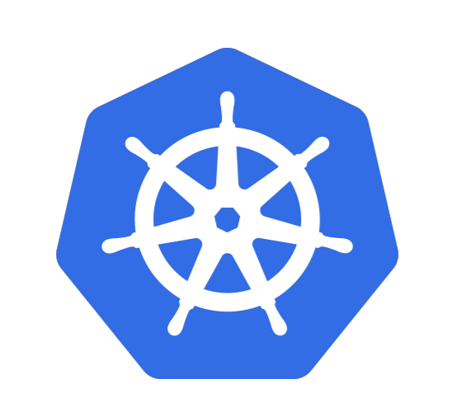
What does “Kubernetes” mean?
Greek for “pilot” or “helmsman of a ship”

Slide 6
A Container Orchestration System. ● A project that was spun out of Google as an open source container orchestration platform (~2 billion containers/week). ● Built from the lessons learned in the experiences of developing and running Google’s Borg and Omega. ● Designed from the ground-up as a loosely coupled collection of components centred around deploying, maintaining and scaling workloads.
What is Kubernetes?

Slide 7
What does Kubernetes do?
● Known as the linux kernel of distributed systems.
● Abstracts away the underlying hardware of the nodes and provides a uniform interface for workloads to be both deployed and consume the shared pool of resources.
● Works as an engine for resolving state by converging the actual and the desired state of the system.

Slide 8
Kubernetes is self-healing
Kubernetes will ALWAYS try and steer the cluster to its desired state.
● User: “I want 3 healthy instances of Redis to always be running.”
● Kubernetes: “Okay, I’ll ensure there are always 3 instances up and running.”
● Kubernetes: “Oh look, one has died. I’m going to attempt to spin up a new one.”

Slide 9
What can Kubernetes really do?
● Autoscale Workloads
● Blue/Green Deployments
● Fire off Jobs and scheduled CronJobs
● Manage Stateless and Stateful Applications
● Built-in Service Discovery
● ~Easily integrate and support 3rd party apps~

Slide 10
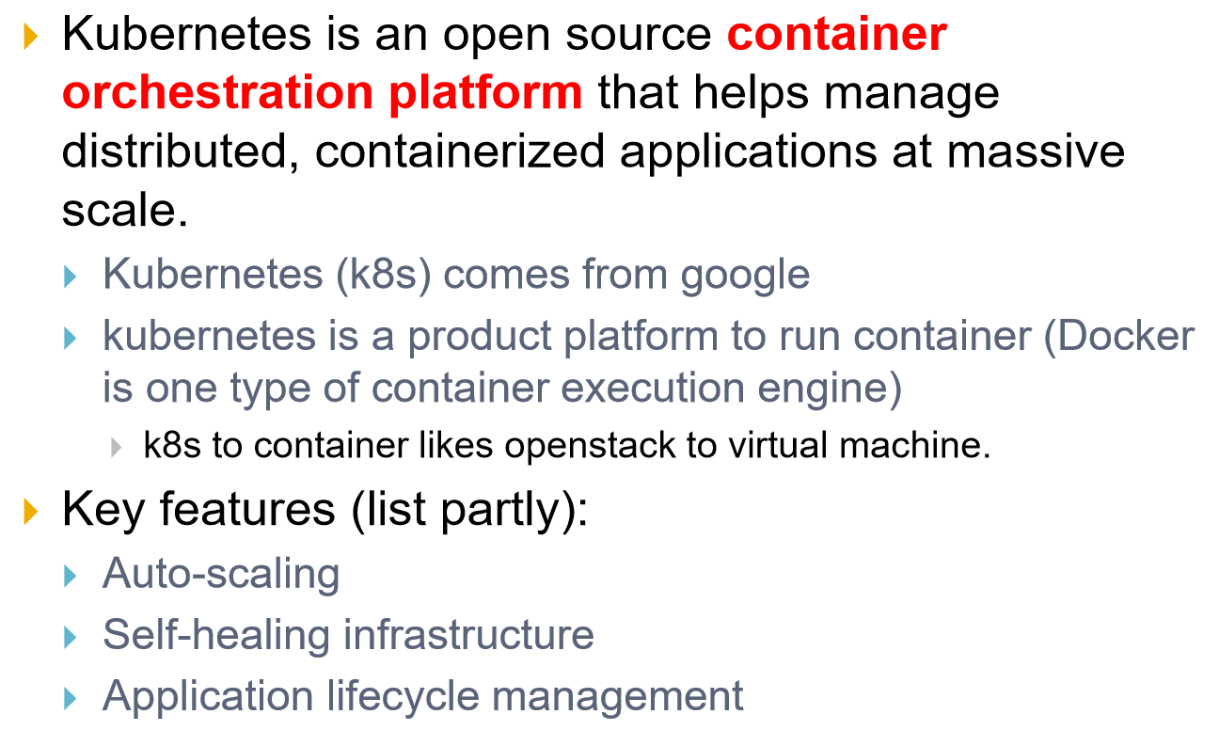
Kubernetes in a nutshell

Slide 11
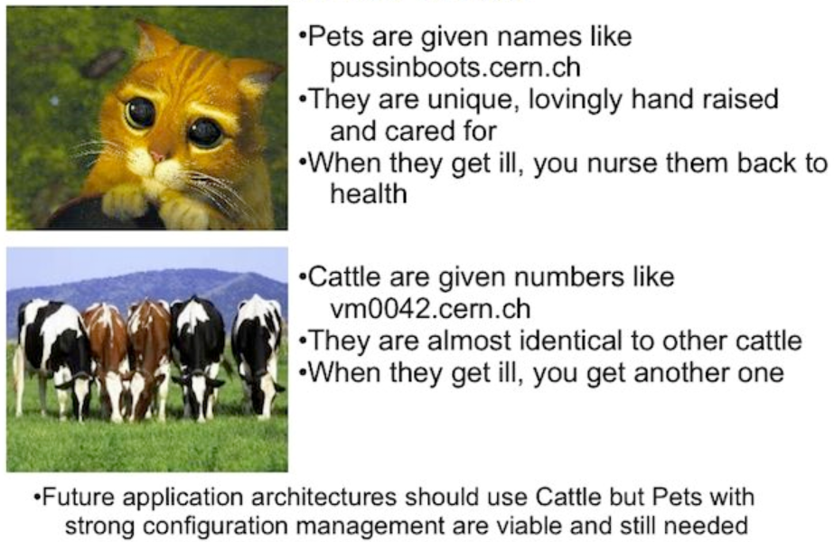



Service Model : Pets vs Cattle

Slide 12
Kubernetes Architecture

Slide 13
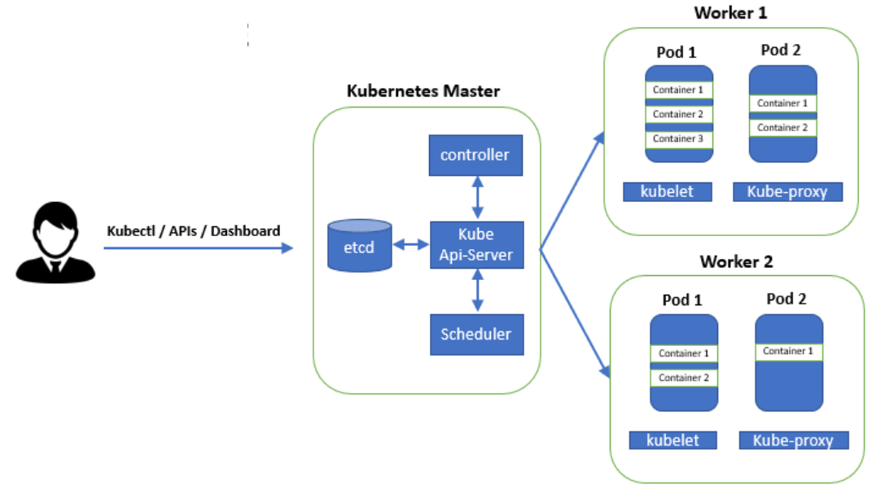
Kubernetes Architecture

Slide 14
Architecture Overview
Masters – Acts as the primary control plane for Kubernetes.
Masters are responsible at a minimum for running the API Server, scheduler and cluster controller.
They also manage storing cluster state, cloud-provider specific components and other cluster essential services.
Nodes - Are the ‘workers’ of a Kubernetes cluster.
They run a minimal agent that manages the node itself, and execute workloads as designated by the master.

Slide 15
kube-apiserver – the heart of the cluster
● Provides a forward facing REST interface into the Kubernetes control plane and datastore.
● All clients and other applications interact with Kubernetes strictly through the API Server.
● Acts as the gatekeeper to the cluster by handling authentication and authorization, request validation and admission control in addition to being the front-end to the backing datastore.
Kubectl
Kubectl is the official Kubernetes command line interface tool. It is used to communicate with the API.

Slide 16
etcd – the key-value datastore
● etcd acts as the cluster datastore.
● A standalone incubating CNCF project https://www.cncf.io/projects/
● Purpose in relation to Kubernetes is to provide a strong, consistent and highly available key-value store for persisting all cluster state.

Slide 17
kube-controller-manager
● Serves as the primary daemon that manages all core components’ reconciliation loops.
● Handles a lot of the business logic of Kubernetes.
● Monitors the cluster state via the API Server and steers the cluster towards the desired state.

Slide 18
kube-scheduler
Evaluates workload requirements and attempts to place it on a matching resource.
● The default scheduler uses the “binpacking” mode.
● Workload Requirements can include: general hardware requirements, affinity/anti-affinity, labels, and other various custom resource requirements.
● Is swappable, you can create your own scheduler

Slide 19
Node Components

Slide 20
kubelet
Acts as the node agent responsible for managing pod lifecycle on its host. Kubelet understands YAML container manifests that it can read from several sources:
File path
HTTP Endpoint
Etcd watch acting on any changes
HTTP Server mode accepting container manifests over a simple API.

Slide 21
kube-proxy
● Manages the network rules for Services on each node.
● Performs connection forwarding or load balancing for Kubernetes Services.
● Available Proxy Modes:
○ ipvs (default if supported)
○ iptables (default fallback)
○ userspace (legacy)

Slide 22
Container Runtime – the executor
● A container runtime is a CRI (Container Runtime Interface) compatible application that executes and manages containers.
○ Docker (default, built into the kubelet atm) ○ containerd
○ cri-o
○ rkt
○ Kata Containers (formerly clear and hyper)
○ Virtlet (VM CRI compatible runtime)

Slide 23
Additional Services
Kube-dns - Provides cluster wide DNS Services. Services are resolvable to
<service>.<namespace>.svc.cluster.local.
Heapster - Metrics Collector for kubernetes cluster, used by some resources such as the Horizontal Pod Autoscaler. (required for kubedashboard metrics)
Kube-dashboard - A general purpose web based UI for kubernetes.

Slide 24
Additional Services
Kube-dns - Provides cluster wide DNS Services. Services are resolvable to
<service>.<namespace>.svc.cluster.local.
Heapster - Metrics Collector for kubernetes cluster, used by some resources such as the Horizontal Pod Autoscaler. (required for kubedashboard metrics)
Kube-dashboard - A general purpose web based UI for kubernetes.

Slide 25
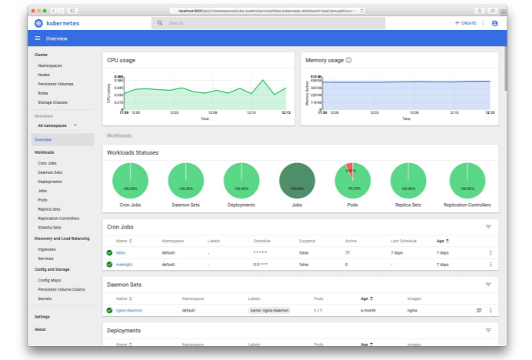
Kube-dashboard

Slide 26
Kubernetes concepts

Slide 27
Pod: The basic building block in Kubernetes. The name is the same idea as a pod of whales, one of more containers– or better said, a running process on the cluster — running on a given system which can be scaled up or down.
Service: A consistent network access point for a pod. What this means is that regardless of the underlying containers’ state – restarts, etc, a service will always provide access to the given pod/application.
ReplicaSet: Ensures a given number of pods are running in the cluster at a given time.
Deployment: Suited for more ephemeral applications like web applications, anything that doesn’t have persistent qualities. It Provides declarative updates for Pods and ReplicaSets by describing a desired state the deployment in turn acts on.

Slide 28
Stateful Set: Suited for stateful applications like databases or even monitoring systems like Prometheus. Similar to a deployment in that it manages the deployment and scaling of a set of pods, but differs in that it ensures ordinal (things happen in a given sequence and are numbered) and uniqueness of pods. Overall, it ensures that all resources in the stateful set have a sticky identity across restarts.
Labels: When creating Kubernetes objects, one can give any number of labels to each object which are discoverable across the system. For instance, one could create a database with the label “customer_database” and another application pod could reference it by simply using that name “customer_database” in the selector value of the manifest file.
Namespaces: Virtual clusters. Provides a means to separate applications in the cluster.

Slide 29
Mini-kube : Install and configure
Refer git repo for instructions.

Slide 30
To be updated from this slide onwards
Networking

Slide 31
Networking - Fundamental Rules
All Pods can communicate with all other Pods without NAT
All nodes can communicate with all Pods (and vice-versa) without NAT.
The IP that a Pod sees itself as is the same IP that others see it as.

Slide 32
Networking – Fundamentals Applied
Containers in a pod exist within the same network namespace and share an IP; allowing for intrapod communication over localhost.
Pods are given a cluster unique IP for the duration of its lifecycle, but the pods themselves are fundamentally ephemeral.
Services are given a persistent cluster unique IP that spans the Pods lifecycle.
External Connectivity is generally handed by an integrated cloud provider or other external entity (load balancer)

Slide 33
Networking - CNI
Networking within Kubernetes is plumbed via the Container Network Interface (CNI), an interface between a container runtime and a network implementation plugin.
Compatible CNI Network Plugins:
Calico
Cillium
Contiv
Contrail
Flannel
GCE
kube-router
Multus
OpenVSwitch
OVN
Romana
Weave

Slide 34
Kubernetes
Concepts

Slide 35
Kubernetes Concepts - Core
Cluster - A collection of hosts that aggregate their available resources including cpu, ram, disk, and their devices into a usable pool.
Master - The master(s) represent a collection of components that make up the control plane of Kubernetes. These components are responsible for all cluster decisions including both scheduling and responding to cluster events.
Node - A single host, physical or virtual capable of running pods. A node is managed by the master(s), and at a minimum runs both kubelet and kube-proxy to be considered part of the cluster.
Namespace - A logical cluster or environment. Primary method of dividing a cluster or scoping access.

Slide 36
Concepts - Core (cont.)
Label - Key-value pairs that are used to identify, describe and group together related sets of objects. Labels have a strict syntax and available character set. *
Annotation - Key-value pairs that contain non-identifying information or metadata. Annotations do not have the the syntax limitations as labels and can contain structured or unstructured data.
Selector - Selectors use labels to filter or select objects. Both equality-based (=, ==, !=) or simple key-value matching selectors are supported.
* https://kubernetes.io/docs/concepts/overview/working-with-objects/labels/#syntax-and-character-set

Slide 37
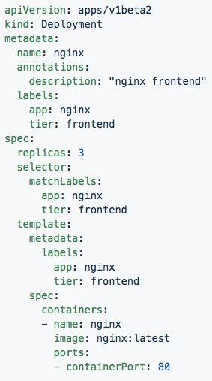
Labels, and Annotations, and Selectors
Labels:
app: nginx tier: frontned
Annotations
description: “nginx frontend”
Selector: app: nginx
tier: frontend

Slide 38
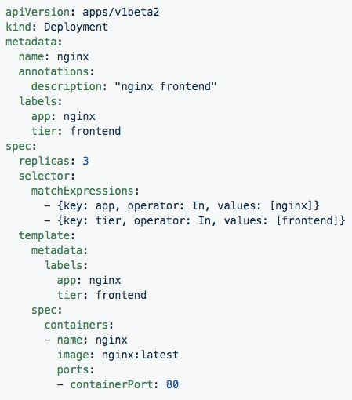
Set-based selectors
Valid Operators:
In
NotIn
Exists
DoesNotExist
Supported Objects with set-based selectors:
Job
Deployment
ReplicaSet
DaemonSet
PersistentVolumeClaims

Slide 39
Concepts - Workloads
Pod - A pod is the smallest unit of work or management resource within Kubernetes. It is comprised of one or more containers that share their storage, network, and context (namespace, cgroups etc).
ReplicationController - Method of managing pod replicas and their lifecycle. Their scheduling, scaling, and deletion.
ReplicaSet - Next Generation ReplicationController. Supports set-based selectors.
Deployment - A declarative method of managing stateless Pods and ReplicaSets. Provides rollback functionality in addition to more granular update control mechanisms.

Slide 40
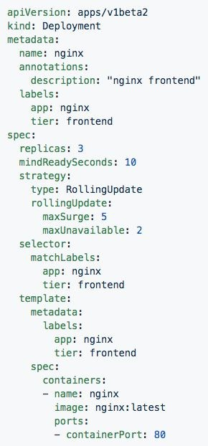
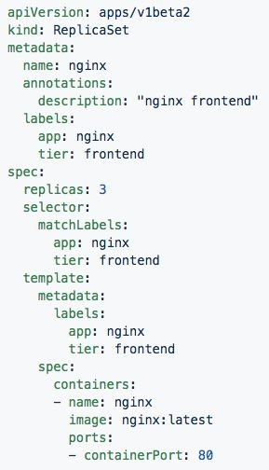
Deployment
ReplicaSet
Generated ReplicaSet from Deployment spec.
Contains configuration of how updates or ‘deployments’ should be managed in addition to the pod template used to generate the ReplicaSet.

Slide 41
Concepts - Workloads (cont.)
StatefulSet - A controller tailored to managing Pods that must persist or maintain state. Pod identity including hostname, network, and storage will be persisted.
DaemonSet - Ensures that all nodes matching certain criteria will run an instance of a supplied Pod. Ideal for cluster wide services such as log forwarding, or health monitoring.

Slide 42
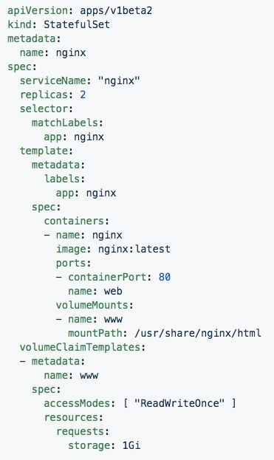
StatefulSet
Attaches to ‘headeless service’ (not shown) nginx.
Pods given unique ordinal names using the pattern
<statefulset name>-<ordinal index>.
Creates independent persistent volumes based on the ‘volumeClaimTemplates’.

Slide 43
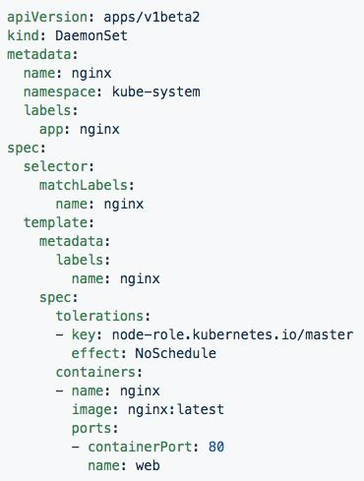
DaemonSet
Bypasses default scheduler
Schedules a single instance on every host while adhering to tolerances and taints.

Slide 44
Concepts - Workloads (cont.)
Job - The job controller ensures one or more pods are executed and successfully terminates. It will do this until it satisfies the completion and/or parallelism condition.
CronJob - An extension of the Job Controller, it provides a method of executing jobs on a cron-like schedule.

Slide 45
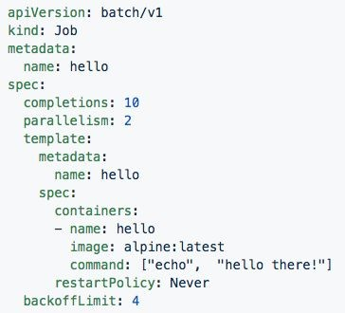
Jobs
Number of pod executions can be controlled via spec.completions
Jobs can be parallelized using spec.parallelism
Jobs and Pods are NOT automatically cleaned up after a job has completed.

Slide 46
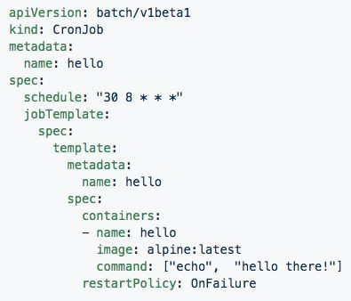
CronJob
Adds cron schedule to job template

Slide 47
Concepts - Network
Service - Services provide a method of exposing and consuming L4 Pod network accessible resources. They use label selectors to map groups of pods and ports to a cluster-unique virtual IP.
Ingress - An ingress controller is the primary method of exposing a cluster service (usually http) to the outside world. These are load balancers or routers that usually offer SSL termination, name-based virtual hosting etc.

Slide 48
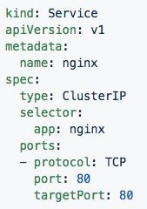
Service
Acts as the unified method of accessing replicated pods.
Four major Service Types:
CluterIP - Exposes service on a strictly cluster-internal IP (default)
NodePort - Service is exposed on each node’s IP on a statically defined port.
LoadBalancer - Works in combination with a cloud provider to expose a service outside the cluster on a static external IP.
ExternalName - used to references endpoints OUTSIDE the cluster by providing a static internally referenced DNS name.

Slide 49
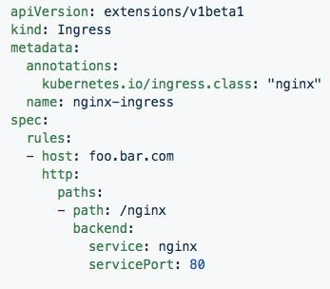
Ingress Controller
Deployed as a pod to one or more hosts
Ingress controllers are an external controller with multiple options.
Nginx
HAproxy
Contour
Traefik
Specific features and controller specific configuration is passed through annotations.

Slide 50
Concepts - Storage
Volume - Storage that is tied to the Pod Lifecycle, consumable by one or more containers within the pod.
PersistentVolume - A PersistentVolume (PV) represents a storage resource. PVs are commonly linked to a backing storage resource, NFS, GCEPersistentDisk, RBD etc. and are provisioned ahead of time. Their lifecycle is handled independently from a pod.
PersistentVolumeClaim - A PersistentVolumeClaim (PVC) is a request for storage that satisfies a set of requirements instead of mapping to a storage resource directly. Commonly used with dynamically provisioned storage.
StorageClass - Storage classes are an abstraction on top of an external storage resource. These will include a provisioner, provisioner configuration parameters as well as a PV reclaimPolicy.

Slide 51
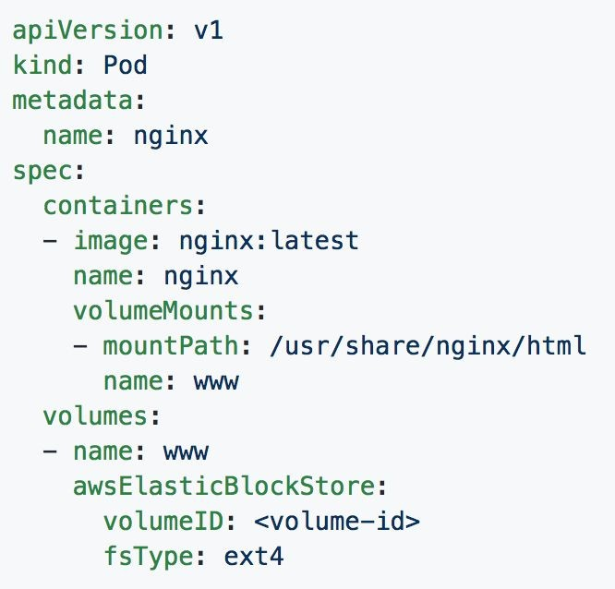
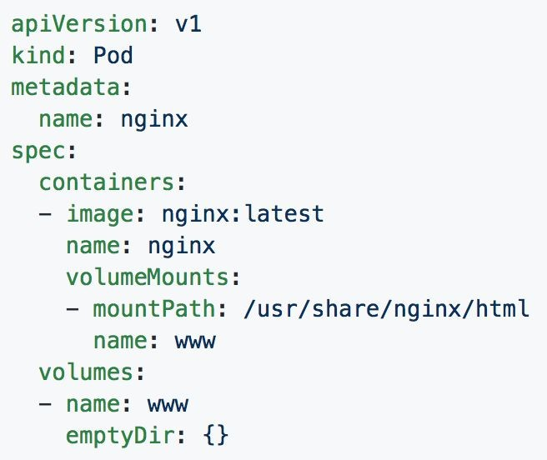
Volumes

Slide 52
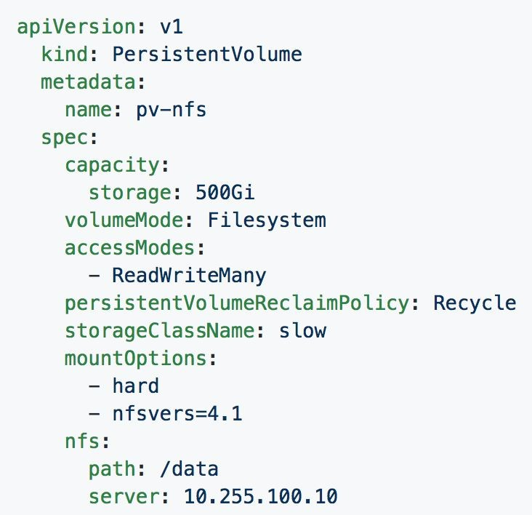
Persistent Volumes
PVs are a cluster-wide resource
Not directly consumable by a Pod
PV Parameters:
Capacity
accessModes
ReadOnlyMany (ROX)
ReadWriteOnce (RWO)
ReadWriteMany (RWX)
persistentVolumeReclaimPolicy
Retain
Recycle
Delete
StorageClass

Slide 53
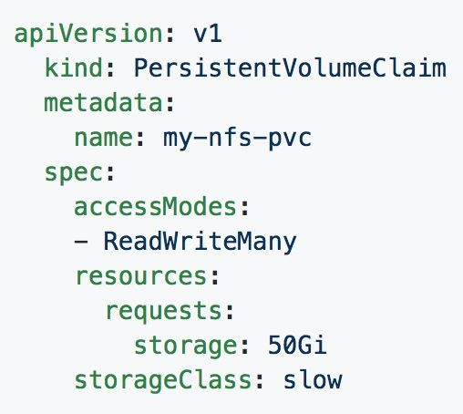
Persistent Volume Claims
PVCs are scoped to namespaces
Supports accessModes like PVs
Uses resource request model similar to Pods
Claims will consume storage from matching PVs or StorageClasses based on storageClass and selectors.

Slide 54
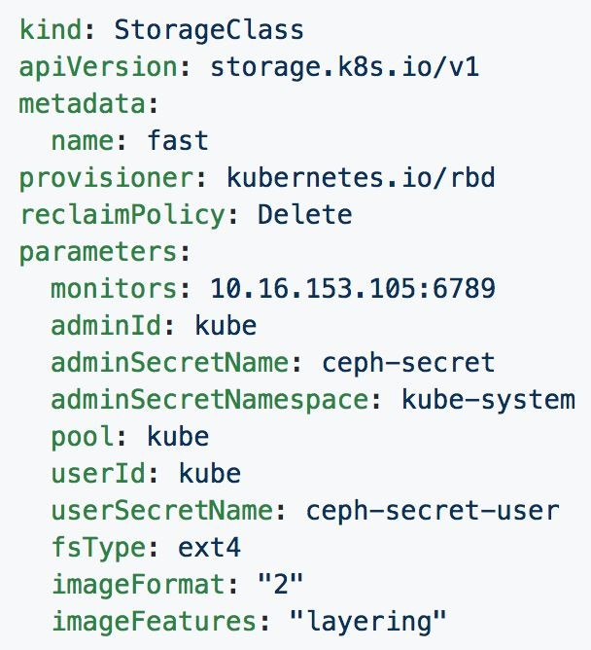
Storage Classes
Uses an external system defined by the provisioner to dynamically consume and allocate storage.
Storage Class Fields
Provisioner
Parameters
reclaimPolicy

Slide 55
Concepts - Configuration
ConfigMap - Externalized data stored within kubernetes that can be referenced as a commandline argument, environment variable, or injected as a file into a volume mount. Ideal for separating containerized application from configuration.
Secret - Functionally identical to ConfigMaps, but stored encoded as base64, and encrypted at rest (if configured).

Slide 56
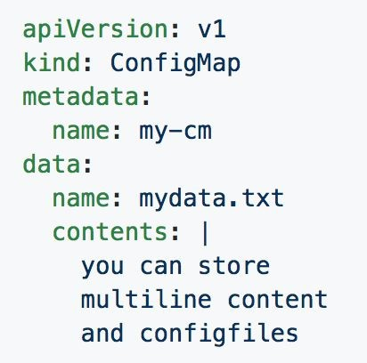
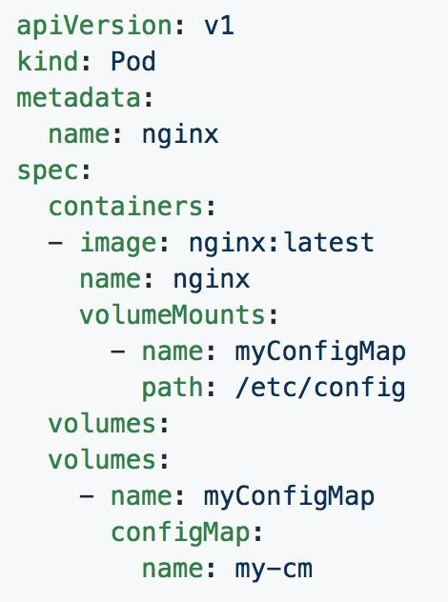
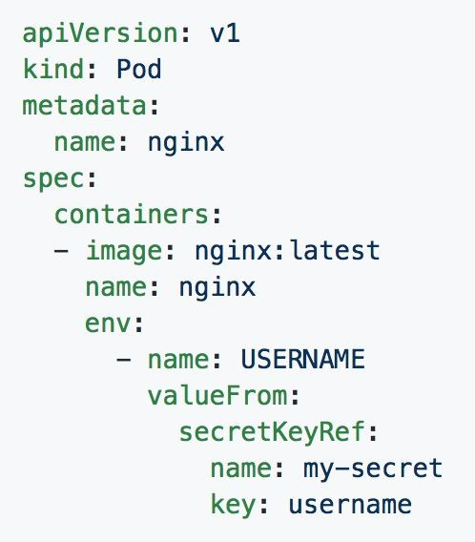
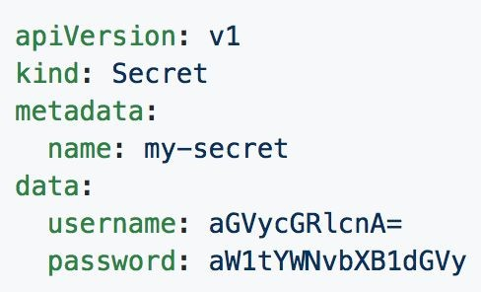
ConfigMaps and Secrets
Can be used in Pod Config:
Injected as a file
Passed as an environment variable
Used as a container command (requires passing as env var)

Slide 57
Concepts - Auth and Identity (RBAC)
[Cluster]Role - Roles contain rules that act as a set of permissions that apply verbs like “get”, “list”, “watch” etc over resources that are scoped to apiGroups. Roles are scoped to namespaces, and ClusterRoles are applied cluster-wide.
[Cluster]RoleBinding - Grant the permissions as defined in a [Cluster]Role to one or more “subjects” which can be a user, group, or service account.
ServiceAccount- ServiceAccounts provide a consumable identity for pods or external services that interact with the cluster directly and are scoped to namespaces.

Slide 58
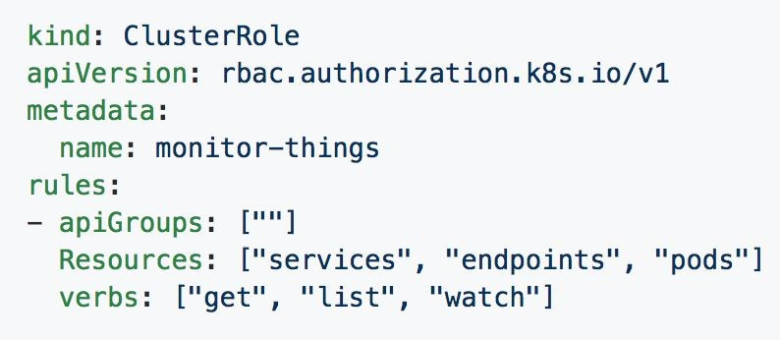
[Cluster]Role
Permissions translate to url path. With “” defaulting to core group.
Resources act as items the role should be granted access to.
Verbs are the actions the role can perform on the referenced resources.

Slide 59
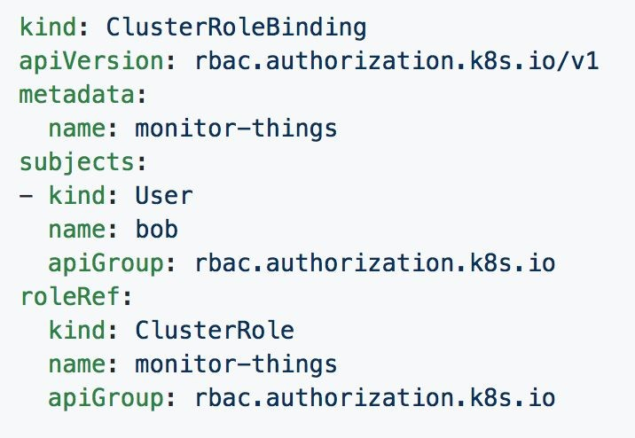
[Cluster]RoleBinding
Can reference multiple subjects
Subjects can be of kind:
User
Group
ServiceAccount
roleRef targets a single role only.

Slide 60
Behind
The Scenes

Slide 61
Deployment From
Beginning to End

Slide 62
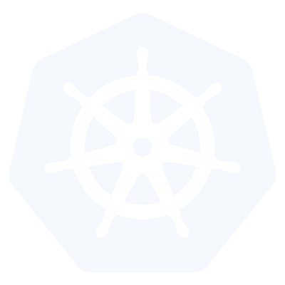
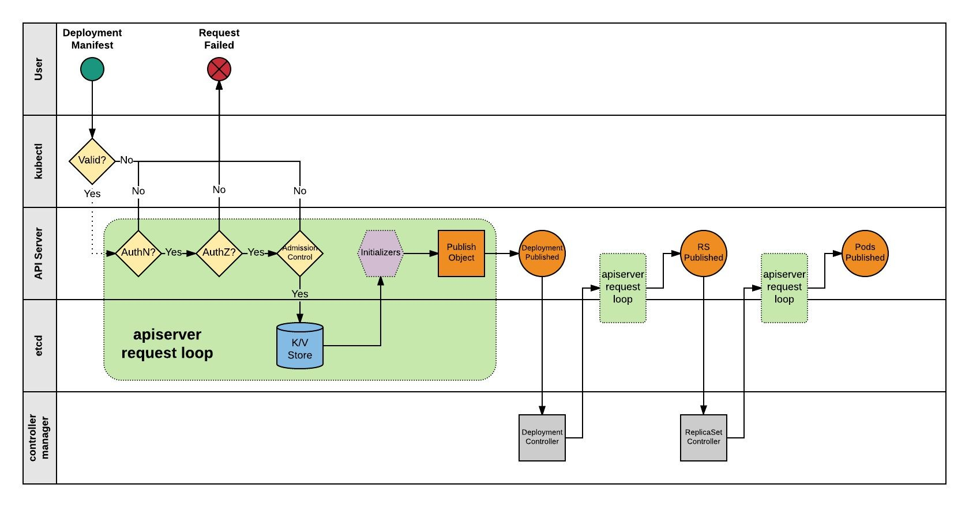

Slide 63
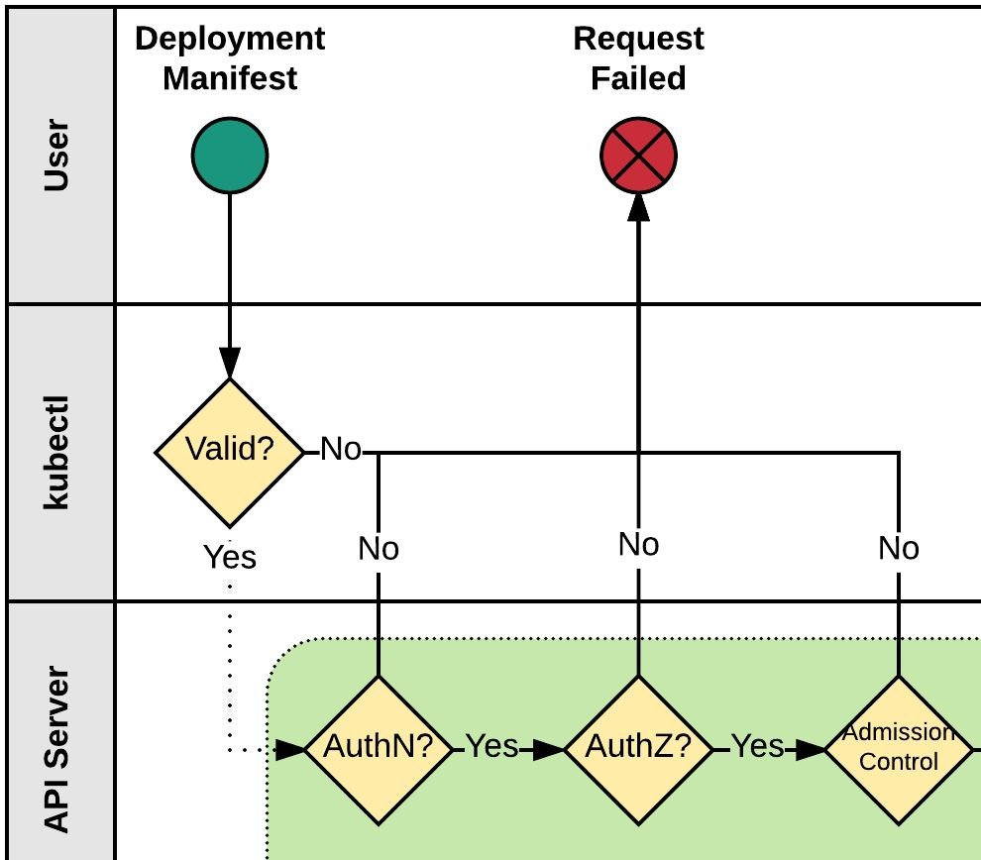
Kubectl
Kubectl performs client side validation on manifest (linting).
Manifest is prepared and serialized creating a JSON payload.

Slide 64
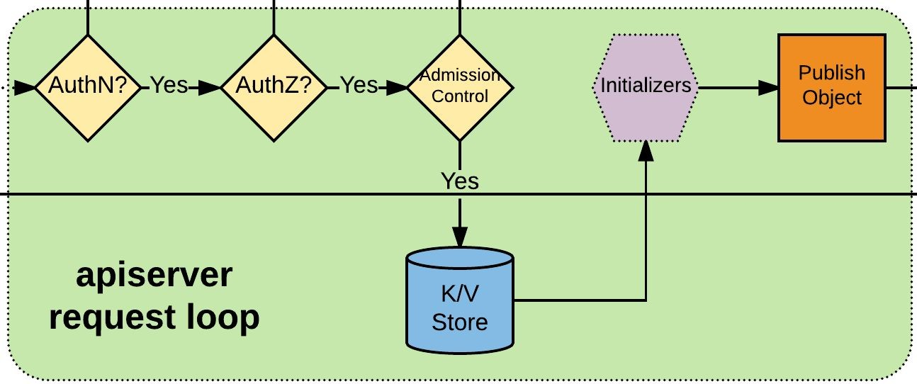
APIserver Request Loop
Kubectl authenticates to apiserver via x509, jwt, http auth proxy, other plugins, or http-basic auth.
Authorization iterates over available AuthZ sources: Node, ABAC, RBAC, or webhook.
AdmissionControl checks resource quotas, other security related checks etc.
Request is stored in etcd.
Initializers are given opportunity to mutate request before the object is published.
Request is published on apiserver.

Slide 65
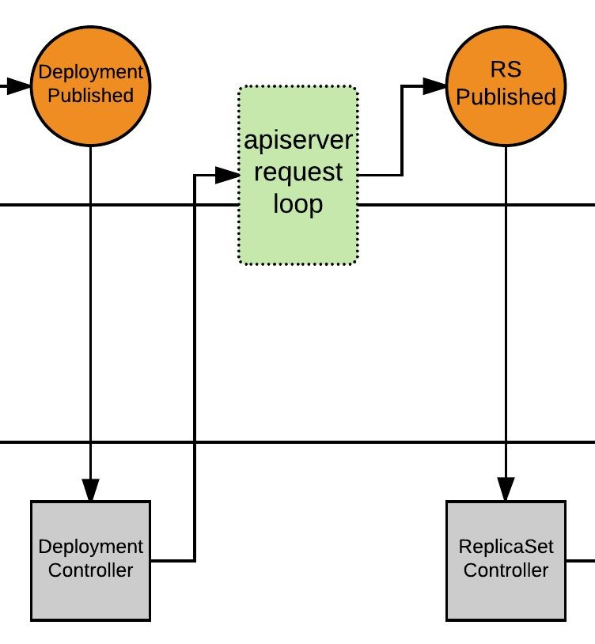
Deployment Controller
Deployment Controller is notified of the new Deployment via callback.
Deployment Controller evaluates cluster state and reconciles the desired vs current state and forms a request for the new ReplicaSet.
apiserver request loop evaluates Deployment Controller request.
ReplicaSet is published.

Slide 66
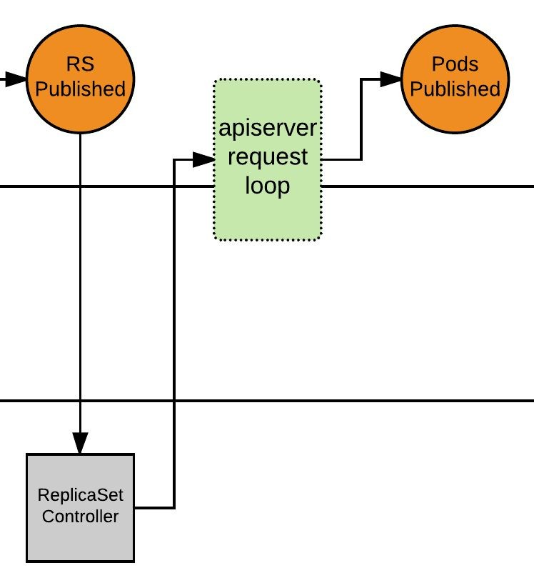
ReplicaSet Controller
ReplicaSet Controller is notified of the new ReplicaSet via callback.
ReplicaSet Controller evaluates cluster state and reconciles the desired vs current state and forms a request for the desired amount of pods.
apiserver request loop evaluates ReplicaSet Controller request.
Pods published, and enter ‘Pending’ phase.

Slide 67
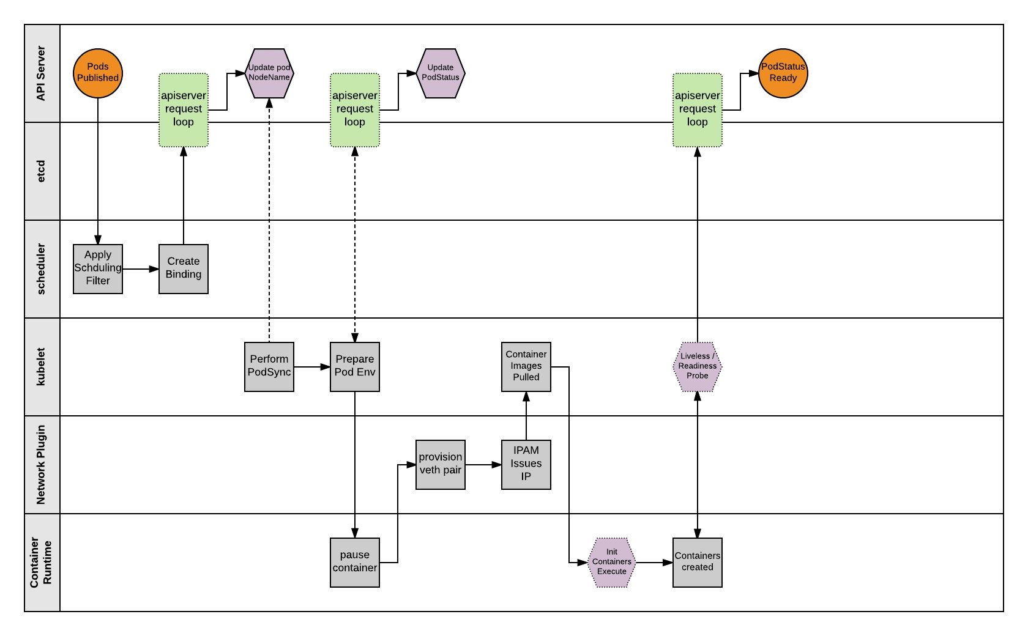

Slide 68
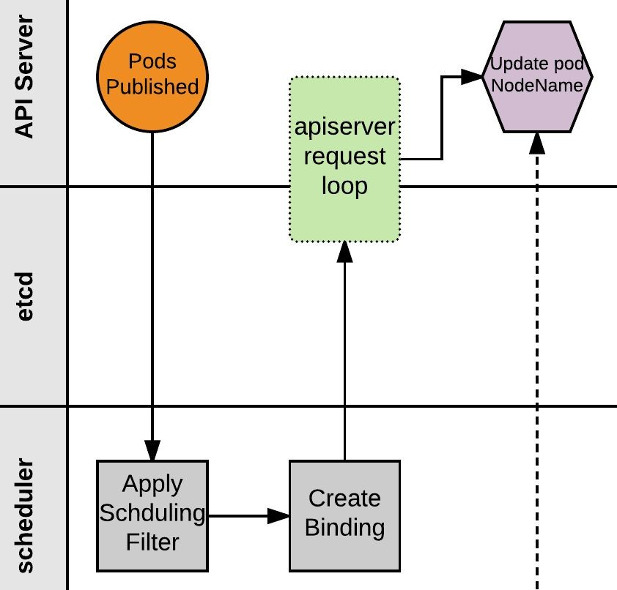
Scheduler
Scheduler monitors published pods with no ‘NodeName’ assigned.
Applies scheduling rules and filters to find a suitable node to host the Pod.
Scheduler creates a binding of Pod to Node and POSTs to apiserver.
apiserver request loop evaluates POST request.
Pod status is updated with node binding and sets status to ‘PodScheduled’.

Slide 69
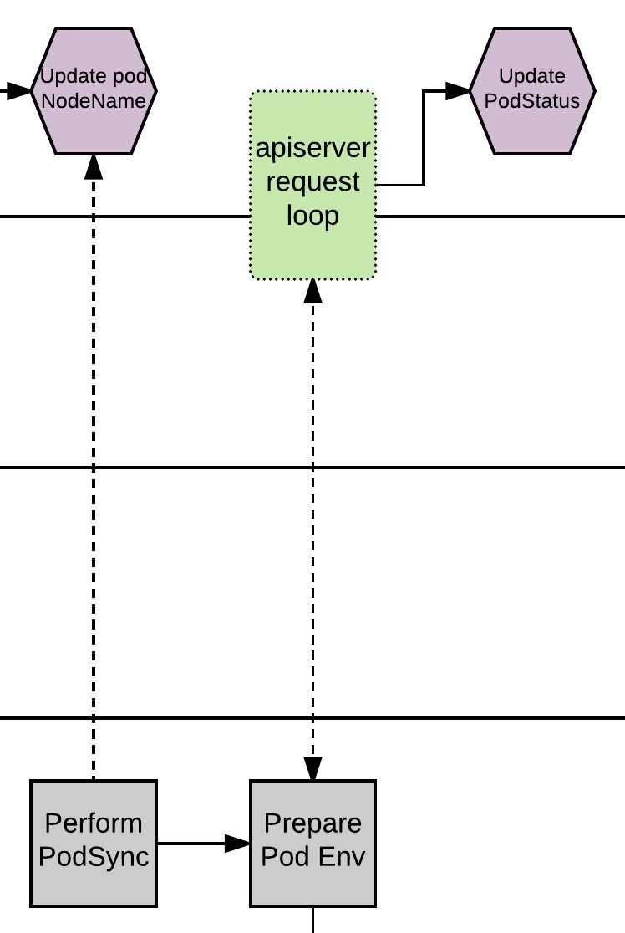
Kubelet - PodSync
The kubelet daemon on every node polls the apiserver filtering for pods matching its own ‘NodeName’; checking its current state with the desired state published through the apiserver.
Kubelet will then move through a series of internal processes to prepare the pod environment. This includes pulling secrets, provisioning storage, applying AppArmor profiles and other various scaffolding. During this period, it will asynchronously be POST’ing the ‘PodStatus’ to the apiserver through the standard apiserver request loop.

Slide 70
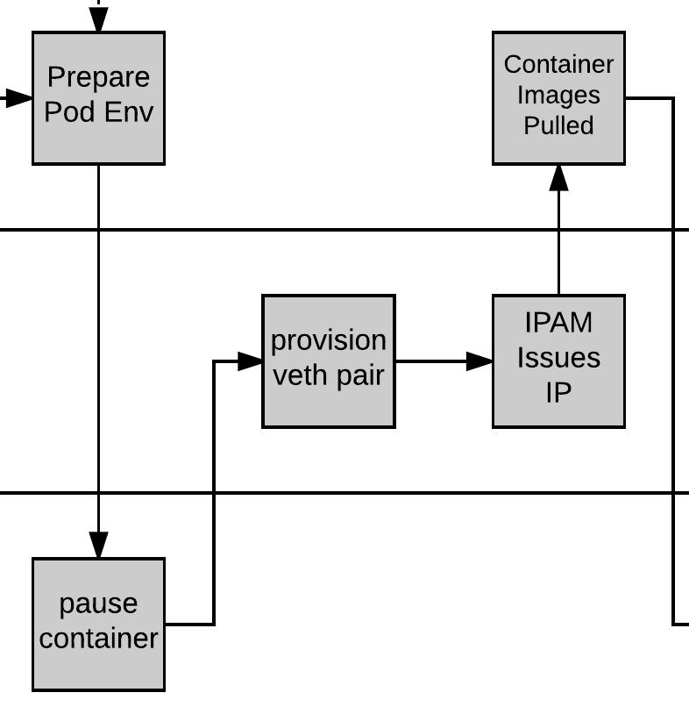
Pause and Plumbing
Kubelet then provisions a ‘pause’ container via the CRI (Container Runtime Interface). The pause container acts as the parent container for the Pod.
The network is plumbed to the Pod via the CNI (Container Network Interface), creating a veth pair attached to the pause container and to a container bridge (cbr0).
IPAM handled by the CNI plugin assigns an IP to the pause container.

Slide 71
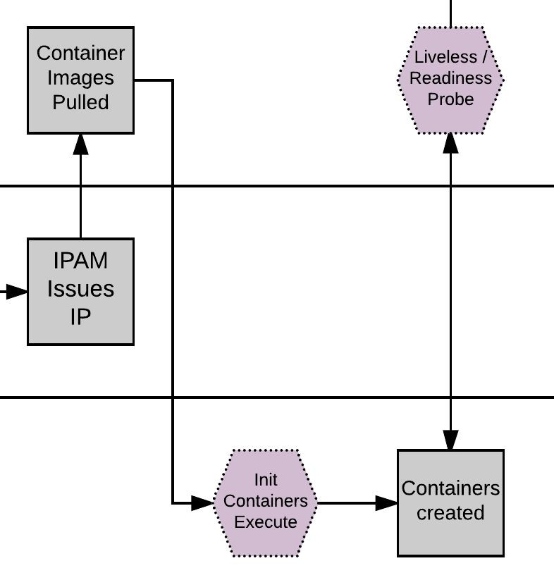
Kublet - Create Containers
Kubelet pulls the container Images.
Kubelet first creates and starts any init containers.
Once the optional init containers complete, the primary pod containers are started.

Slide 72
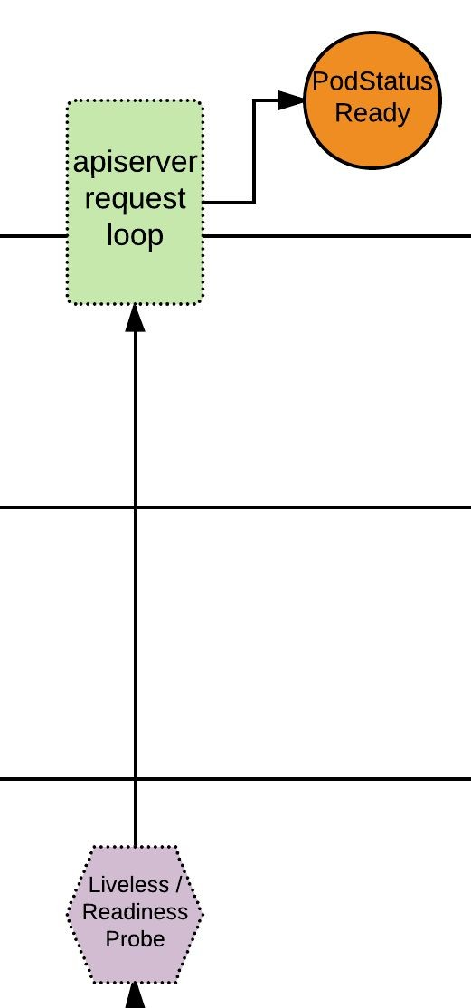
Pod Status
If there are any liveless/readiness probes, these are executed before the PodStatus is updated.
If all complete successfully, PodStatus is set to ready and the container has started successfully.
The Pod is Deployed!

Slide 73
Questions?

