Slide 1
Module1 - Introduction
DevOps

Slide 2
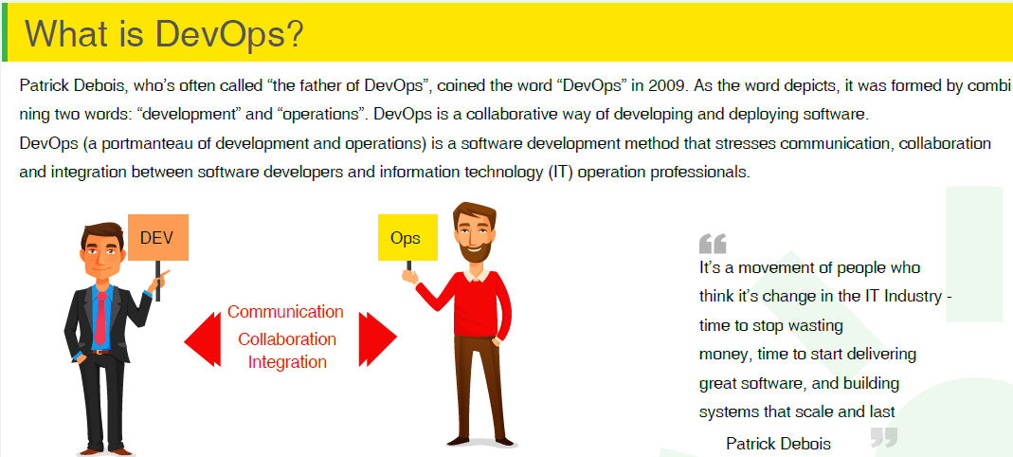

Slide 3
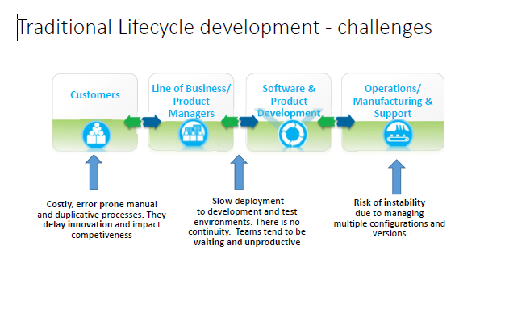
Tradition Development Approach

Slide 4
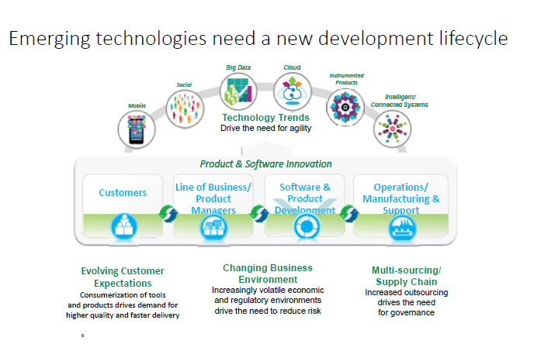
Why We Need DevOps

Slide 5
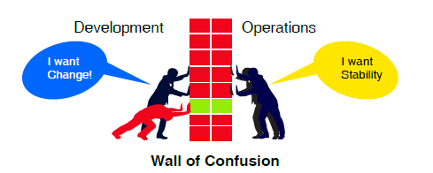
Development and Operations Problem
Developers always want to deliver changes as soon as possible.
Operations want reliability and stability.

Slide 6
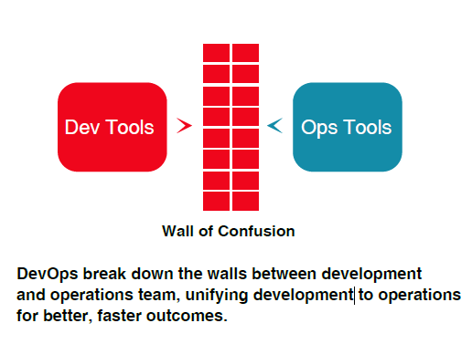
DevOps as a Solution

Slide 7
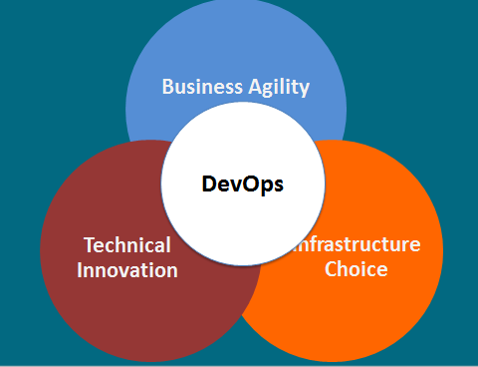
DevOps Advantages
Technological Innovation
Virtualization/Cloud
Automation
Business Agility
Time-to-Market Acceleration
Experimentation
Rapid Prototyping
Infrastructure Choice
Commoditization of Infrastructure
Language and Stack Neutral
Common Application Design and Operations
Flexibility

Slide 8
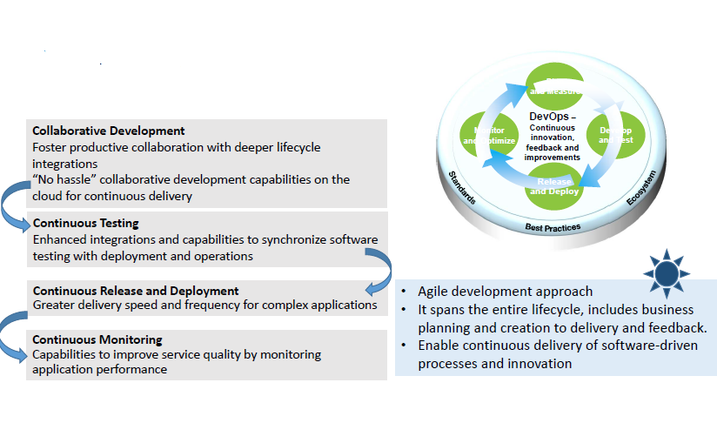
DevOps?
DevOps is a journey, not a destination….

Slide 9
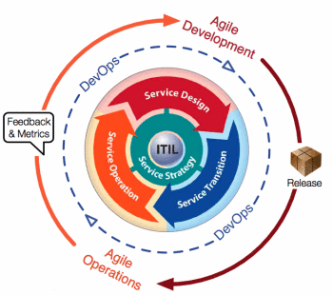
Application Lifecycle

Slide 10
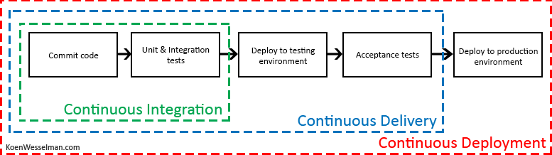
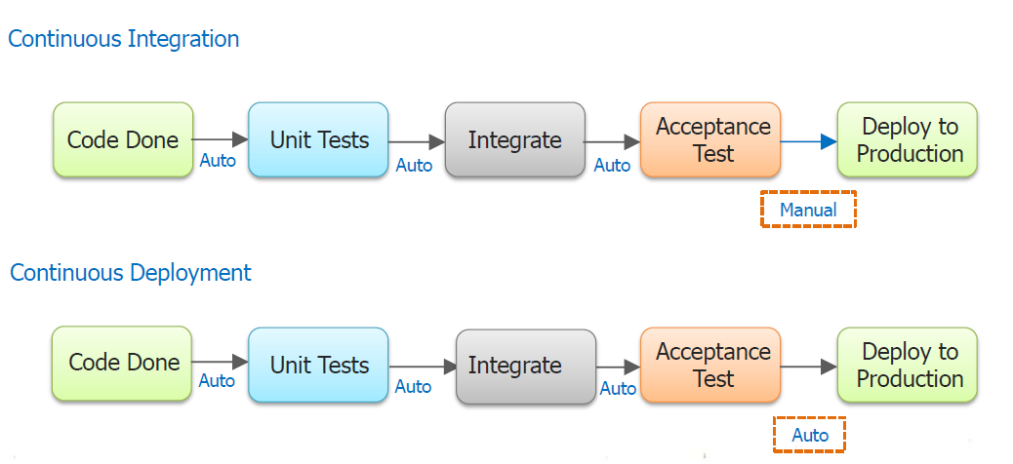
Continuous Integration, Delivery and Deployment

Slide 11


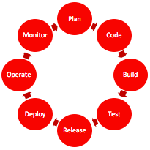
History and Multi-Dimensional Evolution of Computing
Development Process | Application Architecture | Deployment and Packaging | Application Infrastructure
Waterfall | Monolithic | Physical Server | Datacenter
Agile | N-Tier | Virtual Servers | Hosted
DevOps | Microservices | Containers | Cloud
Notes:
All of this is part of a transformation of technologies along a number of fronts, and is the basis for modern agile application development.

Slide 12
DevOps in real life
Apple was the among the first company to develop the DevOps team
Ecommerce companies like Amazon, EBay followed the suite & now almost every product based company is trying to use DevOps team to reduce the time to market
There are companies which have achieved biweekly release cycle targets after introducing DevOps which used to be a month before the introduction of DevOps in their organization

Slide 13
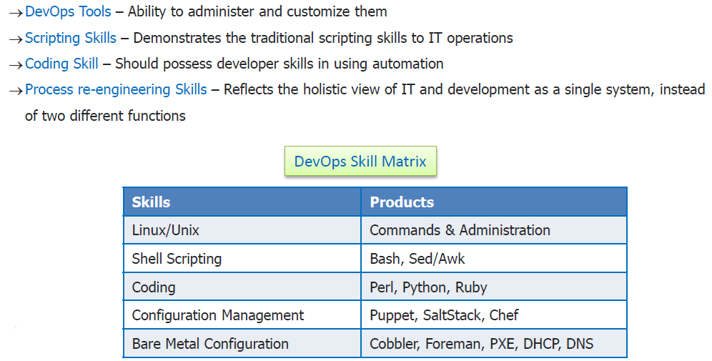
DevOps Skills

