Slide 1


Jenkins
Getting Started with Jenkins

Slide 2



Continuous Integration Basics
Compilation
Test Execution
Database integration
Code inspection
Automated Deployment
Document Generation
Integration Server
Test Server
Code Changes
Version Control Server
Dedicated Build Server
UAT Server
Auto Deployment Process
Production Server
Developer Workstations
Slide 2

Slide 3

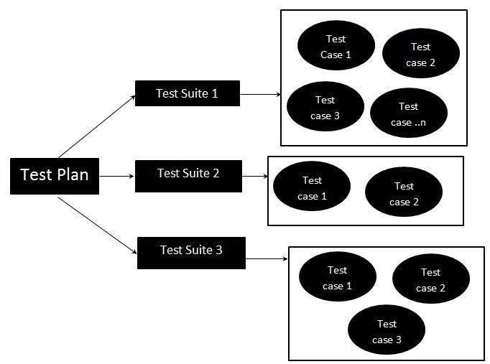
CI Starter Kit - RECAP
Automated Build process
Source Code Repository
Continuous Build Server
Automated Test Suite
Slide 3

Slide 4
Jenkins Supported Platforms - RECAP
→ Windows
→ Ubuntu/Debian
→ Red Hat/Fedora/CentOS
→ Mac OS X
→ openSUSE
→ FreeBSD
→ OpenBSD
→ Solaris/OpenIndiana
→ Gentoo
Slide 4

Slide 5




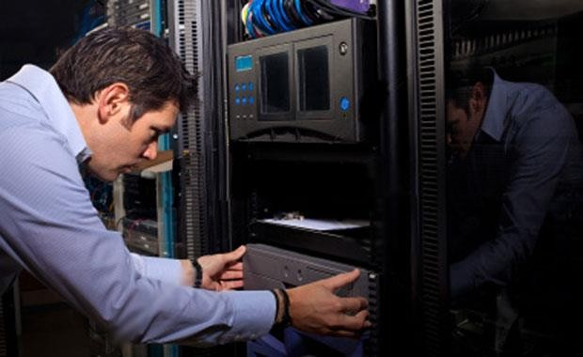


Jenkins – involve all!
Slide 5

Slide 6
Installation Pre-Notes
→Ensure that Java 7 or 8 are setup.
» In production version, only JRE can be present
» For development and test, JDK/JRE can be present.
» Ensure system variable JAVA_HOME is set and present on path.
→Create an Environment variable JENKINS_HOME.
» This is the place where all Jenkins works (including workspaces are stored).
» In production environment this should be on a directory with large amount of space.
» This will also be the place to install JENKINS too.
Slide 6

Slide 7
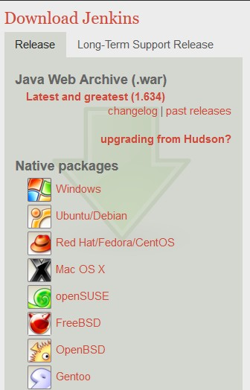
Installing Jenkins on Windows
→Can be installed either as
» Web Archiver (WAR)
» Native Package
→Two versions
» Release
» Long Term Support (LTS) Release
→LTS versions are some point releases away from “latest and greatest” versions.
→They are more stable
→Always use LTS versions for production environments.
Slide 7
CoCoursursee
Url

Slide 8
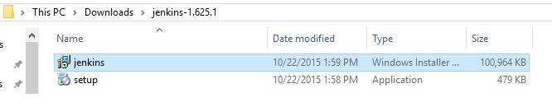

Installing as native package
→Click on link for Windows Package
→Download ZIP file
→Extract files to temporary folder (This is not required strictly).
→Double click on file named Jenkins.msi. Just click on next for all appearing windows to perform a default install.
If you are using Norton, it will complain about the installer file not being trusted.
Slide 8

Slide 9
Installation as Native Package
→The default is to install c:\program files (x86)\Jenkins
» CHANGE THIS to use JENKINS_HOME and ensure that JENKINS_HOME does not contain spaces.
→The native package comes bundled with a JRE which is used.
→All configuration is stored in file Jenkins.xml.
» Internally, you can see it invoke java on Jenkins.war on port 8080
» The engine used is winstone
» Log files are
Jenkins.out.log
Jenkins.err.log Jenkins.wrapper.log

Slide 10
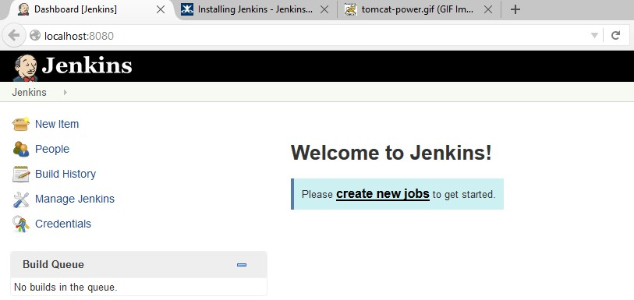
Native Package installation
→Navigate to http://<localhost>:8080. The Jenkins page should be displayed.

Slide 11
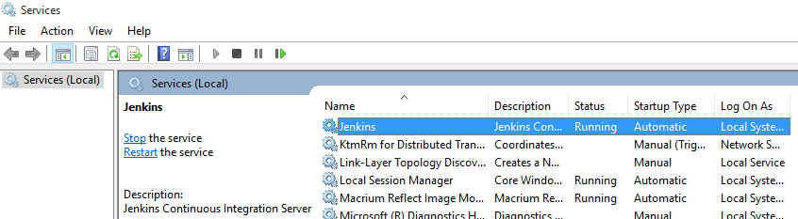
Native package installation
→The default context is / (no need to specify /Jenkins).
→This will automatically install Jenkins as a Windows Service.
→This service will run by default with “Local System Account”.
→The service is marked as Automatic which means that Jenkins will start automatically.

Slide 12
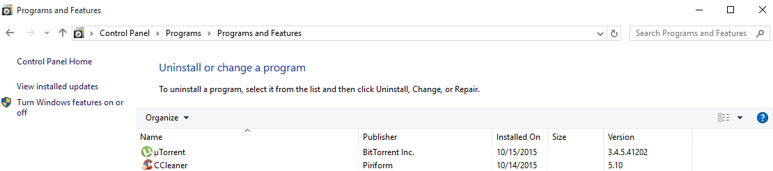
Native Package - Remove Jenkins
→Click on Control Panel -> Program and Features -> Uninstall a program
→ Double click on Jenkins to confirm removal.
→Restart the system
You will need to restart to complete the uninstall operation.

Slide 13
Native Package –Can I run as a war file?
→Yes. All Jenkins.exe does is to invoke java on Jenkins.war.
→Create a batch file that contains this:
» java -Xrs -Xmx1024m -Dhudson.lifecycle=hudson.lifecycle.WindowsServiceLifecycle -jar jenkins.war" -- httpPort=8080
→That will work too! However
» You lose benefits of running as a service with auto start/stop from service control panel.
» Ugly – one closable terminal will continue to be displayed (which can be hidden though)

Slide 14


Installing as Package
→You will need the following:
Apache Tomcat 6+ (We recommend 7 or 8
Oracle JDK 7/8

Slide 15
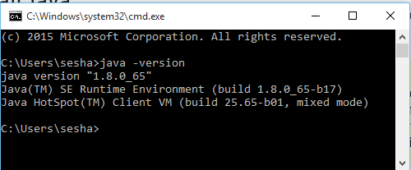
Install Java
→ Download Java from java.com.
→Double click on installer to start.
→Verify correctness of install by typing below from a command line
» java -version
On windows, it is
always recommended
to install to a directory that has no spaces in its name.
JAVA_HOME must be set and JAVA should in PATH

Slide 16
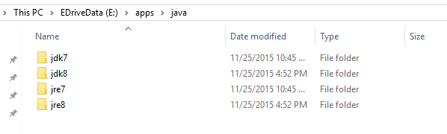
Installing Java
→Choose Correct installer. (JDK or JRE)
→If choosing JDK, ensure Public JRE is also installed and that the JRE and JDK are installed separately.
→JDK 8: 1.8.0_66+ is preferred.

Slide 17
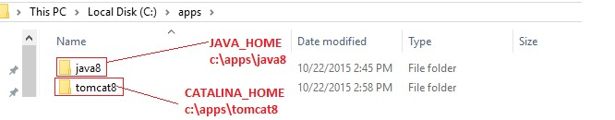
Install Tomcat
→There are multiple ways to install Tomcat.
» Binary installers
» Zip installers
» Install Tomcat as a service
→Refer here: https://tomcat.apache.org/tomcat-8.0-doc/setup.html#Windows
Windows
for setup of Tomcat 8 on
→At end of install of Java and tomcat, the following system variables should be set to point to correct location
» JAVA_HOME: the location where java is installed
» CATALINA_HOME: The location where TOMCAT is installed.

Slide 18
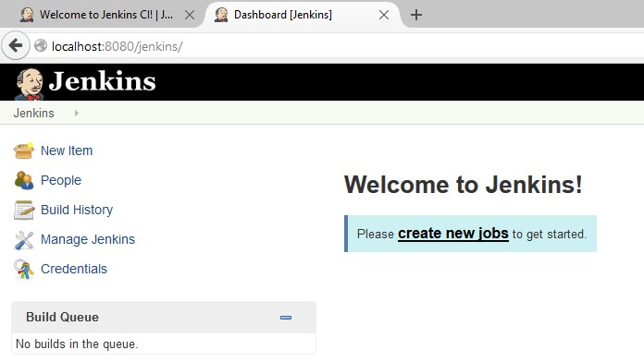
Install as a web WAR
→Download WAR file to %CATALINA_HOME%\webapps directory folder. (if using Tomcat)
→Tomcat should automatically expand Jenkins.war to Jenkins folder and auto-deploy the application.
→Navigate to http://localhost:8080/jenkins

Slide 19
Install as a web WAR
If not using Tomcat or other container, the application can be run
using the following command:
java –jar jenkins.war --httpPort=8080

Slide 20
Installation notes
→Installing as a Win installer creates context under root i.e. http://localhost:8080, while installing as war creates Jenkins context as http://localhost:8080/jenkins
→Configuration under installer can be found under Jenkins.xml while in war file, it is standard server.xml/web.xml file.
→Typically in production, build servers are usually on UNIX and UNIX variants mainly because of
» Better SSH/SSL Support
» Better support for upgrade to latest versions of Jenkins as required.
→In all cases, default port is 8080 which can be changed.

Slide 21
Change Default binding for Jenkins war
→This is a recommended practice for Jenkins.
→On tomcat, there are multiple ways to do this.
→Method 1:
» Unzip the WAR file for Jenkins directly under ROOT folder
→Method 2:
» Change the context for default servlet and change context for Jenkins to /

Slide 22

Install Maven
→Maven is a build tool.
→To install,
» Download the ZIP/GZ file
» Unzip the same
unzip apache-maven-3.3.3-bin.zip (Windows)
tar xzvf apache-maven-3.3.3-bin.tar.gz (Linux)
» Set MAVEN_HOME environmental variable to where Maven has been extracted.
» Add $M2_HOME/bin (%M2_HOME%\bin) to the PATH variable.

Slide 23

Install ANT
→ANT is a build tool.
→To install,
» Download the ZIP/GZ file
» Unzip the same
unzip apache-ant-1.9.6-bin.zip (Windows)
tar xzvf apache-ant-1.9.6-bin.tar.gz (Linux)
» Set ANT_HOME environmental variable to where Ant has been extracted.
» Add $ANT_HOME/bin (%ANT_HOME%\bin) to the PATH variable.

Slide 24
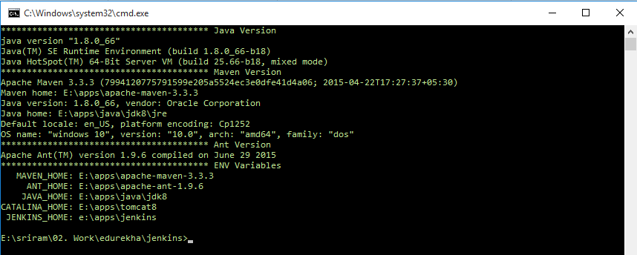
Verification
→If all went fine, you can verify the correct installation path (Custom script) as below:

Slide 25
Installation On Ubuntu
→Install OpenJDK 7
→Install Tomcat 7
→Download WAR file to $CATALINA_HOME/webapps
→Restart tomcat 7
OR SIMPLY INSTALL NATIVE IMAGES

Slide 26



Installation on Ubuntu
→Require
Open JDK 7 or Open JRE 7
Prefer not to use GNU Compiler for Java

Slide 27
Installation on Ubuntu
→To install, you first need to install Jenkins to the list of package source list.
→This is done by first adding the key ring and source to package list
wget -q -O - https://jenkins-ci.org/debian/jenkins-ci.org.key | sudo apt-key add –
sudo sh -c 'echo deb http://pkg.jenkins-ci.org/debian binary/ > /etc/apt/sources.list.d/jenkins.list'
→Next we need to update apt to refresh with the changes
sudo apt-get update
→Finally, we install Jenkins
sudo apt-get install jenkins

Slide 28
Installation on Ubuntu
→Updation
» Just perform an apt-get update and installation
→Removal
» Just perform an apt-remove

Slide 29
Installation on Ubuntu
→Jenkins will start on auto-startup.
» See /etc/init.d/Jenkins for additional details.
→User jenkins is created to run this service
→Log file can be found here: /var/log/jenkins/jenkins.log
→Configuration file can be found here:
» /etc/default/jenkins
→Default port listening is always 8080. Edit above file (line than contains HTTP_PORT) to change the number
→You could install either Apache, NGINX or simply edit iptables to redirect traffic on port 80 to 8080 or use Apache/NGINX as a proxy.

Slide 30
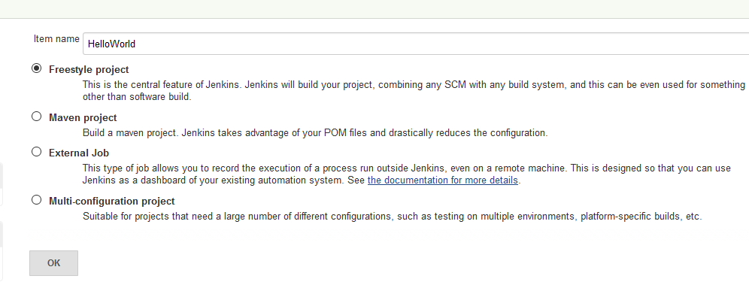
Your First Jenkins Job
→We will start with a free style job
→The build is to just execute 1 shell script
→ The job will be named “HelloWorld”
» Click on New Item
» Enter the name
» Select Free Style project
» Click OK

Slide 31
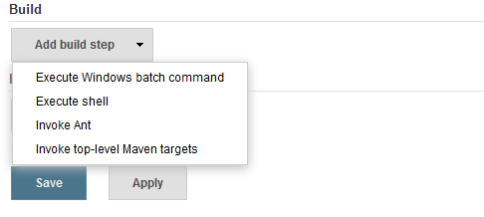
Your First Jenkins Job
→Leave all empty (default) for now.
→In build section, choose “Execute Windows Batch Command” from Add Build Steps and Click Apply.

Slide 32
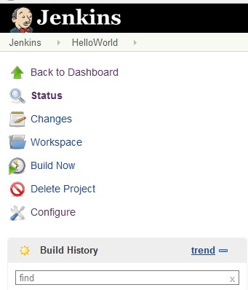
Your First Jenkins Job
→In the Command area, type
» echo Hello World
→Click Save. Jenkins will open the HelloWorld project as shown
→The Build history will be blank – as this has not been run at all.
→To run the project, click on Build now.

Slide 33
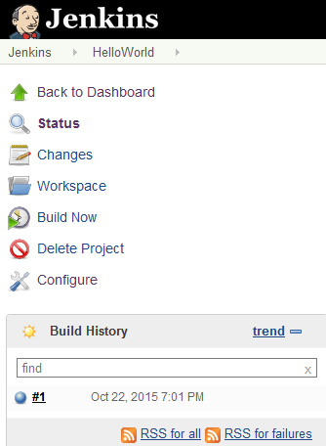
Your First Jenkins Job
→Build run #1 is shown below. A default blue icon indicates a successful ru
→Click on link for Build 1 and click on Console Output.
n.

Slide 34
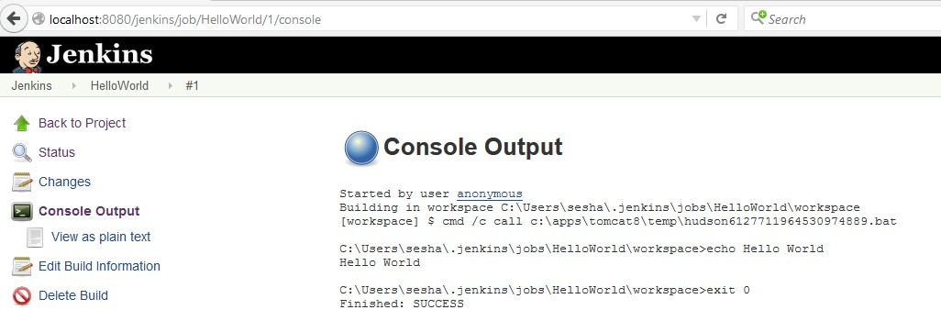
Your First Jenkins Job
→The Console output shows that a temporary batch file was created by Jenkins and executed on your behalf.
Your first job just ran successfully with no issues!

Slide 35










JENKINS – JOBS AND PLUGINS
→ Plugins categorization
Reports
Test
Notification
Deployments
Compile
Slide 35

Slide 36









Jenkins - Plugins
SCM
Over 1100 plugins!!
Report
Plugins
Build
Triggers
Plugins
Build Tools
Notifiers
Build Wrappers
REF: https://wiki.jenkins-
ci.org/display/JENKINS/Plugins

Slide 37
Jenkins - Plugins
Slave Controllers
Other Post Build Tools
Artifacts Uploaders
Plugins
External Tool Integrators
UI Plugins
List View Column Plugins
REF: https://wiki.jenkins-
ci.org/display/JENKINS/Plugins

Slide 38
Thanks
_{Slide 38}

