Slide 1
Chef

Slide 2
Table of contents
What is chef
Chef Architecture
Chef Components
Chef Development Kit
How Chef works
Chef cookbook structure
Chef server and bootstrap chef node

Slide 3
What is chef
Chef is a powerful automation platform that transforms complex infrastructure into code, Chef automates how applications are configured, deployed, and managed across your network, no matter its size.

Slide 4
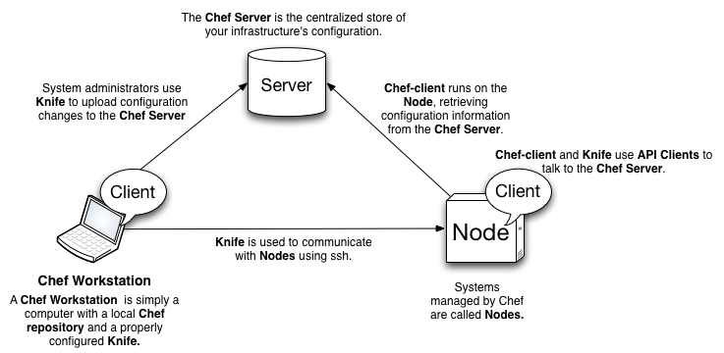
Chef Architecture
When using Chef to manage infrastructure, you will be dealing with three types of hosts: a Chef Server, Nodes, and Chef Workstations.

Slide 5
Chef Components…
Here is a short summary of main parts of Chef architecture:
Chef Server: Centralized server that holds all of your nodes' configuration. It can be self-hosted or hosted by Chef (the company).
Node: Hosts to which recipes and roles are applied during Chef client run. The primary features of a node are its attributes and run list.
Cookbooks: Contain all resources and instructions that you need to configure your nodes. These can be reused across different run lists. Cookbooks typically consist of many recipes.
Recipe: The fundamental part of Chef, it is a collection of resources that are executed in the order to configure a node.
Resource: A cross platform abstraction of configurable parts of a node. For example these could be users, packages, files or directories.

Slide 6
Chef Components
Attributes - Represent node settings, for example hostname, versions of programming languages to install, database server etc.
Chef Client: Does all work on behalf of a node, where it executes recipes to configure and install software.
Chef Repository: The place where cookbooks, roles, configuration files, and other artifacts live.
Chef Solo: A command line tool that allows you to run Chef cookbooks without an actual Chef server. It is an open source version of the Chef client. [being depreciated now and equivalent to chef-client --local-mode]
Knife: A tool used by engineers to upload configuration changes to the Chef server.
Chef Supermarket: Chef Supermarket is the location in which community cookbooks are shared and managed. Cookbooks that are part of the Chef Supermarket may be used by any Chef user. How community cookbooks are used varies from organization to organization.

Slide 7
Chef Development Kit
To make a development environment setup easy, the Chef community has created the Chef Development Kit (ChefDK). The aim of this project is to bring all widely adopted tools in one easily installable package, with support for many different platforms. To start using Chef and its supporting tools we need to install ChefDK first. To do that, go to ChefDK downloads page and download the right package for your platform. After downloading it, simply follow the standard installation steps for your platform.

Slide 8
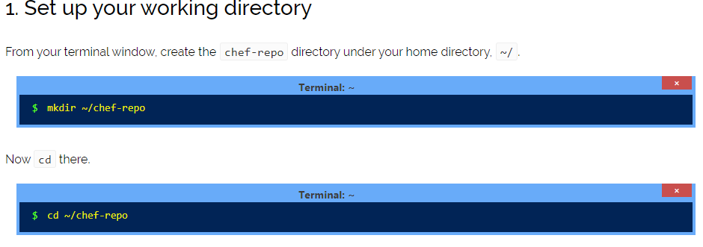
How Chef Works…
Launch EC2 instance on AWS and connect to it through Chef DK using below command.
ssh -i "E:\*\AWS\keys\<private-key>.pem" ubuntu@<public IP address>

Slide 9
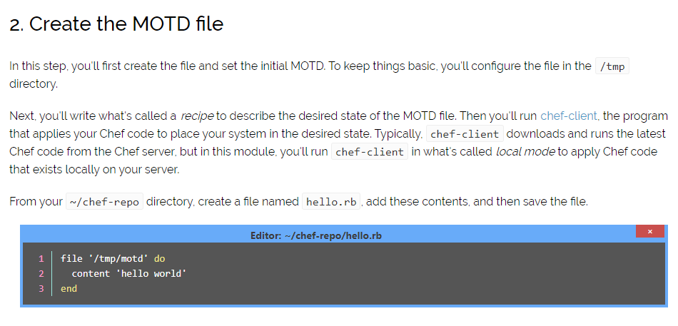
How Chef Works…

Slide 10
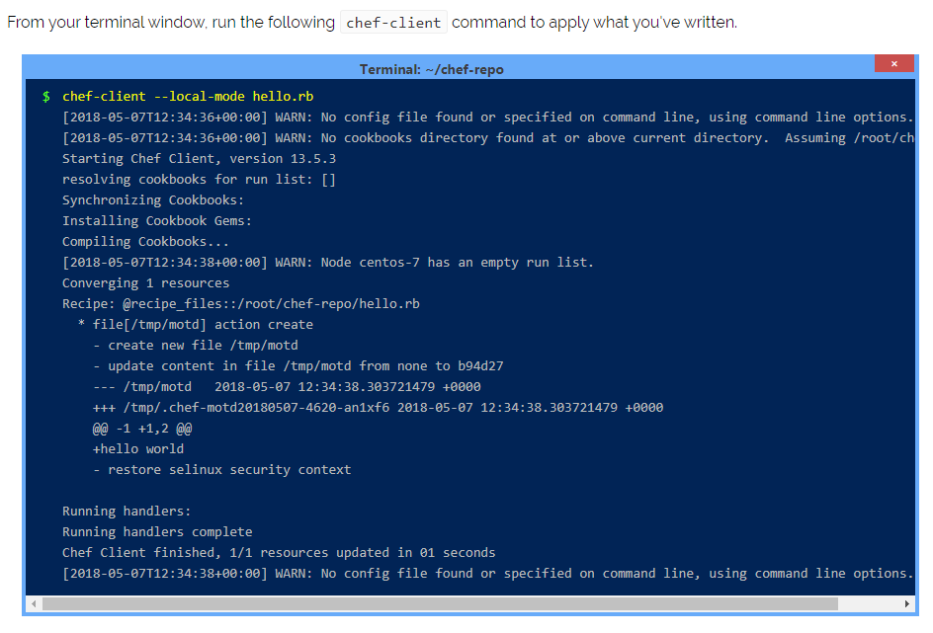
How Chef Works…
The output tells us that a new file, /tmp/motd, was created.

Slide 11
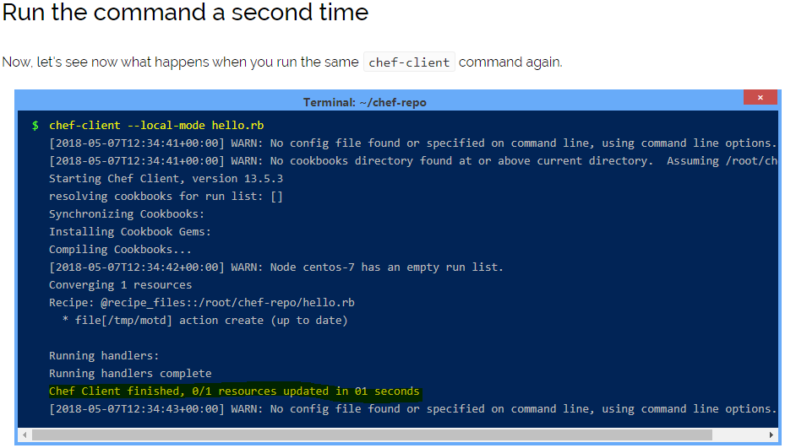
How Chef Works…
This time you get a different response – the file is already up to date. This is because Chef applies the configuration only when it needs to.

Slide 12
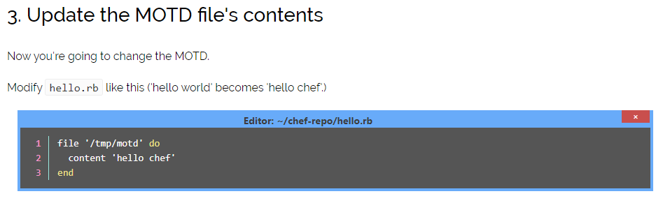
How Chef Works…

Slide 13
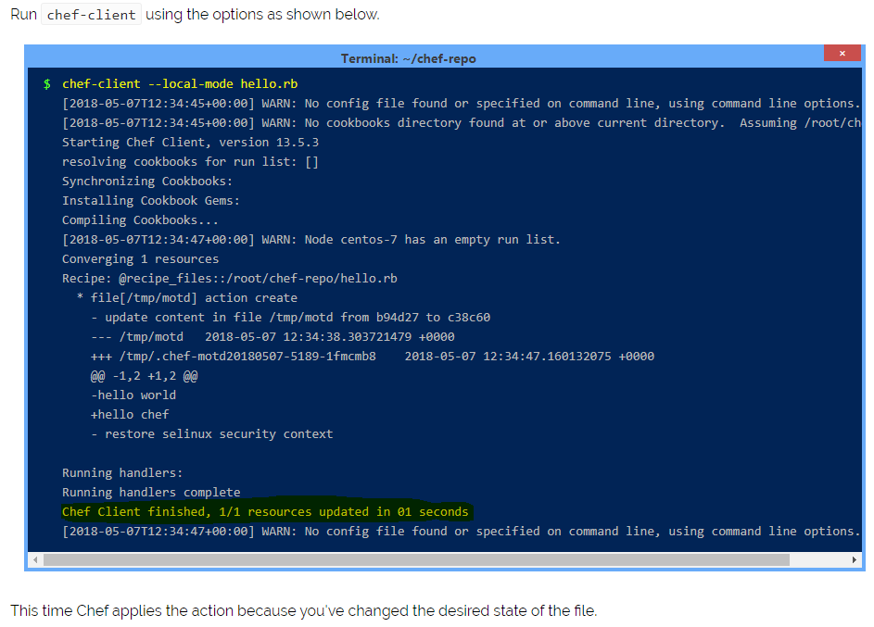
How Chef Works…

Slide 14
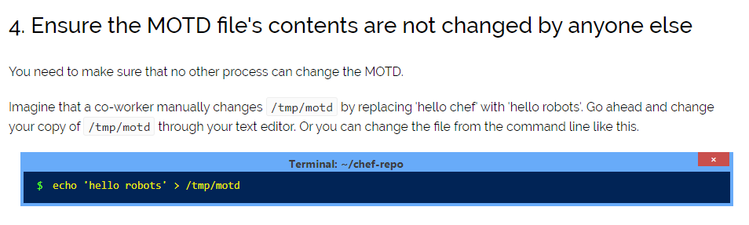
How Chef Works…

Slide 15
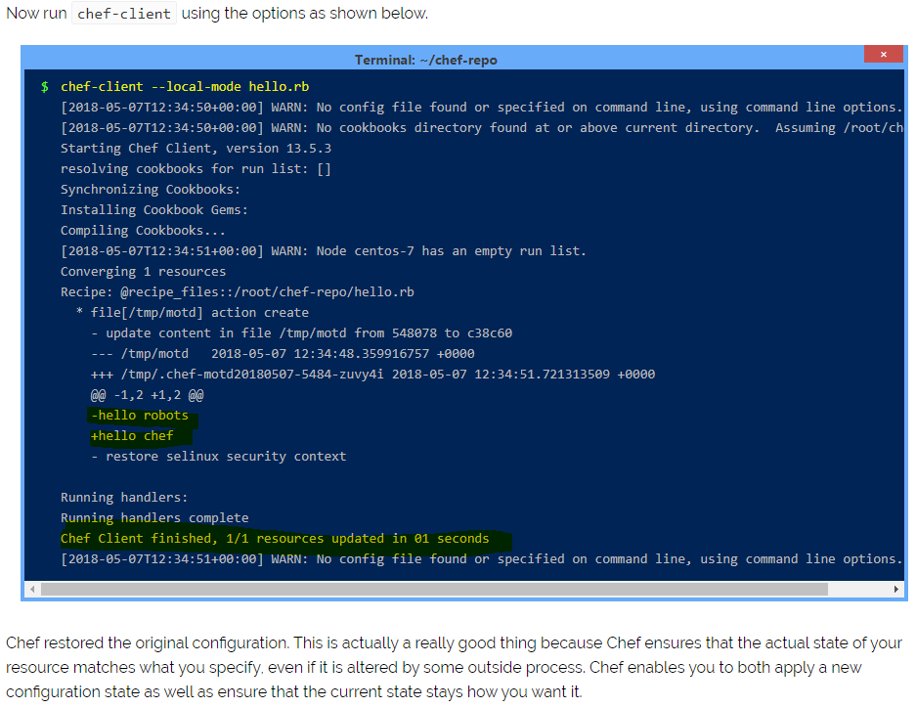
How Chef Works…

Slide 16
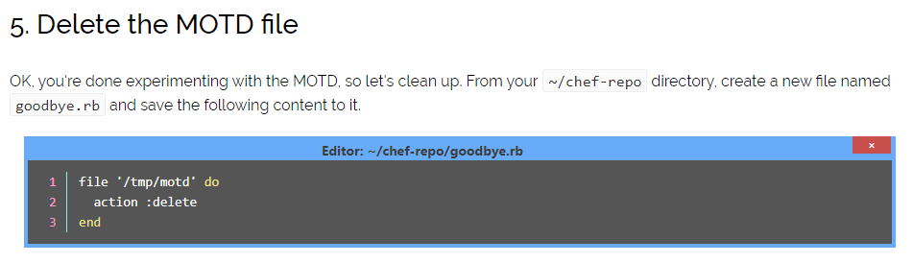
How Chef Works…

Slide 17
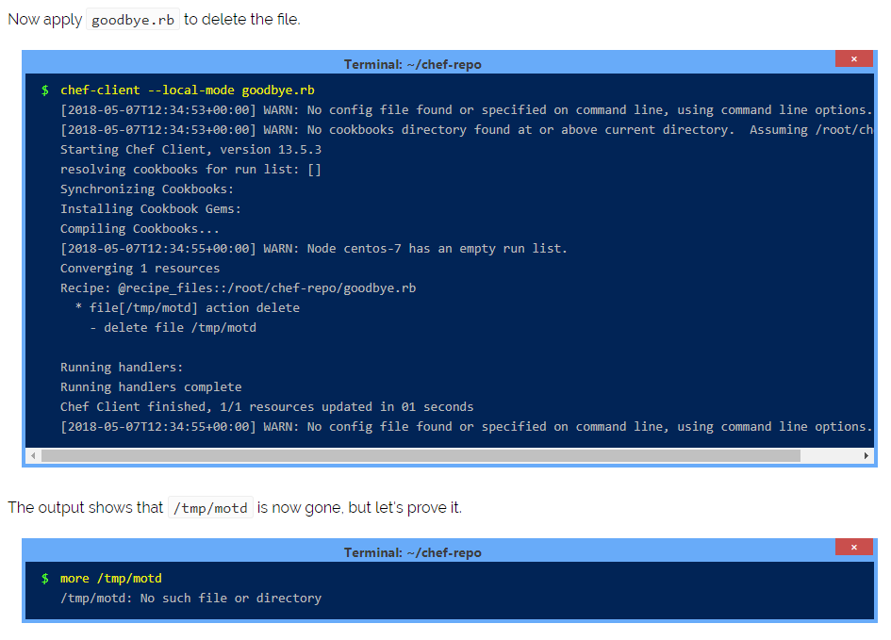
How Chef Works

Slide 18
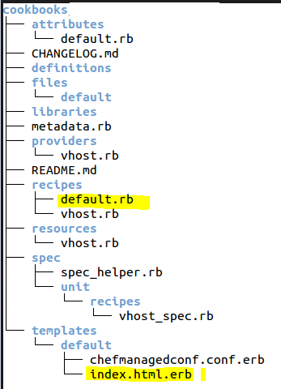
Chef Cookbook Structure…

Slide 19
Chef Cookbook Structure
Following items are also part of cookbooks Resources and providers A resource is a package, a service, a group of users, and so on. A resource tells Chef which provider to use during a Chef run for various tasks like installing packages, running Ruby code, or accessing directories and file systems. The resource is generic: "install program A" while the provider knows what to do with that process on Debian and Ubuntu and Microsoft Windows. A provider defines the steps that are required to bring that piece of the system into the desired state. Chef includes default providers that cover all of the most common scenarios. File distributions A file distribution is a specific type of resource that tells a cookbook how to distribute files, including by node, by platform, or by file version. Definitions A definition is used to create new resources by stringing together one (or more) existing resources. Libraries A library allows the use of arbitrary Ruby code in a cookbook, either as a way to extend the Chef language or to implement a new class. Templates A template is a file written in markup language that uses Ruby statements to solve complex configuration scenarios. Configuration files A metadata file to ensure that each cookbook is correctly deployed to each node.

Slide 20
Chef Cookbook example…
chef generate cookbook cookbooks/learn_chef_apache2 Refer #Berksfile
chef generate template cookbooks/learn_chef_apache2 index.html
vi cookbooks/learn_chef_apache2/recipes/default.rb
----------------------------------------------------------------------
#
# Cookbook:: learn_chef_apache2
# Recipe:: default
#
# Copyright:: 2018, The Authors, All Rights Reserved.
apt_update 'Update the apt cache daily' do
frequency 86_400
action :periodic
end
package 'apache2'
service 'apache2' do
supports status: true
action [:enable, :start]
end
template '/var/www/html/index.html' do
source 'index.html.erb'
end

Slide 21
Chef Cookbook example…
Create index.html.erb
vi cookbooks/learn_chef_apache2/templates/index.html.erb
---------------------------------------------------------------------------------
<html>
<body>
<h1>hello world from Cookbook!! </h1>
</body>
</html>
Run the recipe and check the contents
sudo chef-client --local-mode --runlist 'recipe[learn_chef_apache2::default]'

Slide 22
Chef Server and bootstrap chef node
Configure hosted web server by creating the account in https://api.chef.io
Upload the recipes at chef server and bootstrap chef node (AWS EC2 Ubuntu instance in our case)

