Slide 1
Kubernetes

Slide 2
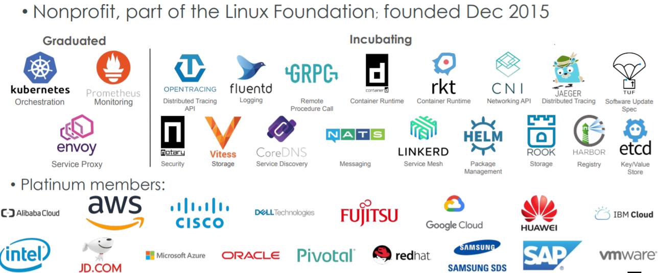
Cloud Native Computing Foundation

Slide 3
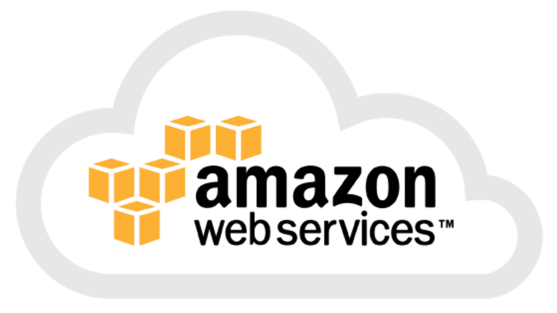
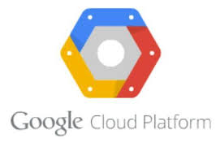
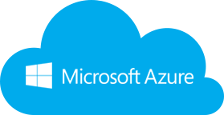
Kubernetes support on cloud
every cloud supports kubernetes
https://www.sinax.be/en/aws/
https://www.westconcomstor.com/za/en/vendors/wc-vendors/microsoft-azure-EN-UK.html
https://www.g2crowd.com/products/google-kubernetes-engine-gke/details

Slide 4
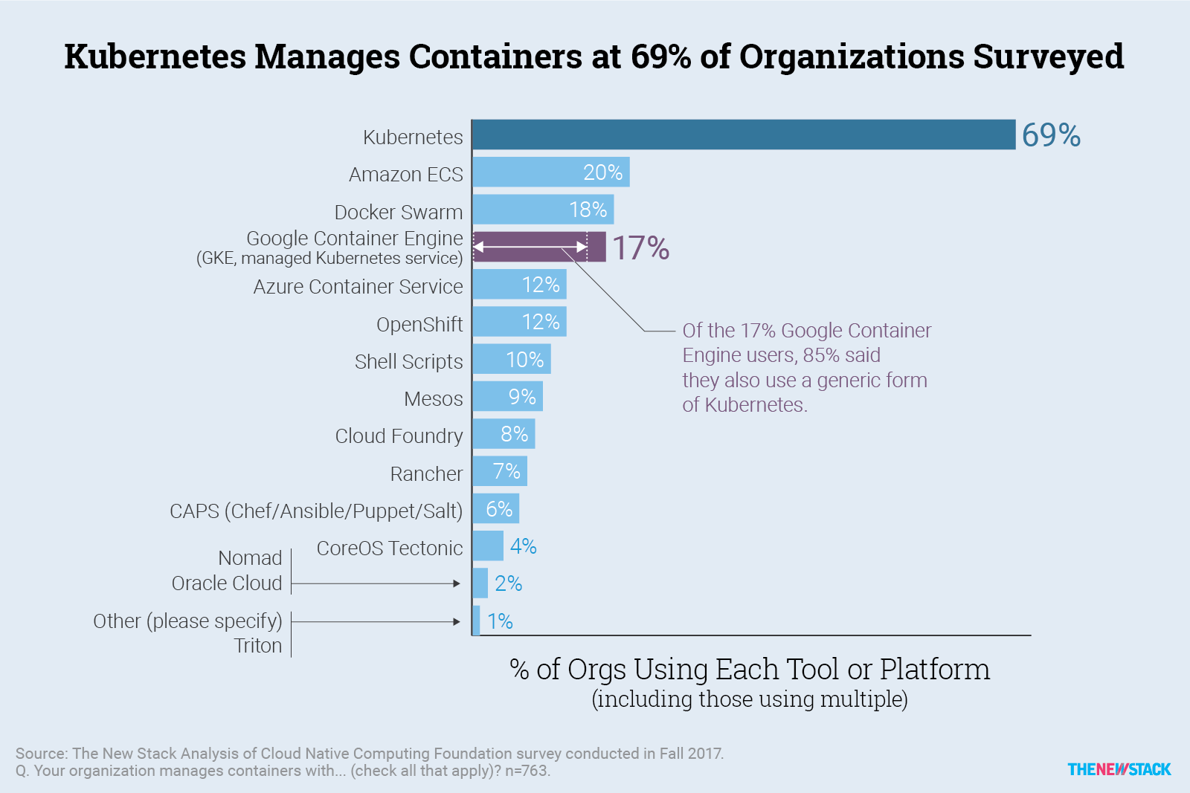
Kubernetes Market Adoption Survey

Slide 5
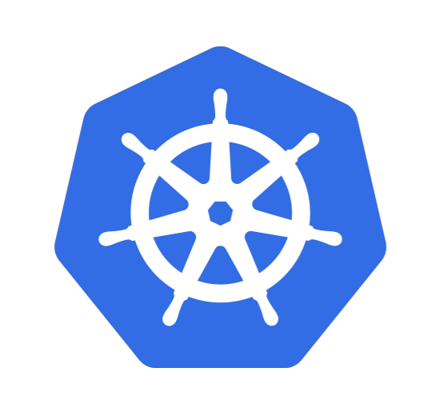
What does “Kubernetes” mean?
Greek for “pilot” or “helmsman of a ship”

Slide 6
A Container Orchestration System. ● A project that was spun out of Google as an open source container orchestration platform (~2 billion containers/week). ● Built from the lessons learned in the experiences of developing and running Google’s Borg and Omega. ● Designed from the ground-up as a loosely coupled collection of components centred around deploying, maintaining and scaling workloads.
What is Kubernetes?

Slide 7
What does Kubernetes do?
● Known as the linux kernel of distributed systems.
● Abstracts away the underlying hardware of the nodes and provides a uniform interface for workloads to be both deployed and consume the shared pool of resources.
● Works as an engine for resolving state by converging the actual and the desired state of the system.

Slide 8
Kubernetes is self-healing
Kubernetes will ALWAYS try and steer the cluster to its desired state.
● User: “I want 3 healthy instances of Redis to always be running.”
● Kubernetes: “Okay, I’ll ensure there are always 3 instances up and running.”
● Kubernetes: “Oh look, one has died. I’m going to attempt to spin up a new one.”

Slide 9
What can Kubernetes really do?
● Autoscale Workloads
● Blue/Green Deployments
● Fire off Jobs and scheduled CronJobs
● Manage Stateless and Stateful Applications
● Built-in Service Discovery
● ~Easily integrate and support 3rd party apps~

Slide 10
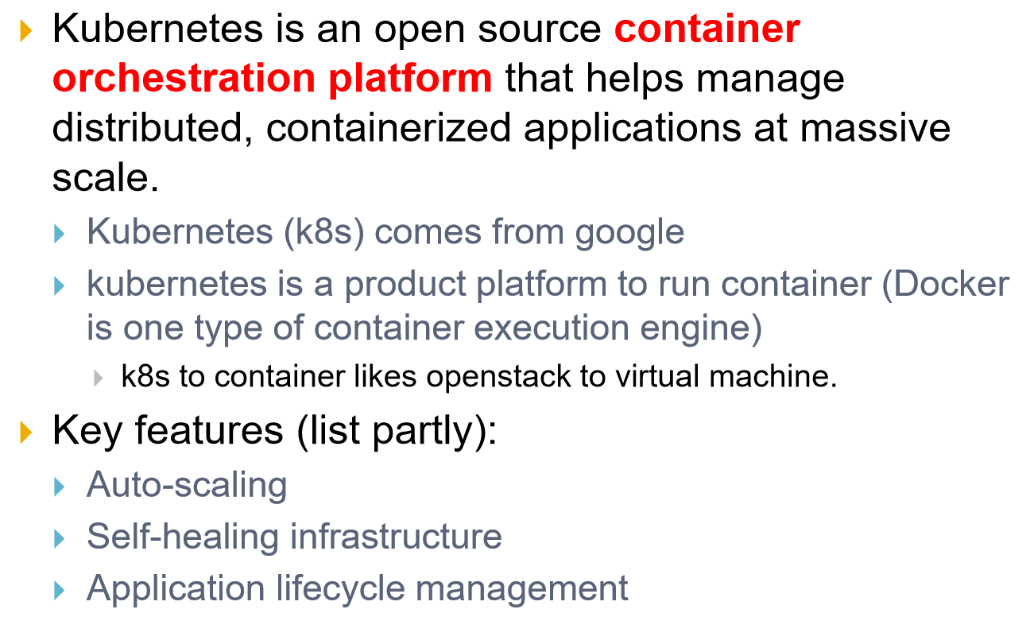
Kubernetes in a nutshell

Slide 11
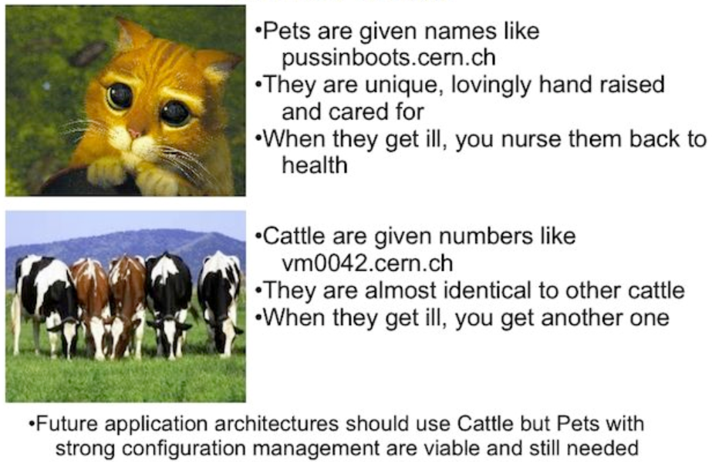



Service Model : Pets vs Cattle

Slide 12
Kubernetes Architecture

Slide 13
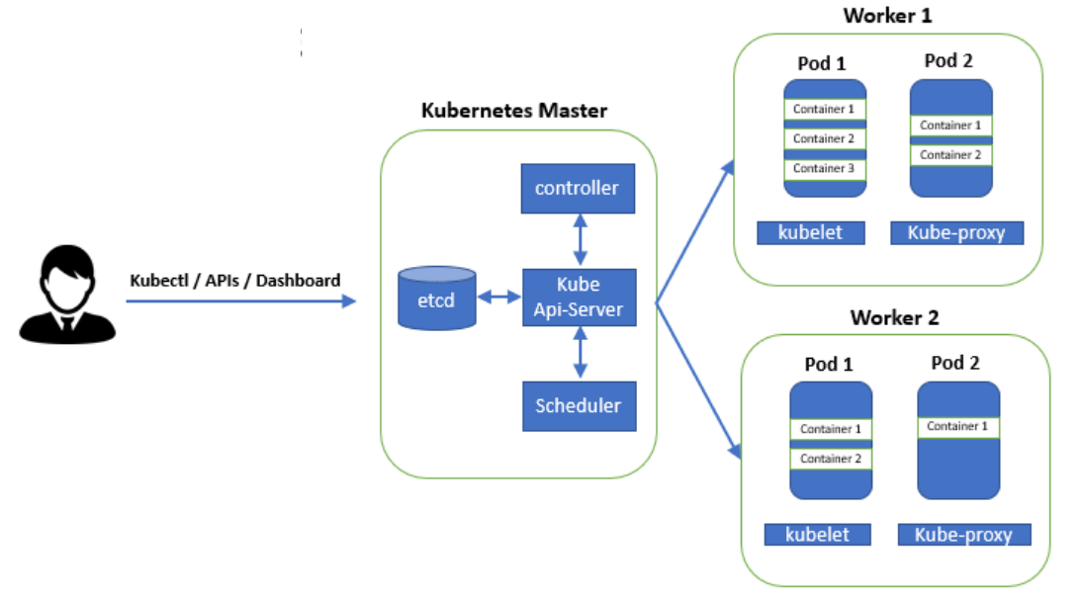
Kubernetes Architecture

Slide 14
Architecture Overview
Masters – Acts as the primary control plane for Kubernetes.
Masters are responsible at a minimum for running the API Server, scheduler and cluster controller.
They also manage storing cluster state, cloud-provider specific components and other cluster essential services.
Nodes - Are the ‘workers’ of a Kubernetes cluster.
They run a minimal agent that manages the node itself, and execute workloads as designated by the master.

Slide 15
kube-apiserver – the heart of the cluster
● Provides a forward facing REST interface into the Kubernetes control plane and datastore.
● All clients and other applications interact with Kubernetes strictly through the API Server.
● Acts as the gatekeeper to the cluster by handling authentication and authorization, request validation and admission control in addition to being the front-end to the backing datastore.
Kubectl
Kubectl is the official Kubernetes command line interface tool. It is used to communicate with the API.

Slide 16
etcd – the key-value datastore
● etcd acts as the cluster datastore.
● A standalone incubating CNCF project https://www.cncf.io/projects/
● Purpose in relation to Kubernetes is to provide a strong, consistent and highly available key-value store for persisting all cluster state.

Slide 17
kube-controller-manager
● Serves as the primary daemon that manages all core components’ reconciliation loops.
● Handles a lot of the business logic of Kubernetes.
● Monitors the cluster state via the API Server and steers the cluster towards the desired state.

Slide 18
kube-scheduler
Evaluates workload requirements and attempts to place it on a matching resource.
● The default scheduler uses the “binpacking” mode.
● Workload Requirements can include: general hardware requirements, affinity/anti-affinity, labels, and other various custom resource requirements.
● Is swappable, you can create your own scheduler

Slide 19
Node Components

Slide 20
kubelet
Acts as the node agent responsible for managing pod lifecycle on its host. Kubelet understands YAML container manifests that it can read from several sources:
File path
HTTP Endpoint
Etcd watch acting on any changes
HTTP Server mode accepting container manifests over a simple API.

Slide 21
kube-proxy
● Manages the network rules for Services on each node.
● Performs connection forwarding or load balancing for Kubernetes Services.
● Available Proxy Modes:
○ ipvs (default if supported)
○ iptables (default fallback)
○ userspace (legacy)

Slide 22
Container Runtime – the executor
● A container runtime is a CRI (Container Runtime Interface) compatible application that executes and manages containers.
○ Docker (default, built into the kubelet atm) ○ containerd
○ cri-o
○ rkt
○ Kata Containers (formerly clear and hyper)
○ Virtlet (VM CRI compatible runtime)

Slide 23
Additional Services
Kube-dns - Provides cluster wide DNS Services. Services are resolvable to
<service>.<namespace>.svc.cluster.local.
Heapster - Metrics Collector for kubernetes cluster, used by some resources such as the Horizontal Pod Autoscaler. (required for kubedashboard metrics)
Kube-dashboard - A general purpose web based UI for kubernetes.

Slide 24
Additional Services
Kube-dns - Provides cluster wide DNS Services. Services are resolvable to
<service>.<namespace>.svc.cluster.local.
Heapster - Metrics Collector for kubernetes cluster, used by some resources such as the Horizontal Pod Autoscaler. (required for kubedashboard metrics)
Kube-dashboard - A general purpose web based UI for kubernetes.

Slide 25
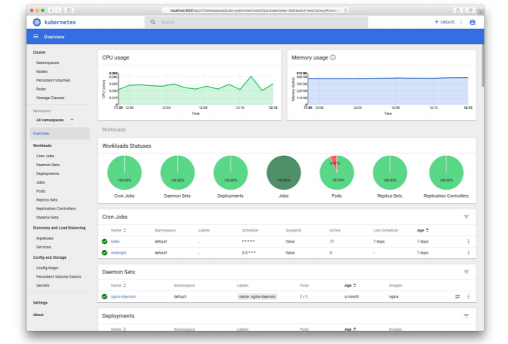
Kube-dashboard

Slide 26
Kubernetes concepts

Slide 27
Pod: The basic building block in Kubernetes. The name is the same idea as a pod of whales, one of more containers– or better said, a running process on the cluster — running on a given system which can be scaled up or down.
Service: A consistent network access point for a pod. What this means is that regardless of the underlying containers’ state – restarts, etc, a service will always provide access to the given pod/application.
ReplicaSet: Ensures a given number of pods are running in the cluster at a given time.
Deployment: Suited for more ephemeral applications like web applications, anything that doesn’t have persistent qualities. It Provides declarative updates for Pods and ReplicaSets by describing a desired state the deployment in turn acts on.

Slide 28
Stateful Set: Suited for stateful applications like databases or even monitoring systems like Prometheus. Similar to a deployment in that it manages the deployment and scaling of a set of pods, but differs in that it ensures ordinal (things happen in a given sequence and are numbered) and uniqueness of pods. Overall, it ensures that all resources in the stateful set have a sticky identity across restarts.
Labels: When creating Kubernetes objects, one can give any number of labels to each object which are discoverable across the system. For instance, one could create a database with the label “customer_database” and another application pod could reference it by simply using that name “customer_database” in the selector value of the manifest file.
Namespaces: Virtual clusters. Provides a means to separate applications in the cluster.

Slide 29
Mini-kube : Install and configure
Refer git repo for instructions.

Slide 30
Thanks

