Slide 1
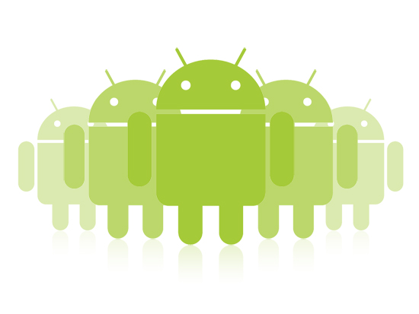
Interacting with Other Apps
Jeffrey Bickford
AT&T Security Research Center
jbickford@nyu.edu

Slide 2

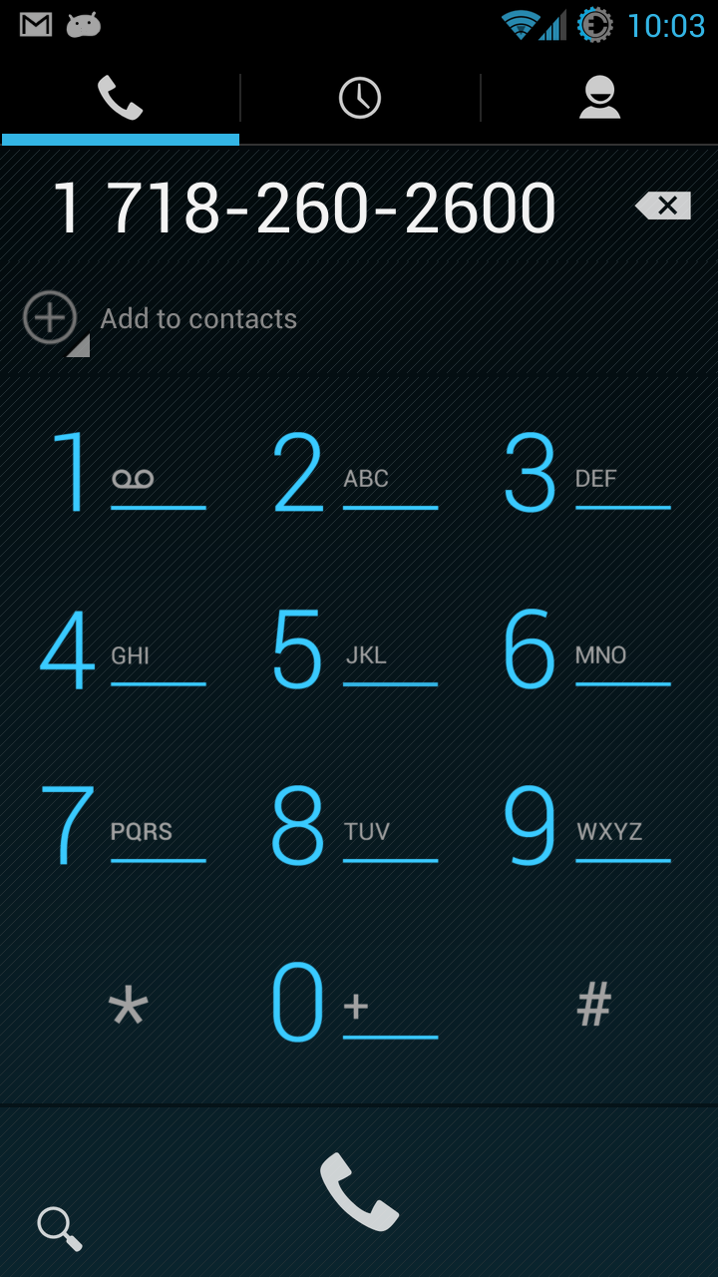
Actions
Ability to send a user to another app based on an “action”
phone number passed
user touch event
718.260.3600

Slide 3
What Happened Here?
Telephone number was “clickable”
When clicked, a new app started
Not only was it an app, it was a specific Activity
The telephone number was shown in a TextView Widget
Questions
How was the telephone number clickable?
How did the system start the specific app/Activity?
How did the telephone number get passed?

Slide 4
What Happened Here?
Telephone number was “clickable”
When clicked, a new app started
Not only was it an app, it was a specific Activity
The telephone number was shown in a TextView Widget
Questions
How was the telephone number clickable?
How did the system start the specific app/Activity?
How did the telephone number get passed?

Slide 5
Recall…
Universal Resource Identifier (URI)
Tells us what table to use in an app’s database
Format: <standard_prefix>://<authority>/<data_path>/<id>
content://com.android.calendar/events
content://contacts/people/10 10th row of the people table

Slide 6
URI
URI is a web standard use to to identify web resources
Classified as locators (URLs), names (URNs), or both
URN defines an item’s identity
URL provides a method for finding it
URN - isbn:0-486-27557-4
Specifies identifier system ISBN
Unique reference to a book within that system
Not how to find it
URL – http://example.org/wiki/Main_Page
Resource wiki/Main_page
Via HTTP protocol
From a network whose domain name is example.org
*http://en.wikipedia.org/wiki/Uniform_resource_identifier
Notes:
See http://en.wikipedia.org/wiki/URI_scheme for actual format

Slide 7
Android URIs
content://com.android.calendar/events
“Events” data via “com.android.calendar” app using the “content provider” protocol/API
mailto:jbickfrd@gmail.com
Identifies email address
imdb:///find?q=godfather
Query for a movie based off the imdb protocol/API defined within the imdb app
*http://openintents.org/en/uris

Slide 8
Android URIs
With this knowledge, how is the telephone number identified?
tel:555-123-4567
How is this URI made clickable within the webpage?
<a href=“tel:7182603600”>718.260.3600</a>
Remember: URL is a URI, so just use “<a href=“ as normal!

Slide 9
What Happened Here?
Telephone number was “clickable”
When clicked, a new app started
Not only was it an app, it was a specific Activity
The telephone number was shown in a TextView Widget
Questions
How was the telephone number clickable?
How did the system start the specific app/Activity?
How did the telephone number get passed?

Slide 10
Recall…
How do you start another activity?
Intents represent an app’s “intention to do something”
Intent intent = new Intent(this, SecondActivity.class); String message = “Data to send next activity” intent.putExtra(“key”, message);
startActivity(intent);
Intents pass a bundle to the next Activity, add key value pairs
Should define keys for data that passes around app
More on intents later…
*http://developer.android.com

Slide 11
Intents
Intents activate the core components of an application and contain various pieces of information
Component name: ComponentName object that contains package name and the class name of the target component
Action: A string naming the action to be performed
ACTION_DIAL, ACTION_VIEW, ACTION_MAIN
Data – The URI of the data to be acted on and the MIME type
*http://developer.android.com
Notes:
http://en.wikipedia.org/wiki/Internet_media_type

Slide 12
Intents
Intents activate the core components of an application and contain various pieces of information
Category: String containing information about the kind of component that should handle the intent
CATEGORY_BROWSABLE, CATEGORY_LAUNCHER
Extras: Key-value pairs with additional info
Some extras correspond with specific actions
ACTION_TIMEZONE_CHANGED has “time-zone” extra
Flags: Listed in the Intent class, most related to starting an Activity
FLAG_ACTIVITY_NO_HISTORY
*http://developer.android.com
Notes:
developer.android.com/reference/android/content/Intent.html

Slide 13
Explicit Intents
Explicit Intents designate the target component by its name
via component name field
Other fields are typically not used (other than extras)
Other developers will not know your component names
For this reason, explicit intents are used for internal application messages, such as starting another component or a second activity
Intent intent = new Intent(this, SecondActivity.class); String message = “Data to send next activity” intent.putExtra(“key”, message);
startActivity(intent);
*http://developer.android.com

Slide 14
Implicit Intents
Implicit Intents do not name a target
Component name is blank
The system finds the best component to handle the intent
Contents of the intent are compared against intent filters
*http://developer.android.com

Slide 15
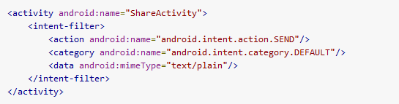
Intent Filters
Intent filters are typically defined within an application’s manifest on a per-component basis
Filters advertise the set of intents a component is willing to receive
Defines which intents a component can handle
Three aspects of an intent object are consulted
Action
Data (both URI and MIME type)
Category
*http://developer.android.com

Slide 16
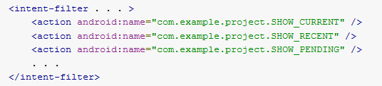
Action Test
Intent filters must have at least 1 action defined
Incoming intent has a single action that these are compared against
To pass the action test, the intent’s action must match an action defined in the intent filter
*http://developer.android.com

Slide 17
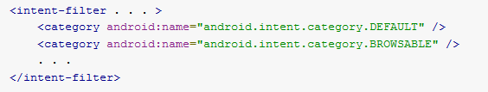
Category Test
Used to define an application type/category
Each category in the intent object must match a category in the intent filter (can have multiple)
Activities usually must include “CATEGORY_DEFAULT” if they want to receive an implicit intent
This is because startActivity() sets this category in its intent
*http://developer.android.com

Slide 18
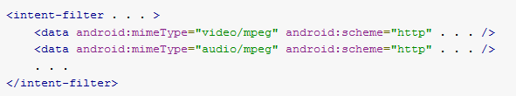
Data Test
Specifies a URI and data type that the component can use
MIME type and full URI can be specified
The values that are set in the intent are checked against the values set in the filter
*http://developer.android.com
Notes:
http://developer.android.com/guide/topics/manifest/data-element.html

Slide 19

Common Data Configurations
Since most data is dispensed by content providers, you can specify only a data type and the system does the rest
Another common setup is to use both a scheme and a data type
*http://developer.android.com

Slide 20
Back to our Example
With what we just learned, how does our example work?
<intent-filter>
<action android:name="android.intent.action.VIEW" />
<action android:name="android.intent.action.DIAL" />
<category android:name="android.intent.category.DEFAULT" />
<category android:name="android.intent.category.BROWSABLE" />
<data android:scheme="tel" />
</intent-filter>
Actual manifest file XML from Android 4.2.2 Contacts app - DialtactsActivity
Notes:
CATEGORY_BROWSABLE means this component can be safely invoked by a browser
ACTION_VIEW – generic action meant to display data to a user
ACTION_DIAL -

Slide 21
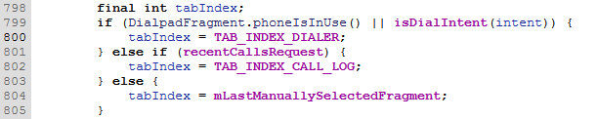
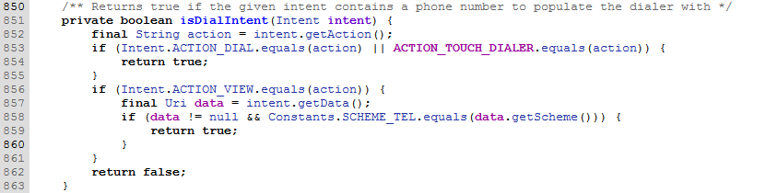
Back to our Example
How is the telephone number passed to the Dialer?

Slide 22
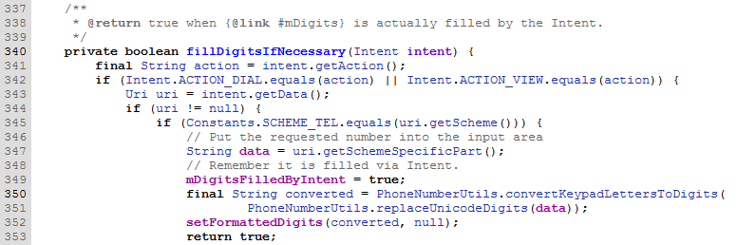
Back to our Example
How is the telephone number passed to the Dialer?

Slide 23
Map Example
2
// Build the intent Uri location = Uri.parse
("geo:0,0?q=1600+Amphitheatre+Parkway,+Mountain+View,+California"); Intent mapIntent = new Intent(Intent.ACTION_VIEW, location); // Verify it resolves PackageManager packageManager = getPackageManager(); List<ResolveInfo> activities = packageManager.
queryIntentActivities(mapIntent, 0);
boolean isIntentSafe = activities.size() > 0; // Start an activity if it's safe if (isIntentSafe) { startActivity(mapIntent); }
Note: When creating implicit intents where apps might not exist, you must check!

Slide 24
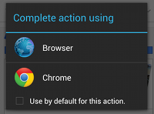
Multiple Eligible Activities
What happens if multiple Activities pass the Intent tests?
*http://developer.android.com

Slide 25
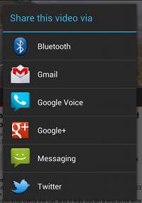
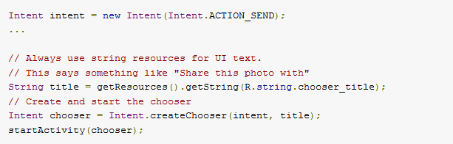
App Chooser
In some cases, you may want to give the user multiple options every time without letting the user select a default
*http://developer.android.com

Slide 26
Getting Result from Activity
How do you get data back from another Activity?
static final int REQUEST_CONTACT = 1; // The request code ... private void pickContact() { Intent pickContactIntent = new Intent(Intent.ACTION_PICK,
ContactsContracts.Contacts.CONTENT_URI
startActivityForResult(pickContactIntent, REQUEST_CONTACT); }
*http://developer.android.com

Slide 27
Getting Result from Activity
Because the activity was started with ACTION_PICK, your activity will receive an intent via onActivityResult()
This intent will include a data URI
In our example, this URI points to a single contact the user picked
Result codes are also passed back to determine if the action was successful or not (the other activity could have crashed)
*Big Nerd Ranch Guide: Android Programming

Slide 28
Getting Result from Activity
static final int REQUEST_CONTACT = 1; // The request code ...
@Override private void onActivityResult(int requestCode,
int resultCode, Intent data{
if(resultCode != Activity.RESULT_OK) return;
Uri contactUri = data.getData(); // gets Uri from Intent object
// now you query the ContentProvider with the data you want
String[] queryFields = new String[] {
ContactsContract.Contacts.DISPLAY_NAME;
};
Cursor c = getActivity().getContentResolver()
.query(contactUri, queryFields, null, null, null);
*Big Nerd Ranch Guide: Android Programming

Slide 29
Getting Result from Activity
// check to make sure you got the results
if(c.getCount()) == 0 {
c.close()
return;
}
// Get first row (will be only row in most cases)
c.moveToFirst();
String person = c.getString(0);
mTrip.setPerson(person);
personField.setText(person);
c.close();
}
*Big Nerd Ranch Guide: Android Programming

Slide 30
Permissions?
Why are we allowed to access the contacts database?
Typically your app needs the READ_CONTACTS permission to read the contact list
In this case, the contact book app extends its permission to our your app
Flag is passed via intent – FLAG_GRANT_READ_URI_PERMISSION
You are only allowed to read that single URI, not everything
*Big Nerd Ranch Guide: Android Programming

Slide 31
Broadcast Intents
One more type of intent called Broadcast Intents
System-wide broadcasts only received by Broadcast Receivers
Used to notify multiple components that some event has occurred
Typically sent via the sendBroadcast() method
Examples:
android.provider.Telephony.SMS_RECEIVED
android.net.wifi.WIFI_STATE_CHANGED
android.intent.action.BOOT_COMPLETED
android.intent.action.BATTERY_LOW
Notes:
Full broadcast intent list under android-sdk\platforms\android-#\data\broadcast_actions.txt

Slide 32
Broadcast Receiver
A broadcast receiver is another component of your Android app
public class StartupReceiver extends BroadcastReceiver {
private static final String TAG = “StartupReceiver”;
@Override
public void onReceive(Context context, Intent intent) {
// do something
}
}
How does the system know to call your receiver?
Intent Filters!
Notes:
Full broadcast intent list under android-sdk\platforms\android-#\data\broadcast_actions.txt

Slide 33
Intent Filter for Receiver
<reciever android:name=“.StartupReceiver”>
<intent-filter>
<action android:name=“android.intent.action.BOOT_COMPLETED” />
</intent-filter>
</receiver>
Here, our receiver is setup to receive the BOOT_COMPLETED system-wide broadcast
Note: Some system broadcasts require you add a permission in the manifest file
<uses-permission android:name=“android.permission.RECEIVE_BOOT_COMPLETED”>
Notes:
Full broadcast intent list under android-sdk\platforms\android-#\data\broadcast_actions.txt

Slide 34
What to do Inside a Receiver
Even if your app is not running, a receiver will run
onReceive() runs on the main thread
No heavy lifting, network activity, heavy storage I/O, etc.
This will freeze the current Activity
Once onReceive() is complete, receiver is finished
Useful for plumbing code
Starting a service after phone boots
Setting flags to notify your app that an event occurred

