Slide 1

Android Internet and Services
Jeffrey Bickford
AT&T Security Research Center
jbickford@nyu.edu

Slide 2
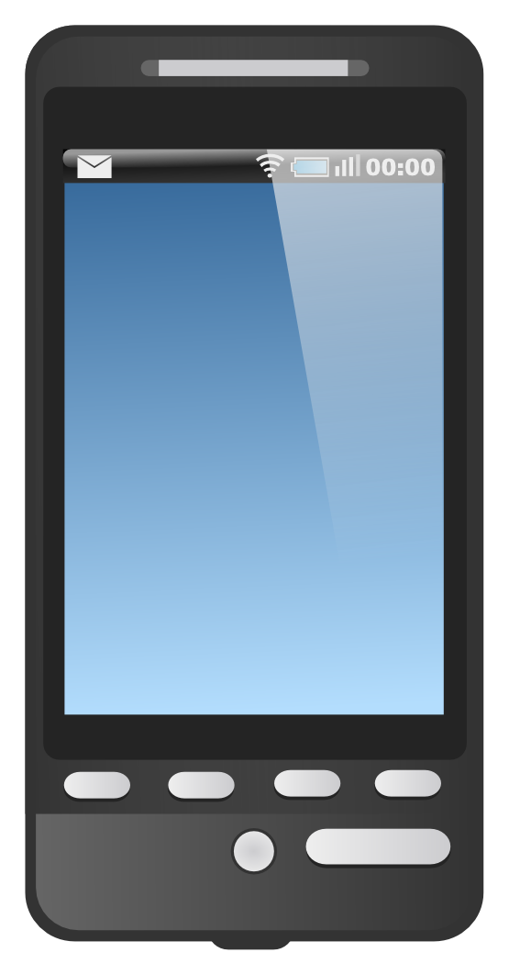


















Mobile Cloud Systems
Most apps do not work alone, they could be considered complete mobile systems working alongside web/cloud services
Internet Connectivity
Note: Most apps utilize HTTP to communicate with the Internet
Web/Cloud Services

Slide 3
Steps to Connect to the Internet
Check for network connectivity
Create an HttpURLConnection object
Connect to the endpoint
Read data
Close connection

Slide 4
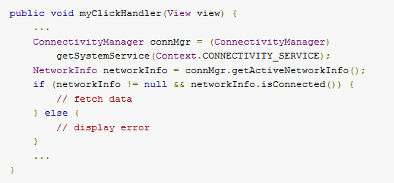
Checking Network Connectivity
Get ConnectivityManager object
Get NetworkInfo object and check if connected
Note: You must do this before you make any network connection!
*http://developer.android.com

Slide 5
Where in app do you download?
Network operations can have unpredictable delays
Different network speeds and latencies (2G, 3G, LTE, WiFi)
Servers can be overloaded and have other delays
What component/thread should downloads occur in?
Not the UI/main thread!
Must download within a background “thread”
AsyncTask: good for quick tasks linked to an Activity
IntentService: background threads activated via Intents
Service: background component with no UI on main thread
HandlerThread: background thead more flexible than AsyncTask

Slide 6
Threads
Background Thread
Main Thread
System or user event
Note: Since Android 3.0, network activity MUST originate via a background thread
Run some code
Process Event
Done
Main thread runs all code that updates the UI. Sits in an infinite loop waiting for events.
*Big Nerd Ranch Guide: Android Programming

Slide 7
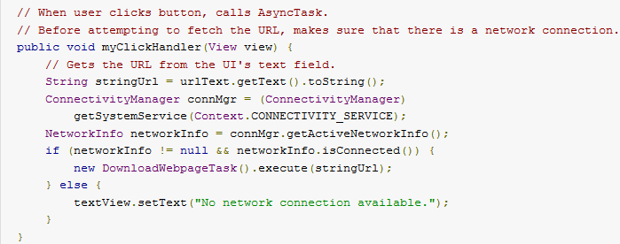
AsyncTask
AsyncTask objects are commonly used for quick network events that are triggered by the UI thread
Get URL
AsyncTask
*http://developer.android.com

Slide 8
AsyncTask
Create a private class that extends AsyncTask
Subclass must override doInBackground(Params…)
Typically also overrides onPostExecute(Result)
AsyncTask must be defined with 3 types
Params: the type of parameters sent to doInBackground
Progress: the type of progress units published during task
Result: the type of the result of the background task
Note: Not all types have to be used, use Void instead

Slide 9
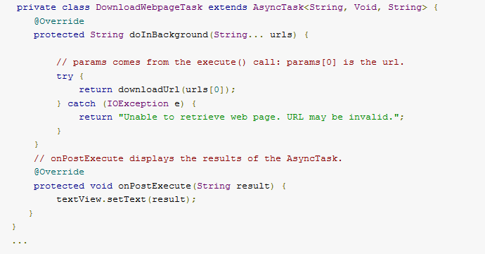
AsyncTask
Note: String…. notation means arbitrary number of arguments in the form of an array
*http://developer.android.com

Slide 10
AsyncTask
public String downloadUrl(String inUrl) throws IOException {
URL url = new URL(inUrl);
HttpURLConnection connection = (HttpURLConnection)url.openConnection();
// may want to set read and connect timeouts
try {
ByteArrayOutputStream out = new ByteArrayOutputStream();
InputStream in = connection.getInputStream();
if (connection.getResponseCode() != HttpURLConnection.HTTP_OK)
{
return null;
}
int bytesRead = 0;
byte[] buffer = new byte[1024];
while((bytesRead = in.read(buffer)) > 0) {
out.write(buffer,0,bytesRead);
}
out.close();
return new String(out.toByteArray());
} finally {
connection.disconnect(); // happens even if return occurred
}
}
Note: HttpURLConnection uses HTTP GET method by default. Use setDoOutput(true) for POST or setRequestMethod(String).
*Big Nerd Ranch Guide: Android Programming

Slide 11
Permissions
Must add a permission to your app to use the network
Also need permission to check network state via ConnectivityManager and getActiveNetworkInfo()
<uses-permission android:name="android.permission.INTERNET" />
<uses-permission android:name="android.permission.ACCESS_NETWORK_STATE" />
*http://developer.android.com

Slide 12
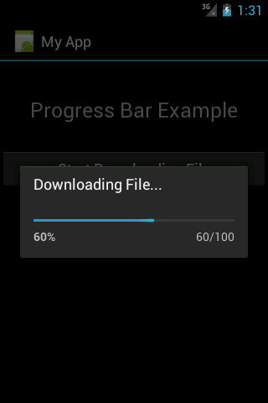
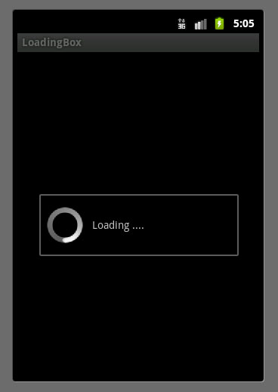
Progress Bar
What about the progress type passed to AsyncTask?

Slide 13
Progress Bar
Progress bars are another type of widget in Android typically shown in a dialog box
Indeterminate (wheel, default)
Determinate (bar with values)
AsyncTask makes it very easy to utilize a progress bar.
Typically the background thread cannot interact with the UI directly.
<ProgressBar android:id=“@+id/progress” android:layout_width="wrap_content" android:layout_height="wrap_content" style="@android:style/Widget.ProgressBar.Horizontal" android:layout_marginRight="5dp" />
*http://developer.android.com

Slide 14
Progress Bar
final ProgressBar progressBar = (ProgressBar) findViewById(R.id.progress);
progressBar.setMax(100);
AsyncTask<Integer,Integer,Void> task = new AsyncTask<Integer,Integer,Void>() {
public Void doInBackground(Integer... params) {
for(Integer progress : params) {
publishProgress(progress);
Thread.sleep(1000);
}
}
public void onProgressUpdate(Integer... params) {
int progress = params[0];
progressBar.setProgress(progress);
}
}
onProgressUpdated then
called in UI thread
*Big Nerd Ranch Guide: Android Programming

Slide 15
Common Problems with AsyncTask
What happens if an Activity is destroyed? (i.e. via screen rotation)
AsyncTask will still be running
Problem if onPostExecute uses objects that no longer exist
AsyncTask could crash and new Activity won’t see output!
You must manage AsyncTask yourself via AsyncTask.cancel()
Your doInBackground method must also check for cancel
Set thread as interruptable
Or periodically check if AsyncTask.isCancelled()
*http://logc.at/2011/11/08/the-hidden-pitfalls-of-asynctask/
Notes:
http://logc.at/2011/11/08/the-hidden-pitfalls-of-asynctask/

Slide 16
Services
Services perform long running tasks in the background and are not correlated to a UI
Services are typically more complicated to implement, but can be powerful if you need to do things often in the background
Examples:
Play music in the background
Check blog postings via RSS feed
Check status of our trip

Slide 17
IntentService
IntentService is a simplified version of a service that handles incoming commands in a background thread
command
queue
Intent 1
Intent 2
Intent 3
Intent 3
Intent Service
Intent 3
Intent 2
other components or apps
Intent 1
Intent 2
Intent 1
Intent 3
send intent
Service
*Big Nerd Ranch Guide: Android Programming

Slide 18
IntentService
IntentService must override onHandleIntent(Intent)
public class PollTripService extends IntentService {
private static final String TAG = “PollTripService”;
public PollTripService {
super(TAG)
}
@Override
protected void onHandleIntent(Intent intent) {
// check trip status via cloud
// pass identifiers needed via intent
}
}
*Big Nerd Ranch Guide: Android Programming

Slide 19
Service is a Component
Service the final component type in Android
This means you must add the component to the manifest file
<manifest ... >
...
<application ... >
<service android:name=".PollTripService" />
...
</application>
</manifest>

Slide 20
Starting IntentService
Now you can start the IntentService via an Intent from another component, i.e. an Activity
@Override
public void onCreate(Bundle savedInstanceState) {
super.onCreate(savedInstanceState);
Intent i = new Intent(this, PollTripService.class);
startService(i);
}

Slide 21
Alarm Manager
What if you want to trigger an IntentService every so often?
Especially when there is no Activity in the foreground
AlarmManager
System service that sends Intents for you
Use PendingIntent to tell AlarmManager what to do on behalf of your app
This is good because your app may not be running
*Big Nerd Ranch Guide: Android Programming

Slide 22
Using AlarmManager
public class PollTripService extends IntentService {
... ... ...
private static final int POLL_INTERVAL = 1000 * 15 // 15 seconds
... ... ...
public static void setServiceAlarm(Context context, boolean isOn){
Intent i = new Intent(context, PollTripService.class);
PendingIntent pi = PendingIntent.getService(context, 0, i, 0);
AlarmManager alarmManager = (AlarmManager)
context.getSystemService(Context.ALARM_SERVICE);
if(isOn) {
alarmManager.setRepeating(AlarmManager.RTC,
System.currentTimeMillis(), POLL_INTERVAL, pi);
} else {
alarmManager.cancel(pi);
pi.cancel();
}
}
}
*Big Nerd Ranch Guide: Android Programming
Notes:
PendingIntent getService (Context context, int requestCode, Intent intent, int flags)

Slide 23
Starting IntentService
Instead of calling startService, we now call the setServiceAlarm function we just created
@Override
public void onCreate(Bundle savedInstanceState) {
super.onCreate(savedInstanceState);
Intent i = new Intent(this, PollTripService.class);
startService(i);
PollTripService.setServiceAlarm(this, true);
}
*Big Nerd Ranch Guide: Android Programming

Slide 24
Notifications
Your service polls a webserver and wants to notify the user of the result
Other examples:
Facebook notification
New email
New text message
Missed phone call

Slide 25
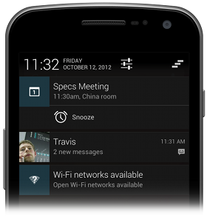

Notifications
Notification objects usually contain the following
Ticker text – shown in the status bar when first notified
Icon – icon to show in the status bar
View – object that actually is shown in the notification drawer
Content Title – title of notification
Content Text – smaller text in notification
PendingIntent – fires when the user presses the notification
Notes:
https://developer.android.com/guide/topics/ui/notifiers/notifications.html

Slide 26
Notifications
public class PollTripService extends IntentService {
... ... ...
protected void onHandleIntent(Intent intent) {
// new trip status information
Resources r = getResources();
PendingIntent pi = PendingIntent
.getActivity(this,0,new Intent(this,ViewTrip.class),0);
Notification notification = newNotificationCompat.Builder(this)
.setTicker(r.getString(R.string.trip_update)
.setSmallIcon(R.drawable.notification_icon)
.setContentTitle(r.getString(R.string.trip_update_title);
.setContentText(r.getString(R.string.trip_update_text);
.setContentIntent(pi);
.setAutoCancel(true); // removes after user click
.build();
NotificationManager notificationManager = (NotificationManager)
getSystemService(Context.NOTIFICATION_SERVICE);
notificationManager.notify(0, notification);
}
}
*Big Nerd Ranch Guide: Android Programming

Slide 27
More Complex Services
If IntentServices do not fit your needs you can create your own service and interact it using different mechanisms
Things gets complicated...
Handlers, Messengers, Threads
Binding to Services via IBinder
IPC and AIDL
We will talk about more advanced Services next class

Slide 28
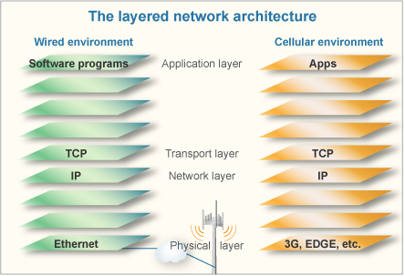
Wireless Networks
*A Call for More Energy-Efficient Apps

Slide 29
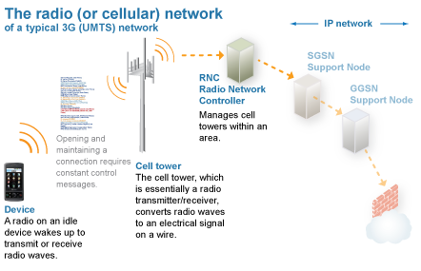
Wireless Networks
*A Call for More Energy-Efficient Apps

Slide 30
Wireless Networks
In theory, app developers shouldn’t have to worry about this
Reality:
Cell network has high latency
Limited-resource environment due to spectrum
Device has limited battery
Network connections typically use the most power
Note: This is especially true when app developers carelessly use network resources!!!

Slide 31
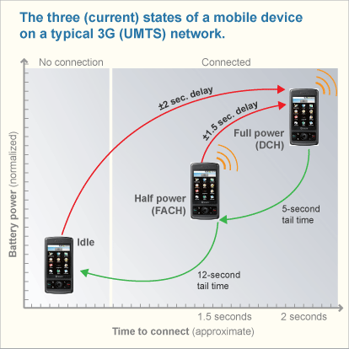
Radio Resource Control States

Slide 32
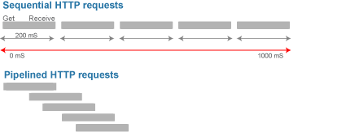
Pipelining is Better
Much less time in the high power state
If pipelined in a single TCP connection, you remove the multiple TCP setups as well

Slide 33
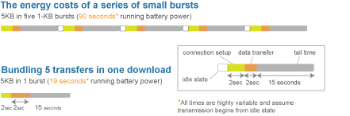
Bundling Transfers is Better

Slide 34
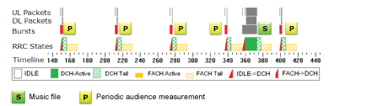
Pandora Case Study
Every 62.5 seconds, Pandora woke up to report some measurements , 2KB in size
Songs were downloaded in batches
Because of the RRC, these periodic measurements used 46% of the app’s energy while only using 0.2% of the data

Slide 35
Findings
Transmit as much as data in a single burst, then close the connection
Large files (videos) should be downloaded in chunks over 2-5 minute intervals
Prefetch data that might be needed later
Pipeline traffic within a single TCP connection

Slide 36
Application Resource Optimizer
AT&T has a tool in order to measure your app’s resource usage
Free for developers
http://developer.att.com/developer/include/Home/Develop/GetATTARO/9700312

Slide 37
Question
Even if every developer in the world used ARO, would it completely solve the problem?
NO!

