Slide 1

Android Storage
Jeffrey Bickford
AT&T Security Research Center
jbickford@nyu.edu
Notes:
<number>

Slide 2

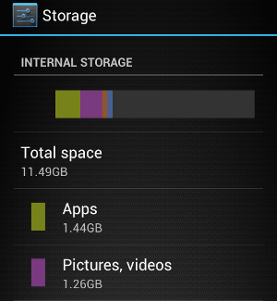




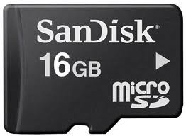











Storage
Apps need to store data!
External Storage
Internal Storage
Cloud Storage
NYU Poly 10/5/2015

Slide 3
Android Storage Options
Android supports many methods of storage
Shared Preferences – private primitive data in key-value pairs
Internal Storage – meant for private data
External Storage – public data (be careful!)
SQLite Databases – private structured data
NYU Poly 10/5/2015

Slide 4
Shared Preferences
Shared Preferences – private primitive data in key-value pairs
Similar to Bundle (remember these?)
String, int, float, boolean, long
Good for configurations, user preferences, etc.
public class Person {
... ...
public static final String PREF_HOME_LOCATION = "home";
... ...
}
Define “keys” in your Model objects so they are publically addressable
NYU Poly 10/5/2015
Notes:
Bundles are used to save state. They are typically passed into Activities by the system. They store key-value pairs. putString, getExtra
<number>

Slide 5
Shared Preferences
SharedPreferences object handles backend (actually XML)
SharedPreferences.edit() gives you editable object
Put writes together, commit for single FS write
Can have multiple SharedPreferences
public class PreferencesActivity extends Activity {
... ...
public void onClick(View v) {
String homeLocation = homeEditText.getText()
PreferenceManager.getDefaultSharedPreferences(this)
.edit()
.putString(Person.PREF_HOME_LOCATION, homeLocation)
.commit();
}
... ...
}
Convention – use the default
NYU Poly 10/5/2015
Notes:
Use Context.getSharedPreferences(String, int) method to get a different shared preferences object.
<number>

Slide 6
Shared Preferences
You can get a value in a similar fashion
public class CreateTripActivity extends Activity {
... ...
public void onCreate(Bundle savedInstanceState) {
... ...
TextView fromLocationView = (TextView)findViewById(R.id.fromLocation);
String homeLocation = PreferenceManager.getDefaultSharedPreferences(this)
.getString(Person.PREF_HOME_LOCATION, null)
fromLocationView.setText(homeLocation) // probably should check for null
... ....
}
... ...
}
NYU Poly 10/5/2015
Notes:
Bundles are used to save state. They are typically passed into Activities by the system. They store key-value pairs. putString, getExtra
<number>

Slide 7
Shared Preferences Enum
package com.example.preferences;
import android.content.SharedPreferences;
public enum AppPreferences {
DEVICE_ID {
@Override
public String getString(SharedPreferences sharedPreferences){
return sharedPreferences.getString(DEVICE_ID.name(), "");
}
@Override
public void set(SharedPreferences sharedPreferences, String value){
SharedPreferences.Editor editor = sharedPreferences.edit();
editor.putString(DEVICE_ID.name(), value); editor.commit();
}
};
public abstract String getString(SharedPreferences sharedPreferences);
public abstract void set(SharedPreferences sharedPreferences,
String value);
}
NYU Poly 10/5/2015
Notes:
<number>

Slide 8
Shared Preferences Enum
Use Enum class throughout your application by passing instance of sharedPreferences
SharedPreferences prefs =
PreferenceManager.getDefaultSharedPreferences(getApplicationContext());
String deviceId = AppPreferences.DEVICE_ID.getString(prefs)
Even better, create your own class that contains an private enum and a reference to shared preferences. Use your object throughout your application
NYU Poly 10/5/2015

Slide 9
Internal Storage
You can also store data on the internal file system
This is actually where the XML sharedPreferences file is stored
Private data is sandboxed – remember Linux user id sandbox
Location is /data/data/com.package.name
Databases will be stored in here as well
NYU Poly 10/5/2015

Slide 10
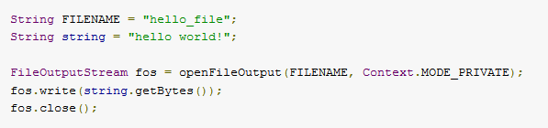
Saving Data to Files
Write to files using normal Java functions
File Flags
MODE_PRIVATE – create or replace private file
MODE_APPEND – if file exists, append
MODE_WORLD_READABLE – don’t use!
MODE_WORLD_WRITEABLE – don’t use!
NYU Poly 10/5/2015

Slide 11
Data Formats
If you save data in a file, must choose a format
Delimited (csv, pipe, etc.)
XML
JSON
JavaScript Object Notation has recently become very popular
Many web services now use JSON to transfer data
org.json package
More info: http://json.org
NYU Poly 10/5/2015

Slide 12
How to use JSON
Add a toJSON method to your Model class
Converts your member fields to JSONObject
Add static fields for keys as well
Create new JSONSerializer for Model
Writes data to file
Use JSONSerializer when you want to save state to disk
NYU Poly 10/5/2015

Slide 13
public class Trip {
private static final String JSON_ID = "id";
private static final String JSON_DESTINATION = “destination";
private static final String JSON_PEOPLE = "people";
private static final String JSON_DATE = "date";
private UUID mId;
private String mDestination;
private Date mDate;
private ArrayList<String> people; // could be list of objects too
public Trip() {
mId = UUID.randomUUID();
mDate = new Date();
mDestination = null;
people = new ArrayList<String>;
}
public JSONObject toJSON() throws JSONException() {
JSONObject json = new JSONObject();
json.put(JSON_ID, mId.toString());
json.put(JSON_LOCATION, mDestination);
json.put(JSON_PEOPLE, new JSONArray(people));
json.put(JSON_DATE, mDate.getTime());
return json;
}
}
NYU Poly 10/5/2015
*Modified from Big Nerd Ranch Guide: Android Programming

Slide 14
public class TripJSONSerializer {
private Context mContext;
private String mFilename;
public TripJSONSerializer(Context c, String f) {
mContext = c;
mFilename = f;
}
public void saveTrips(ArrayList<Trip> trips)
throws JSONException, IOException {
// Build an array in JSON
JSONArray array = new JSONArray();
for (Trip t : trips)
array.put(t.toJSON());
// Write the file to disk
Writer writer = null;
try {
OutputStream out = mContext
.openFileOutput(mFilename, Context.MODE_PRIVATE);
writer = new OutputStreamWriter(out);
writer.write(array.toString());
} finally {
if (writer != null)
writer.close();
}
}
}
NYU Poly 10/5/2015
*Modified from Big Nerd Ranch Guide: Android Programming

Slide 15
public class TripHistory {
private static final String TAG = "TripHistory";
private static final String FILENAME = "triphistory.json";
private ArrayList<Trip> mTrips;
private TripJSONSerializer mSerializer;
private static TripHistory sTripHistory;
private Context mAppContext;
private TripHistory(Context appContext) {
mAppContext = appContext;
mTrips = new ArrayList<Trip>();
}
... ...
... ...
NYU Poly 10/5/2015
*Modified from Big Nerd Ranch Guide: Android Programming
Notes:
TtripHistory history = new TripHistory(this)
<number>

Slide 16
... ...
... ...
public void addTrip(Trip t) {
mTrips.add(t);
}
public boolean saveTrips() {
try {
mSerializer.saveTrips(mTrips);
Log.d(TAG, "Trips saved to file.");
return true;
} catch (Exception e) {
Log.e(TAG, "Error saving trips: ", e);
return false;
}
}
}
NYU Poly 10/5/2015
*Modified from Big Nerd Ranch Guide: Android Programming

Slide 188
When to Save File
When should you save the file? Recall the Activity Lifecycle
@Override
public void onPause {
super.onPause();
tripHistory.saveTrips();
}
NYU Poly 10/5/2015

Slide 189
Reading Files
Also add a constructor that creates a new Object based off of JSON file (in your model)
Read in file in your JSON Serializer class, use JSON Tokener to parse and build objects
Call this when you make your object or in onCreate()
Challenge: build this code yourself
NYU Poly 10/5/2015

Slide 190
External Storage
External storage works the same way
Interact with files using normal Java I/O classes
Note that these files are typically not private
Used for data that you would share with other apps, music, web downloads, documents, etc.
NYU Poly 10/5/2015

Slide 191
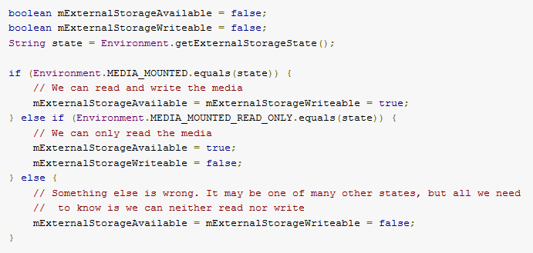
External Storage
When using external storage, you must check if it is available
Could be mounted to a computer
Media could be removed
In a read-only state
NYU Poly 10/5/2015

Slide 192
External Storage
Where do you store these files?
Dependent on kind of file
DIRECTORY_MUSIC, DIRECTORY_PICTURES, etc.
Use getExternalFilesDir(String type) get directory location
new File(getExternalFilesDir(DIRECTORY_MUSIC),“recording1.mp3”);
Data is stored in Android/data/your_package/directory on SD card
If you pass null, it is stored in root folder of your package
Note: Android 4.4 adds getExternalFilesDirs() which returns a list of possible external storage locations if you have more than one external storage device
NYU Poly 10/5/2015

Slide 193
External Storage
Files can also be stored in public directories
Use getExternalPublicStorageDirectory()
Music
Podcasts
Ringtones
Alarms
Notifications
Pictures
Movies
Download
NYU Poly 10/5/2015

Slide 194
Databases
Databases are used for large or complex structured data sets
Android uses SQLite databases
Database can be used from any class in your application
Cannot be accessed by any other application
NYU Poly 10/5/2015

Slide 195
Databases
Create database by creating a subclass of SQLiteOpenHelper
Here is where you create your schema and tables
Database is created the first your helper object is created
Be careful about modifying database, you must increment VERSION number in order for the change to occur
NYU Poly 10/5/2015

Slide 196
Create Static Variables
public class TripDatabaseHelper extends SQLiteOpenHelper {
private static final int DATABASE_VERSION = 1;
private static final String DATABASE_NAME = "trips";
private static final String TABLE_TRIP = "trip";
private static final String COLUMN_TRIP_ID = "_id"; // convention
private static final String COLUMN_TRIP_DATE = "date";
private static final String COLUMN_TRIP_DESTINATION = "destination";
private static final String TABLE_LOCATION = "location";
private static final String COLUMN_LOC_TRIPID = "trip_id";
private static final String COLUMN_LOC_TIMESTAMP = "timestamp";
private static final String COLUMN_LOC_LAT = "latitude";
private static final String COLUMN_LOC_LONG = "longitude";
private static final String COLUMN_LOC_ALT = "altitude";
private static final String COLUMN_LOC_PROVIDER = "provider";
NYU Poly 10/5/2015

Slide 197
Create Database
public TripDatabaseHelper(Context context) {
super(context, DATABASE_NAME, null, DATABASE_VERSION);
}
@Override
public void onCreate(SQLiteDatabase db) {
// create trip table
db.execSQL("create table " + TABLE_TRIP + "("
+ COLUMN_TRIP_ID + " integer primary key autoincrement, "
+ COLUMN_TRIP_DATE + " integer, "
+ COLUMN_TRIP_DESTINATION + " text)");
// create location table
db.execSQL("create table " + TABLE_LOCATION + "("
+ COLUMN_LOC_TRIPID + " integer references trip(_id), "
+ COLUMN_LOC_TIMESTAMP + " integer, "
+ COLUMN_LOC_LAT + " real, "
+ COLUMN_LOC_LONG + " real, "
+ COLUMN_LOC_ALT + " real, "
+ COLUMN_LOC_PROVIDER + " varchar(100))");
}
NYU Poly 10/5/2015

Slide 198
Upgrading
@Override
public void onUpgrade(SQLiteDatabase db, int oldVersion, int
newVersion) {
// Drop older table if exists
db.execSQL("DROP TABLE IF EXISTS " + TABLE_TRIP);
db.execSQL("DROP TABLE IF EXISTS " + TABLE_LOCATION);
// create tables again
onCreate(db);
}
NYU Poly 10/5/2015

Slide 199
Inserting Values
public long insertTrip(Trip trip) {
ContentValues cv = new ContentValues();
cv.put(COLUMN_TRIP_DATE, trip.getDate().getTime());
cv.put(COLUMN_TRIP_DESTINATION, trip.getDestination());
// return id of new trip
return getWritableDatabase().insert(TABLE_TRIP, null, cv);
}
public long insertLocation(long tripId, Location location) {
ContentValues cv = new ContentValues();
cv.put(COLUMN_LOC_TRIPID, tripId);
cv.put(COLUMN_LOC_TIMESTAMP, location.getTime());
cv.put(COLUMN_LOC_LAT, location.getLatitude());
cv.put(COLUMN_LOC_LONG, location.getLongitude());
cv.put(COLUMN_LOC_ALT, location.getAltitude());
cv.put(COLUMN_LOC_PROVIDER, location.getProvider());
// return id of new location
return getWritableDatabase().insert(TABLE_LOCATION, null, cv);
}
}
NYU Poly 10/5/2015
Notes:
You can call these functions from an activity
<number>

Slide 200
Querying Database
Once data has been inserted, you will need to query the db
List all trips or locations for a single trip
Can use db.query or db.rawQuery – returns Cursor object
Difference is the arguments
public List<Trip> getAllTrips() {
List<Trip> tripList = new ArrayList<Trip>();
SQLiteDatabase db = this.getReadableDatabase();
Cursor cursor = db.rawQuery("select * from " + TABLE_TRIP, null);
// loop through all query results
for (cursor.moveToFirst(); !cursor.isAfterLast();
cursor.moveToNext()) {
Trip trip = new Trip();
trip.setId(cursor.getInt(0));
trip.setDate(cursor.getInt(1));
trip.setDestination(cursor.getString(2));
tripList.add(trip);
}
}
NYU Poly 10/5/2015
Notes:
http://developer.android.com/reference/android/database/sqlite/SQLiteDatabase.html#query%28java.lang.String,%20java.lang.String[],%20java.lang.String,%20java.lang.String[],%20java.lang.String,%20java.lang.String,%20java.lang.String,%20java.lang.String%29
<number>

Slide 201
Querying Database
You can also build your own Cursor to return your objects directly
You create a class which extends CursorWrapper
If there is interest, I can go over this at a later date
Remember Adapters? You can use CursorAdapters to create a list of views based on query results, i.e. list of trips
NYU Poly 10/5/2015

Slide 202
Exposing Data to Other Apps
Apps must share data with other apps
Contacts, Calendar, Notes, etc.
Data is usually stored privately
How do we share data between apps?
Content Providers
NYU Poly 10/5/2015

Slide 203
Content Provider
Used to manage data access
You don’t need to create one unless your application is going to share data with other applications
Interface into the sqlite database backend
Content Provider | Data
Browser | Browser bookmarks, browser history, etc.
CallLog | Missed calls, call details, etc.
Contacts | Contact details
Settings | Device settings and preferences
NYU Poly 10/5/2015
*http://www.devx.com/wireless/Article/41133

Slide 204
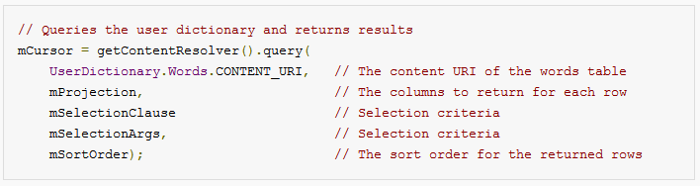
Content Resolver
ContentResolver actually accesses the data inside the provider
query, delete, insert, update, getType, etc.
Query returns a Cursor object which you can iterate through
Can create a database for your own app and expose its data using a ContentProvider
NYU Poly 10/5/2015
*http://developer.android.com

Slide 205
URI
Universal Resource Identifier (URI)
Tells us what table to use in an app’s database
Format: <standard_prefix>://<authority>/<data_path>/<id>
content://com.android.calendar/events
content://contacts/people/10 10th row of the people table
NYU Poly 10/5/2015

Slide 206
Provider Permissions
The application who owns the content provider can specify a permission that other applications must have
Examples:
android.permission.READ_USER_DICTIONARY
android.permission.WRITE_CONTACTS
android.permission.READ_CALENDAR
com.example.app.provider.permission.READ_PROVIDER
NYU Poly 10/5/2015

Slide 207
Implementing a Content Provider
Implement a Content Provider in your app if you want to expose data to other apps
You implement an interface into your SQLiteDatabase object
See guide/topics/providers/content-provider-creating.html
If there is interest later, I can go over this process
Note: You don’t need a content provider to use a SQLite database
NYU Poly 10/5/2015
*http://developer.android.com

