Slide 1

Android Introduction and Activities
Jeffrey Bickford
AT&T Security Research Center
jbickford@nyu.edu

Slide 2
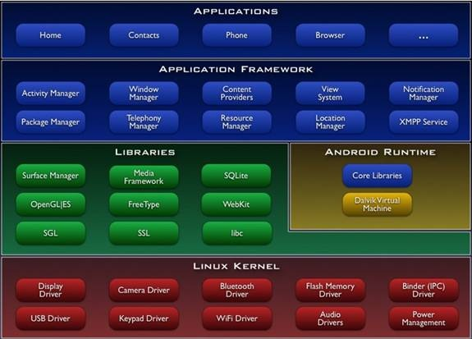
Android Anatomy

Slide 3
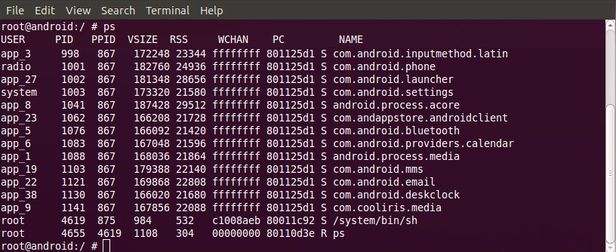
Android Anatomy
Each application is installed within its own Linux user id
Provides a sandbox between applications
Permission based access control policy

Slide 4
Android Anatomy
Each application also runs within its own Dalvik VM instance
Modified JVM which is optimized for mobile device use
Used to support a wide range of devices
Dalvik VM | Java VM
Register-based architecture | Stack-based architecture
Executes .dex files | Executes .class files
Utilizes shared memory for libs | No shared memory for libs

Slide 5
Why Dalvik?
Must function on a slow CPU
Small amount of RAM
No swap space within the OS
While on battery power
*Dalvik Virtual Machine Internals Google I/O 2008

Slide 6
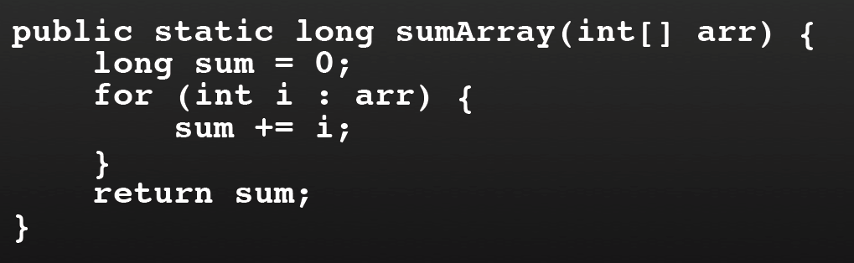
Register-Based Architecture
*Dalvik Virtual Machine Internals Google I/O 2008

Slide 7
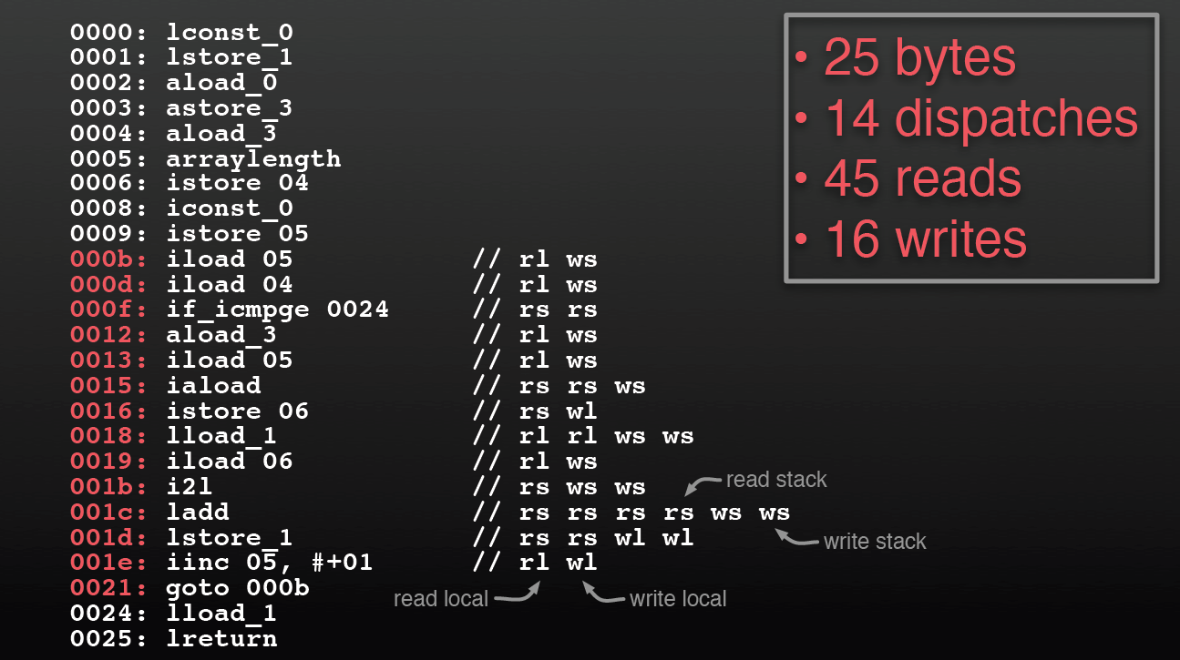
Register-Based Architecture
*Dalvik Virtual Machine Internals Google I/O 2008

Slide 8
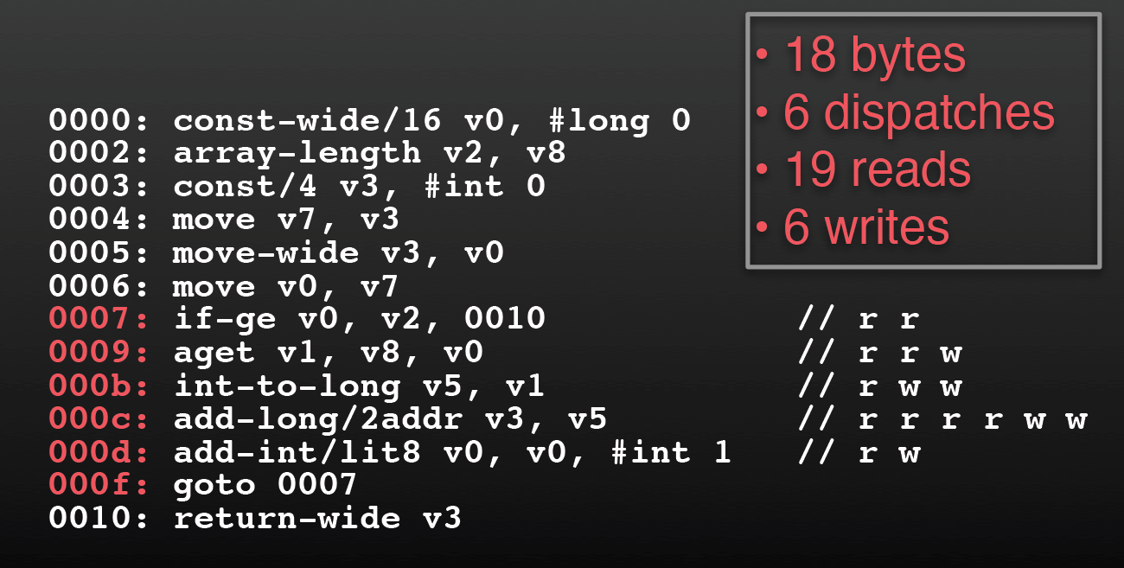
Register-Based Architecture
*Dalvik Virtual Machine Internals Google I/O 2008

Slide 9
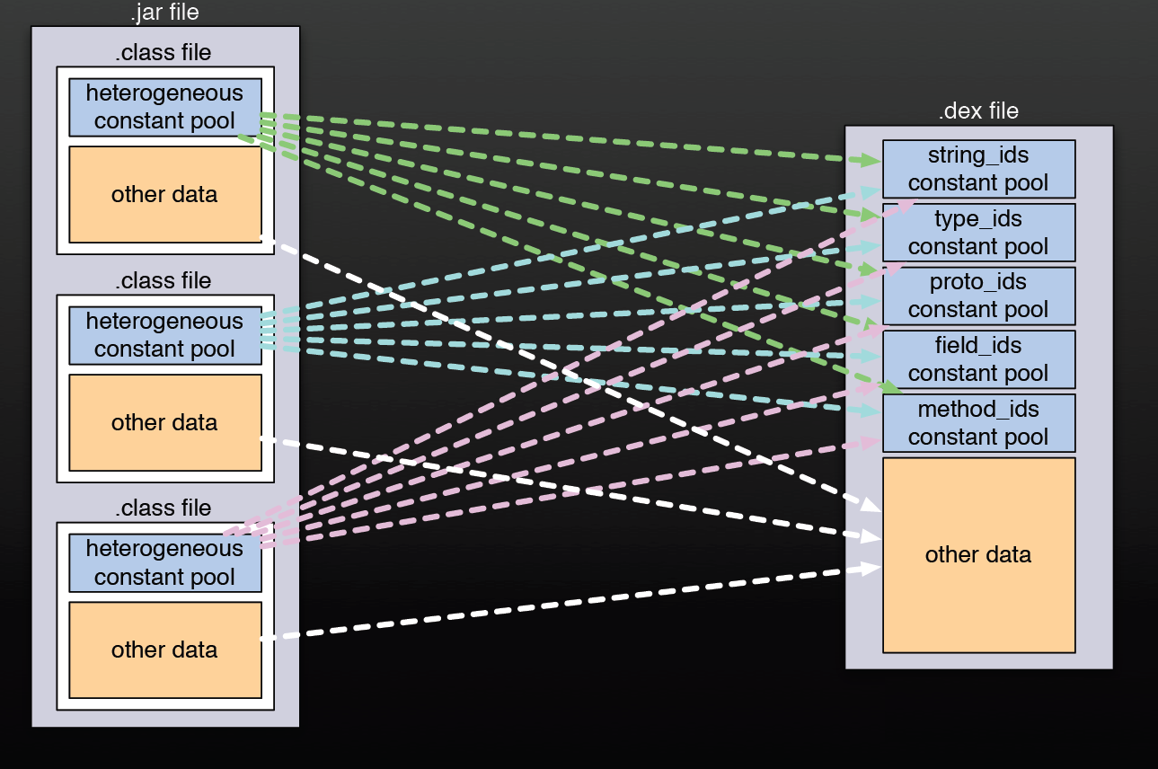
Dex Files
*Dalvik Virtual Machine Internals Google I/O 2008

Slide 10
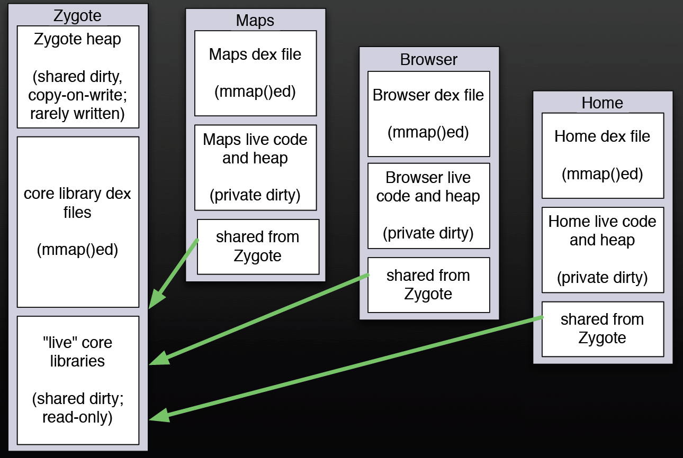
Shared Memory
Each Dalvik VM Instance is spawned from an initial VM called the Zygote process
*Dalvik Virtual Machine Internals Google I/O 2008

Slide 11
Applications
Applications are made up of 4 main components
Activity – the user interface of an application
Service – background activity with no UI
Content Provider – manage access to structured data
Broadcast Receiver – responds to system-wide broadcasts
Resources folder (MyProject/res/)
UI layouts, strings, images, animations, etc.

Slide 12
Applications
public static void main(String[] args)
int main(int argc, char **argv)
There is no main function of the application
Separate methods for activating each type of component
Each component is maintained in a specific way

Slide 13
Manifest File
Presents essential information about an application and must exist before any code is executed
Identifies unique package name of application
Describes each component with intents
Describes permissions required to use restricted APIs
Describes permissions other apps require to interact with app components
Minimum API
List of libraries to link against

Slide 14
Activities
Applications have multiple activities
One activity is considered the “main” activity
Create a subclass of activity
“public class ExampleActivity extends Activity {“
Callback methods
Must have onCreate()
Call setContentView() to define a layout of the UI

Slide 15
Activities
Activities can be in three static states
Resumed (Running)
In the foreground interacting with the user
Paused
Partially obscured by another activity
Stopped
Completely invisible to the user (in the background)

Slide 16
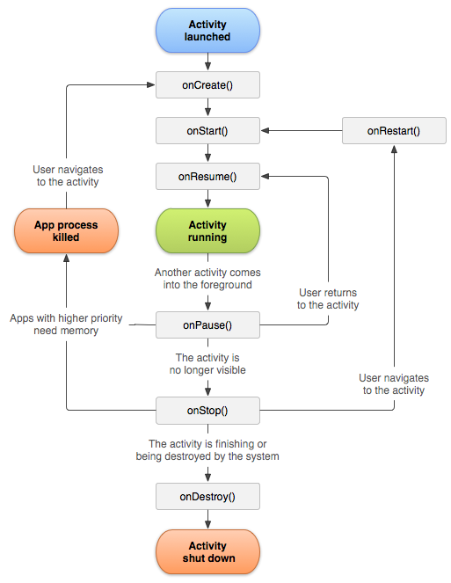
Activity Life Cycle
onCreate():
Perform all static setup
Create UI
Passed a “Bundle” object which contains previous UI state if you implement onSaveInstanceState()
*http://developer.android.com

Slide 17
Activity Life Cycle
onStart():
Called every time the app
arrives at foreground
Verify system features
(sensors) are enabled
Counterpart to onStop()
*http://developer.android.com

Slide 18
Activity Life Cycle
onPause():
Activity is placed in background but “partially visible”
Stop animations and CPU work
Save state quickly (draft email)
Release resources
*http://developer.android.com

Slide 19
Activity Life Cycle
onResume():
Initialize components that you stopped in onPause()
Start animations again
Restore resources
*http://developer.android.com

Slide 20
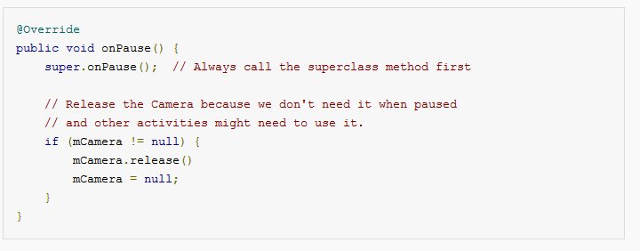
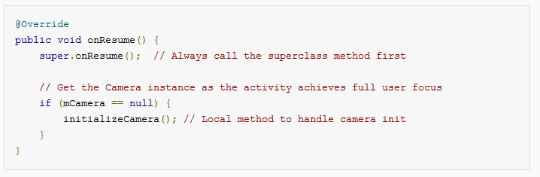
Example
*http://developer.android.com

Slide 21
Activity Life Cycle
onStop():
Activity is placed in background, “not visible”
Used to perform CPU intensive shutdown procedures (writing to a database)
*http://developer.android.com

Slide 22
Activity Life Cycle
onDestroy():
Someone called finish()
User back button
System chose to destroy for memory sake
*http://developer.android.com

Slide 23
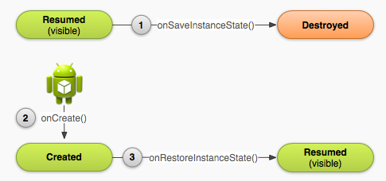
Saving State on Destroy
If the user presses back to destroy the activity, no state is saved
If the system destroys the activity, state is saved automatically
*http://developer.android.com

Slide 24
Saving State on Destroy
System uses a Bundle to save state
UI objects and their text
If you want to save additional state, you must override:
onSaveInstanceState()
onRestoreInstanceState()
*http://developer.android.com

Slide 25
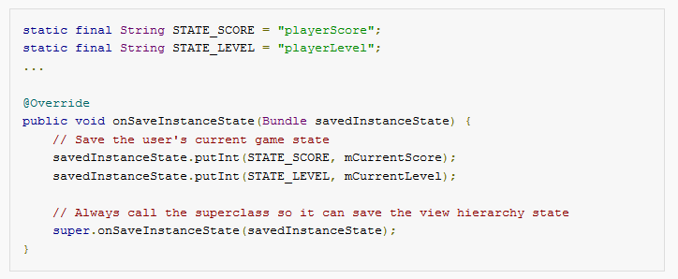
Saving State on Destroy
*http://developer.android.com

Slide 26
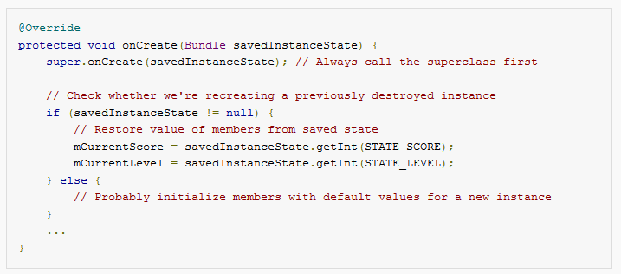
Saving State on Destroy
*http://developer.android.com

Slide 27
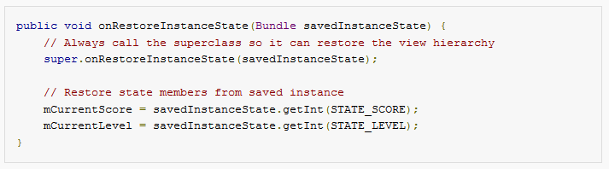
Saving State on Destroy
Alternative: onRestoreInstanceState is called after onStart() and only if there is a saved state to restore
*http://developer.android.com
Notes:
calls after the onStart() method. The system calls onRestoreInstanceState() only if there is a saved state to restore, so you do not need to check whether the Bundle is null:

Slide 28
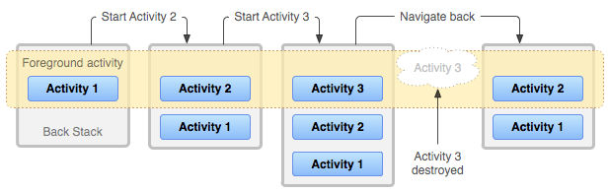
Back Stack
Activities are pushed and popped off the current stack
*http://developer.android.com

Slide 29
How do you start another Activity?
Intents represent an app’s “intention to do something”
Intent intent = new Intent(this, SecondActivity.class); String message = “Data to send next activity” intent.putExtra(“key”, message);
startActivity(intent);
Intents pass a bundle to the next Activity, add key value pairs
Should define keys for data that passes around app
More on intents later…
*http://developer.android.com

