Slide 1
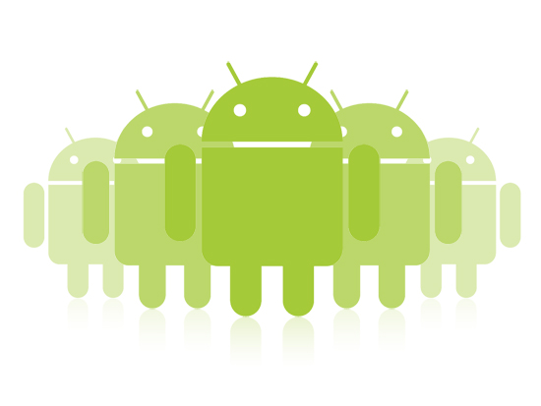
Android MVC Framework
Jeffrey Bickford
AT&T Security Research Center
jbickford@nyu.edu

Slide 2
MVC Framework
The Model-View-Controller Framework is used in many different types of application development
Mobile: Android, iOS
Web: Ruby on Rails, ASP.NET
MVC allows you to partition your application in such a way that changes to each component do not effect the other
Easily change the UI without effecting anything else
Support multiple devices and UI types
Change the backend without effecting the UI

Slide 3
MVC Framework
Model – model of the application data, design logic
Example: User, question, trip, product, photo, TV show
View – the UI of the application
Controller – Glue between the Model and the View
Manages the flow of data between the View and the Model
What components of an Android app naturally fit this framework?

Slide 4
Example
The Pacific Ocean is larger than the Atlantic Ocean.
Quiz
True
False
Next
Big Nerd Ranch Guide: Android Programming

Slide 5
Example
TrueFalse
Model
TrueFalse
TrueFalse
mQuestion
mAnswer
mQuestion
mAnswer
mQuestion
mAnswer
Controller
array of TrueFalse objects
QuizActivity
mCurrentIndex
View
question
true
false
next
TextView
Button
Button
Button
Big Nerd Ranch Guide: Android Programming

Slide 6
MVC Flow
User Input
1. User interacts with View
3. Controller updates Model
2. View sends message to Controller
Views
Controller
Model
5. Controller updates View with changes from Model
4. Controller takes data from model object that View is interested in
Big Nerd Ranch Guide: Android Programming

Slide 7
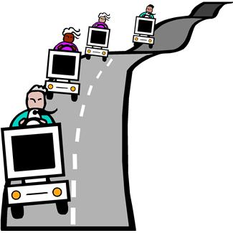
Homeworks
Problem – friends schedule short trips all the time
Lunch, dinner, night out, movies, etc.
People are typically late
No one wants to wait
ETA – a social networking app for you and your friends
Schedule trips with friends
Notify a user when each person will get there
Provide a user the best time to leave
ETA

Slide 8
Homework 2
Create 3 Activities
MainActivity, CreateTripActivity, ViewTripActivity
Create 2 Models
Location, Person
Pass Model objects between Activities

Slide 9
Parcelable
Object that can be passed between Activities via Intents or Bundles
Add constructor to populate fields
Add constructor that takes in Parcel to populate fields
writeToParcel writes out fields to Parcel object
Use intent.putExtra(“key”, parcel object) to pass data between Activities

Slide 10
Project Design Documents
First milestone of the project will be the initial design document
I will post examples from previous years on NYU Classes
Also will post the assignment and what I expect
The initial design document will be reviewed and count towards the final grade, but you will be able to update it as the project goes along. Initial and final will count as 20% (10/10 split).

Slide 11
Design Expectations
Problem Overview
Current solutions and related work
Overview of your solution and features
Use Cases
Components that will be included in the app
MVC framework
UI drawings
Project member breakdowns (who will work on what)
Goals for each milestone (what will be done when)

