Slide 1
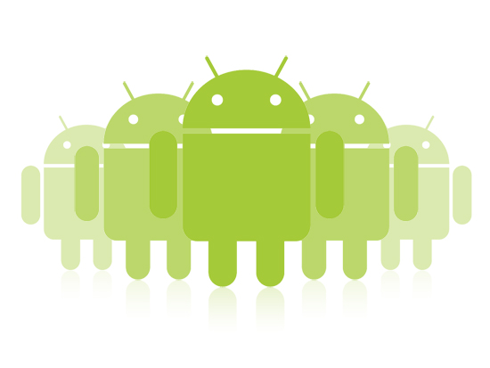
Android UI
Jeffrey Bickford
AT&T Security Research Center
jbickford@nyu.edu

Slide 2
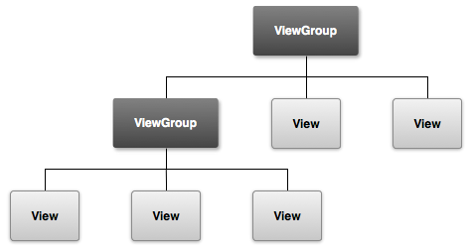
UI Overview
UI is made up of ViewGroups and Views (widgets)
ViewGroups | Views
LinearLayout | TextView (button, edit field, check box)
GridLayout | ImageView (image button, contact widget)
AdapterView (lists) | AnalogClock
*http://developer.android.com

Slide 3
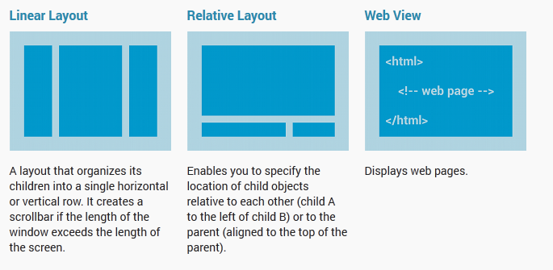
Layouts (ViewGroups)
*http://developer.android.com

Slide 4
Layouts (ViewGroups)
You typically only want one layout per Activity
Why?
Faster
Less resource intensive

Slide 5
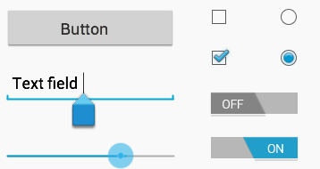
Widgets (Views)
Also called Input Controls – interactive components of the UI
Example: text fields, seek bars, checkboxes, buttons, switches, etc.

Slide 6
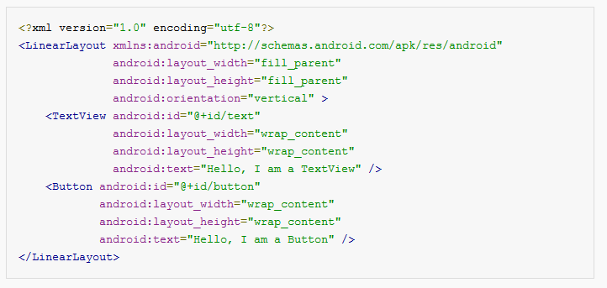
XML Layouts
MyProject/res/layout/main_layout.xml:
*http://developer.android.com

Slide 7
View Atrributes
Every View object must include a width and a height
android:layout_width=“match_parent”
android:layout_height=“match_parent”
View as big as parent View allows
android:layout_width=“wrap_content”
android:layout_height=“wrap_content”
Size to dimensions of content
android:layout_width=“20dp”
android:layout_height=“20dp”
Specify with actual measurements Use “dp” for density-independent pixel units

Slide 8
View Atrributes
Defines the placement at which children Views are placed T – B or L – R
android:orientation=“vertical”
android:orientation=“horizontal”
android:text=“Hello World!”
android:text=“@string/name”
Text to display in the View
Add space around the content within the View
Check documentation for all of the attributes!
android:padding=“20dp”
android:marginLeft=“16dp”
android:marginRight=“16dp”
Add space to the right or left of the content within the View
android:gravity=“center”
Aligns the content inside the View object
android:gravity_layout=“center”
Aligns the View with respect to its parent
Notes:
http://developer.android.com/reference/android/widget/TextView.html
http://developer.android.com/reference/android/widget/LinearLayout.html
http://developer.android.com/reference/android/widget/Spinner.html
http://developer.android.com/reference/android/widget/GridLayout.html

Slide 9
Screen Pixel Densities
Android provides dimension units so you get the same size on different screen sizes and pixel densities
Android automatically translates these units to pixels at runtime so you don’t have to worry about it
Unit | Name | Use
dp | density-independent pixel | padding, margins, sizes
sp | scale-independent pixel | text size – takes into account font size preference

Slide 10
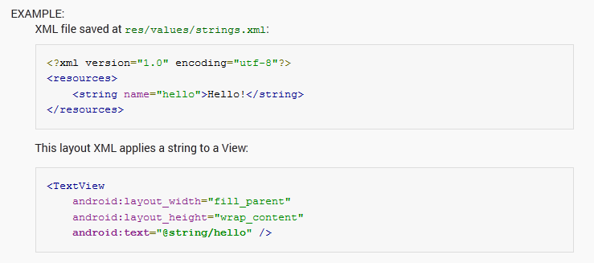
Strings
Every project contains a strings file named strings.xml
res/values directory
Use this to keep track of your strings as well as use them in multiple places

Slide 11
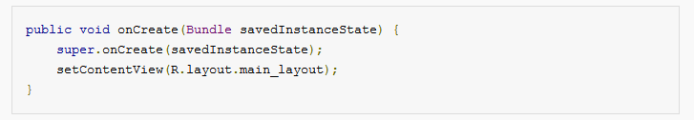
Back to onCreate()
Remember onCreate() and setContentView()?
Takes your XML layout and displays it on screen
*http://developer.android.com

Slide 12
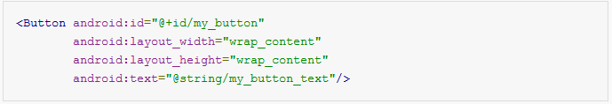
Using Views in Activites
Your UI is created. How do you use it in an Activity?
Every view is defined with an ID at compile time
Within XML layout, you give it an alias
Use this to actually manipulate the view within app
main_layout.xml:
onCreate(): create instance to use within activity
*http://developer.android.com

Slide 13
What is R?
Each app contains many resources
We have talked about layouts and values
Also animations, color, drawable, etc.
See: guide/topics/resources/providing-resources.html
At compile time, all the resources are compiled into objects and given numerical IDs so that the system can address these objects
R.java defines these IDs and is automatically generated
*http://developer.android.com

Slide 14
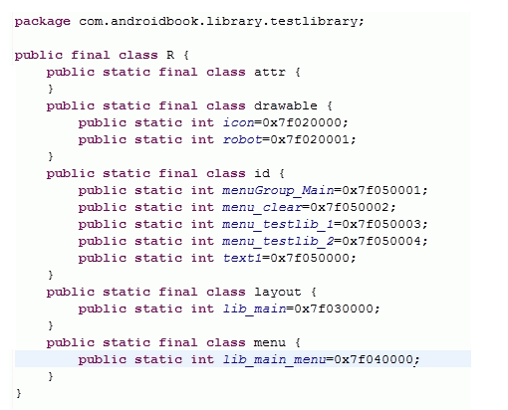
R Class

Slide 15
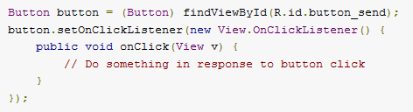
Events
How do you interact with your widgets?
Event Listeners
Convention – use anonymous classes as shown
*http://developer.android.com

Slide 16
What to do after event?
This depends on the widget, but here are examples:
if (checkbox.isChecked())
//Do Something
String username = username_field.getText()
Remember – you must instantiate your objects using findViewById()
*http://developer.android.com

Slide 17
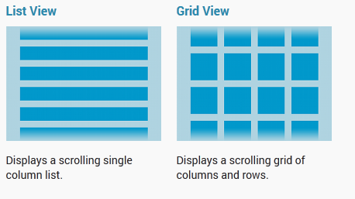
Layouts (ViewGroups)
How do we use these types of layouts?
*http://developer.android.com

Slide 18
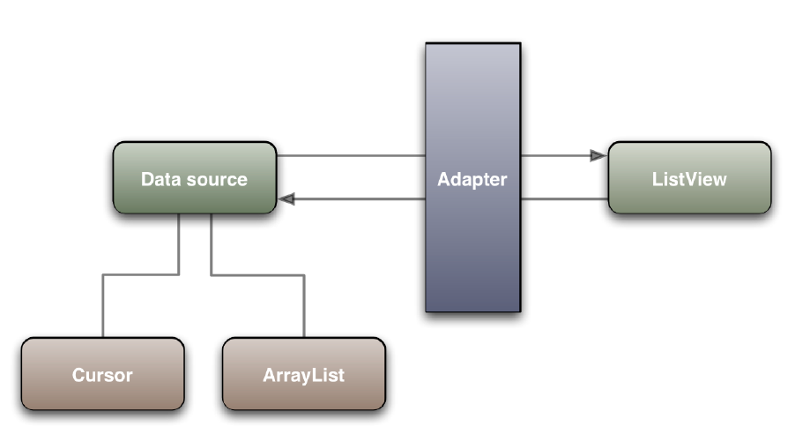
Adapters
Adapter creates all the widgets for the ListView based on the data source
Google I/O 2009 Make your UI Fast and Efficient

Slide 19
List View Example
list_view_example.xml:
<LinearLayout xmlns:android=http://schemas.android.com/apk/res/android
android:layout_width=“match_parent”
android:layout_height=“match_parent”
android:orientation=“vertical”
<ListView android:id=“@+id/list”
android:layout_height=“match_parent”
android:layout_width=“match_parent” />
</LinearLayout>

Slide 20
List View Example
ArrayAdapter is used when the data source is an array
The adapter creates a TextView object for each string
within the array
Note! simple_list_item_1 is a default xml layout in Android
*http://developer.android.com

Slide 21

List View Example
Create a ListView variable using findViewById and setAdapter()
Add an event to the objects in the ListView
listView.setOnItemClickListener(new OnItemClickListener() {
public void onItemClick(AdapterView parent, View v, int position, long id) {
// Do something in response to the click
}};
);
*http://developer.android.com

Slide 22
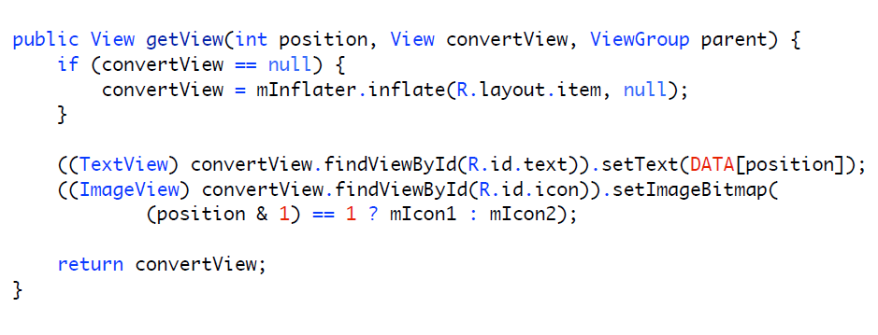
List View Example
If you want to use something more complicated than a TextView, you need to extend ArrayAdapter and override getView()
Google I/O 2009 Make your UI Fast and Efficient

