Slide 1

Team Name: TechX
Problem Statement: Cybersecurity , Digital Trust and safety– tools or systems to secure digital infrastructure, privacy, and personal data.
College : Maharaja Agrasen Institute Of Technology(MAIT).
Team Member Name :
01

Slide 2
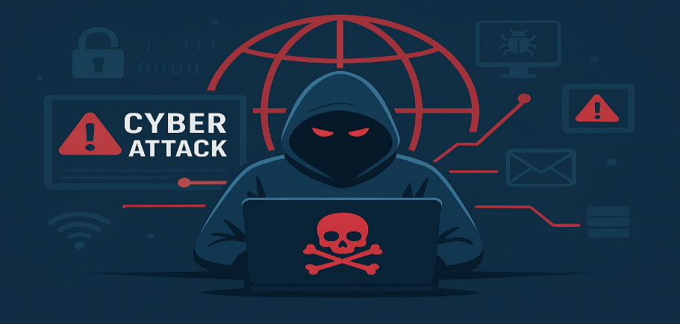

#Problem: Rising cyber threats: fake news, phishing, fraud transactions, and digital intrusions are increasing every day. Detection gap: most current tools are either too complex for common users or too resource-heavy for real-time use. Impact: leads to misinformation, financial losses, and security breaches affecting individuals, organizations, and even national security. #Solution:
Our MVP: A lightweight, ai-powered system that detects suspicious patterns and threats in real time. Key features: ⚡ Fast & accurate – ML model trained to spot anomalies/fake content instantly. 🖥️ User-friendly dashboard – simple interface for non-technical users.
🔗 Modular Design – Can be applied to multiple domains (fake news, fraud detection, intrusion alerts).
🌍 Deploy Anywhere – Runs locally for demos or cloud-hosted for large-scale use.
Problem & Solution
GitHub Repository (Code Base): https://github.com/puneetcoder31/Kavach.git
02

Slide 3
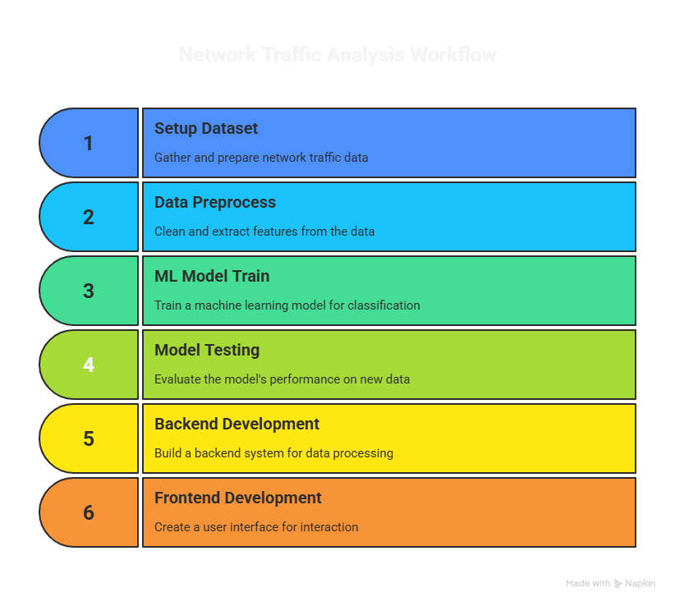
Flow of Solution
UNIQUE SELLING PREPOSITION (USP) of AI FIREWALL (KAVACH)
AI-Powered Threat Detection
Uses lightweight ML models to detect anomalies, fake content, or suspicious activity in real time.
Edge-friendly (can run on laptops/servers without heavy GPU).
Hackathon-Ready MVP
Built in just 2 weeks → shows fast prototyping ability.
Modular design → can be extended for government/enterprise use later.
Simple but Scalable Architecture
Frontend (React/HTML) + Backend (Flask) + ML model → clear separation.
Easy to upgrade ML models or plug in larger datasets.
User-Centric Interface
Clean, minimal UI → even non-technical users can interact.
Real-time prediction/alerts visible in dashboard form.
Open & Affordable
Uses open-source libraries (scikit-learn, Flask, React).
No dependency on paid APIs or heavy infrastructure → cost-efficient.
Customizable for Multiple Use-Cases.
STEP 1: setup dataset
-Use zeek(packet logs)
-Get pubic datasets
STEP 2: Data preprocess
-Clean packet logs
-Extract features (IP,port,protocol,flags)
STEP 3: ML model train
-Classification : normal
-Vs malicious traffic – try logistic regression
Step 4:model testing
-test on new packets
-accuracy/precision
-save model (joblib)
STEP 5: backend (
-build flask
-End point : upload packet
#return safe/attack
SREP 6:FRONTEND(UI)
-simple dashboard
-upload logs ,see result in real time..
03

Slide 4
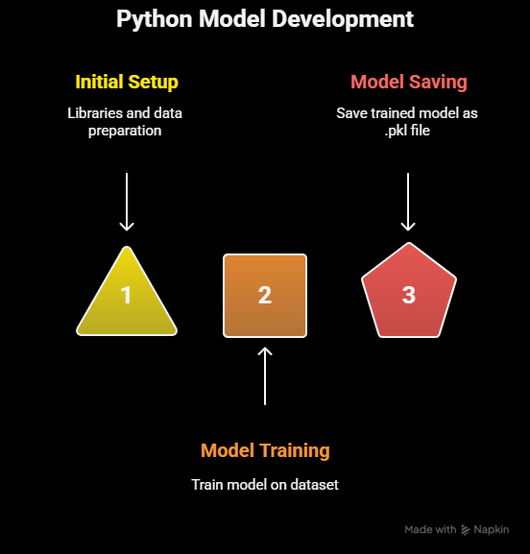
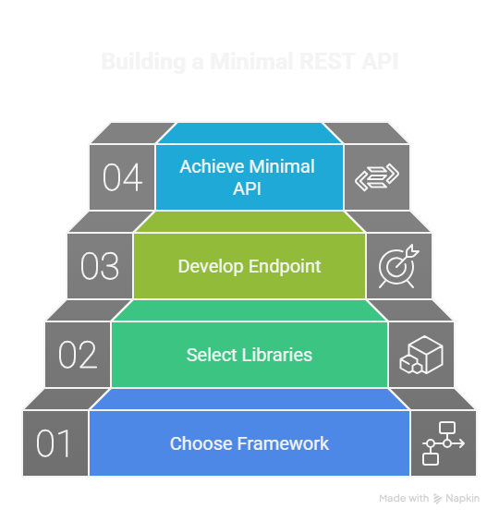
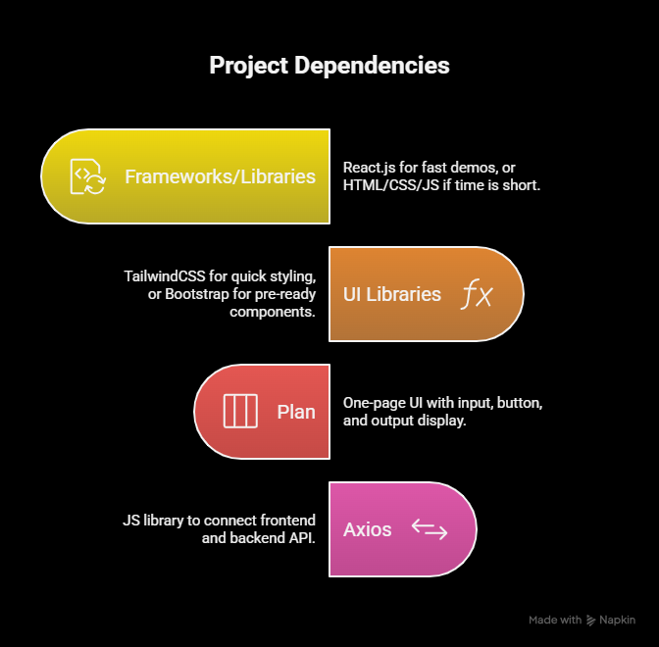
Tech Stack & Approach
#Language: PYTHON
Libraries: scikit-learn → quick prototyping (classification, clustering, anomaly detection),
pandas + numpy → data handling, matplotlib/seaborn → visualization (optional, just for analysis)
If text-based → nltk or transformers (HuggingFace, only if lightweight is possible)
Plan: Train a small dataset OR mock-up model with fake/sample data to prove concept.
Save model as .pkl using joblib.
# Language: Python
Framework: Flask (preferred, faster, better docs for hackathon) OR Flask (if comfort needed).
Libraries: uvicorn (for running Flask), pydantic (for input validation), joblib/pickle (to load model)
Output: REST API endpoint like /predict that returns result.
Note: Keep it minimal — only 1–2 endpoints.
#Language: JavaScript (basic level is enough)
Frameworks/Libraries:
React.js (fast, hackathon-friendly, good for demos) OR HTML + CSS + JS (if time very less)
UI Libraries: TailwindCSS (for styling quickly) OR Bootstrap (if we want pre-ready components)
Plan: One-page UI → Input box + button + output display
Axios (JS library) to connect frontend ↔ backend API.
Example: User enters input → frontend sends API request → backend loads ML model → returns prediction → frontend shows result.
04

Slide 5
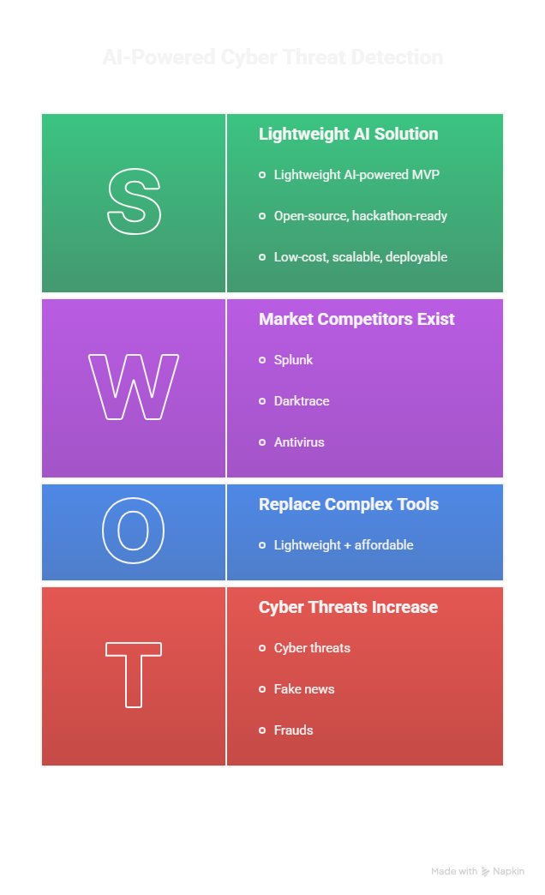
FLOWCHART
🔴 Problem
Cyber threats, fake news, frauds → costly & complex detection tools
🟢 Solution
Lightweight AI-powered MVP → fast, scalable & user-friendly
🔵 USP
Open-source, hackathon-ready → simple UI +modular backend
🟠 Feasibility
Low-cost, scalable, deployable locally & on cloud
🟣 Competitors
Splunk, Darktrace, Antivirus → costly & complex ✅ Our edge: lightweight + affordable
05

Slide 6
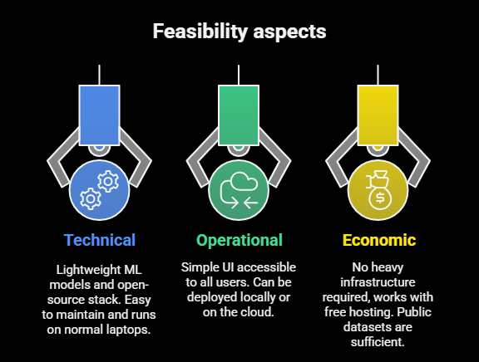
Feasibility: Technical feasibility Uses lightweight ML models (scikit-learn, flask) → runs on normal laptops without gpus. Open-source stack → no licensing cost, easy to maintain. Modular design → scalable for multiple domains (fake news, anomaly detection, fraud). Operational feasibility Simple UI → accessible to both technical & non-technical users. Can be deployed locally for hackathon demos or on cloud (heroku/render/vercel) for wider use. Economic feasibility No heavy infra required → works with free hosting and public datasets. Cost-effective mvp → minimal resources but scalable for enterprise/government adoption. Competitors (and how we stand out): Existing security tools SIEM tools (splunk, IBM qradar) → powerful but expensive & complex. Antivirus/firewall software (mcafee, kaspersky) → good for end devices but not adaptive ai-based. Ai-based detection platforms Darktrace, crowdstrike → advanced AI systems but require high infra, costly licenses. Our edge (usp) ⚡ Lightweight & hackathon-ready → doesn’t need heavy infra. 🌍 Flexible use-cases → same model framework can serve fake news, fraud detection, or intrusion alerts. 💰 Cost-effective & open source → affordable alternative to enterprise solutions.
Feasibility & Competitors
06

Slide 7
Research and References
1. Fake news detection in indian languages: A case study : authors- R.K. Gupta et al. (2025)
2. AI and cybersecurity capabilities in india
Document: india's AI/ML cybersecurity capabilities by DSCI (data security council of india)
3. Factdril: multilingual fact-checking dataset for regional indian languages
Authors: shivangi singhal, rajiv ratn shah, ponnurangam kumaraguru (2021)
4. Mitigating the spread of misinformation in india through a multimodal adversarial network
Journal: IJISAE, 2023
5. AI for cyber threat intelligence in smart manufacturing in india.
Title: using ai for real-time cyber threat intelligence for smart manufacturing supply chains in india.
Reference link
https://www.sciencedirect.com/science/article/pii/S1877050925010609/pdfmd5=b0681a23a07b9ce41856960e40301f04&pid=1-s2.0-S1877050925010609-main.pdf
https://link.springer.com/article/10.1007/s40747-021-00552-1
https://ijisae.org/index.php/IJISAE/article/view/3934
https://www.researchgate.net/publication/385124565_THE_USE_OF_ARTIFICIAL_INTELLIGENCE_TO_CONTROL_CYBER_CRIMES_IN_INDIA_AN_OVERVIEW
07

