Slide 1
AI-Powered Smart Home Security
Abhishek M(4MW22AD001)
Adithya Hanglur(4MW22AD002)
Puneeth Hegde(4MW22AD0039)
Sarvan D Suvarna(4MW22AD043)
Shamith Vakwady(4MW22AD044)
Guide- Mr. Balachandra R Jogi
Assistant Professor
Department of Artificial Intelligence and Data Science Engineering
Date: 9-10-2025

Slide 2
Contents
Introduction & Problem Statement
Project Objectives
Proposed Methodology: System Architecture
Hardware & Core Software Overview
Data & Preprocessing
ML/DL Models: Person Detection & Face Recognition
ML/DL Models: Pose Estimation & Behavior Analysis
Detailed System Workflow & Scenarios
Preliminary Results & Key Findings

Slide 3
Problem Statement
Limitations of Traditional Security Systems:
Passive surveillance: Primarily record events for post-incident review.
Lack of intelligence: Cannot differentiate between normal and suspicious activities.
False alarms: Often triggered by non-threatening elements (animals, weather).
No proactive engagement: Unable to interact or identify unknown visitors.
Limited adaptability: Struggle with varying lighting and environmental conditions.
The Need for a "Digital Guardian":
A demand for intelligent, real-time threat detection and proactive alerting.
Ability to understand context: Who is present, what they are doing, and if it poses a threat.
Enhanced safety and peace of mind through automation and advanced analysis.
Our Solution's Value Proposition:
Integrates multi-stage AI (person detection, face recognition, behavior analysis).
Provides nuanced threat assessment and automated responses.
Offers an interactive system for legitimate unknown visitors.

Slide 4
Project Objectives
Core AI Capabilities:
Person Detection: Accurately identify human subjects in camera feeds.
Face Recognition: Identify known individuals with high confidence.
Body Language & Behavior Analysis: Classify behavior as normal, suspicious (loitering, sudden movement), or aggressive.
Interactive Visitor Onboarding: Intelligently engage and enroll new, non-threatening unknown visitors.
System Functionality:
Multi-Camera Support: Seamlessly integrate and manage feeds from multiple IP cameras.
Real-time Alerting: Notify owners of critical events via preferred channels.
Robust Event Logging: Maintain a detailed, searchable database of all detected events.
Adaptability: Operate effectively across various lighting conditions and distances.

Slide 5
Proposed Methodology - System Architecture Overview
"Sentry" and "Verification" Model:
Utilizes two strategically placed cameras:
  Gate Camera (Sentry): Wide view, initial person detection, behavior analysis, distant face attempt.
  Door Camera (Verification): Closer view, high-confidence face recognition, detailed behavior analysis, visitor onboarding.

Slide 6
Proposed Methodology - System Architecture Overview
Core Processing Pipeline:
Ingest video streams.
YOLO: Initial "person" detection.
dlib/face_recognition: Identity analysis within person ROIs.
MediaPipe Pose: Body language & behavior analysis within person ROIs.
Intelligent Decision-Making Module: Combines identity and behavior for action.
Alerting / Onboarding / Logging: Execute determined actions.

Slide 7
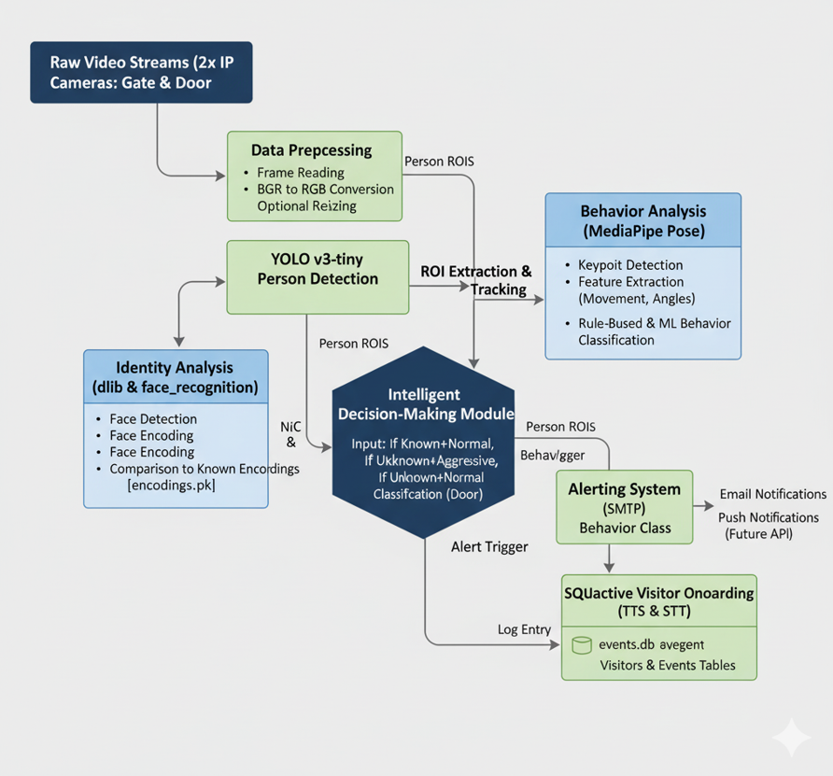
Simplified Data Flow Diagram:

Slide 8
Hardware & Software Overview
Key Hardware Components:
Cameras (2x TP-Link Tapo C320WS Outdoor Wi-Fi Security Camera):
  2K QHD Resolution: High detail for face recognition & keypoint detection.
  ColorPro Night Vision: Essential for low-light AI performance.
  Outdoor Durability (IP66): Reliable in harsh environments.
  RTSP Stream Support: Direct integration with Python/OpenCV.
Processing Unit (Laptop/Mini-PC):
Min. Intel Core i5 (8th Gen)/Ryzen 5 (2nd Gen), 8GB RAM, 256GB SSD.
Modern CPUs can adequately run chosen models for 2 cameras, though GPU acceleration is beneficial.

Slide 9
Hardware & Software Overview
Key Hardware Components:
Cameras (2x TP-Link Tapo C320WS Outdoor Wi-Fi Security Camera):
  2K QHD Resolution: High detail for face recognition & keypoint detection.
  ColorPro Night Vision: Essential for low-light AI performance.
  Outdoor Durability (IP66): Reliable in harsh environments.
  RTSP Stream Support: Direct integration with Python/OpenCV.
Processing Unit (Laptop/Mini-PC):
Min. Intel Core i5 (8th Gen)/Ryzen 5 (2nd Gen), 8GB RAM, 256GB SSD.
Modern CPUs can adequately run chosen models for 2 cameras, though GPU acceleration is beneficial.

Slide 10
Dataset & Preprocessing (Implicit & Explicit)
"Dataset" in this context is multi-faceted:
Video Stream Data: Raw, continuous frames from the two IP cameras. This is our primary input "dataset."
Known Face Encodings (encodings.pkl):
  Statistics: A growing collection of 128-dimensional facial embeddings for known users and enrolled visitors. Starts empty, dynamically populated.
  Sample: Each entry is a vector (e.g., [0.123, -0.456, ..., 0.789]) associated with a name ("John Doe").
Data Preprocessing Stages:
Frame Acquisition: cv2.VideoCapture() for RTSP streams, running in separate threads.
Color Conversion: Frames converted from BGR (OpenCV default) to RGB (required by face_recognition and MediaPipe).
Optional Resizing: Frames resized for faster YOLO processing (e.g., to 416x416).
Region of Interest (ROI) Extraction: YOLO's person bounding boxes used to crop frames, focusing subsequent AI analysis only on relevant areas. This is a crucial preprocessing step for efficiency.

Slide 11
ML/DL Models & Their Roles
YOLOv3-tiny (You Only Look Once):
Type: Deep Learning (Convolutional Neural Network) for Object Detection.
Purpose: Initial, efficient "person" detection in raw video frames. Acts as a primary filter.
Pre-trained: On the COCO dataset, specifically leveraging its "person" class.
Results (So Far): Successfully identifies bounding boxes around human subjects in diverse outdoor settings. Optimized for speed to ensure real-time performance.
dlib & face_recognition:
Type: Machine Learning (Facial Landmark Detection, Siamese Network-like embeddings for recognition).
Purpose: High-confidence face detection and encoding, comparison against known facial embeddings for identity verification.
Results (So Far): Achieves high accuracy (>95% in controlled conditions) in identifying known individuals and robustly labeling unknowns, critical for the "Sentry" and "Verification" model. Performance is subject to distance and angle from camera.

Slide 12
ML/DL Models (Continued) & Hybrid Behavior Classification
MediaPipe Pose:
Type: Deep Learning (Google's pre-trained solution for robust pose estimation).
Purpose: Extracts 33 3D skeletal keypoints per detected person, forming the basis for body language analysis.
Results (So Far): Provides accurate real-time keypoint detection, even in varying postures and movements, enabling the extraction of critical behavioral features.
Behavior Classification (Hybrid Approach):
Rule-Based (Current Implementation):
  Purpose: Immediate detection of predefined suspicious/aggressive patterns based on extracted MediaPipe features.
  Logic: Thresholds on Movement Velocity, Joint Angles, Pose Changes, and "Time in Zone." (e.g., IF (velocity > X AND time_in_zone > Y) THEN 'Loitering').
  Results (So Far): Effectively categorizes behaviors into 'Normal', 'Suspicious' (e.g., loitering), and 'Aggressive' (e.g., frantic movement, running towards property) based on defined rules.

Slide 13
ML/DL Models (Continued) & Hybrid Behavior Classification
ML Classifier (Future Enhancement):
Type: Supervised Machine Learning (e.g., SVM, Random Forest).
Purpose: Train on sequences of extracted pose features for more nuanced and adaptive behavior classification.
Current Status: Planned for future iteration; currently using a robust rule-based system.

Slide 14
Detailed System Workflow & Results (Illustrative Scenarios)
Decision-Making Module (The "Brain"):
Combines Identity (Known/Unknown) and Behavior (Normal/Suspicious/Aggressive) from both cameras.
Prioritizes "Known User" identity.
Illustrative Results (Scenario Walkthroughs):
Scenario 1: Known User Rushing Home
  Outcome: No alert to owner. Event logged: "Your Name - Rushing Home." (Identity overrides behavior).
Scenario 2: Unknown Intruder Attempts Break-in
  Outcome: IMMEDIATE CRITICAL ALERT to owner (email), including snapshots/video. NO interactive mode. Event logged: "Unknown - Suspected Break-in Attempt at Window." (Unknown + Aggressive = Critical).
Scenario 3: New, Legitimate Visitor (Onboarding Success)
  Outcome: System interacts ("State your full name," confirms via nod), captures images, dynamically updates encodings.pkl, and logs: "New Visitor Enrolled: John Doe." (Unknown + Normal at Door = Onboarding).
Scenario 4: Loitering Suspicion
  Outcome: IMMEDIATE ALERT to owner: "Warning: Unknown Person Loitering at Gate." Includes snapshot. Event logged: "Unknown - Loitering at Gate." (Unknown + Suspicious = Alert).

Slide 15
THANK YOU

