Slide 1
HandyScan: Compile written docs into an audio book
Gagan Karunakara Shetty
Pawan Ranjith Muthaiah Subramanian
Puneeth Gante Hanumappa
Notes:
Hi all, this is Pawan, and I have with me here Gagan and punetth . Today we are going to talk about our project - handyscan

Slide 2
Agenda
Project Goals
Software and hardware components
Architectural diagram
Project demonstration
Debug strategy
Key takeaways
Notes:
This is the agenda for this video. We’ll first talk about the project goal. Then, we’ll go over the software and hardware components we used for the project. After that we will take a look at the architecture and the component interactions, followed by a quick demo of the project. Finally, we’ll discuss about the debugging strategies we used and the key learnings from the project.

Slide 3
Project Goals
Provide cloud-hosted service to users that compiles written notes into audiobooks.
Users upload image files of notes and expect a compiled audio book
Build simple, user-friendly UI and RESTful APIs.
Search feature to retrieve files tagged similar.
Notes:
In the recent years, there is a rise of audio book listeners, and we are getting more comfortable with audio only information. But we usually have most of the data in the form of images. So we built a service that can compile audio books out of these images. Using our service, users can upload images on our application, which will extract the textual data from the images and convert it into audio files. The application will organize this data into audio books for easier access and lets the user search and listen to them when needed.

Slide 4
Software components
Docker and Kubernetes.
SpringBoot REST API interfaces for backend.
React UI for application frontend.
OCR engine for converting image to text.
Text to Speech Engine for converting text to audio
Kafka Message Queues
MongoDB Database
Redis in-memory Key-Value Store
Notes:
Let’s take a look at the software components involved. First of all, we have the docker and kubernetes where our application is deployed. We used docker to containerize our application, and used kubernetes to orchestrate the docker containers. The backend of the application is a rest api build using spring boot and the frontend is built using react. For converting the image to text, we have the OCR engine which run on a kubernetes pod. Once the image is converted to text, we then run the text to speech engine on another kubernetes pod to convert the text to an audio file. The interprocess communication is achieved using kafka and the metadata of these images are stored in mongo db. Finally, we use redis to cache the data.

Slide 5
Hardware components
Google Kubernetes Cluster with autoscaling nodes of e2-medium (4 vCPU) and 8GB RAM in each node
Kafka Basic tier that supports 250MBps ingress and 750MBps egress, hosted on GCP.
MongoDB hosted on Amazon Web Service(AWS) with 500MB storage with shared vCPU and 3 read replica nodes
Redis cache on kubernetes pod.
Minio Object storage hosted on kubernetes
Notes:
Discussing on Hardware we have used to implement. We spun up a kubernetes cluster on GCP, which has 2 nodes, with 4 cpus and 8 GB Ram each. The Kafka, cluster is hosted of GCP while the mongodb was hosted on AWS. The Redis cache, and the minio object storage runs in a pod in kubernetes cluster.

Slide 6
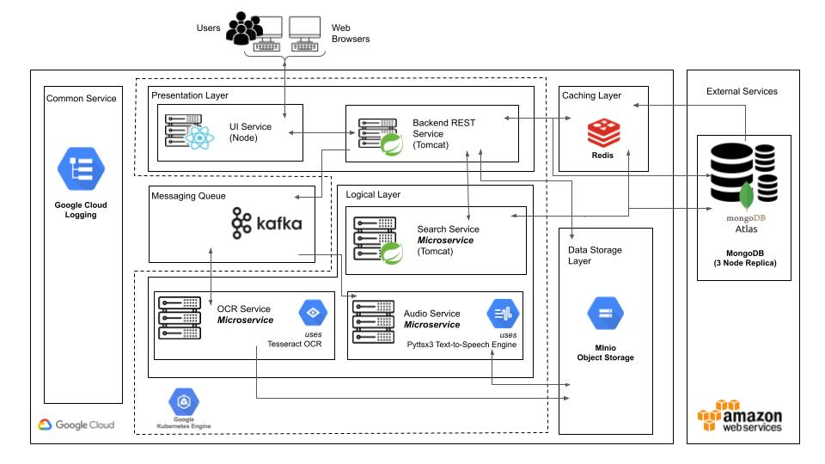
Architectural diagram
Notes:
This is the architecture diagram. Fancy right?
Let’s take a deeper look at the individual components and their interactions.
First we have the users who will interact with the system through the Ui service. This Ui service is deployed on a kubernetes pod and has a loadbalancer routing traffic to it. The UI interacts with the rest of the application via the backend service, which is running on a separate kubernetes pod. The backend service interacts with various other services. Firstly, it connects with the database and the redis cache to retrieve the user data. It also communicates with the search service for specific search tasks. When the user uploads an image, the backend service stores the image in minio and publishes a message to kafa to notify the ocr service to process this image. The ocr service runs as a standalone pod and acts as a consumer listening to a particular kafa topic, will pick the image from minio and generate the text file out of it. The ocr service stores the text file back into the minio object storage and publishes a message to another kafka topic to notify the audio service to process the text file. The audio service is another micro service running on a pod that listens to a kafka topic. When notified, it picks the text file, generates the audio file and persists the metadata such as status, file location, etc in mongo db. The entire process is monitored using google cloud logging, which helps us debug the individual pods.

Slide 7
Debugging and Testing
Unit tests for each microservice.
Kubernetes cluster logs.
Event and debug message logs.
Local testing with minikube cluster.
Notes:
We just went through a tonne of components interacting with each other. Without a solid testing and debugging framework, it would be impossible to maintain this architecture. For testing, we have separate unit tests for each of the components. This helps us test each microservice in isolation and helps us make changes to components individually. We also have the kubernetes cluster logs which helps us get information about all the kubernetes pods and the events. This helped us debug the system and identify which component was faulty when there was a bug in the system.
For local development and testing, we used a local minikube cluster.

Slide 8
Key takeaways
Ability to modularize the application and maintain each component in isolation.
Harnessing the benefits of distributed system design using various independently scalable components.
Ease of development and deployment using kubernetes.
Notes:
So what did we learn from the project?
First of all, we learnt how to modularize the different components of the application. This helped us maintain each component separately and scale each component independently. For example, the text to audio service is a performance intensive task. This allowed us to independently scale that particular service so there is no delays in the processing of the files. Moreover, this micro service architecture helped us divide the tasks amongst ourselves easily and work independently. The testing process was a lot easier as we were about isolate each application and figure out the bugs more easily. Finally for changes in code, we only needed to deploy the particular component that was changed. This was a lot easier than deploying all the components everytime there was a change in the code bae.

Slide 9
Limitations/Future scope
Enable better security using OAuth for user logins.
Use of config server to store application configurations.
Use of cloud secret manager for storing secret keys.
Encryption of data and files stored in minio.
Notes:
There are a couple of things we plan to implement in the future. First of all, the login process could use OAuth for better security.
We could make use of a a config server to store the application configurations instead of passing them in manually as environment variables.
The files stored in the object storage could also be encrypted.

Slide 10
Thank You!
Notes:
Thank you

