Slide 1


VISVESVARAYA TECHNOLOGICAL UNIVERSITY Jnanasangama, Belgaum-590018, Karnataka, India.
EAST WEST INSTITUTE OF TECHNOLOGY
Bangalore- 560091
PRESENTATION ON “Content Based Image Retrieval Using Color and Shape Features”
Submitted By: PUNEETH A HEGDE 1EW14IS079
PUNEETH P 1EW14IS080
SANJAY GOWDA J R 1EW14IS093
SHASHI KIRAN D C 1EW14IS095
Under the Guidance of
Dr.SURESH M B
Professor & Head
Department of ISE, EWIT

Slide 2
ABSTRACT
Growth of digital technology along with use of internet has increased the use of data such as images and videos in domains like digital museums, commercial use, crime prevention, medical images, remote sensing and so on. With increasing volume of digital data search and retrieval of relevant images from large datasets in accurate and efficient way is a challenging problem.CBIR combines the features of image like color and shape rather than keywords related to an image. An approach is proposed for retrieval based on combination of color and shape features of image.

Slide 3
INTRODUCTION
Image processing is the study of any algorithm that takes an image as input and returns an image as output.
Content-based image retrieval (CBIR), also known as query by image content (QBIC) , content based visual image retrieval(CBVIR) is the application of computer vision techniques to the image retrieval problem, that is, the problem of searching for digital images in large databases.
Color is the most widely used visual content for image retrieval. Color spaces are required for description of CBIR. Mostly RGB & HSV.
Several methods are used for shape based image retrieval which involves different kind of image filtering and image transformations.

Slide 4
LITERATURE SURVEY
Sl. No. | Title | Author | Advantages | Disadvantages
1 | Experiments on Content Based Image Classification using Color Feature Extraction | Sandhya R. | Experimental results show that the maximum Accuracy of 81.25%. | Shape features are not considered.
2 | Content-Based Image Retrieval Using SOM and DWT | Ammar Huneit | CBIR method using color feature vectors using the DWT and SOM artificial neural networks. | Shape features are not considered.

Slide 5
…continued
Sl. No. | Title | Author | Advantages | Disadvantages
3 | Visual Feature Extraction for Content- Based Image Retrieval | Saadet | It includes the design of an image database and retrieval of specific features from the images for the CBIR, then the analysis of the CBIR system performed by using color histogram and the Euclidian distance measurement. | Combination of features is not considered.
4 | Content Based Image Retrieval System | Bodhkeet | Uses color image which is uniformly divided into 8 parts as a first step, the centroid of each partition is selected. Texture of an image is obtained by GLCM and it proposes partial shape matching. | Retrieval time is more.

Slide 6
SYSTEM REQUIREMENT SPECIFICATION
HARDWARE:
System : Pentium IV 2.4 GHz.
Hard Disk : 40 GB.
Monitor : 15 VGA Colour.
Mouse : Logitech.
Ram : 512 Mb
SOFTWARE:
Operating system : Windows XP/ Windows 7.
Software Tool : Matlab 8.10.
Coding Language : Matlab.
Toolbox : Image processing toolbox.

Slide 7
ANALYSIS AND DESIGN
Color and Shape are the 2 features used to retrieve the relevant images for the database w.r.t an query image.
Color moments, hsv histogram and scale invariant feature transform helps in extraction of the image.
Manhattan distance and Eucledian distance are used to find the distance between 2 vectors.

Slide 8
continued…
Color Moments:-Color moments are measures that can be used differentiate images based on their features of color.The most important moments are Mean, Standard deviation and Skewness which have been proved to be efficient and effective in representing color distributions of images. In RGB, each channel will be 3-values vector. In total we have 3 x 3 = 9 values for each image.
HSV Histogram:-In the HSV color space hue is used to distinguish colors, saturation is the percentage of white light added to a pure color and value refers to the perceived light intensity. Each component is quantized with non-equal intervals: H: 8 bins; S: 3 bins and V: 3 bins.

Slide 9
continued…
Scale Invariant Feature Transform:-Also known as SIFT is an algorithm used to detect and describe shape features from an image.
Harris Corner Detection:-Harris Corner Detector is an algorithm which is used in image processing especially in CBIR to detect the corners of an image.
Manhattan Distance:- It is also called the L1 distance. If u=(x1, y1) and v=(x2, y2) are two points, then the Manhattan Distance between u and v is given by: MH (u, v) = |x1-x2|+|y1-y2|
Euclidean Distance:-: It is also called the L2 distance. If u=(x1, y1) and v=(x2, y2) are two points, then the Euclidean Distance between u and v is given by:EU (u, v) = √(x1-x2)² + (y1-y2)²

Slide 10
continued…
K-Nearest Neighbour :- It is one of the methods that can also be used in domains such as data mining, statistical classification and pattern recognition. This method is based on correlation. In this method the test tuple is compared with trained tuples which are similar to it. The trained tuples would have been given ‘n’ number of attributes. Tuples represent the single points in a space. If there exist an unknown tuple then K-Nearest Neighbour method searches the ‘k’ trained tuples in a space which are similar to the unknown tuple.

Slide 11
IMPLEMENTATION of MODULES
The basic fundamentals of content based image retrieval are divided into three parts :-
Feature Extraction
Feature Matching
Retrieval System Design

Slide 12
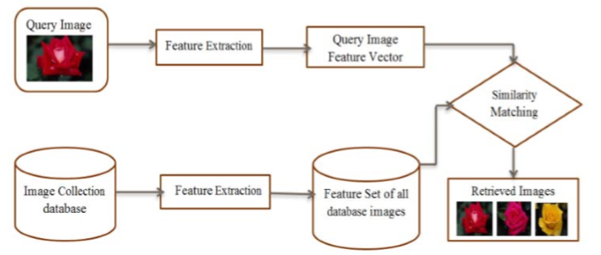
Block Diagram of a CBIR System

Slide 13
The CBIR system has following steps:-
Create a Database
Input Query Image
Feature Extraction
Feature Matching
Evaluate Results

Slide 14
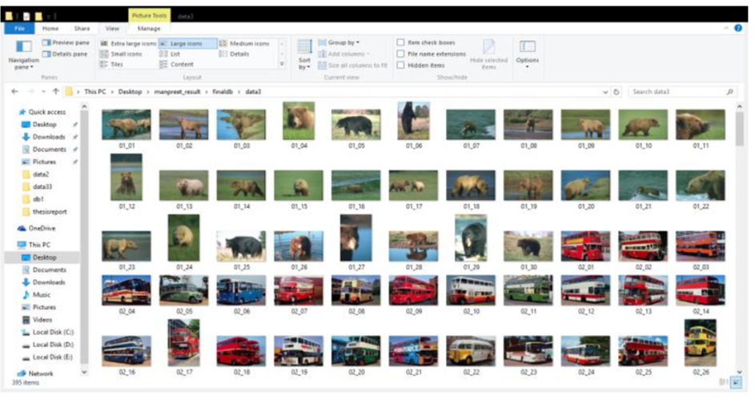
Create a database
Store images in a database to prepare own database or use inbuilt databases.

Slide 15
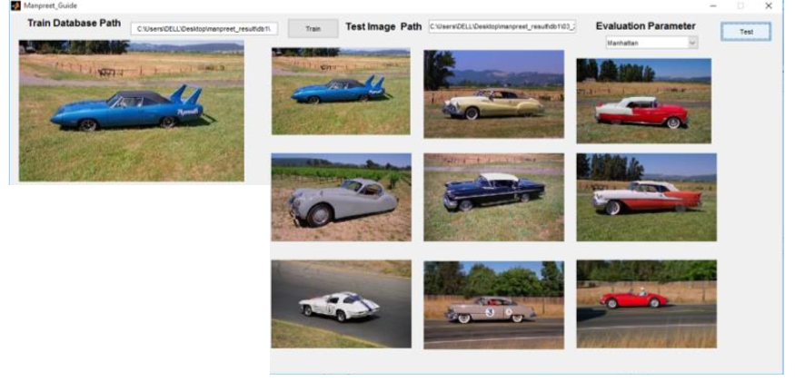
Input Query Image
Input image for which similar images in the database has to be retrieved.

Slide 16
Feature Extraction:-Extracting the important features of database images and query image based on various image features like color and shape features etc.
Feature Matching:-Measure similarity between query image and stored database images based on Manhattan distance, Euclidean distance, chisquare distance etc. is checked and the features which are closer to the query image features the corresponding image of that features are retrieved.
Evaluate Results:-Based on certain parameters like sensitivity, specificity, accuracy rate evaluate retrieved images.

Slide 17

END OF PRESENTATION

