Slide 1
DATABASE MANAGEMENT SYSTEM • DEPARTMENT OF ARTIFICIAL INTELLIGENCE • BATCH B • GROUP 18
STOCK MASTER
Enterprise Multi-Warehouse Inventory & Intelligent Supply Chain Management System
Department of Artificial Intelligence • Amrita Vishwa Vidyapeetham, Coimbatore, India
PROJECT TEAM MEMBERS — BATCH B | GROUP 18
• Puneeth Kumar Kalinga (CB.SC.U4AIE24146) — Team Lead — Backend Architecture, Schema DDL, REST APIs & Forecasting
• Varshitha P (CB.SC.U4AIE24144) — Database Design — Entity-Relationship Modeling, 3NF/BCNF Normalization & Constraints
• M Sarveshwara Reddy (CB.SC.U4AIE24131) — Frontend Engineering — Responsive Web UI & Interactive Modals
• S Tagur Misra (CB.SC.U4AIE24150) — Backend & QA — Complex Joins, View Design, Seed Data & Audit Exports

Slide 2
STOCK MASTER | DATABASE MANAGEMENT SYSTEM
01 / 19
Problem Statement & Industry Motivation
Operational breakdowns in multi-warehouse supply chains and inventory management
CORE CHALLENGE:
Modern enterprises operating distributed distribution centers struggle with decentralized stock tracking, manual transaction logging, and disconnected procurement-to-cash workflows—resulting in frequent stockouts, phantom inventory, and inaccurate financial reporting.
01 — Lack of Centralized Visibility
Stock quantities and warehouse storage capacities across multiple geographic sites are fragmented across disconnected spreadsheets, leaving managers blind to real-time inventory levels.
02 — Manual & Inconsistent Stock Adjustments
Stock updates from supplier receipts and sales dispatches rely on manual entry, creating human errors, inventory drift, and lack of atomic transaction guarantees.
03 — Disconnected Procurement & Billing Workflows
Purchase Orders (PO), Customer Sales Orders (SO), Carrier Logistics, and Accounts Receivables operate in silos, causing fulfillment bottlenecks and ledger discrepancies.
04 — No Predictive Stockout Prevention
Warehouses cannot forecast product burn-rate velocities or days of remaining inventory, resulting in sudden stockouts or expensive capital lockup from over-stocking.

Slide 3
STOCK MASTER | DATABASE MANAGEMENT SYSTEM
02 / 19
Project Objectives
Structured technical goals designed around relational integrity, automation, and analytics
01 — Centralize Multi-Warehouse Holdings
Design and implement a fully normalized (3NF/BCNF) relational schema modeling products, warehouses, suppliers, inventory levels, order pipelines, shipments, and billing ledgers.
02 — Automated Inventory Synchronization via Triggers
Implement event-driven database triggers for automated stock decrement upon sales dispatch (with non-negative CHECK constraint rollback) and automated UPSERT replenishment upon purchase order receipt.
03 — Complete Procurement-to-Billing Pipeline
Relate purchase orders, supplier fulfillment, customer sales distribution, carrier shipments, and financial billing ledgers with strict foreign key constraints and cascade rules.
04 — Smart Demand Forecasting & Auto-PO Drafting
Compute dynamic sales run-rate velocity, days-to-stockout, and tiered stockout risk levels (Critical, Moderate, Healthy) to automatically generate recommended restock Purchase Orders.
05 — Role-Based Access Control (RBAC) & Spreadsheet Audit
Implement session-governed authentication isolating System Admin authority from Warehouse Staff operational duties, with 1-click CSV spreadsheet data exports across all master entities.

Slide 4
STOCK MASTER | DATABASE MANAGEMENT SYSTEM
03 / 19
System Actors & Role Capabilities
Delineation of stakeholder responsibilities across the StockMaster platform
01 — SYSTEM ADMIN
Executive Authority & Management
• Master Product Catalog & Pricing Management (Register SKU, update limits)
• Supplier Directory & Vendor Onboarding (Contacts, company profiles)
• Warehouse Depot Administration (Capacity allocation, location setup)
• Executive Financial Auditing (Revenues, Purchasing Costs, Net Balance)
• Billing Ledger Oversight & Compliance CSV Spreadsheet Exports
• User Account Governance & Role-Based Access Configuration
02 — WAREHOUSE STAFF
Operational Warehouse Specialist
• Live Stock Levels & Warehouse Storage Utilization Inspection
• Inbound Supply Receiving (Mark POs as 'Received' to trigger replenishment)
• Outbound Logistics Progression (Processing ➔ In Transit ➔ Delivered)
• Low-Stock Threshold Monitoring & Automated Restock Verification
• Security Lockout: Financial Aggregates & Ledger Billings are masked
• Restricted Actions: Cannot alter master SKU definitions or base pricing
03 — ACTIVE DATABASE DAEMON
Event-Driven Relational Subsystem
• Automated Trigger Execution upon sales and purchase order events
• Integrity & CHECK Constraint Enforcement (Rolls back invalid transactions)
• Real-Time Low-Stock View Evaluation (Joins inventory, products & warehouses)
• Foreign Key Cascade Propagation (Referential integrity preservation)
• ACID Transaction Isolation (Atomic order creation and billing linkage)
• Demand Forecasting Run-Rate Velocity Calculations

Slide 5
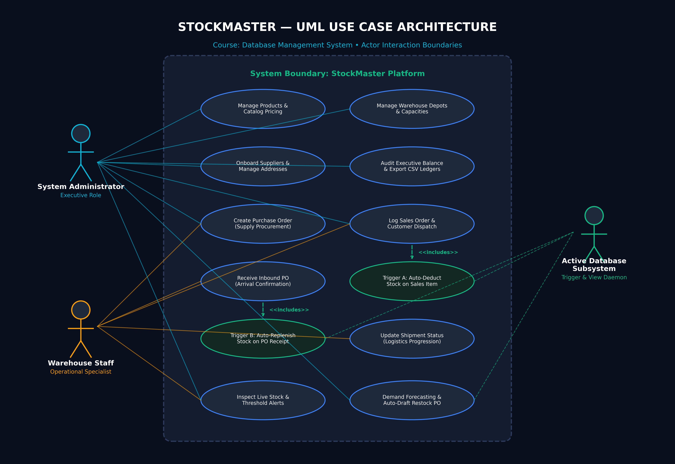
STOCK MASTER | DATABASE MANAGEMENT SYSTEM
04 / 19
System Architecture — UML Use Case Diagram
Actor interaction boundaries, permissions, and database trigger inclusions
USE CASE HIGHLIGHTS
▶ Actor Boundaries
System Admin (full configuration & financial audit) vs. Warehouse Staff (inbound & outbound fulfillment).
▶ <<includes>> Logic
Sales Order item insertion includes atomic inventory stock decrement.
▶ Auto-Restock Trigger
Purchase Order receipt executes an UPSERT stock restock trigger.
▶ 11 Master Entities
Full boundary covers master catalogs, transactions, shipments, and billing ledgers.
▶ Security Gate
Role-based authentication guarantees data isolation across operations.

Slide 6
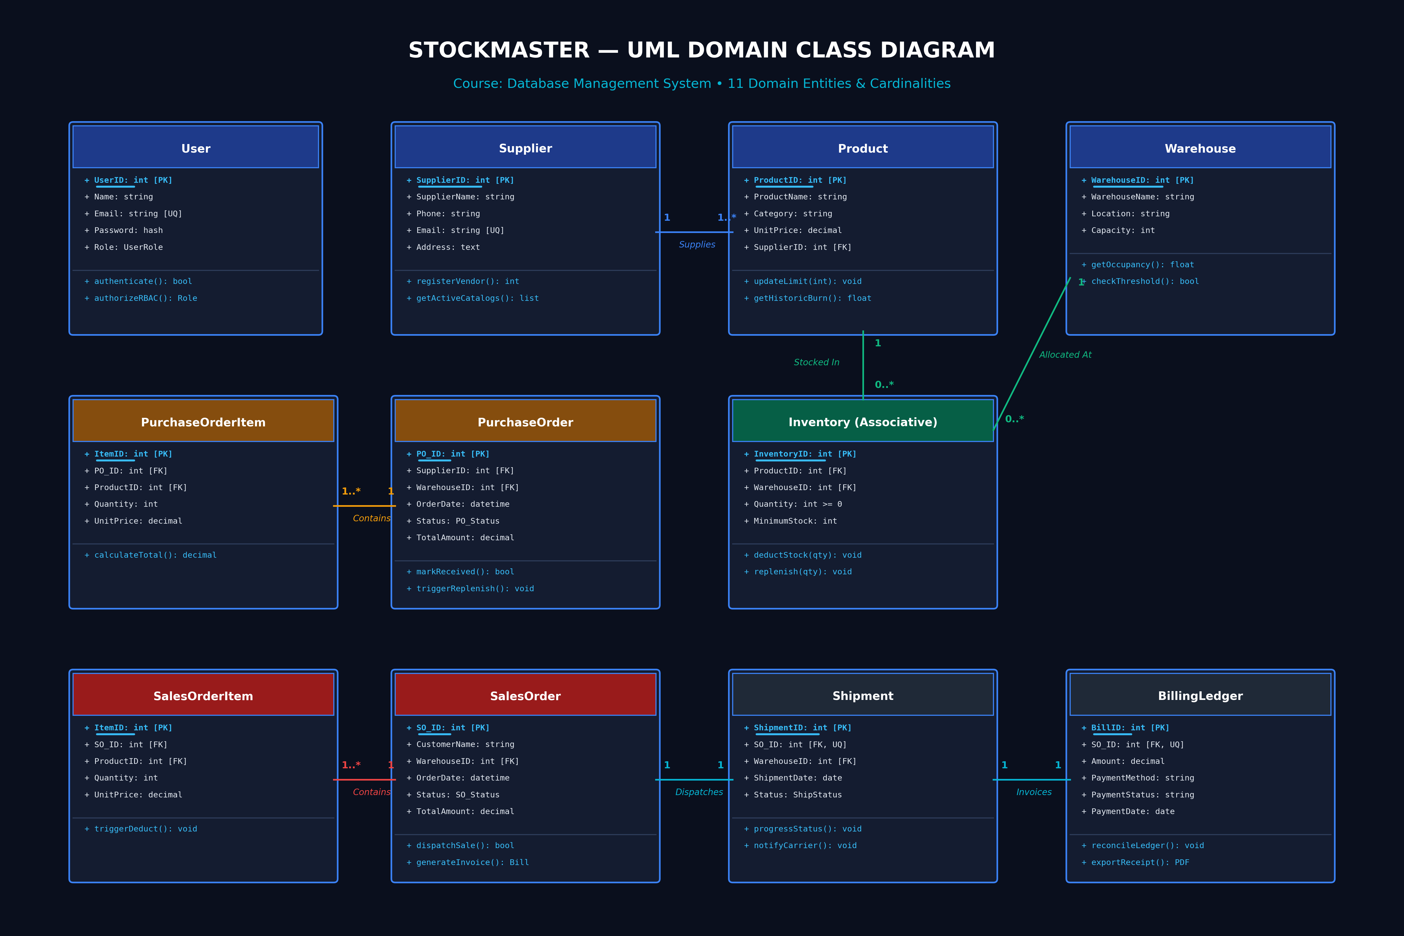
STOCK MASTER | DATABASE MANAGEMENT SYSTEM
05 / 19
System Architecture — UML Class Diagram
Object-oriented domain model mapping attributes, methods, and entity multiplicities
CLASS MODEL HIGHLIGHTS
▶ 11 Domain Classes
Directly mirrors the normalized 3NF relational database schema.
▶ Multiplicities
1:N for Orders to Items; 1:1 strictly enforced for Orders to Shipments and Billing.
▶ Encapsulated Methods
Business actions like verifyStock(), dispatchShipment(), processPayment().
▶ Audit Integrity
TotalAmount and Balance ledgers automatically reconciled via backend logic.

Slide 7
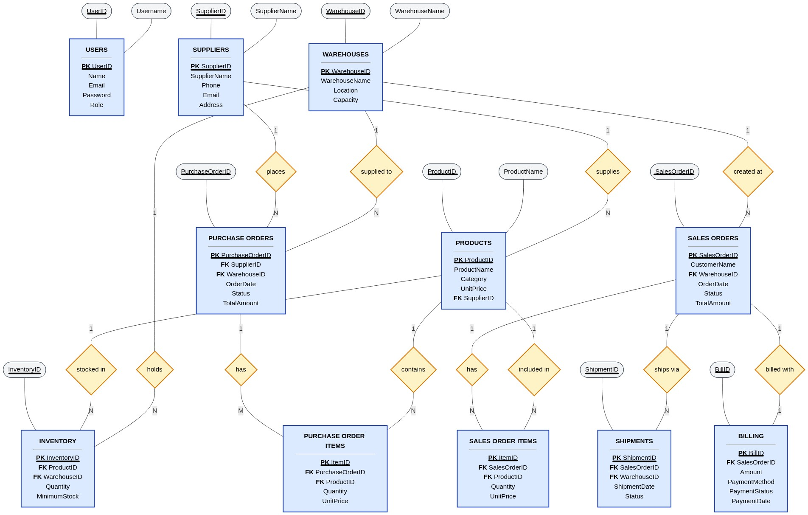
STOCK MASTER | DATABASE MANAGEMENT SYSTEM
06 / 19
Conceptual Model — Entity-Relationship (ER) Diagram
Chen's notation mapping 11 relational entities, key attributes, relationships, and cardinalities
ER DESIGN HIGHLIGHTS
• 11 Entities:
Normalized into Master, Transaction, and Ledger domains.
• M:N Resolution:
Products & Warehouses resolved via INVENTORY junction table.
• 1:N Relationships:
Suppliers ➔ Products, Warehouses ➔ Orders, PO ➔ PO Items.
• 1:1 Invoicing:
Sales Orders ➔ Shipments and Sales Orders ➔ Billing enforce UNIQUE keys.
• Active Triggers:
Modeled via event diamonds (Deducts Stock, Increases Stock).
• Referential Rules:
Strict ON DELETE CASCADE preserves referential integrity.

Slide 8
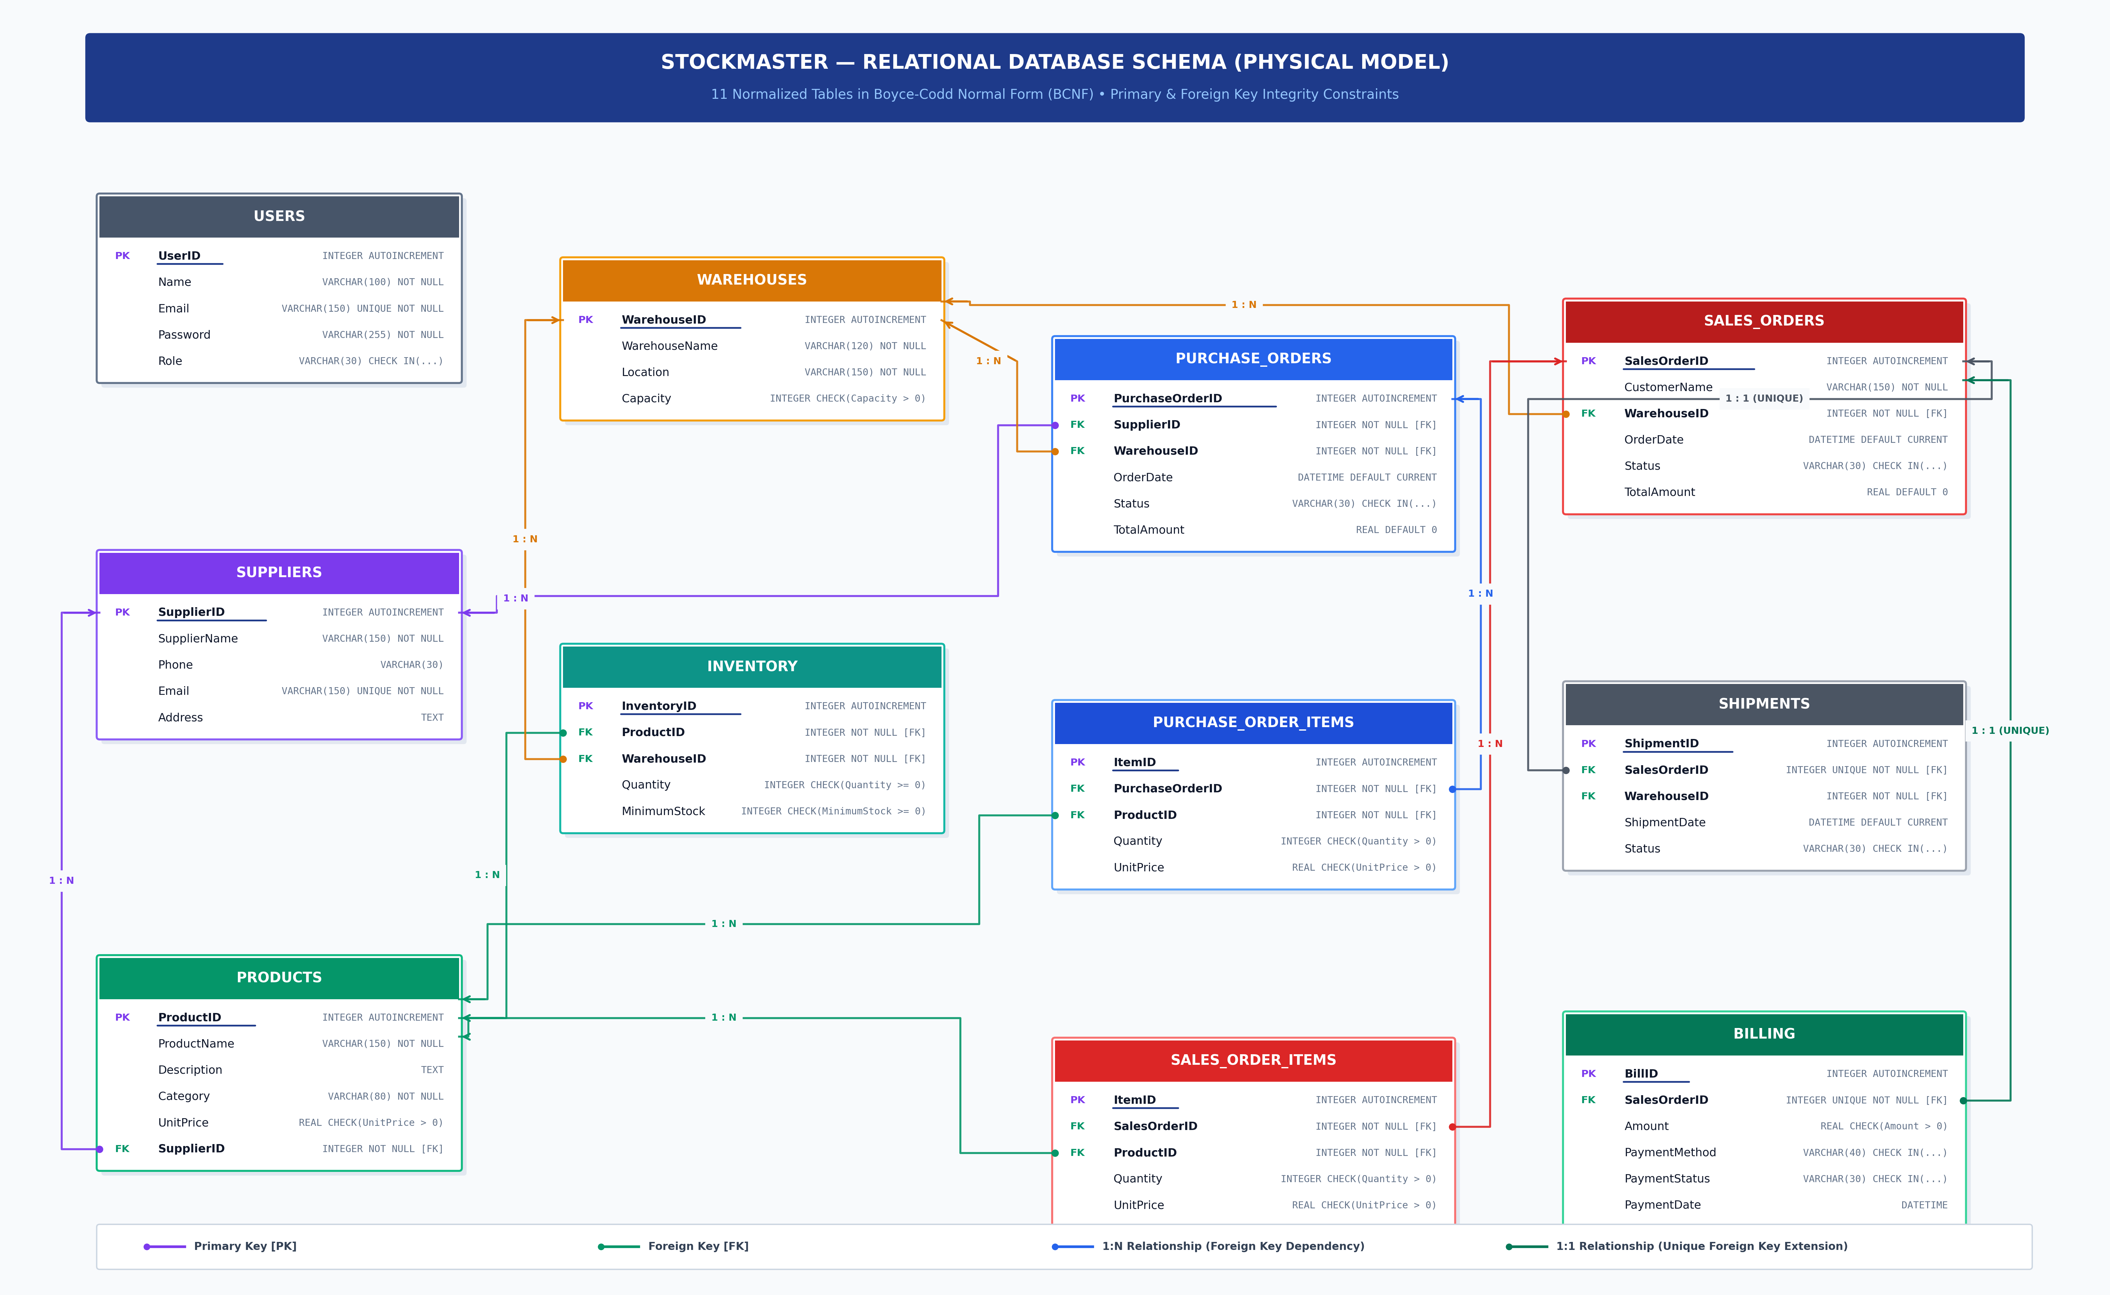
STOCK MASTER | DATABASE MANAGEMENT SYSTEM
07 / 19
Physical Relational Database Schema Diagram
Visual mapping of 11 normalized tables, Primary Keys [PK], Foreign Keys [FK], and Integrity Constraints
SCHEMA HIGHLIGHTS
▶ 11 Tables
Complete coverage: Users, Suppliers, Products, Warehouses, Inventory, POs, SOs, Shipments & Billing.
▶ Referential Integrity
Foreign key cascades (ON DELETE CASCADE) guarantee zero orphan child rows.
▶ 1:1 Enforcement
UNIQUE constraints on SalesOrderID in Shipments and Billing guarantee clean 1:1 extensions.
▶ Domain Constraints
CHECK constraints guarantee positive pricing (UnitPrice > 0) and non-negative stock (Quantity >= 0).

Slide 9
STOCK MASTER | DATABASE MANAGEMENT SYSTEM
08 / 19
Relational Database Schema (Physical Model)
11 normalized tables categorized into Master Data, Inventory/Orders, and Billing Pillars
PILLAR 1: MASTER DATA
USERS
UserID [PK], Name, Email [UNIQUE], Password, Role
SUPPLIERS
SupplierID [PK], SupplierName, Phone, Email [UNIQUE], Address
PRODUCTS
ProductID [PK], ProductName, Description, Category, UnitPrice, SupplierID [FK]
WAREHOUSES
WarehouseID [PK], WarehouseName, Location, Capacity
PILLAR 2: INVENTORY & ORDERS
INVENTORY
InventoryID [PK], ProductID [FK], WarehouseID [FK], Quantity, MinimumStock
PURCHASE_ORDERS
PurchaseOrderID [PK], SupplierID [FK], WarehouseID [FK], OrderDate, Status, TotalAmount
PURCHASE_ORDER_ITEMS
ItemID [PK], PurchaseOrderID [FK], ProductID [FK], Quantity, UnitPrice
SALES_ORDERS
SalesOrderID [PK], CustomerName, WarehouseID [FK], OrderDate, Status, TotalAmount
PILLAR 3: DISPATCH & BILLING
SALES_ORDER_ITEMS
ItemID [PK], SalesOrderID [FK], ProductID [FK], Quantity, UnitPrice
SHIPMENTS
ShipmentID [PK], SalesOrderID [FK, UNIQUE], WarehouseID [FK], ShipmentDate, Status
BILLING
BillID [PK], SalesOrderID [FK, UNIQUE], Amount, PaymentMethod, PaymentStatus, PaymentDate

Slide 10
STOCK MASTER | DATABASE MANAGEMENT SYSTEM
09 / 19
Database Normalization: Master Entities
Functional dependencies, candidate keys, and BCNF verification for master entities
Table | Candidate Keys (PK Underlined) | Normal Form | Representative Functional Dependency / Proof
users | UserID ; Email | BCNF | UserID → Name, Email, Password, Role; Email → UserID, Name, Password, Role. Both determinants are superkeys. No non-key attributes determine other attributes.
suppliers | SupplierID ; Email | BCNF | SupplierID → SupplierName, Phone, Email, Address; Email → SupplierID. All attributes are fully functionally dependent on candidate keys. No partial or transitive dependencies.
products | ProductID | BCNF | ProductID → ProductName, Description, Category, UnitPrice, SupplierID. Supplier attributes are factored into suppliers table, preventing transitive dependency (ProductID ↛ SupplierName).
warehouses | WarehouseID | BCNF | WarehouseID → WarehouseName, Location, Capacity. The determinant WarehouseID is a primary key. All non-key attributes are atomic and independently scalable.

Slide 11
STOCK MASTER | DATABASE MANAGEMENT SYSTEM
10 / 19
Database Normalization: Inventory & Orders
Decomposition of Many-to-Many junction records and order transaction headers
Table | Candidate Keys (PK Underlined) | Normal Form | Representative Functional Dependency / Proof
inventory | InventoryID ; (ProductID, WarehouseID) | BCNF | InventoryID → ProductID, WarehouseID, Quantity, MinimumStock. The candidate key (ProductID, WarehouseID) has a UNIQUE constraint. Quantity depends on the whole pair (zero partial dependency).
purchase_orders | PurchaseOrderID | BCNF | PurchaseOrderID → SupplierID, WarehouseID, OrderDate, Status, TotalAmount. Order items are separated into line-item children, avoiding repeating groups (1NF) and transitives (3NF/BCNF).
purchase_order_items | ItemID ; (PurchaseOrderID, ProductID) | BCNF | ItemID → PurchaseOrderID, ProductID, Quantity, UnitPrice. Price and quantity depend on the specific line item, eliminating partial dependencies on PurchaseOrderID alone.
sales_orders | SalesOrderID | BCNF | SalesOrderID → CustomerName, WarehouseID, OrderDate, Status, TotalAmount. Fully normalized header entity. Warehouse allocation is decoupled from multi-item lines.

Slide 12
STOCK MASTER | DATABASE MANAGEMENT SYSTEM
11 / 19
Database Normalization: Line Items, Shipments & Billing
Verification of fulfillment, ledgers, and formal zero-anomaly proof
Table | Candidate Keys (PK Underlined) | Normal Form | Representative Functional Dependency / Proof
sales_order_items | ItemID ; (SalesOrderID, ProductID) | BCNF | ItemID → SalesOrderID, ProductID, Quantity, UnitPrice. Item line quantities depend on the composite pair. Product attributes are referenced via FK, preventing data anomalies.
shipments | ShipmentID ; SalesOrderID | BCNF | ShipmentID → SalesOrderID, WarehouseID, ShipmentDate, Status. SalesOrderID is UNIQUE, creating a normalized 1:1 fulfillment extension without carrier transitives.
billing | BillID ; SalesOrderID | BCNF | BillID → SalesOrderID, Amount, PaymentMethod, PaymentStatus, PaymentDate. SalesOrderID is UNIQUE, isolating accounting records from order status changes.
FORMAL NORMALIZATION VERDICT: 100% BCNF COMPLIANT
All 11 relational tables in the StockMaster database satisfy Boyce-Codd Normal Form (BCNF). Every non-trivial functional dependency X → Y has a determinant X that is a superkey. This mathematically guarantees zero update, insertion, or deletion anomalies across all transactions.

Slide 13
STOCK MASTER | DATABASE MANAGEMENT SYSTEM
12 / 19
Functional Architecture & Core Modules
Modular breakdown of StockMaster subsystems and capability boundaries
01 — USER & RBAC
Session authentication, role policies, permission masking (Admin vs Staff)
02 — CATALOG & SUPPLIERS
Master SKU definitions, supplier directories, address registries, unit pricing
03 — MULTI-DEPOT INVENTORY
Many-to-Many stock allocation, real-time quantity monitoring, capacity limits
04 — ORDER & DISPATCH
Procurement POs, sales dispatch SOs, automated stock adjustment triggers
05 — LOGISTICS & BILLING
Carrier shipment tracking, delivery status, 1:1 invoice generation, ledgers
06 — DEMAND FORECASTING
Sales run-rate velocity modeling, stockout days calculation, auto-PO drafting

Slide 14
STOCK MASTER | DATABASE MANAGEMENT SYSTEM
13 / 19
Module Interactions & Transaction Lifecycle
End-to-end execution flow from procurement to fulfillment and predictive reordering
1. User Auth & Role Authorization
User logs in; Flask session establishes identity. UI applies RBAC, restricting financial ledgers and SKU alterations for Warehouse Staff.
2. Supply Procurement (PO)
Admin/Staff selects supplier, product, destination depot, and quantity. System creates purchase_orders and purchase_order_items records in 'Pending' state.
3. Warehouse Inbound Delivery & Trigger
Warehouse marks PO 'Received'. The active trigger after_po_receive fires, automatically executing an atomic UPSERT replenishment into the inventory table.
4. Sales Order Dispatch & Stock Deduction
Customer sale is registered. The active trigger after_so_item_insert fires, atomically decrementing inventory stock. CHECK constraint rolls back if stock < 0.
5. Carrier Logistics & Invoicing
Sales dispatch automatically generates a 1:1 shipments record and a 1:1 billing ledger invoice. Shipment delivery milestone syncs invoice payment dates.
6. Predictive Forecasting & Auto-PO
Sales run-rate velocity engine recalculates days of remaining stock. Products approaching exhaustion generate automated 1-click restock PO drafts.

Slide 15
STOCK MASTER | DATABASE MANAGEMENT SYSTEM
14 / 19
Multi-Tier System Architecture
Decoupled presentation, application backend, analytics engine, and relational database layers
PRESENTATION LAYER
Modern Responsive Web Client
• HTML5 Semantic Layout & Responsive Component Styling
• Vanilla ES6+ JavaScript Client with Hash-based Router
• Dynamic SVG Warehouse Capacity Occupancy Bar Generators
• Clean Vector Iconography & Interactive Modal Dialogues
APPLICATION BACKEND
Python Flask REST Microservice
• Python 3.10+ Flask Web Microservice Architecture
• RESTful API Endpoints (/api/products, /api/inventory, /api/orders, etc.)
• Flask Session-based Authentication & Role-Based Access Control (RBAC)
• Automated CSV Spreadsheet Generator Pipeline (RFC 4180)
ANALYTICS ENGINE
Predictive Demand & Forecasting Service
• Historical Sales Run-Rate Velocity Algorithm (units/day)
• Dynamic Days-to-Stockout Remaining Calculator
• Multi-Tiered Stockout Risk Classifier (Critical, Moderate, Healthy)
• 1-Click Auto-Draft Purchase Order Generator
DATABASE LAYER
SQLite3 Relational Database Engine
• 11 Normalized Tables with Foreign Key Cascade Enforcement (PRAGMA foreign_keys = ON)
• Event-Driven Active Triggers (after_so_item_insert, after_po_receive)
• Materialized Database View (low_stock_alerts_view)
• B-Tree Performance Indexes on Foreign Keys (idx_inventory_prod, etc.)

Slide 16
STOCK MASTER | DATABASE MANAGEMENT SYSTEM
15 / 19
DBMS Concept Mapping & Implementation
Direct correlation between theoretical database principles and StockMaster implementation
System Function | DBMS Concept Used | Implementation Detail & Rationale
Master Entities Setup | Primary Keys, AUTOINCREMENT, NOT NULL | Enforces unique row identification and disallows null integrity voids.
Multi-Warehouse Allocation | Many-to-Many Relationships, Junction Table | inventory table resolves M:N mapping with composite UNIQUE(ProductID, WarehouseID).
Referential Integrity | Foreign Keys, ON DELETE CASCADE | Guarantees orphan record prevention when parent entities are removed.
Stock Consistency Sync | Active Event Triggers (AFTER INSERT / UPDATE) | after_so_item_insert and after_po_receive automate inventory balance adjustments.
Negative Stock Prevention | CHECK Constraints, Transaction Rollback | CHECK(Quantity >= 0) in inventory forces transaction rollback on stock overdraft.
Low-Stock Notification | Database Views (CREATE VIEW), INNER JOIN | low_stock_alerts_view dynamically evaluates stock <= threshold across depots.
High-Speed Search & Lookups | B-Tree Indexes (CREATE INDEX) | Indexes on ProductID, WarehouseID, and OrderIDs eliminate full table scans.

Slide 17
STOCK MASTER | DATABASE MANAGEMENT SYSTEM
16 / 19
Database Operations & Advanced SQL Triggers
Concrete SQL operations powering transaction handling and automated inventory updates
TRIGGER A: AUTOMATIC STOCK DEDUCTION
TRIGGER B: AUTOMATED UPSERT REPLENISHMENT
Executes after customer sale line item insertion:
Executes when purchase order status updates to 'Received':
CREATE TRIGGER after_so_item_insert
AFTER INSERT ON sales_order_items
BEGIN
UPDATE inventory
SET Quantity = Quantity - NEW.Quantity
WHERE ProductID = NEW.ProductID
AND WarehouseID = (
SELECT WarehouseID
FROM sales_orders
WHERE SalesOrderID = NEW.SalesOrderID
);
END;
CREATE TRIGGER after_po_receive
AFTER UPDATE OF Status ON purchase_orders
FOR EACH ROW WHEN NEW.Status = 'Received'
AND OLD.Status = 'Pending'
BEGIN
INSERT INTO inventory (
WarehouseID, ProductID, Quantity, MinimumStock
)
SELECT NEW.WarehouseID, poi.ProductID, poi.Quantity, 10
FROM purchase_order_items poi
WHERE poi.PurchaseOrderID = NEW.PurchaseOrderID
ON CONFLICT(WarehouseID, ProductID) DO UPDATE SET
Quantity = Quantity + excluded.Quantity;
END;
• Correct Warehouse Scoping: Uses subquery on sales_orders to ensure stock is deducted only from the dispatching depot.
• Non-Negative Safeguard: If Quantity drops below 0, the table CHECK(Quantity >= 0) constraint causes an immediate atomic rollback.
• Atomic Restocking: Updates multiple items from line items table in one query.
• UPSERT Logic: Uses SQLite ON CONFLICT DO UPDATE to insert new inventory slots or increment existing stock counts.

Slide 18
STOCK MASTER | DATABASE MANAGEMENT SYSTEM
17 / 19
Work Completed & Deliverables (Review 1 & Review 2)
Evolution of StockMaster across course milestone reviews
01 — DATABASE ARCHITECTURE (Review 1)
• 11 fully normalized tables implementing BCNF/3NF specifications.
• Complete data population: 25 interconnected records per table (625 inventory records).
• Active triggers (stock decrement & replenishment) and database views.
• Foreign key referential integrity with ON DELETE CASCADE rules.
02 — FULL-STACK WEB PLATFORM (Review 1)
• Responsive Web UI powered by Python Flask REST APIs.
• Dynamic SVG warehouse storage capacity occupancy visualizations.
• Complete modal workflows for adding products, suppliers, POs, and sales dispatches.
• Real-time operational dashboard with financial summaries and event logs.
03 — ROLE-BASED ACCESS CONTROL (Review 2)
• Session-based user authentication with live user profile in sidebar.
• 1-Click live role switcher between System Admin and Warehouse Staff.
• Dynamic UI enforcement: hides executive financials and locks billing for staff.
• Administrative button gating (restricts SKU alterations for non-admins).
04 — FORECASTING & SPREADSHEETS (Review 2)
• Smart Demand Forecasting Engine calculating sales velocity & stockout days.
• Multi-tiered risk categorization (Critical, Moderate, Safe buffer).
• 1-Click 'Auto-Draft PO' action pre-filling restock purchase orders.
• Spreadsheet CSV export buttons across products, inventory, orders, and ledgers.

Slide 19
STOCK MASTER | DATABASE MANAGEMENT SYSTEM
18 / 19
Live Application Showcase & Interface Modules
Primary system views operational in the web application (http://localhost:5000/)
1. Central Operations Dashboard
Features real-time KPI metrics, dynamic SVG warehouse capacity occupancy bars, financial revenue/expense aggregates, and live database union activity logs.
2. Real-Time Inventory Stock Table
Displays product stocks across warehouses with status badges, warehouse dropdown filters, and a dedicated 'Verify Stock' alert filter.
3. Orders, Logistics & Billing Ledger
Multi-tab transaction hub managing Supply POs (with 'Mark Received' action), Customer Sales Orders, Carrier Shipment progression, and Billing invoice ledgers.
4. Demand Forecasting & Restock Engine
Real-time sales velocity modeling, days-of-stock countdown, tiered risk indicators (Urgent Reorder, Moderate, Safe), and 1-click 'Auto-Draft PO' prefill.

Slide 20
STOCK MASTER | DATABASE MANAGEMENT SYSTEM
19 / 19
Conclusion & Future Scope
Summary of achievements and future engineering roadmap
PROJECT CONCLUSION
FUTURE ENGINEERING SCOPE
• Bridged Theory & Application:
Successfully engineered a multi-warehouse management system embodying core DBMS concepts (BCNF, Triggers, Views, Indexes, ACID).
• Eliminated Operational Drift:
Automated database triggers replace manual stock math, guaranteeing that inventory strictly mirrors real-world sales and inbound supplies.
• Enterprise-Ready RBAC:
Session-based role authorization ensures operational staff only access fulfillment modules while protecting corporate balance sheets.
• Proactive Supply Protection:
Smart demand forecasting eliminates the guesswork from restocking, transforming reactive warehouses into predictive logistics hubs.
▶ Mobile Barcode / RFID Scanning:
Integrate camera/scanner APIs for rapid stock auditing, reducing dispatch scan times at physical warehouse loading bays.
▶ Automated Supplier Webhook APIs:
Establish direct B2B Electronic Data Interchange (EDI) webhooks to automatically submit purchase orders to external suppliers.
▶ Cloud Database Migration:
Transition from embedded SQLite to cloud PostgreSQL on AWS RDS with connection pooling for multi-region concurrent access.
▶ Machine Learning Demand Prediction:
Incorporate seasonal ARIMA or regression models to factor in holiday demand spikes and supply lead times.

Slide 21
THANK YOU

