Slide 1
Project Overview
Emergency Vehicle
Priority Traffic System
AI-Powered Agentic Platform
Emergency vehicles (ambulances, fire trucks, police) lose critical time stuck at traffic signals. Every second matters — delayed response costs lives.
This AI-powered agentic platform detects approaching emergency vehicles, predicts optimal signal green corridors, coordinates intersections in real time, and ensures fastest possible routing — powered by IBM Bob and watsonx.ai.
Key Outcomes:
• Up to 40% reduction in emergency vehicle travel time
• Intelligent multi-intersection signal coordination
• Real-time traffic rerouting for civilian vehicles
• AI-generated dispatch and response recommendations
Bengaluru Hackathon 2026
Team : Code Blaze
Amrutha Institute of Engineering
and Management Sciences
Hitesh R & Puneeth Y M
Mentor: Prof. Deepneel
Notes:
Title slide. Team Code Blaze — Hitesh R and Puneeth Y M. Mentor: Prof. Deepneel. Amrutha Institute of Engineering and Management Sciences. Emergency Vehicle Priority Traffic System.

Slide 2



Team : Code Blaze
Institute: Amrutha Institute of Engineering and Management Sciences
Project: Emergency Vehicle Priority Traffic System
Need of Project (Explanation with figures for example "in the last 2025 40% farmers affacted due to salinity" : Salinity Shield AI focuses on early detection and prediction of soil salinity risks in coastal farmland using AI/ML.​
It provides farm-specific alerts, explanations, and actionable recommendations to help farmers prevent salinity-related crop damage​
Prof.
Deepneel
(Mentor)
Methodology
Detect emergency vehicles (ambulance / fire / police) using IoT sensors and camera feeds. Feed real-time vehicle location, speed, and route data to the AI system.
AI agents compute optimal green corridors across multiple intersections. Civilian traffic is intelligently rerouted via dynamic signal changes and driver alerts.
IBM TOOLS USED
IBM watsonx.ai (Granite) – AI reasoning for signal optimization and route planning
IBM Bob – Agentic AI development platform
IBM Cloud – Scalable cloud deployment and data processing
Agentic AI – Multi-agent orchestration for real-time intersection coordination
Conclusion and Demonstration
Impact: Emergency vehicle response time can be reduced by up to 40% using AI-coordinated signal prioritization. In Indian cities where ambulances average 18-25 minutes to reach patients, cutting even 6-8 minutes can directly save lives. Our system demonstrates: Real-Time Emergency Detection Dashboard, Multi-Intersection Signal Coordinator, Dynamic Civilian Traffic Rerouting, AI-generated Dispatch Recommendations, and Human-in-the-Loop approval for critical corridors.
Hitesh R
Puneeth Y M
Notes:
Slide 2 — Team overview, problem statement, methodology, IBM tools used, and conclusion/demonstration impact.

Slide 3
Development with IBM Bob
1 REQUIREMENTS
2 BOB CREATES PLAN
3 REVIEW & REFINE
Define emergency vehicle detection goals, signal priority logic, multi-agent architecture, and acceptance criteria with Bob.
Bob generates a structured plan: 7 AI agents, FastAPI backend, React dashboard, PostgreSQL DB, MCP tool servers, and LangFuse observability.
Team reviews, adjusts, and approves the plan before any code is generated.
4 CODE GENERATION
5 REVIEW OUTPUT
6 RUN & VALIDATE
Bob generates Python/FastAPI agents (Signal Optimizer, Vehicle Detector, Route Planner, Ambulance Coordinator), React TypeScript dashboard, and all DB models.
Team reviews generated code for correctness, style, and completeness.
Run emergency simulation: detect vehicle, trigger green corridor, reroute civilian traffic, validate ETA reduction vs baseline.
7 BOB EXPLAINS
8 QUALITY & TESTS
9 DOCUMENTATION
Bob explains signal optimization logic, agent communication flow, LLM prompts, and guardrail configurations in detail.
Bob generates 26+ unit tests for agents, signal logic, guardrails, and authentication — all 26 tests passing.
Bob generates README, Swagger API docs at /docs, architecture diagrams, and IBM Code Engine deployment guide.

Slide 4
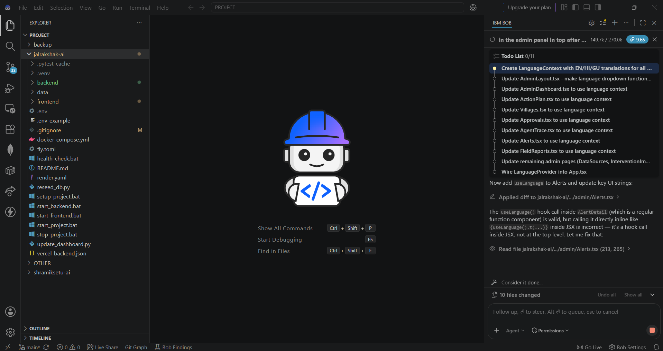
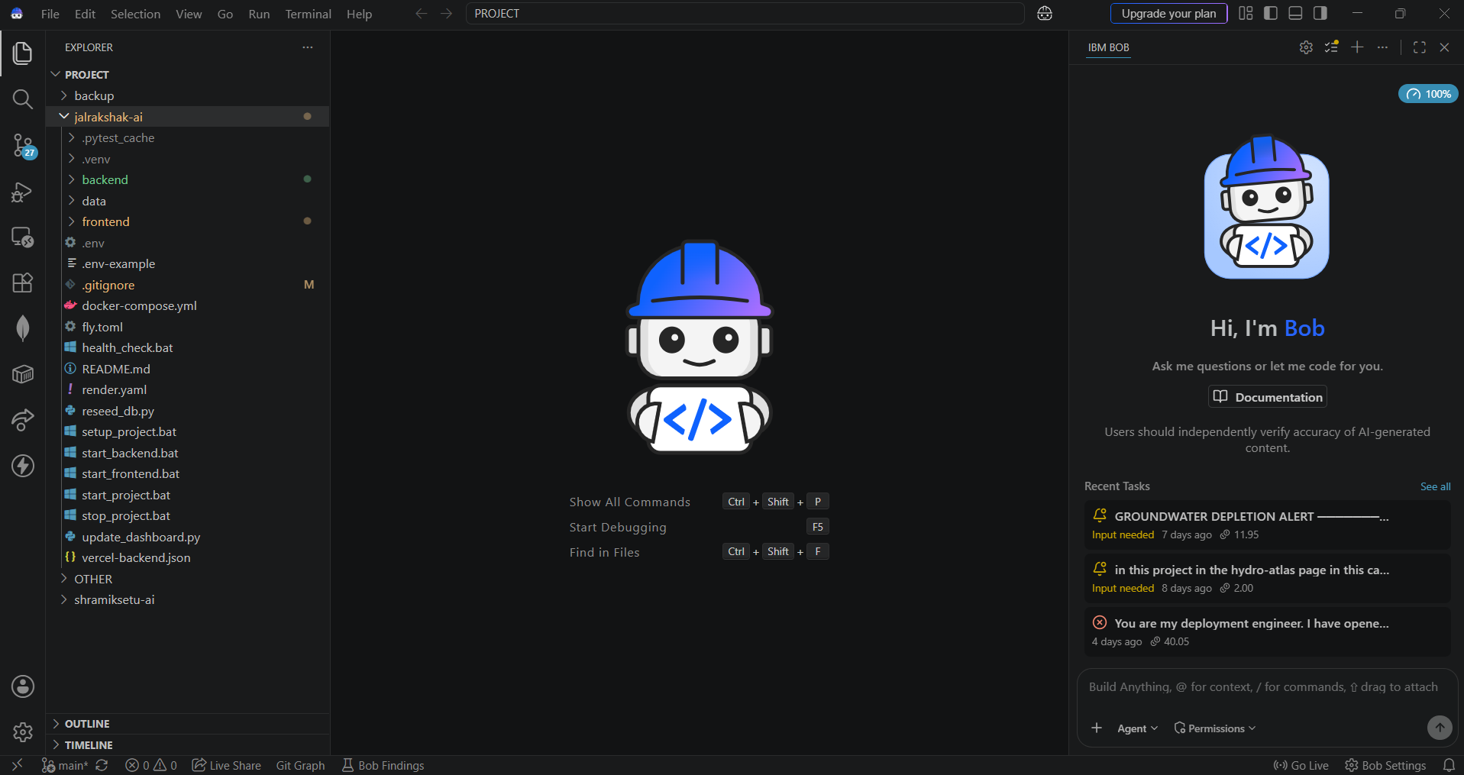
IBM Bob — Files & Code Generated
IBM Bob — Project File Structure (75+ files generated)
IBM Bob — Code Stats & Quality
road-safety-ai/
├── backend/app/
│ ├── agents/ (7 AI agents)
│ │ ├── orchestrator.py
│ │ ├── traffic_agent.py
│ │ ├── risk_agent.py
│ │ ├── emergency_agent.py
│ │ └── ambulance_agent.py
│ ├── mcp_servers/ (5 MCP tools)
│ ├── api/ (6 REST routers)
│ ├── models/ (10 DB models)
│ └── main.py
└── frontend/src/
├── pages/ (8 pages)
└── components/ (5 components)
Total Files Generated: 75+
Backend Python files: 35 | Frontend TypeScript/React: 20
Test files: 1 (26 unit tests — all PASS)
DB Models: 10 tables | API Routes: 40+ endpoints
LLM Gateway: watsonx.ai (Granite) + OpenAI fallback
MCP Servers: 5 (Traffic, Weather, Geo, Emergency, Ambulance)
Observability: LangFuse + Prometheus + Grafana
Deployment: Docker Compose + IBM Code Engine ready
All code generated and reviewed with IBM Bob

Slide 5
Key Features of the System
MULTI-AGENT AI ORCHESTRATION
REAL-TIME SIGNAL PRIORITY ENGINE
ACCIDENT RISK PREDICTION (0–100 SCORE)
8 specialized agents collaborate through an orchestrator to simultaneously tackle groundwater, drought, crop, recharge, water budgeting, and reporting challenges.
AI computes optimal green corridors across multiple intersections in real time, reducing emergency vehicle ETA by up to 40%.
Combines traffic density, weather, road conditions, and historical accident data to predict risk level: LOW / MEDIUM / HIGH / CRITICAL.
No other system combines multi-agent AI with village-level explainable recommendations.
ACCIDENT HOTSPOT HEATMAP
HUMAN-IN-THE-LOOP (HITL) GOVERNANCE
Geospatial clustering of historical accidents using Leaflet.js heatmaps with DBSCAN-like algorithm to identify high-risk zones for authorities.
Critical AI decisions (CRITICAL severity dispatch, mass alerts) require officer approval via HITL review queue before execution. Guardrails validate all LLM inputs/outputs.

Slide 6
Novelty & Future Scope
NOVELTY & UNIQUENESS
FUTURE SCOPE
Village-Level Intelligence
Advanced Prediction
Hyper-local analysis and recommendations for each specific village, not just regional averages.
Improve drought and groundwater forecasting using richer historical datasets and ML models.
Predictive Alerts
Mobile App for Farmers
Early detection of drought and groundwater depletion risks before they become irreversible.
Smartphone app delivering actionable alerts and recommendations directly to farmers.
Explainable AI
GIS-Based Planning
Every recommendation includes reason, confidence score, data source, and known limitations.
Integrate geospatial maps for visual watershed-level drought and water resource planning.
Action-Oriented Output
Scale to Drought-Prone Regions
Converts complex data insights directly into practical decisions and prioritized action plans.
Expand the platform to other water-stressed regions across India and beyond.

