Slide 1
rStock : A Reinforcement Learning based Chess Engine
Puneeth N
Rahul A R Sindhu Priyadarshini

Slide 2
Objective
To create a self learning chess engine
Should improve over time
Should learn from a teacher
Should mimic human learning

Slide 3
Background
Current engines : Minimax and α-β pruning
Most of the engines do not learn
Explicit feature extraction. Eg: Piece value, Board control, Connectivity, etc
No successful NN based engines

Slide 4
Terms to know
UCI / XBoard
PGN, FEN, ELO
Castling, En Passant, Zugzwang, etc
Rank and File

Slide 5
Architecture
4 components
Teacher
Trainer / Tester
Player
UI
Mutually independent

Slide 6
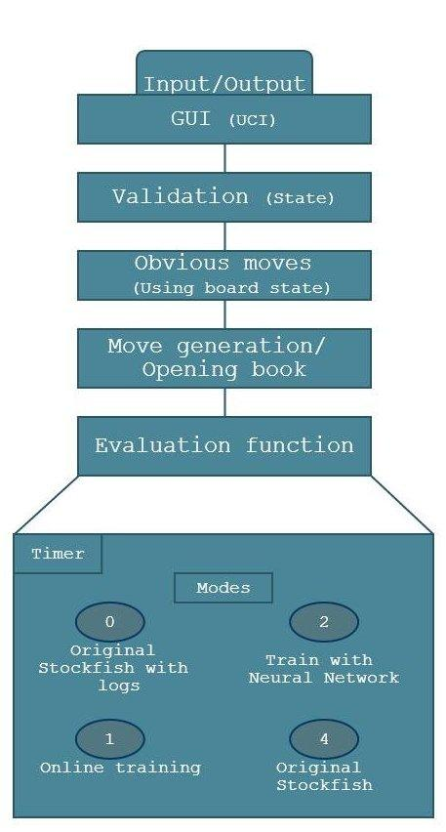
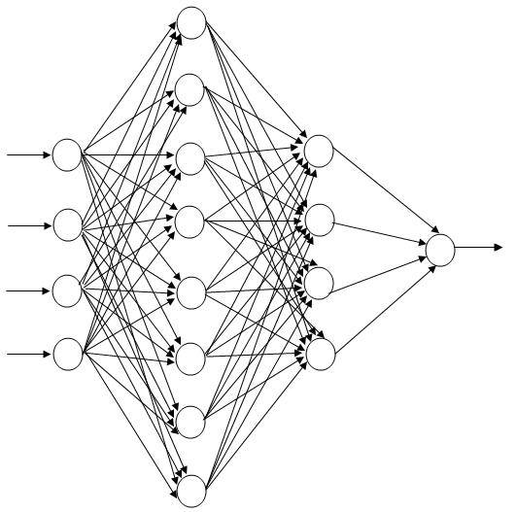
Architecture Diagram
Trainer
Training Data

Slide 7
Teacher
Stockfish : http://stockfishchess.org/
Most powerful open source engine
ELO rating : 3222
Used with SCID and UCI

Slide 8
Neural Network
NN = {262, 262, 262, 1}
µ = 0.1 and ɛ = 0.35
Backpropagation
Activation : Sigmoid
Training data : FEN, Eval score
Output : -30001 to 30001

Slide 9
Conclusion
Learning depends on quality of thinking lines
Ability for complex analysis is weak
3 potential reasons for weakness :
Neural Networks not optimal for Chess
The network is too small
The training is not sufficient

Slide 10
Future Work
Optimize training time
Test with different learning modules
Ensemble NN with other models
Integrate endgame books

