Slide 1
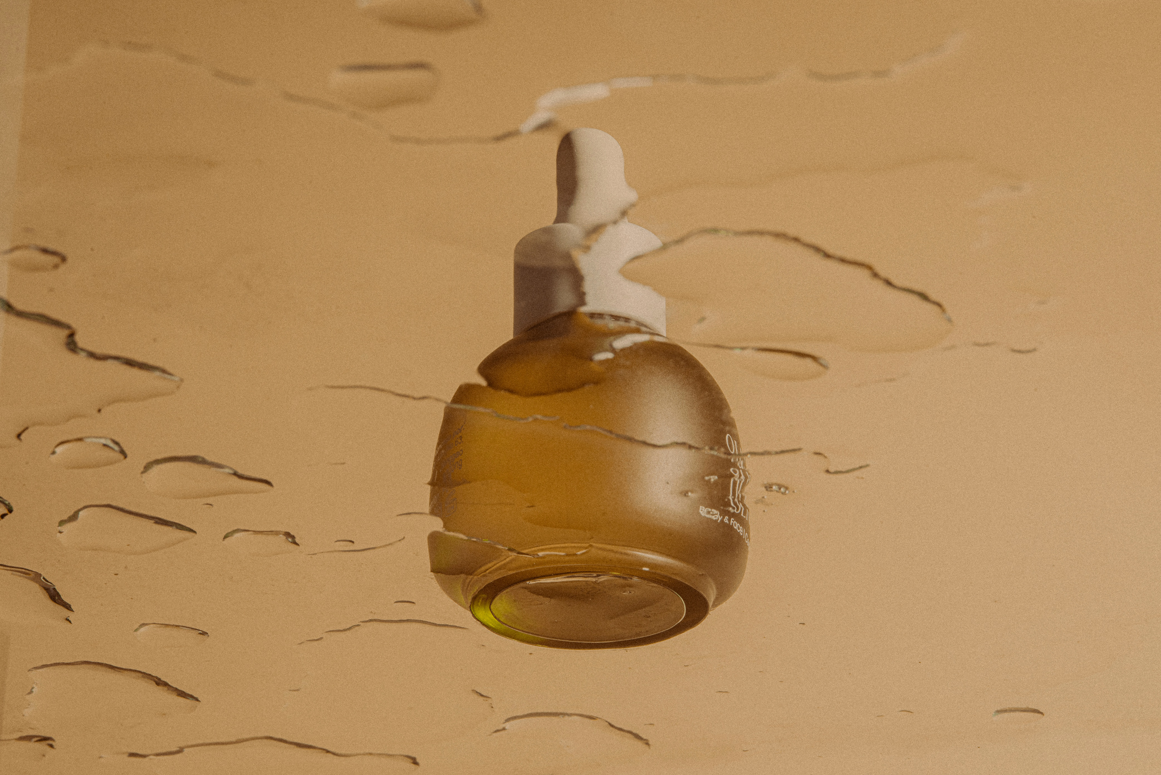
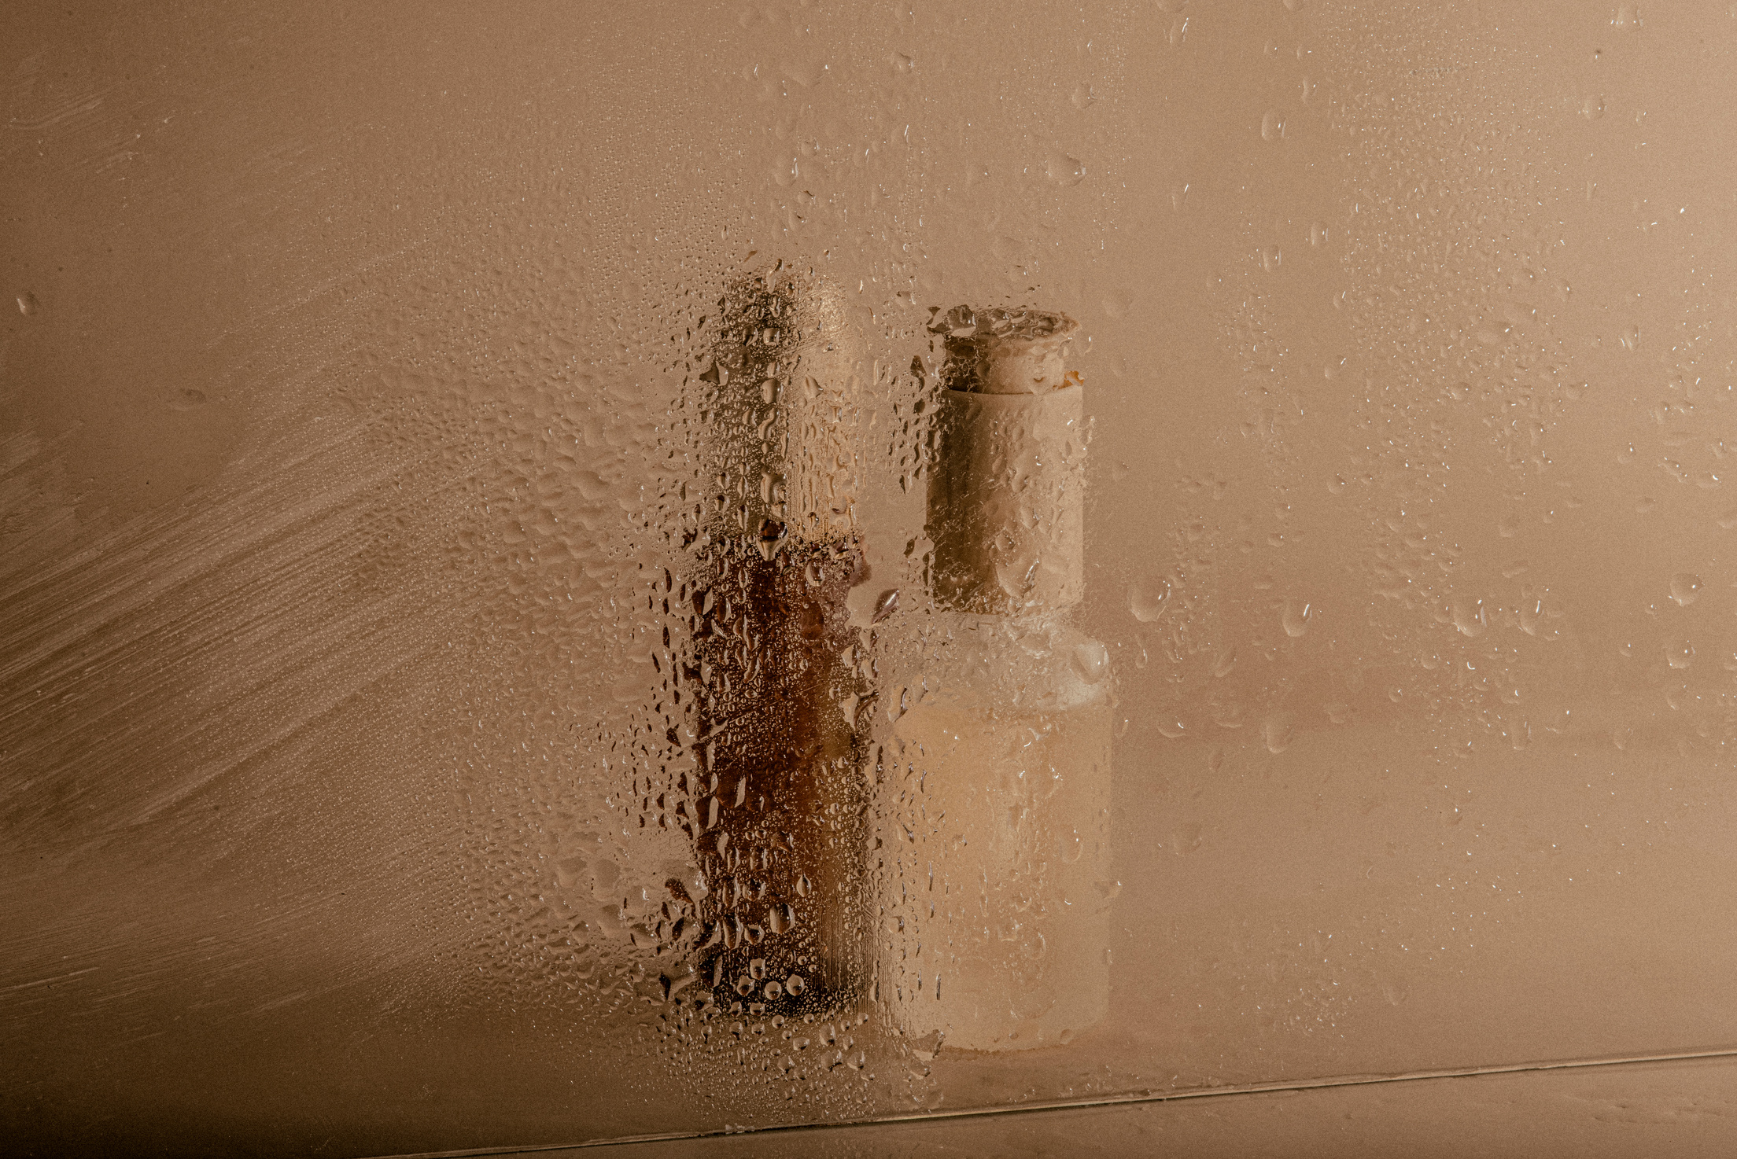
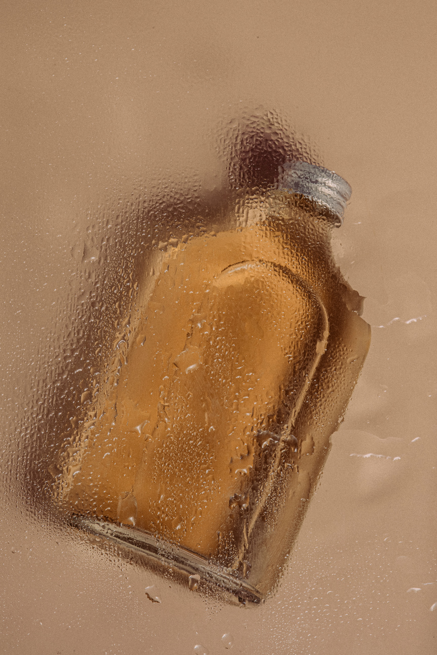
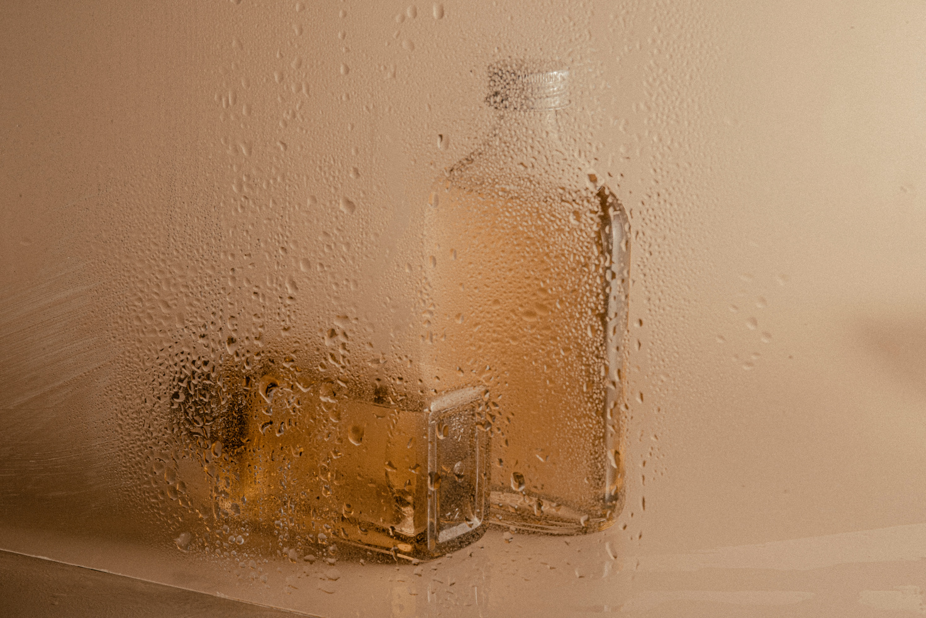
GLOWORA
About
Project
Service
Team
Buy Now
Contact us
SKINCARE

Slide 2
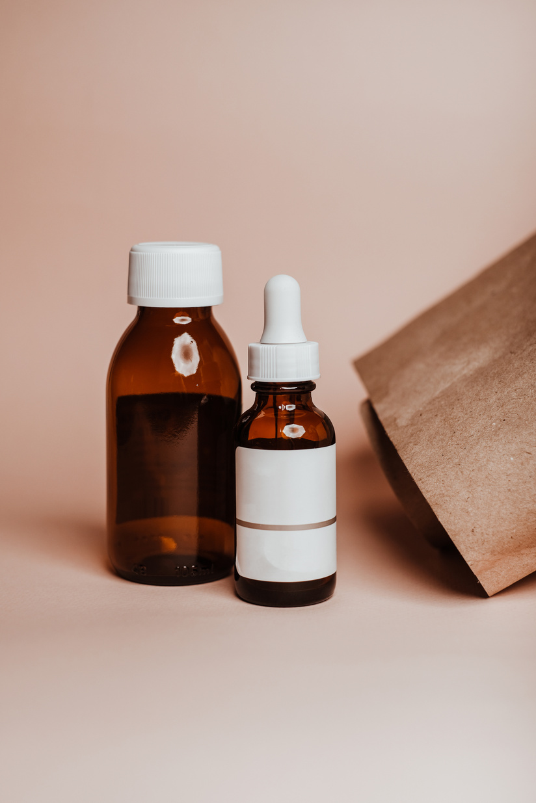
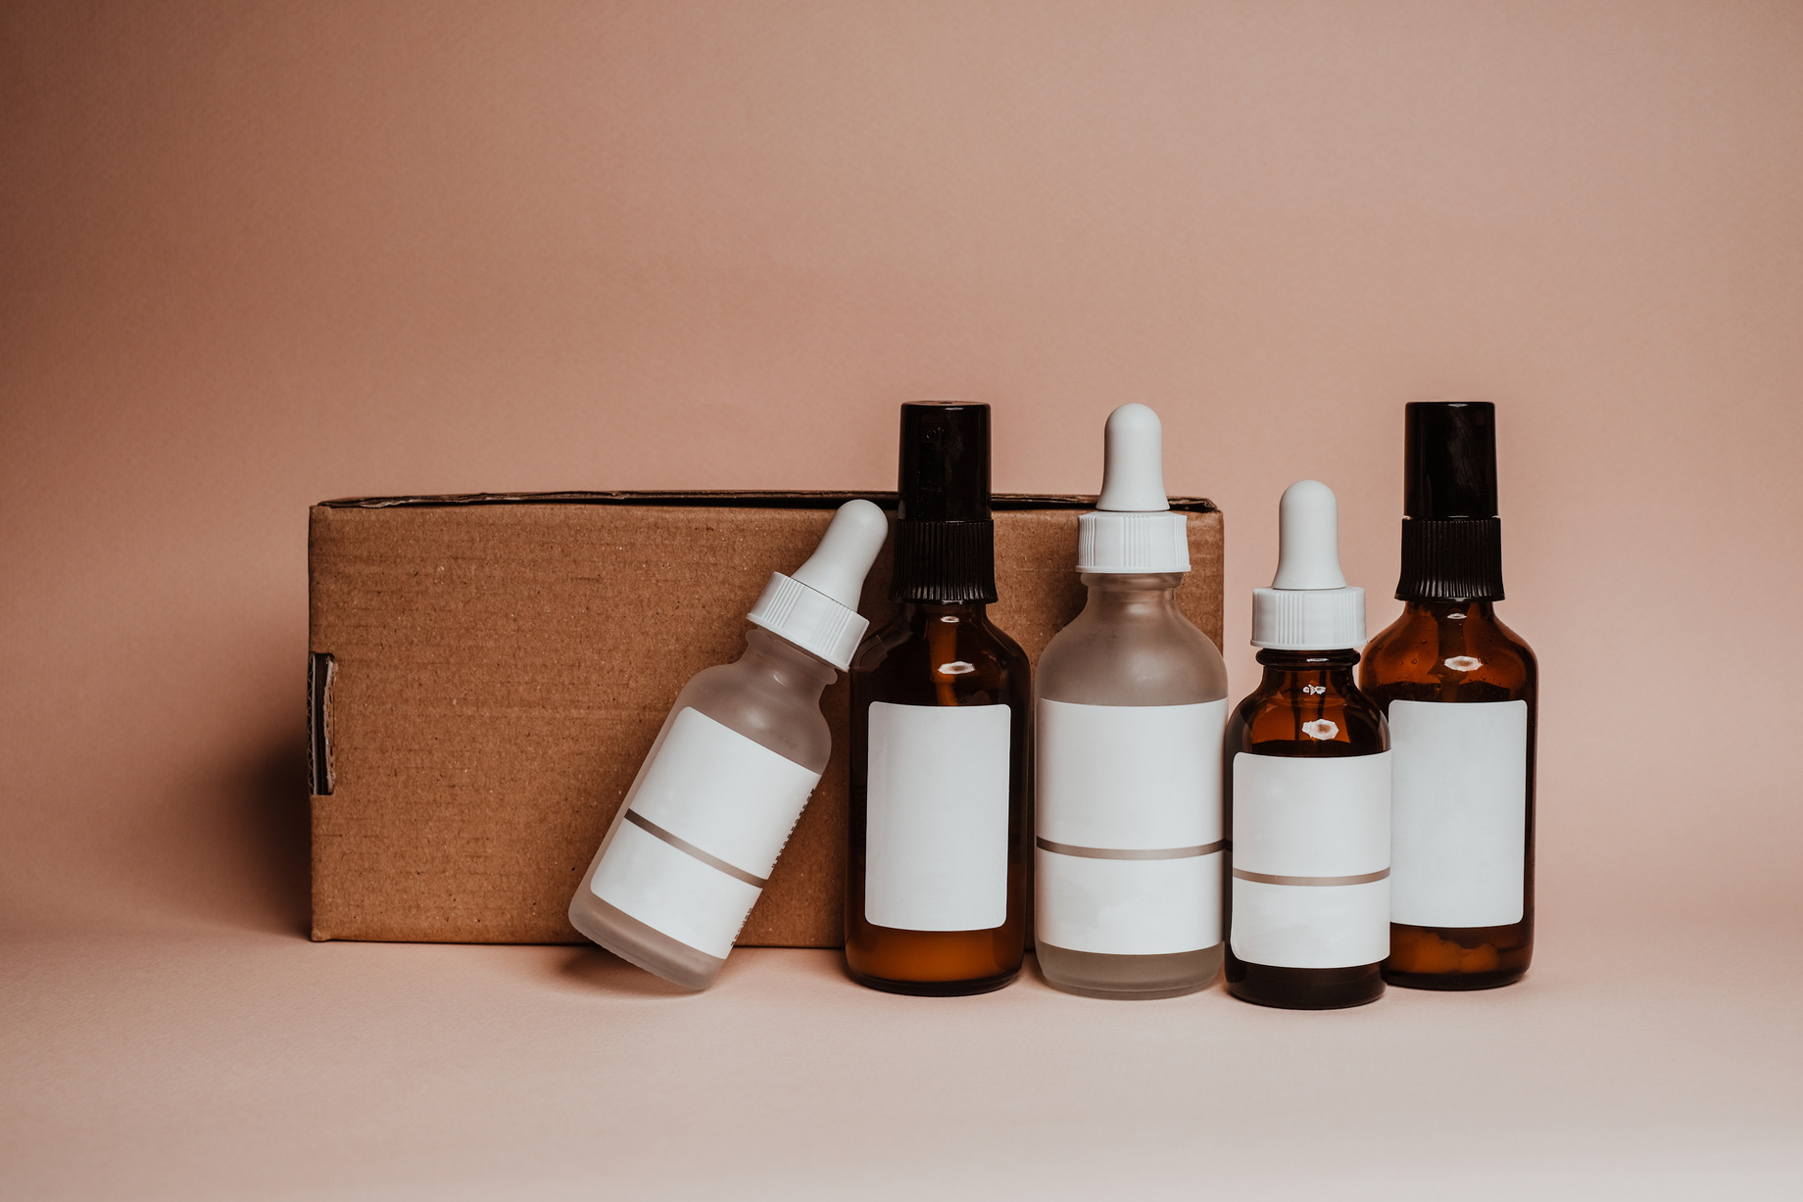
GLOWORA
About
Project
Service
Team
Buy Now
Contact us
GLOWORA
Daily Skincare
Simple and gentle skincare products made for everyday use.
3
Clean · Hydrate · Protect
Everyday Care
Care for healthy-looking skin every day.
www.glowora.com

Slide 3
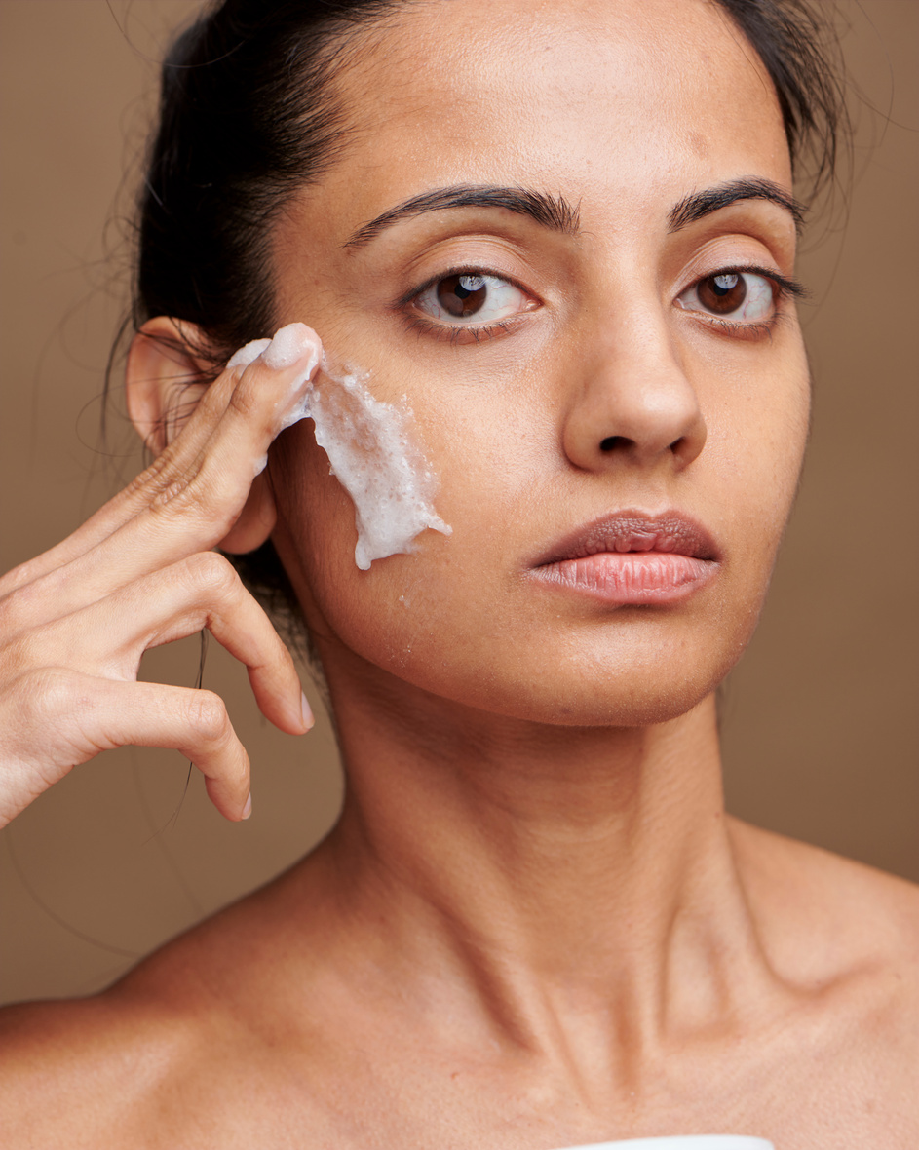
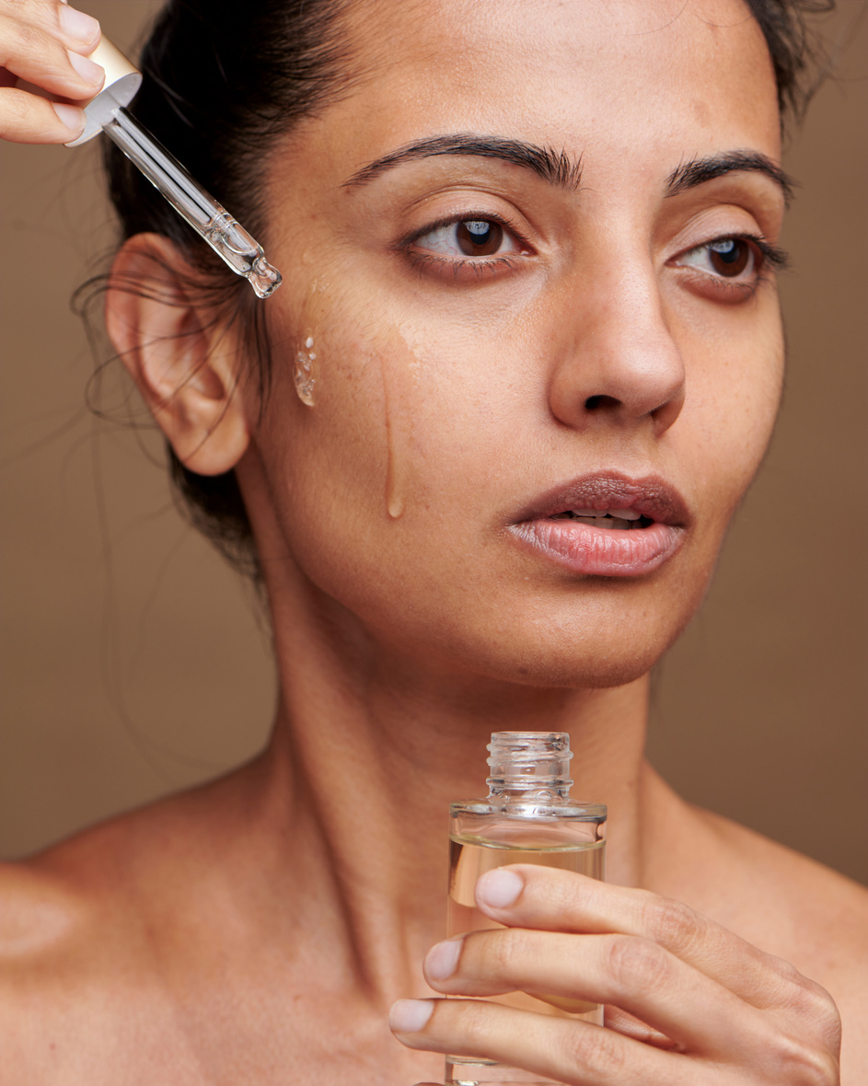
GLOWORA
About
Project
Service
Team
Buy Now
Contact us
Skin Ritual
01
02
03
Morning Glow
Evening Renewal
Daily Balance
Start your day with a gentle cleanser and moisturizer to keep your skin fresh and hydrated.
Cleanse your skin at night and apply a moisturizer to help your skin feel soft and refreshed.
Follow a simple skincare routine every day to keep your skin clean, healthy and balanced.

Slide 4
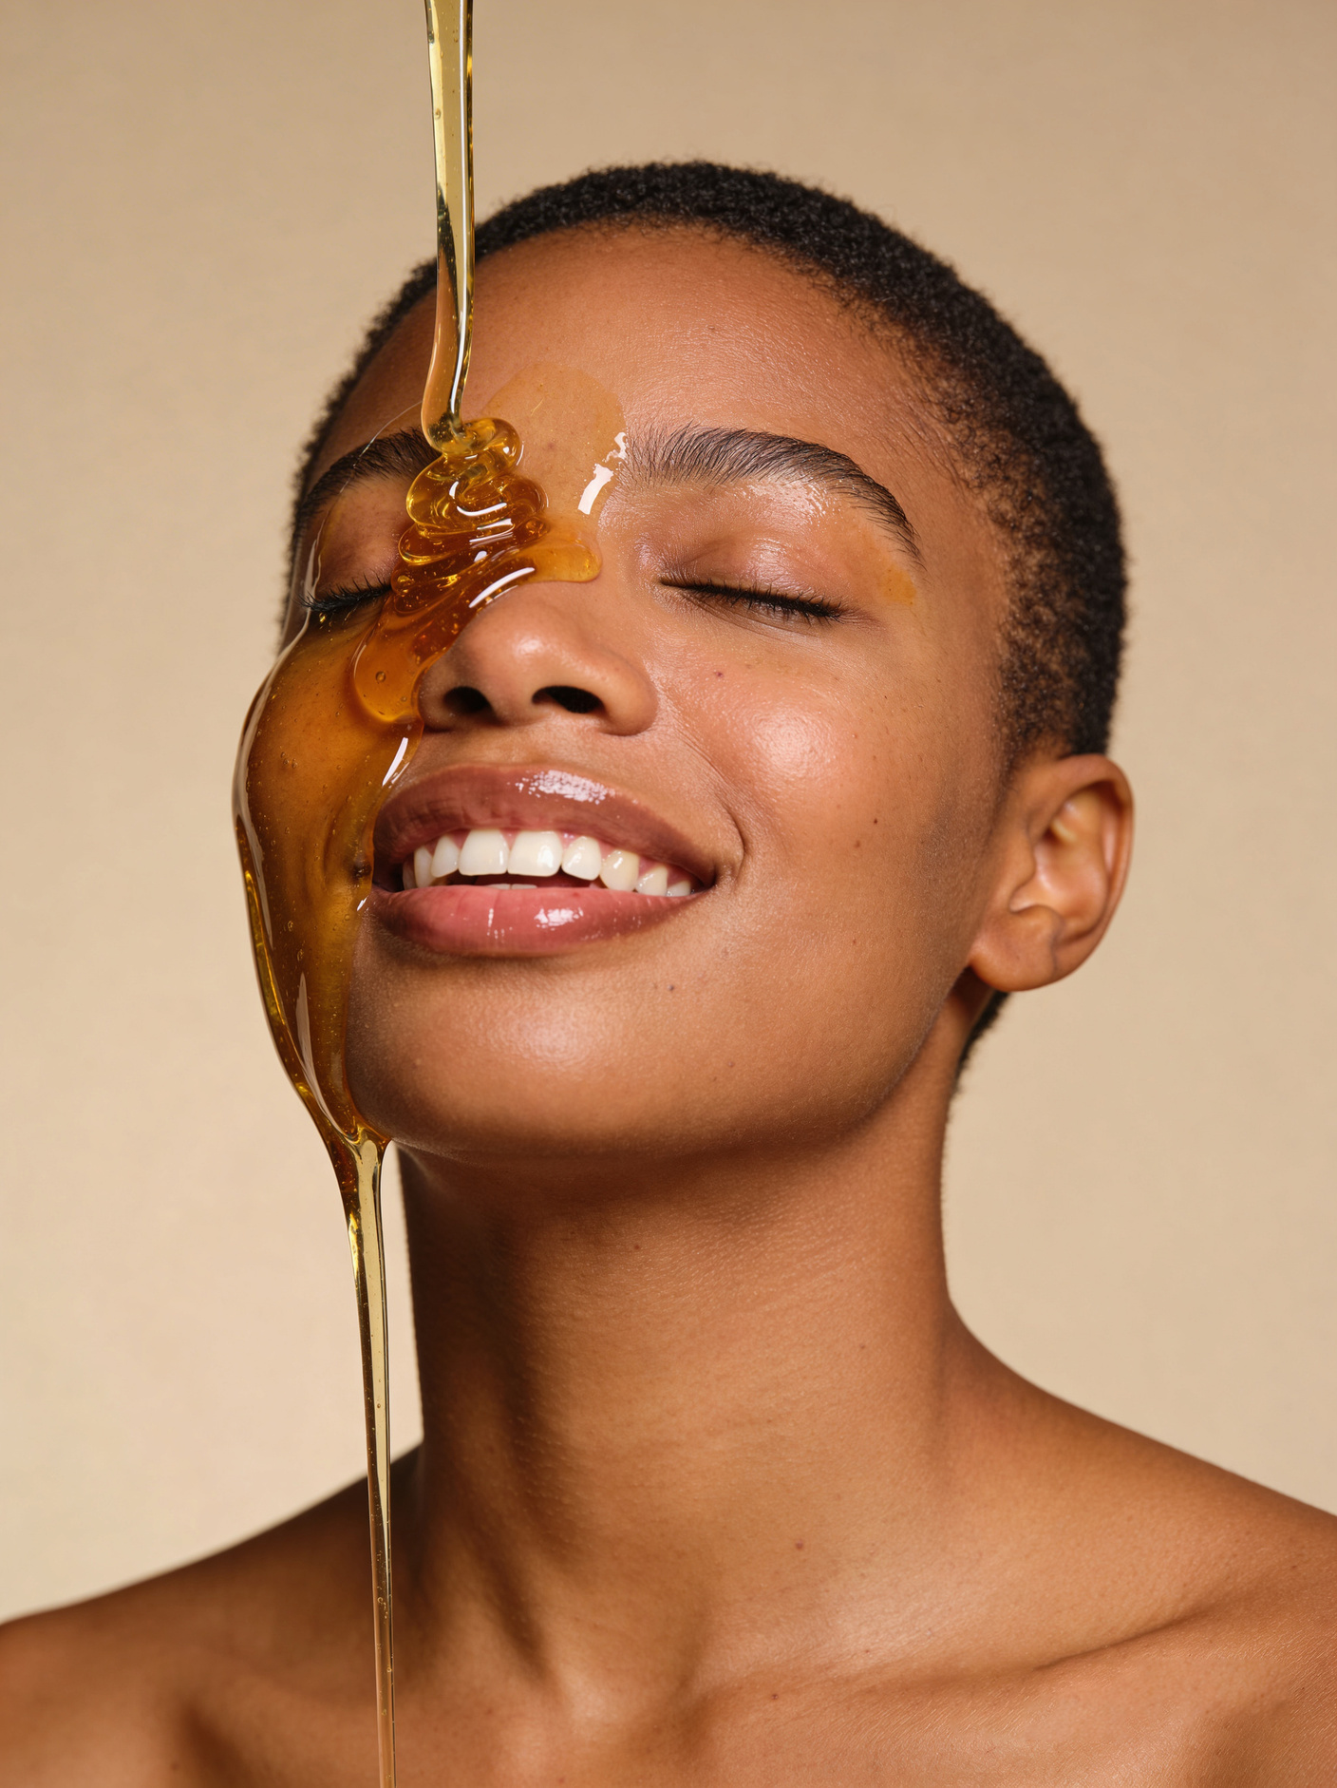
GLOWORA
About
Project
Service
Team
Buy Now
Contact us
40%
Daily Glow
Keep your skin fresh, hydrated and naturally glowing with a simple daily skincare routine.
Fresh Complexion
Cleanse and moisturize your skin regularly for a clean and fresh look.
45%
50%
Morning Radiance
Natural Luminosity
Start your day with gentle skincare to keep your skin fresh, soft and glowing.
Use simple skincare products to maintain healthy and naturally glowing skin.

Slide 5
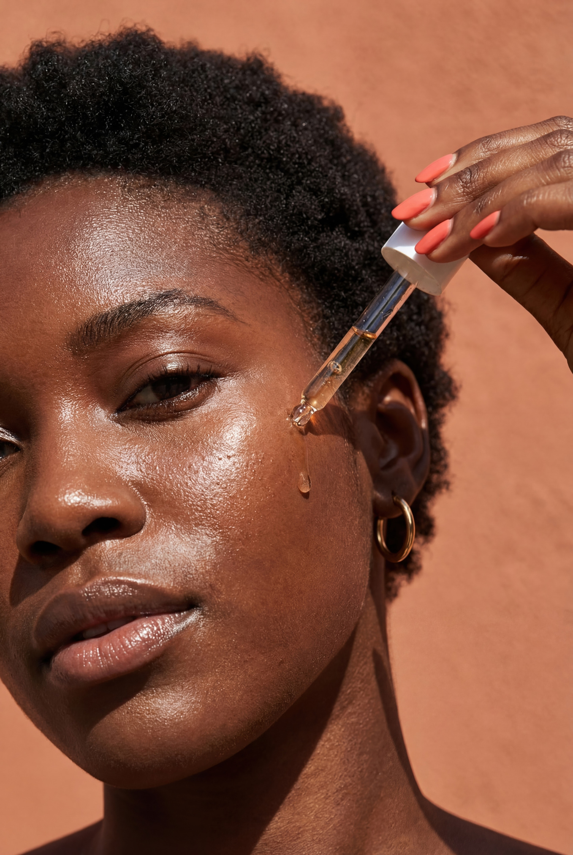
GLOWORA
About
Project
Service
Team
Buy Now
Contact us
Natural Beauty
45%
Simple skincare inspired by nature for fresh and healthy-looking skin.
40%
Pure Radiance
Botanical Nourishment
Gentle care for naturally fresh and glowing skin.
Natural ingredients that nourish and keep your skin soft.
50%
Healthy Glow
Daily care to keep your skin hydrated, balanced, and glowing.

Slide 6
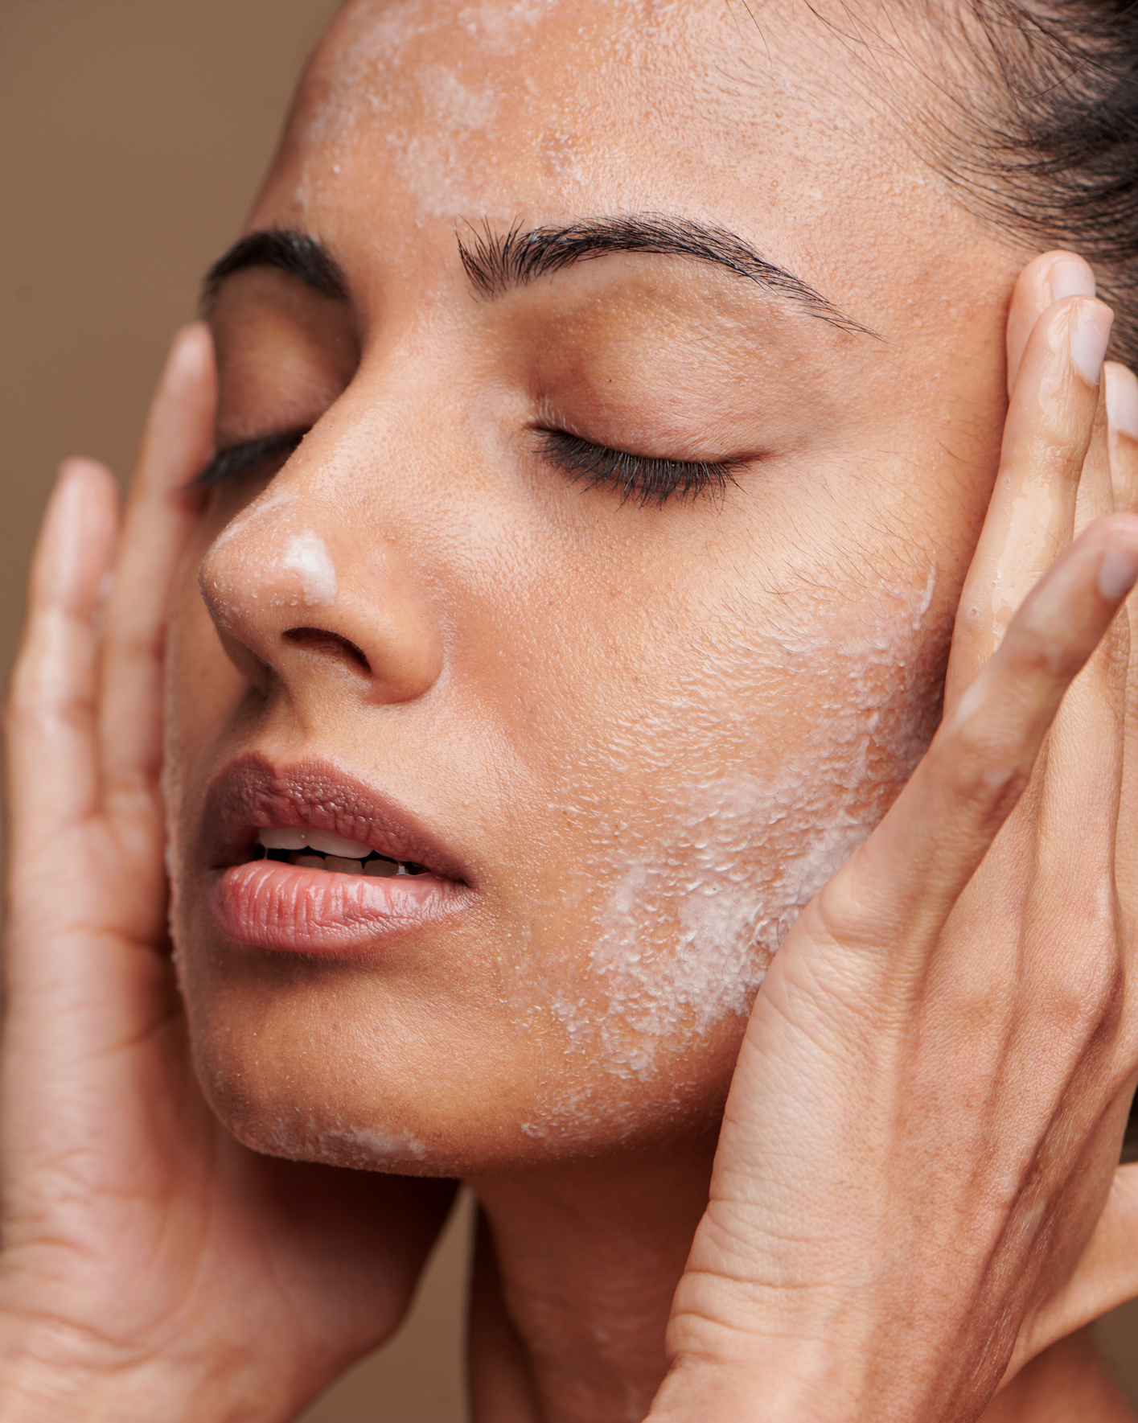
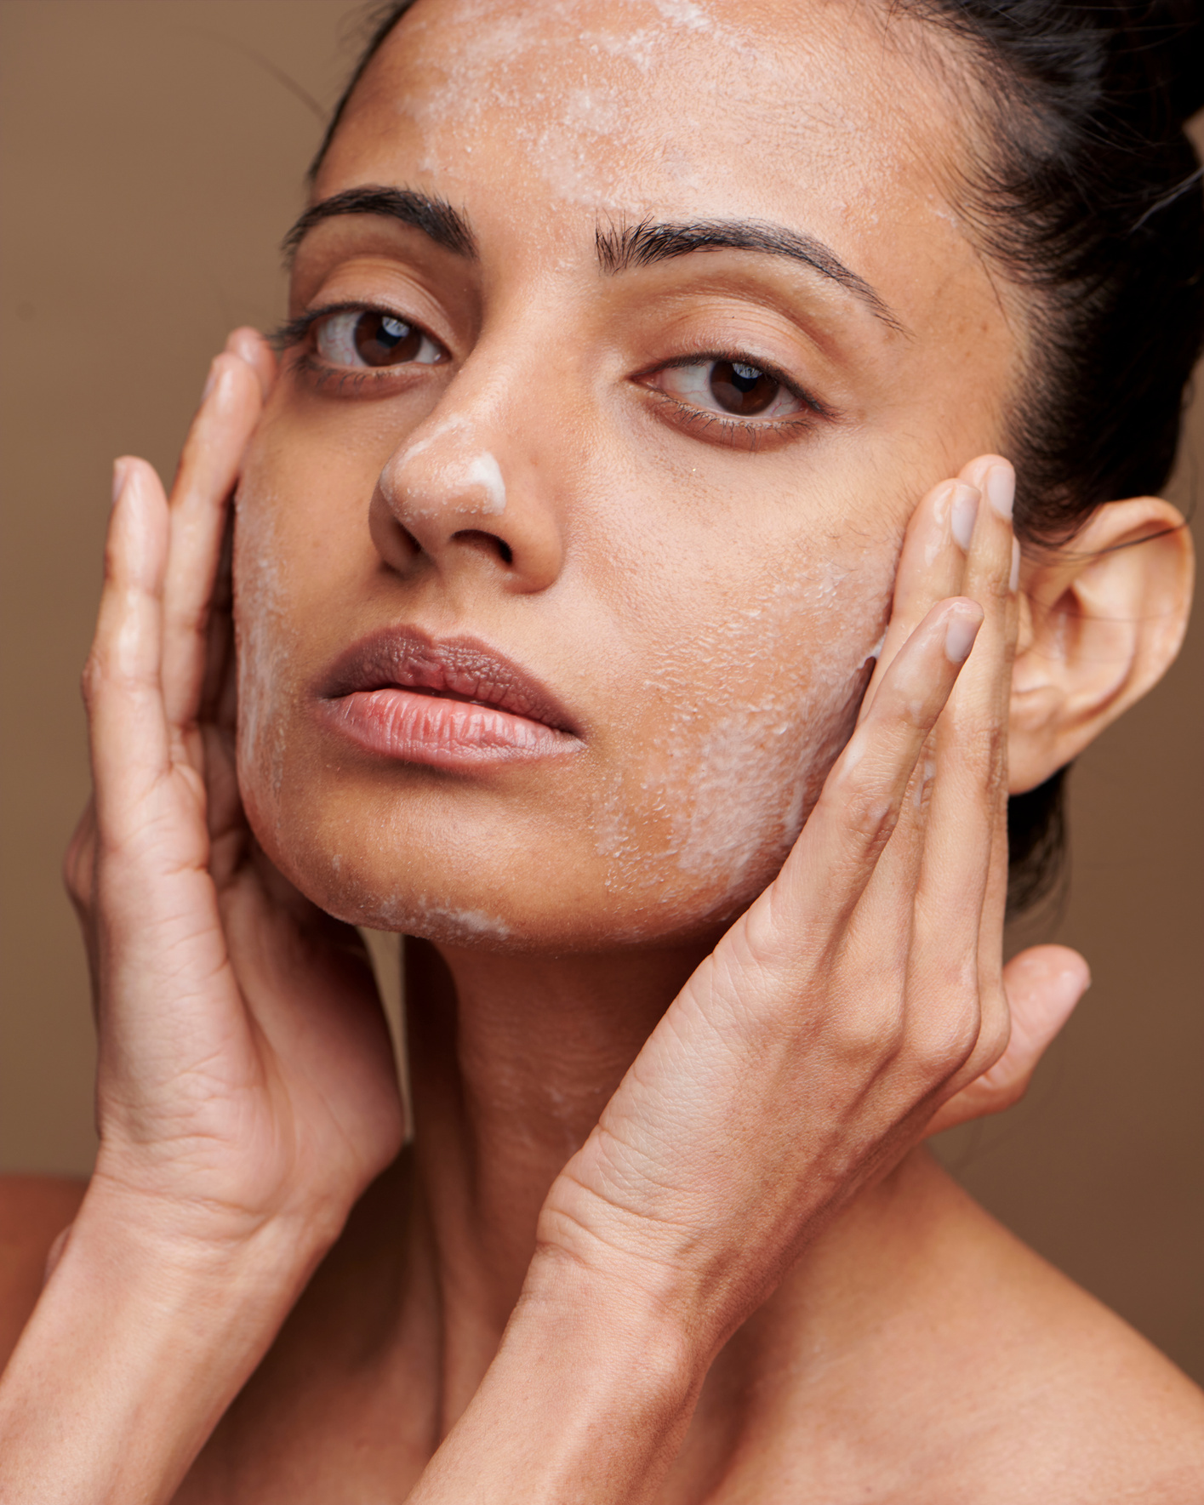
GLOWORA
About
Project
Service
Team
Buy Now
Contact us
Healthy Skin
Deep Hydration
Deep hydration helps replenish moisture and keeps your skin feeling soft, smooth and refreshed. It supports healthy-looking skin and gives it a natural, fresh glow throughout the day.
Skin Protection
Skin protection helps shield your skin from daily environmental stress. Using sunscreen and gentle skincare regularly can help maintain healthy-looking skin, prevent dryness, and keep your skin feeling fresh and comfortable.

Slide 7
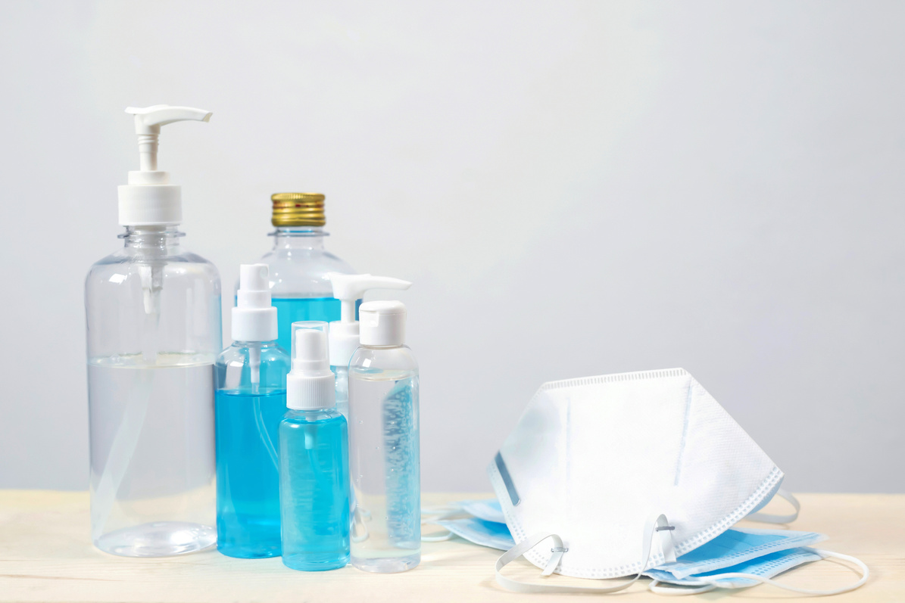
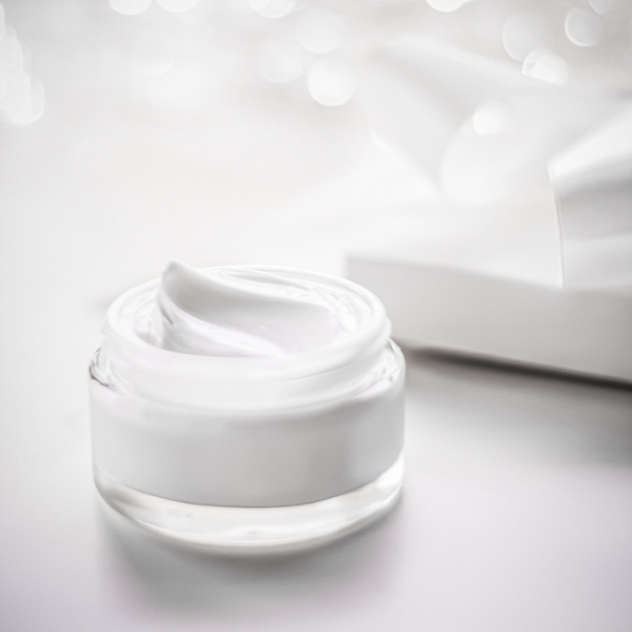
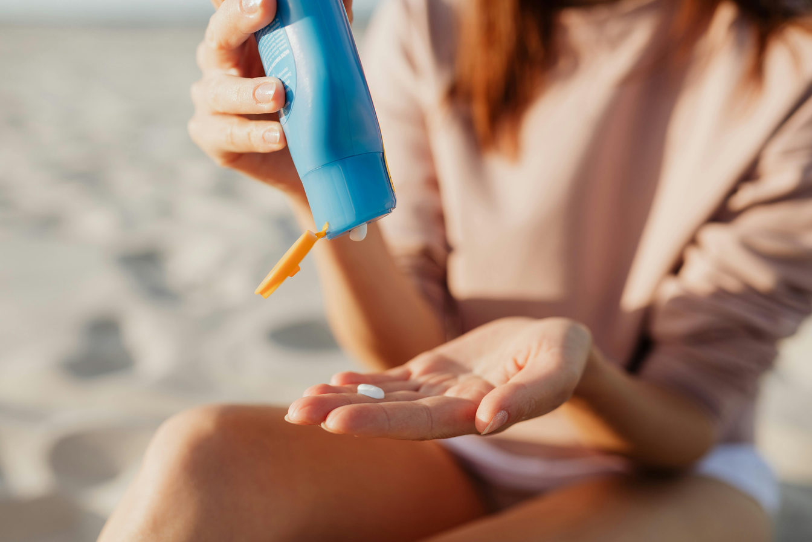
GLOWORA
About
Project
Service
Team
Buy Now
Contact us
OUR PRODUCTS
Gentle Face Wash
₹299 · BUY NOW
Hydrating Moisturizer
₹399 · BUY NOW
Daily Sunscreen
₹449 · BUY NOW

