Slide 1

Case Studies : Overview
Opportunities Identified
Modelling policyholders lapse behaviours is important to a life insurer since lapses affect pricing, reserving, profitability, liquidity, risk management, as well as the solvency of the insurer.
We used data set on homeowner’s Insurance covering period 2007-2012 for customers looking for quote and who bought the policy and developed a predictive Model to estimate. Whether a policy is likely to lapse or not

Slide 2
Solution Overview
1
1
EDA (explore data )
2
Data Cleaning
Exploratory
Data
Analysis
Explore the data and the feature set
create the objective function
Clean the data and create additional
features to to add to model also create some insights about the data
2
Data
Cleaning &
Feature Engineering
3
Baseline
4
Hyper Tune
3
Create a baseline Logistic Regression model using stratified folds and hold-out set to check stability
Run advance algorithms and hypertune the model to achieve the objective metric
Create Baseline
Solution
Over view
4
Hyper tune Model
5
Validation
6
Productise
Validate
The model
Find the factors affecting the model. And how we can improve the accuracy further
Cloud based solution to deploy the architecture in poduction
5
Productize
6

Slide 3
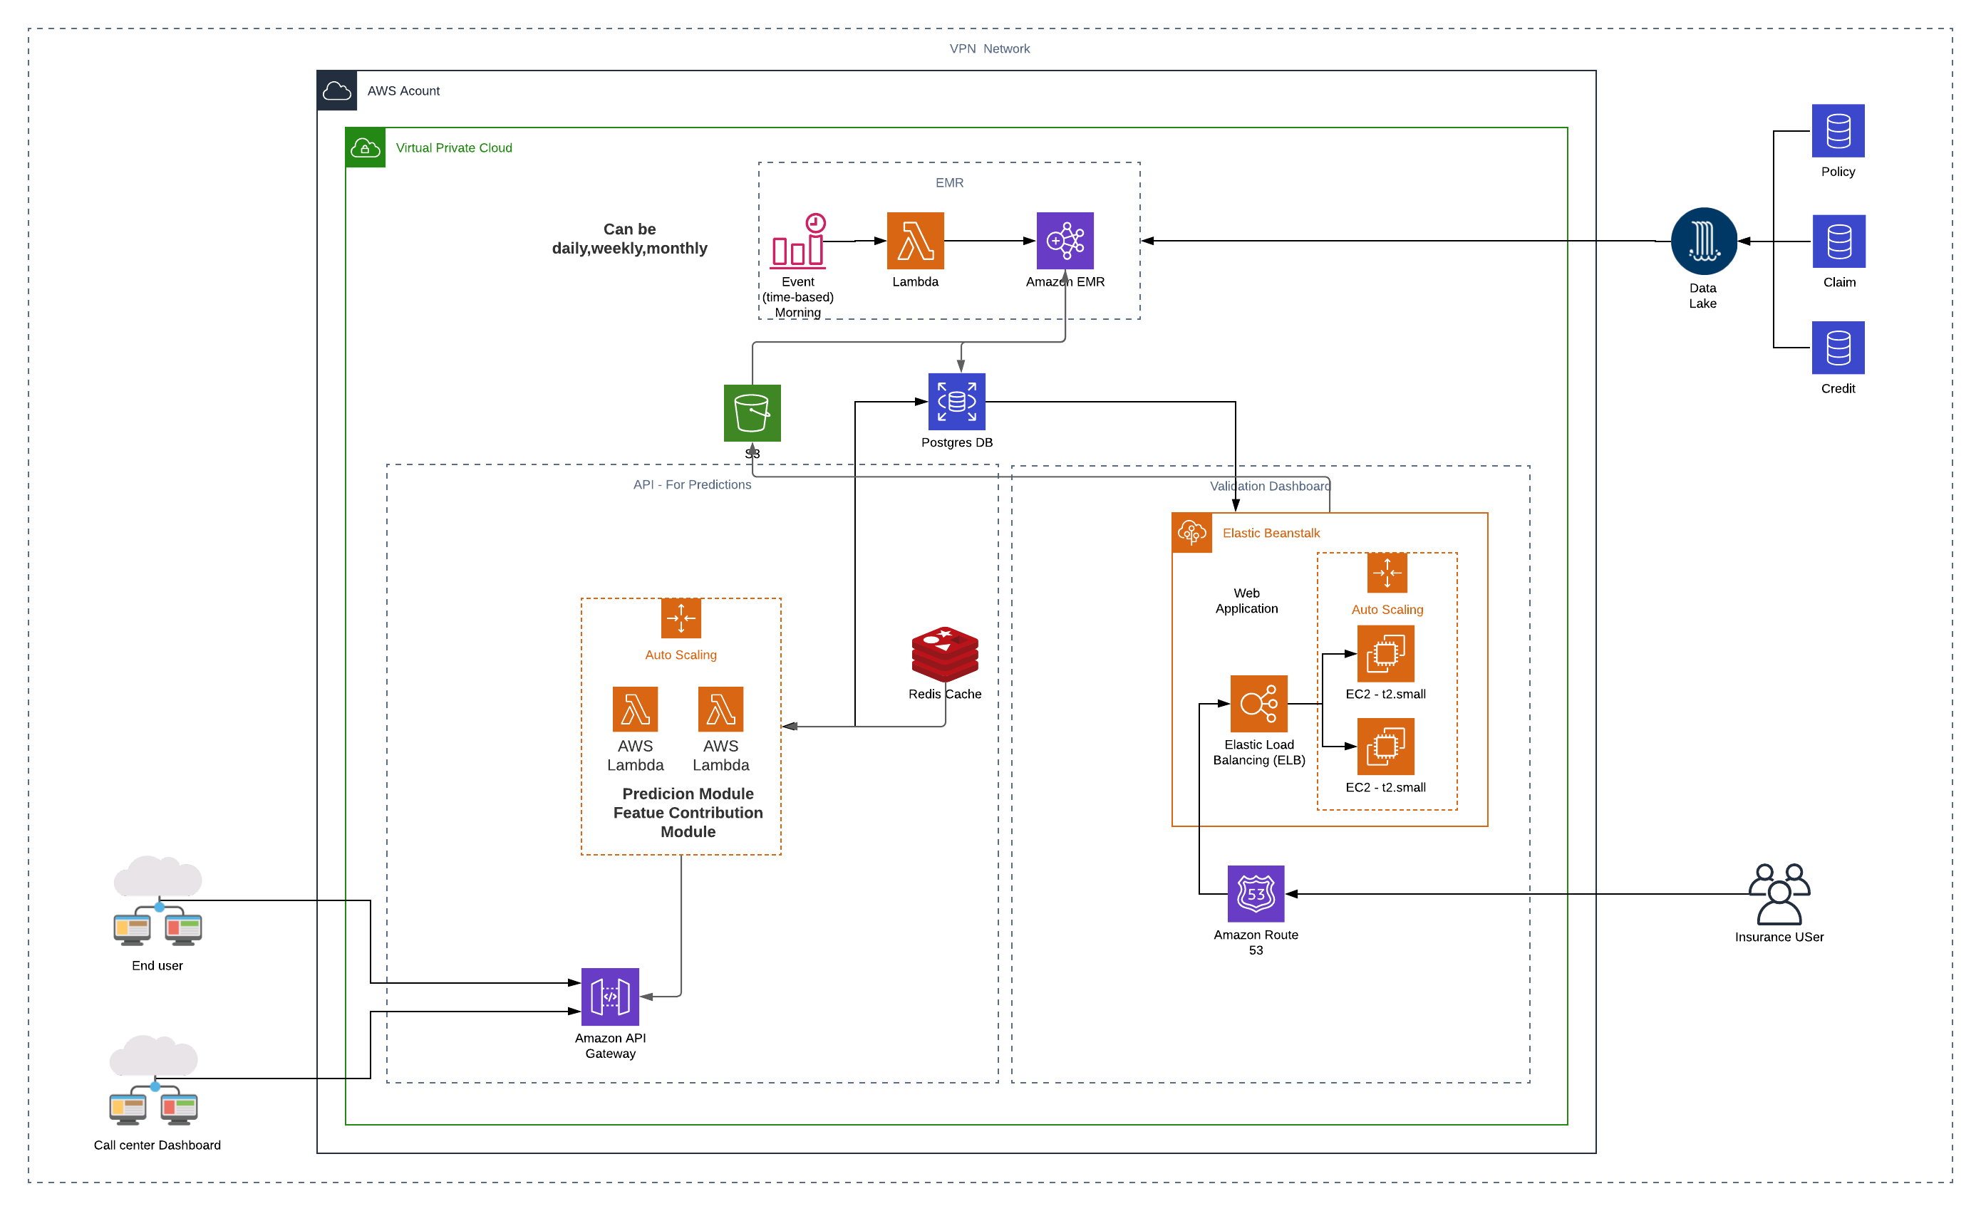
Productise

