Slide 1
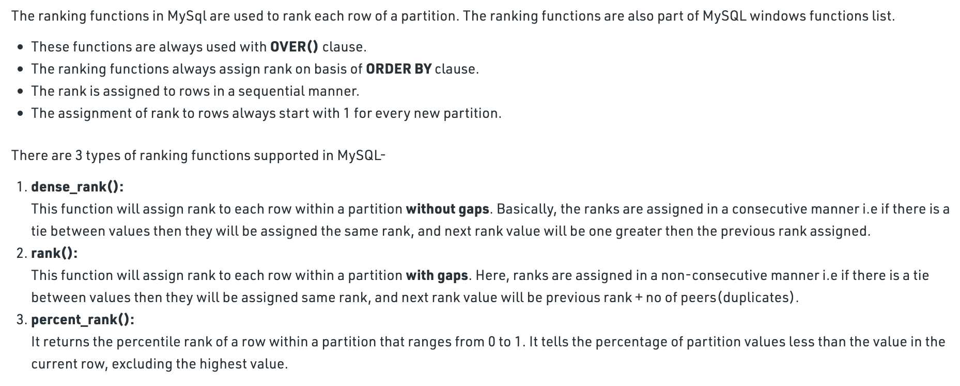
MySQL | Ranking Functions

Slide 2
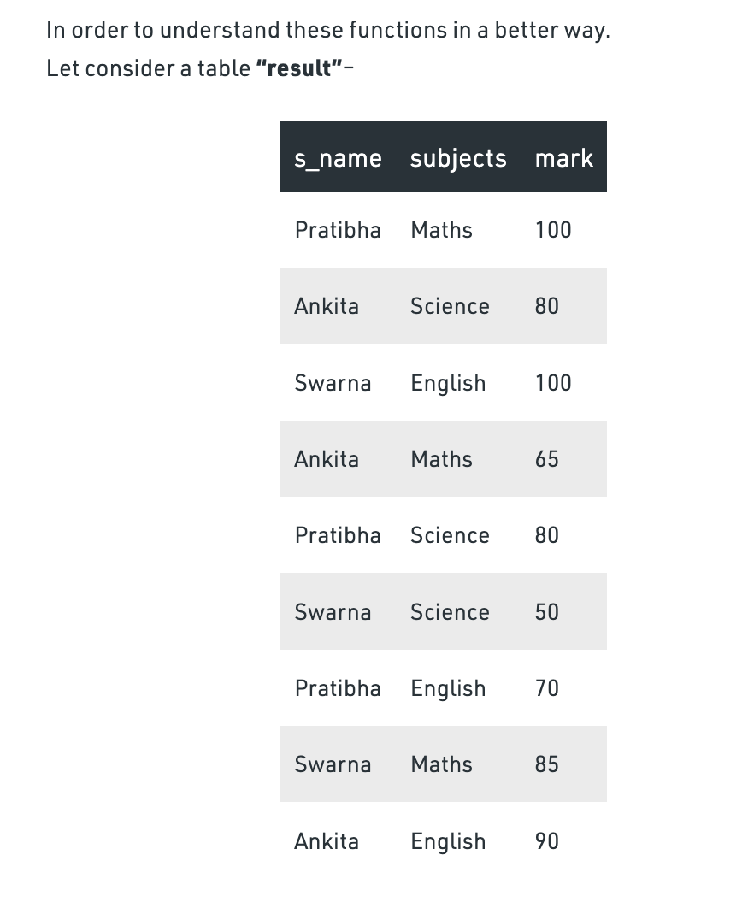
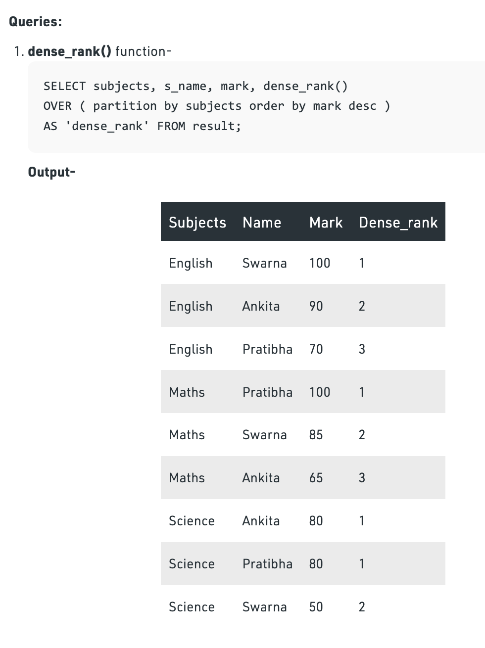
Based on marks descending ranking done
Explanation-
Here, table is partitioned on the basis of “subjects”.
order by clause is used to arrange rows of each partition in descending order by “mark”.
dense_rank() is used to rank students in each subject.
Note, for science subject there is a tie between Ankita and Pratibha, so they both are assigned same rank. The next rank value is incremented by 1 i.e 2 for Swarna.

Slide 3
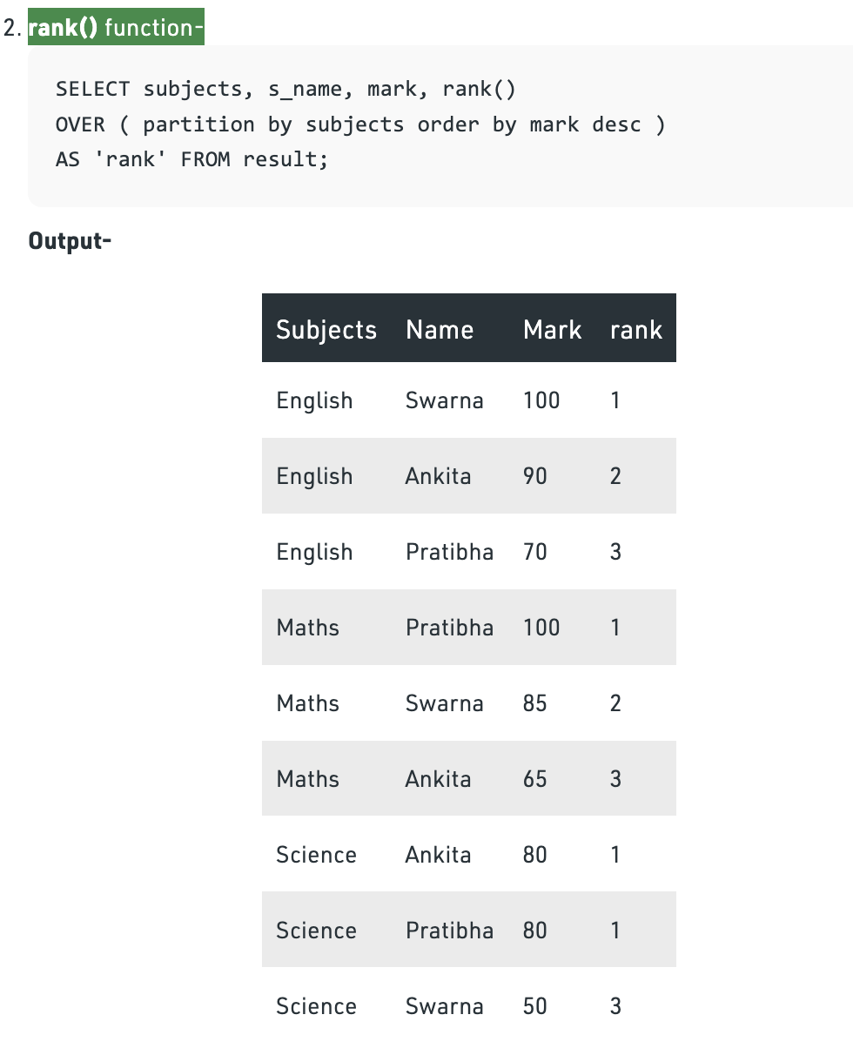
Explanation-
It’s output is similar to dense_rank() function.
Except, that for Science subject in case of a tie between Ankita and Pratibha, the next rank value is incremented by 2 i.e 3 for Swarna.

Slide 4
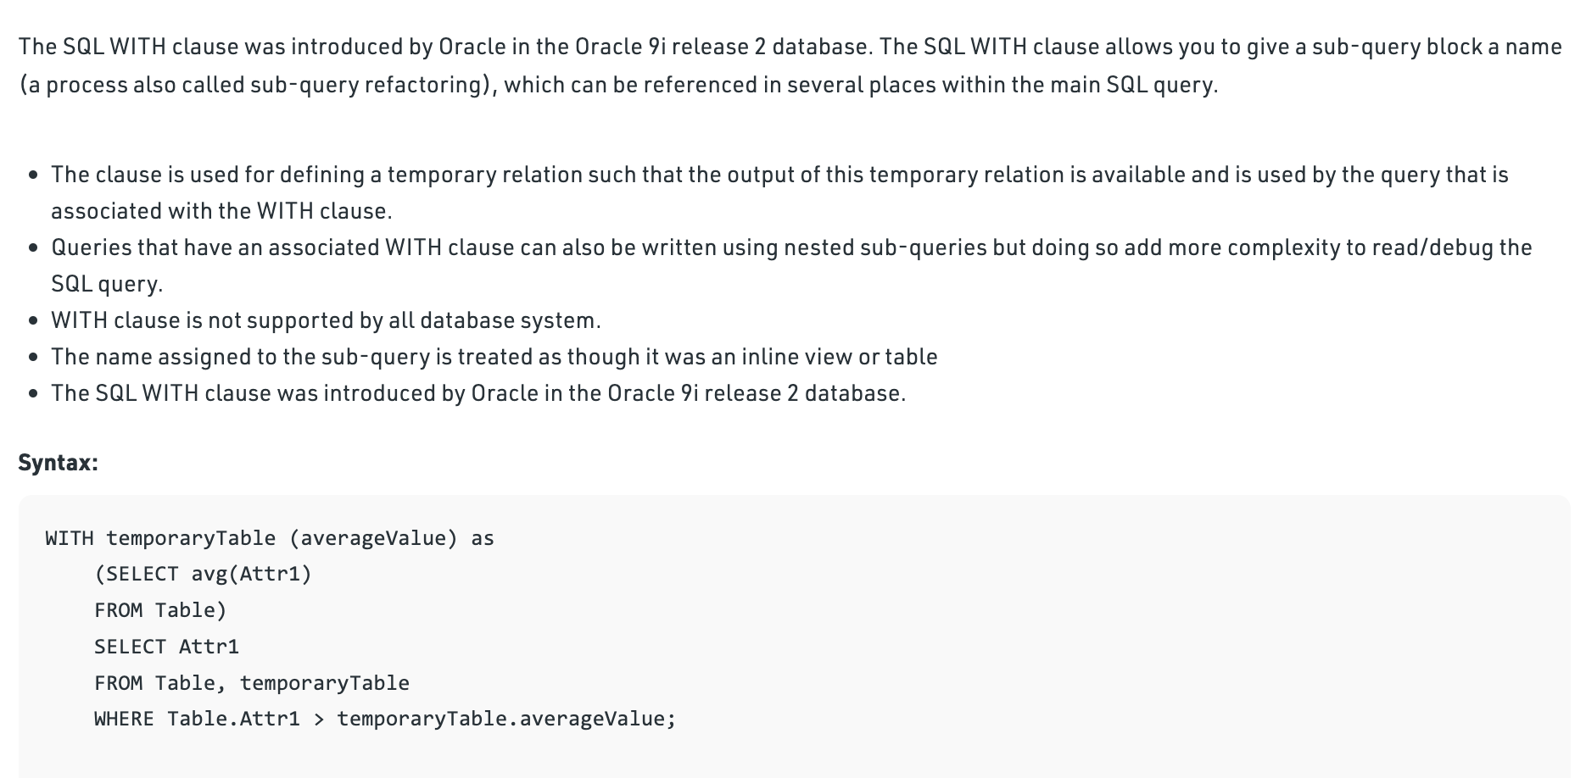
SQL WITH CLAUSE

Slide 5
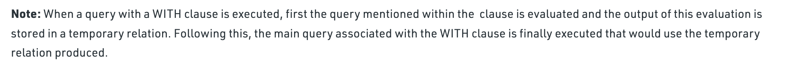
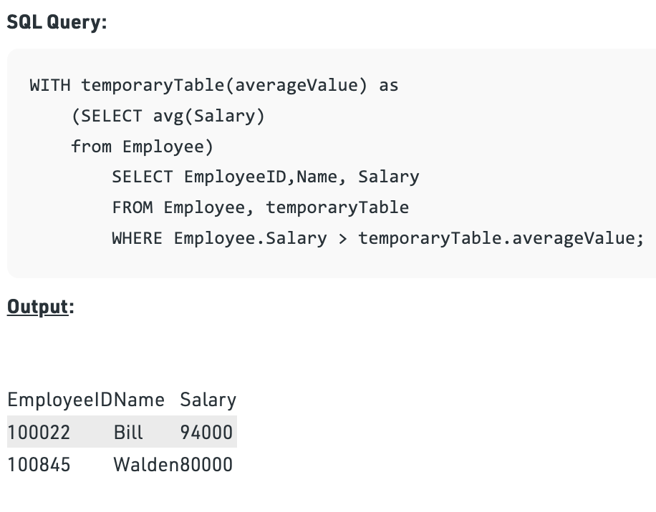
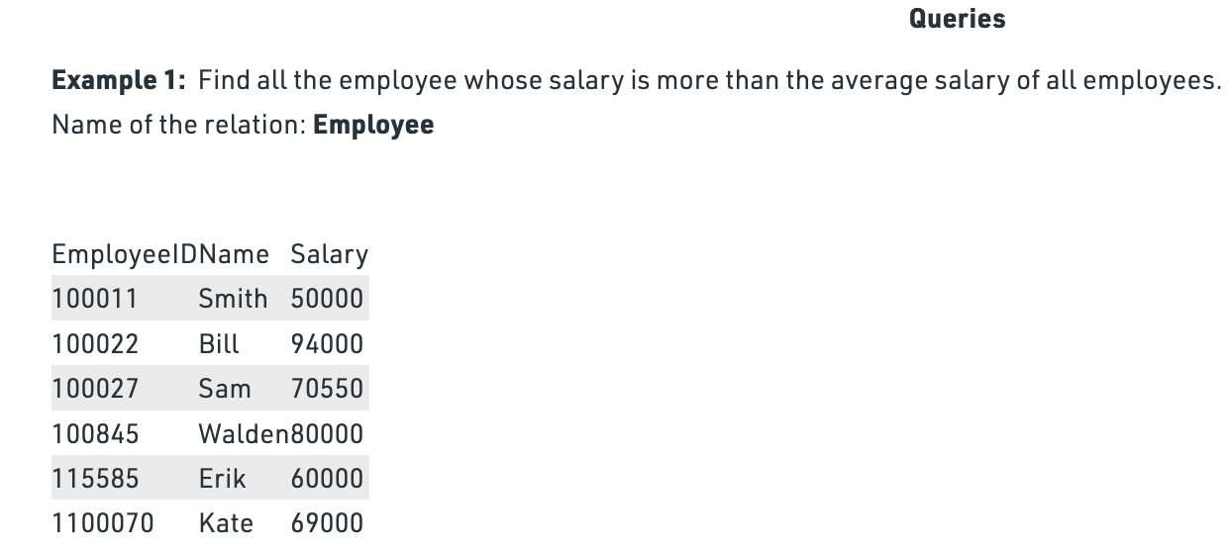
Explanation: The average salary of all employees is 70591. Therefore, all employees whose salary is more than the obtained average lies in the output relation.

Slide 6
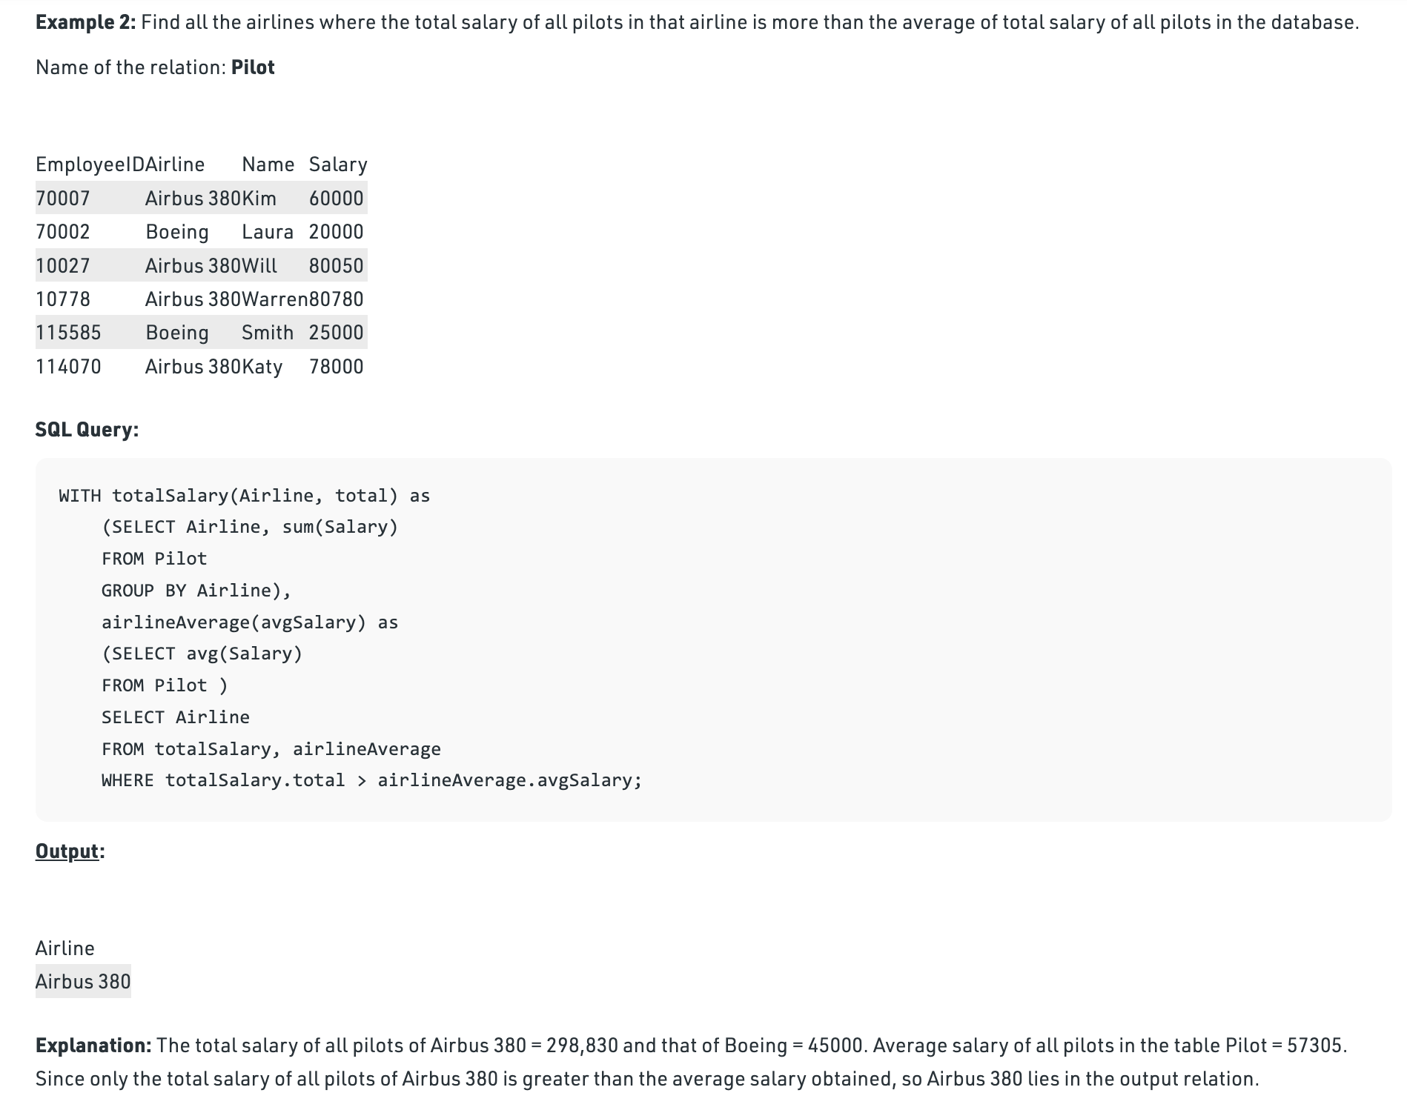

Slide 7
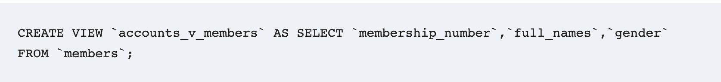
MySQL Views
What are Views in MySQL?
VIEWS are virtual tables that do not store any data of their own but display data stored in other tables. In other words, VIEWS are nothing but SQL Queries. A view can contain all or a few rows from a table. A MySQL view can show data from one table or many tables.
Example:

Slide 8
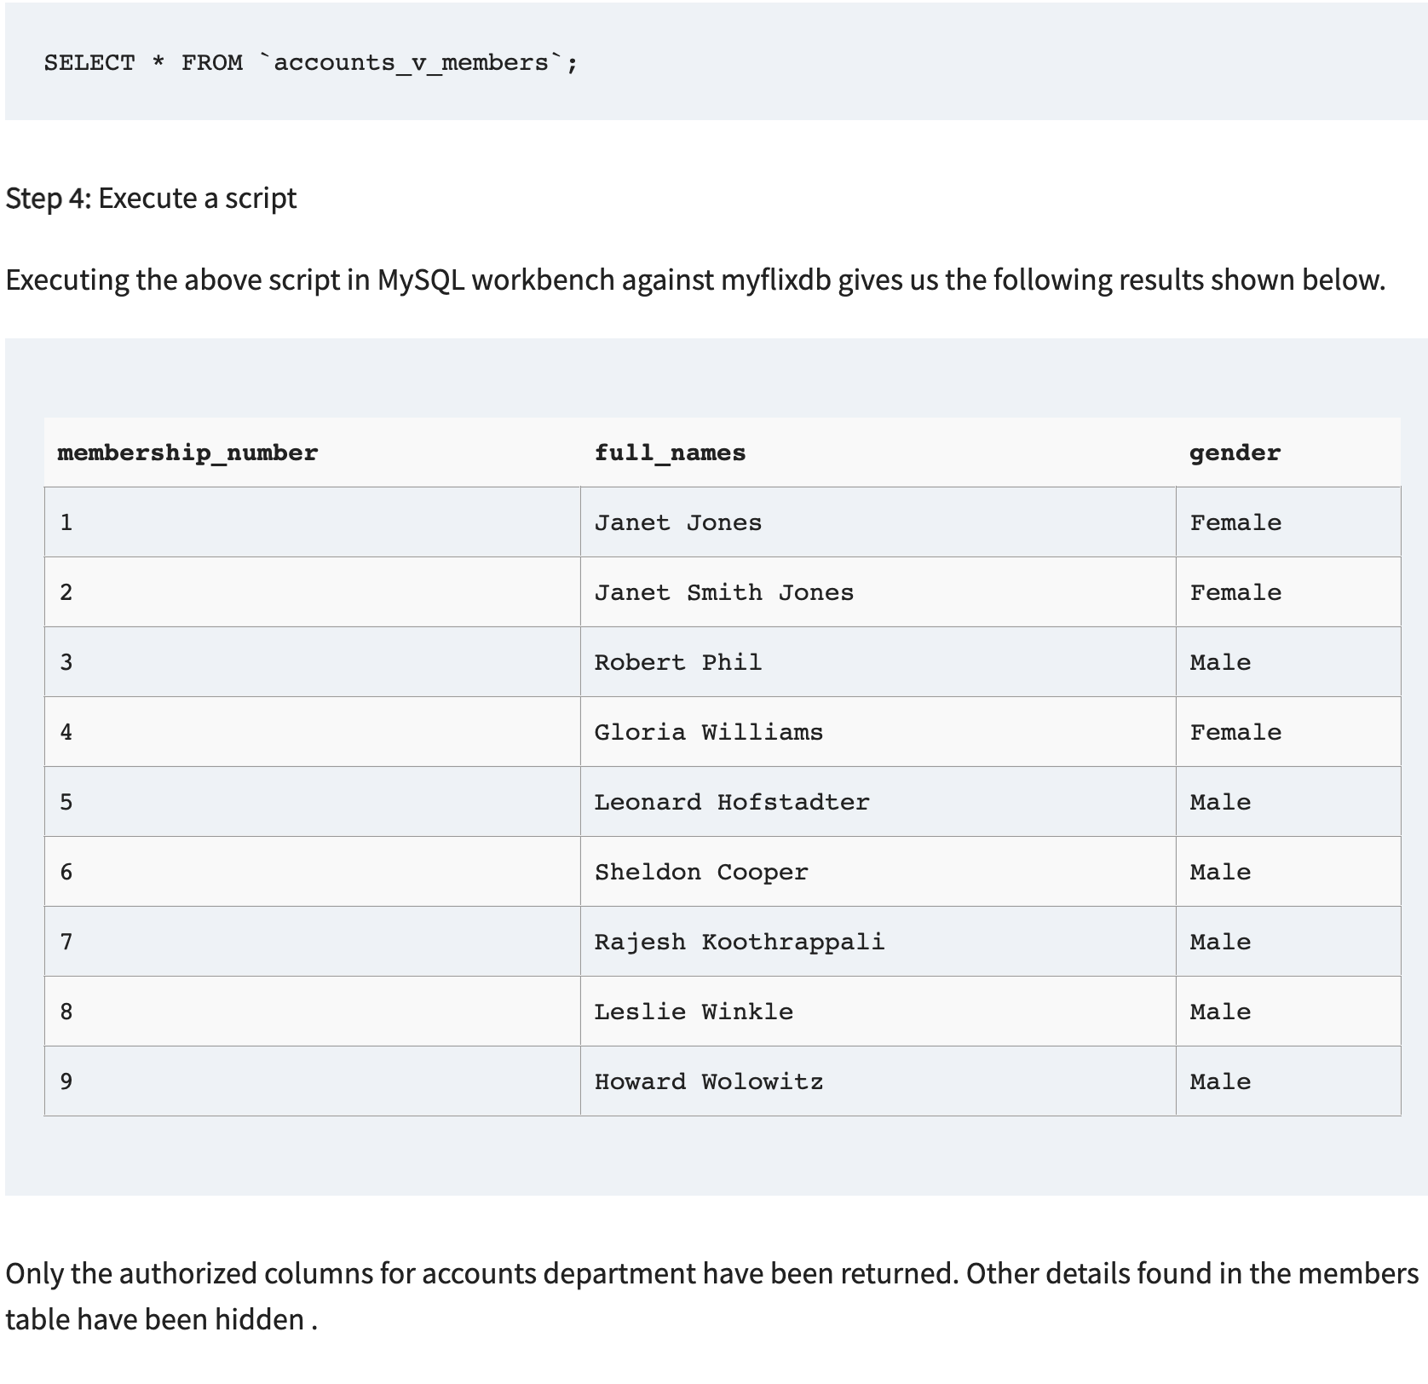

Slide 9
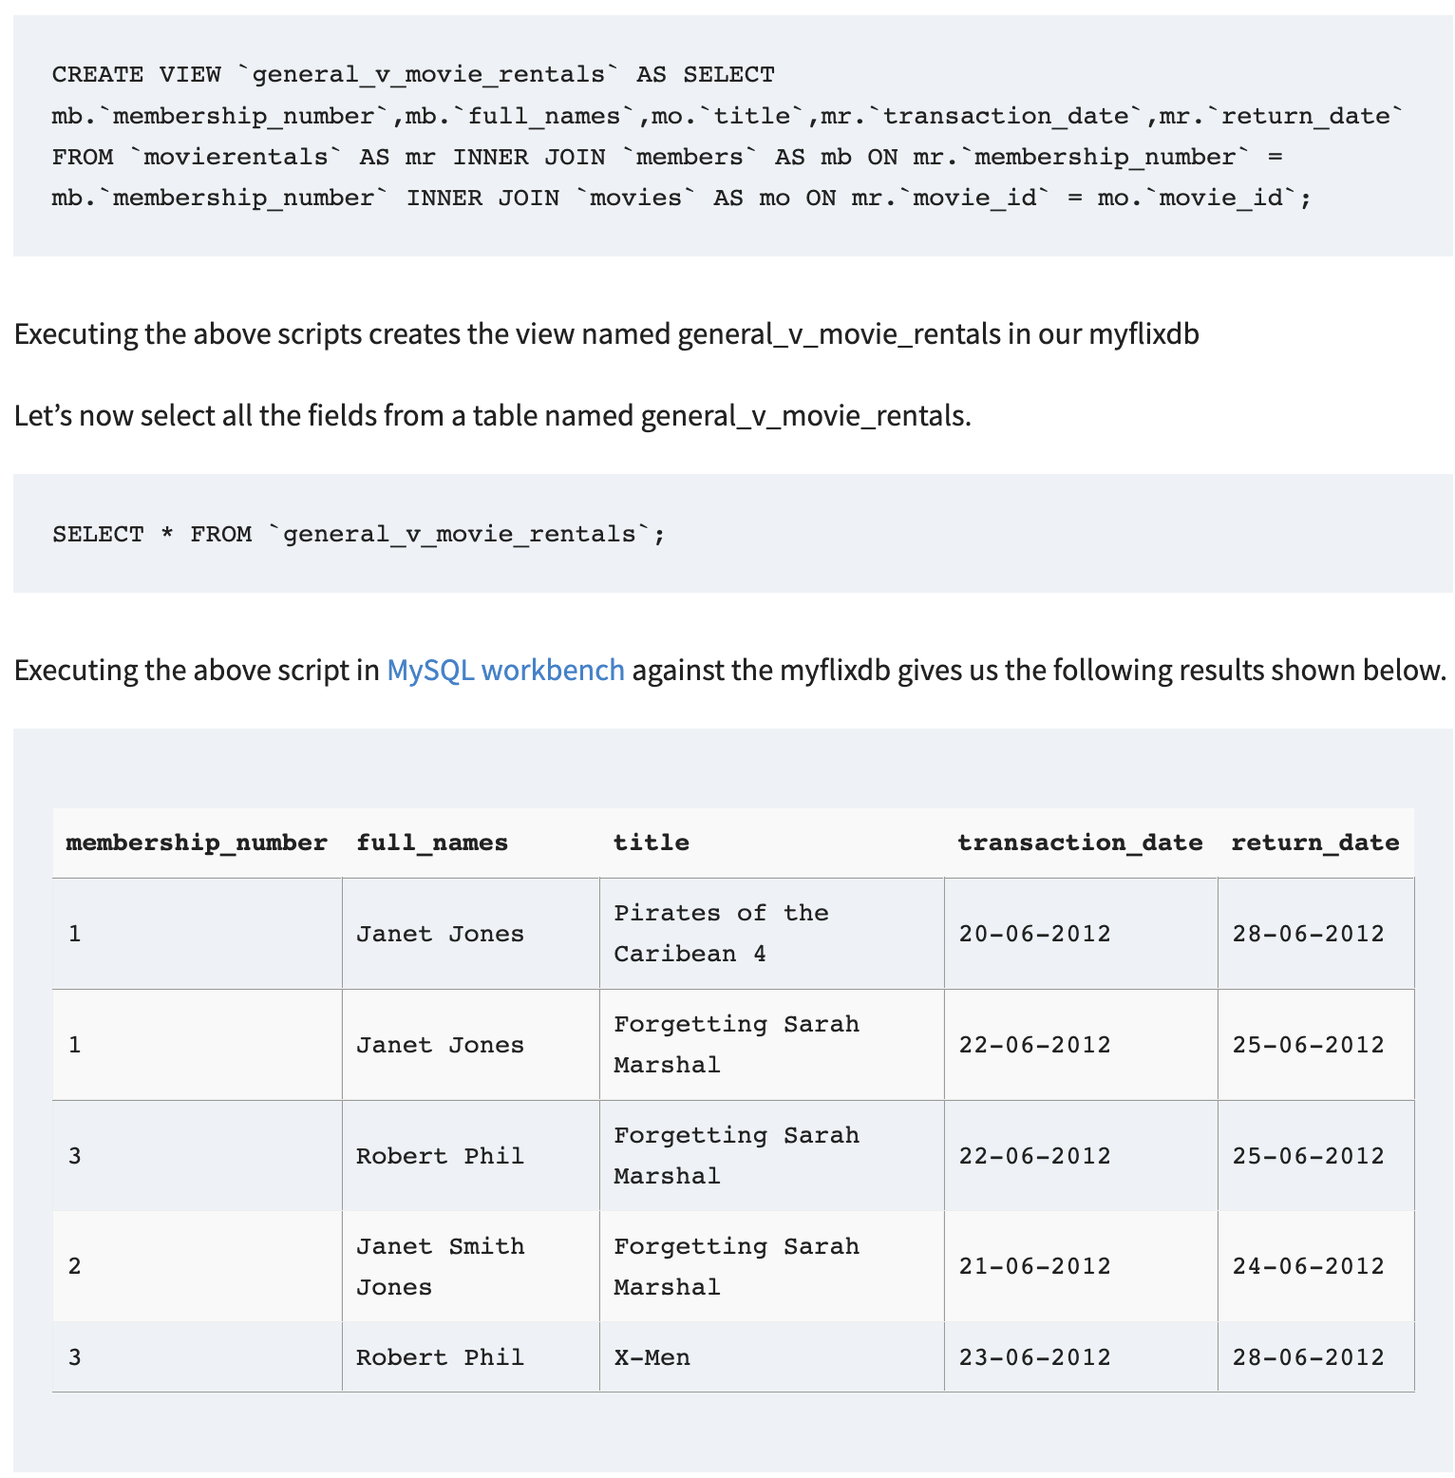
Joins and Views in MySQL

Slide 10
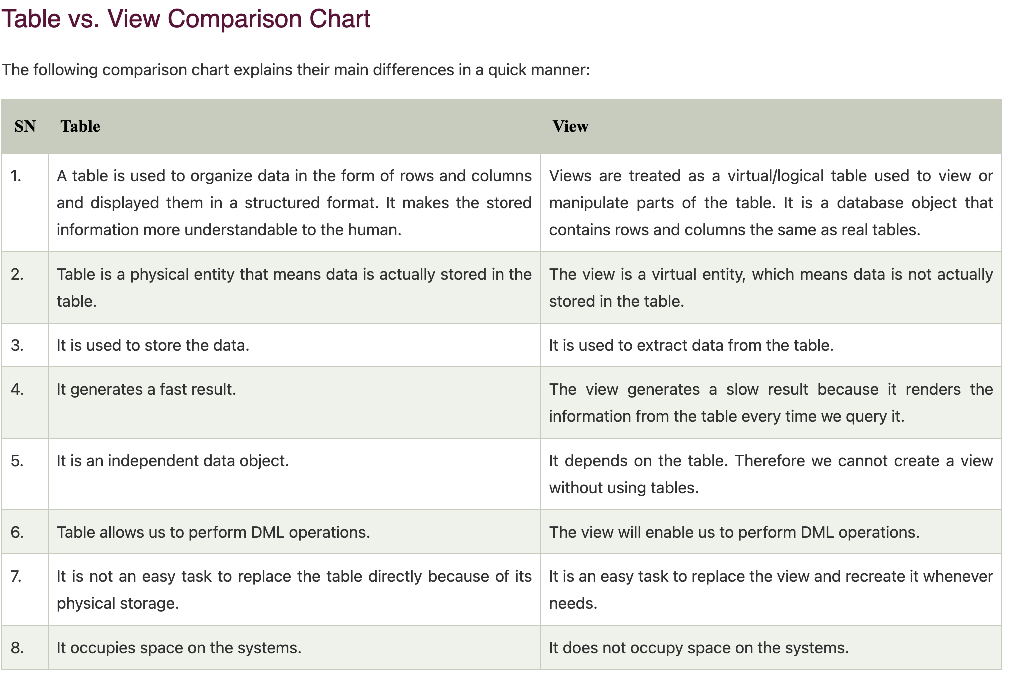
Views are virtual tables; they do not contain the data that is returned. The data is stored in the tables referenced in the SELECT statement.
Views improve security of the database by showing only intended data to authorized users. They hide sensitive data.
Views make life easy as you do not have write complex queries time and again.
It’s possible to use INSERT, UPDATE and DELETE on a VIEW. These operations will change the underlying tables of the VIEW. The only consideration is that VIEW should contain all NOT NULL columns of the tables it references. Ideally, you should not use VIEWS for updating.
References: https://www.geeksforgeeks.org/sql-with-clause/?ref=lbp https://www.guru99.com/views.html#:~:text=What%20are%20Views%20in%20MySQL,few%20rows%20from%20a%20table.

